Slide 1


Let’s solve it

Slide 2



























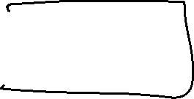







Slide 3


















































Slide 4











Slide 5







Slide 6











Slide 7








































Slide 8

































