Slide 1

Let’s solve it

Slide 2













































Slide 3

























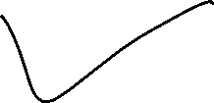





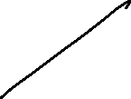











Slide 4









































Slide 5





















































Slide 6



































Slide 7































Slide 8











Slide 9

































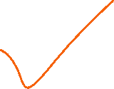












Slide 10





































Slide 11







Slide 12
























































