Slide 1


Let’s solve it

Slide 2




























































Slide 3
























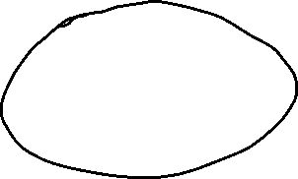


















Slide 6



























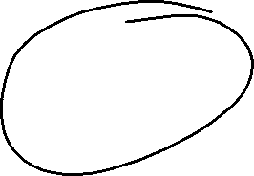























Slide 7



























Slide 8


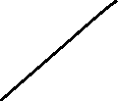













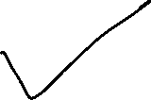




















Add arithmetic operators (plus, minus, times, divide) to make the following expression true:
3 1 3 6 == 8
You can use any parentheses you’ d like.

Slide 9
























































Slide 10






























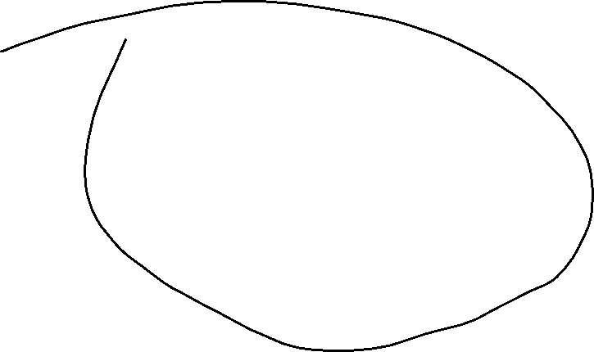































Slide 11






























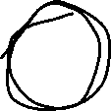
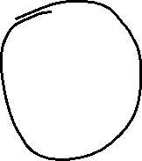





Slide 12





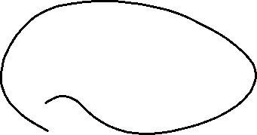


















































Slide 13































Slide 14































