Slide 1

Let’s solve it

Slide 2


































Slide 3


















































Slide 4

































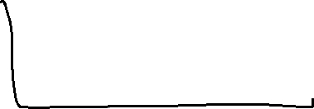














Slide 5
















Slide 6




























Slide 7






















Slide 8

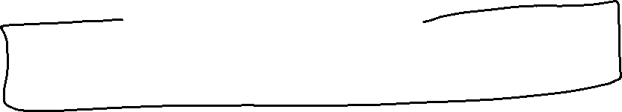

































Slide 9




























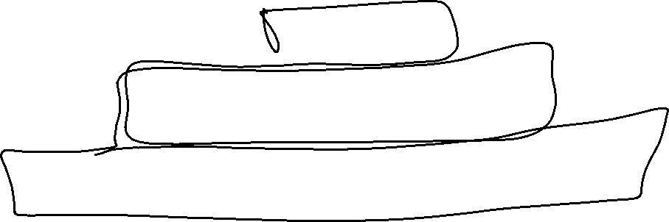

Slide 10

































Slide 11


























Slide 12

















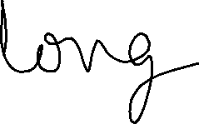

Slide 13






















Slide 14

































