Slide 1
vizzes for Visualizations
Big Data Analytics / Data Science
Presentation Phase

Slide 2
Ready Results; Known Insights; Clean DataSets
Which Viz will you choose and why?

Slide 3
Example 1
The Data Science has below three equally important primary aspects involved.
Mathematics
Computer Science Technology
Subject matter expertise
There are other internal sub aspects like Machine Learning, where NO involvement of human/subject matter expertise but only Mathematics and Computer Science Technology.

Slide 4
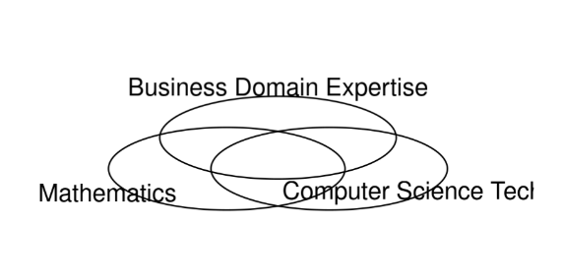
Venn diagram (Think what can be improved here)
my-dev/R/VennDiagram

Slide 5
Example 2:
Voting Results
Party Name | Votes
Party A | 20
Party B | 50
Party C | 25
NOTA | 5

Slide 6
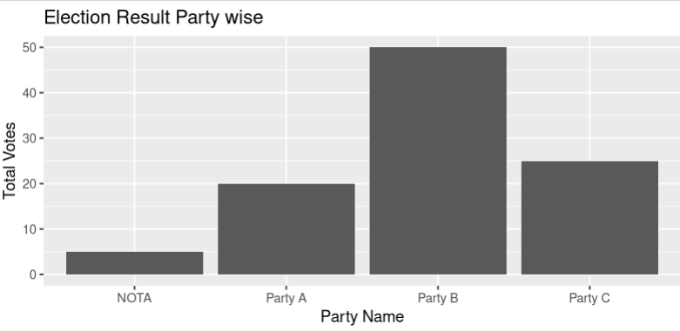
How about some ordering/sorting?

Slide 7
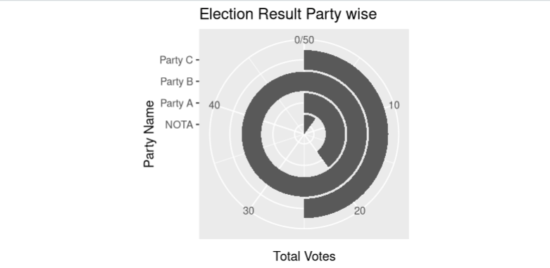

Slide 8
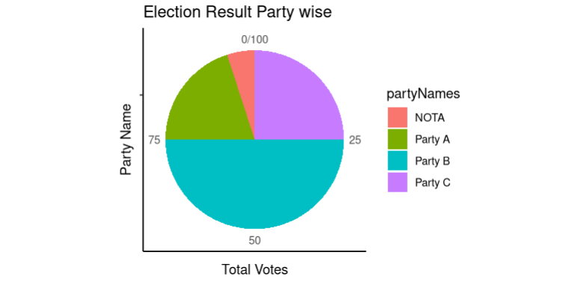
my-dev/R/PieChart

Slide 9
Example 3:
Every year during Winter season, Sales is high and every year it increases too. Note that sales over years may or may not have increased.

Slide 10
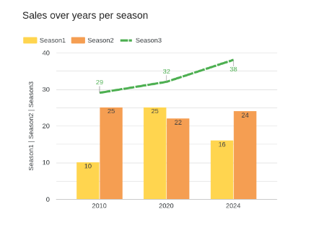
SalesYear | Season1 | Season2 | Season3
2010 | 10 | 25 | 29
2020 | 25 | 22 | 32
2024 | 16 | 24 | 38
Crated using google looker studio web

Slide 11
Example 4:
Known that participants during a technical workshop have practiced many computer commands. But some of them are trending and useful to many participants. Showcase top n most used commands from participants’ work history.

Slide 12
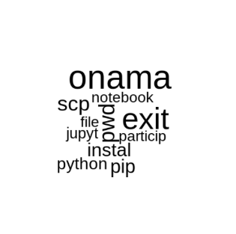
WordCloud/TagCloud showcase words with bigger font size having higher frequencies of occurrence
my-dev/R/participantsWorkRTagCloud

Slide 13
Example 5:
CO2 Per Capita needs to be highlighted interactively from 2000 to 2011 years including all if chosen for the world.

Slide 14
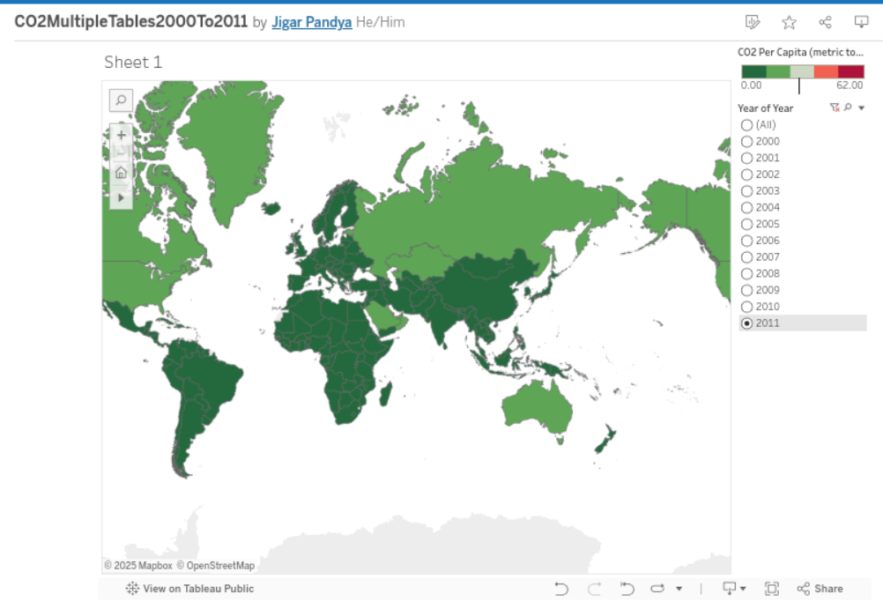

Slide 15
Example 6:
University dataset is available and interactive report is expected to show university wise CS/Non-CS students details.

Slide 16
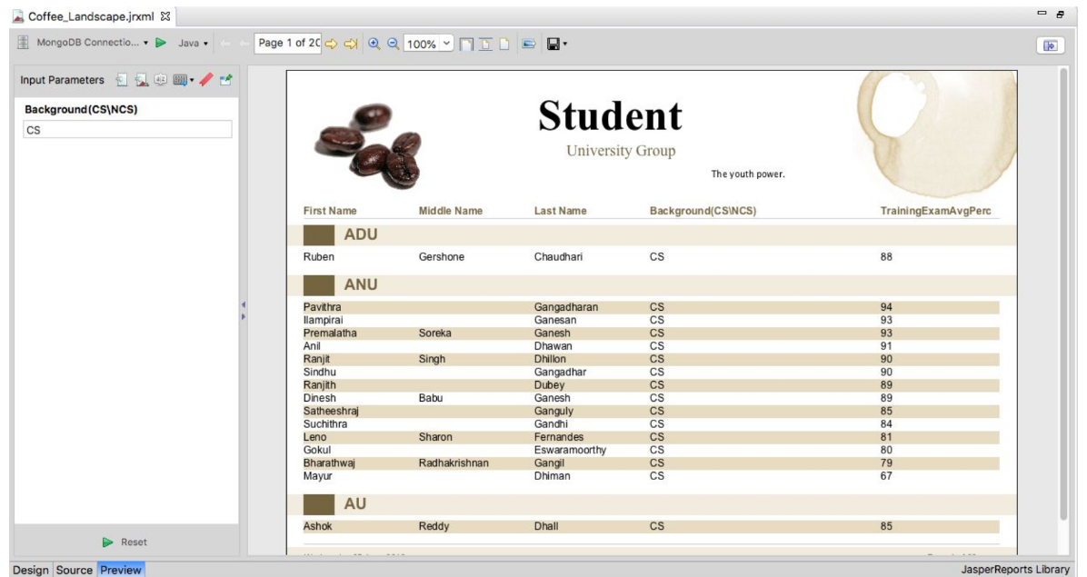
https://community.jaspersoft.com/wiki/designing-report-jaspersoft-studio
https://community.jaspersoft.com/wiki/jaspersoft-mongodb-query-language
Text Book: Big Data And Analytics by Subhashini Chellappan Seema Acharya

Slide 17

It’s been said that “A picture is worth a thousand words”
But for those who are willing to understand and highly gifted.
For others, it’s still a challenge.
And this is why even designing visualization is a challenge
and more than just an art.
Warning #1 Never represent non-genuine matter.
Warning #2 WIN-WIN for humanity and world a must.
Warning #3 Beware of misunderstanding (misrepresentation).
#EthicalVisulization

Slide 18
Various aspects for conveying information
Shape
Size
Color
Orientation/Direction
Data characteristics (Discrete Vs Continuous, etc)
Ordering/Reversing
Grouping
Reserving
Border, scale/zoom, shadow, etc.
locales

Slide 19
General Guidelines
Have a title, subtitle and legends wherever applicable
Make sure the baseline for bar chart is appropriate
Make sure the pie chart accumulates to total 100%
Provide support to download in various formats
Provide support to view/access more context/details if any.
Have input/feedback from group of people/peer blind after seeing draft viz
Give about 5-10 seconds after presenting visualization and then explain
Put yourself in shoe of viewers (end user,client,leadership) and viceversa when grasping someone else viz yourself
Accessibility Support
Date of last modification and others

Slide 20
Interesting facts
Google looker has 48 chart types as of Aug’25
Apache has data exploration and visualization platform called Superset
Jaspersoft (2011 A.D.) and Tableau are independent product
There can be grammar of graphics like ggplot2 talks about (i.e. layering)
Google Visualization API, Motion charts and Fusion charts are grown up
Integration to primary website/app seems secondary
Interactive Vizs are simply famous
Informatica got Built-In Reporting capabilities
A single company also uses more than one tools in harmony and happily
Dashboards have to be dashing
ETL is close to all reporting/visualization tools
Visuals can help during various phases of analytics and presentation is itself a phase!

Slide 21





https://www.linkedin.com/in/jigar-pandya/
https://github.com/profjigarpandya/
https://www.kaggle.com/jigarpandya
https://public.tableau.com/app/profile/jigarpandya/vizzes

