Slide 1


Let’s solve it

Slide 2
























Slide 3































Slide 4

































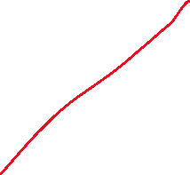


















Slide 5













































Slide 6





















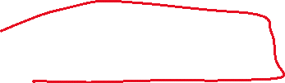















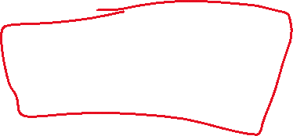









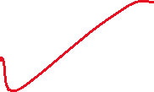




















Slide 7









































Slide 8














































Slide 9
























Slide 10




























































Slide 11





















