Slide 1


Let’s solve it

Slide 2

















Slide 3
















































Slide 4














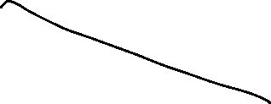





































Slide 5












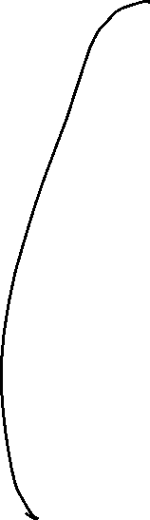




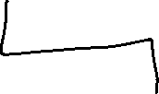














Slide 6

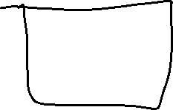











Slide 7








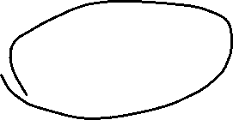




















































Slide 8





















Slide 9

































Slide 10




























Slide 11














































Slide 12






