Slide 1

Let’s solve it

Slide 2









































Slide 3

















































Slide 4

























































Slide 5



























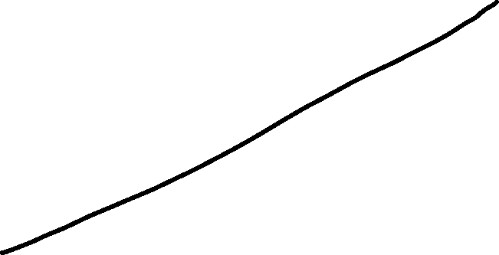




















































Slide 6



















































Slide 7



