Slide 1
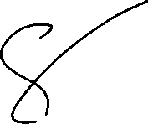
Let’s solve it

Slide 2












































Slide 3



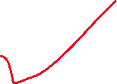











































Slide 4














































Slide 5























































Slide 6

































Slide 7
















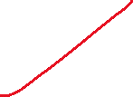






























Slide 8










































Slide 9












































Slide 10



















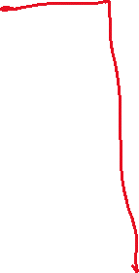













Slide 11











































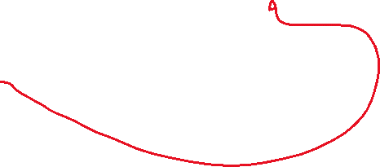










Slide 12















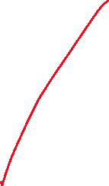







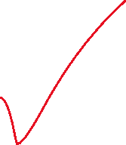


















Slide 13






























































Slide 14
































Slide 15































Slide 16





































