Slide 1

Let’s solve it

Slide 2




























Slide 3

































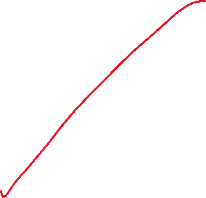


















Slide 4













































Slide 5



















Slide 6

























Slide 7

































Slide 8































Slide 9






















































Slide 10

















Slide 11














































