Slide 1


Let’s solve it

Slide 2



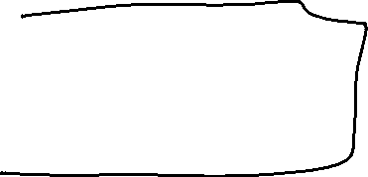






















































Slide 3




















Slide 4
































Slide 5




Slide 6







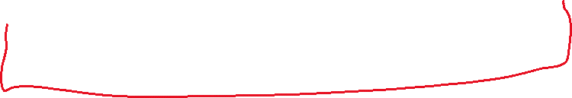















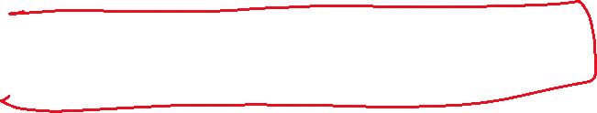



























Slide 7















































Slide 8


















































Slide 9













Slide 10




















































