Slide 1


Let’s solve it

Slide 2










































Slide 3



































Slide 4



















































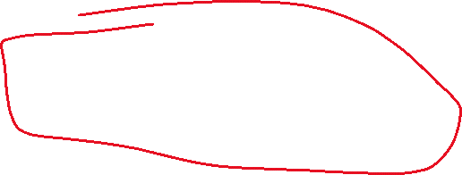









Slide 5





























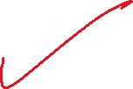









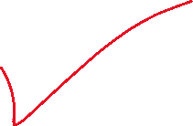





Slide 6
































