Slide 1

Let’s solve it

Slide 2
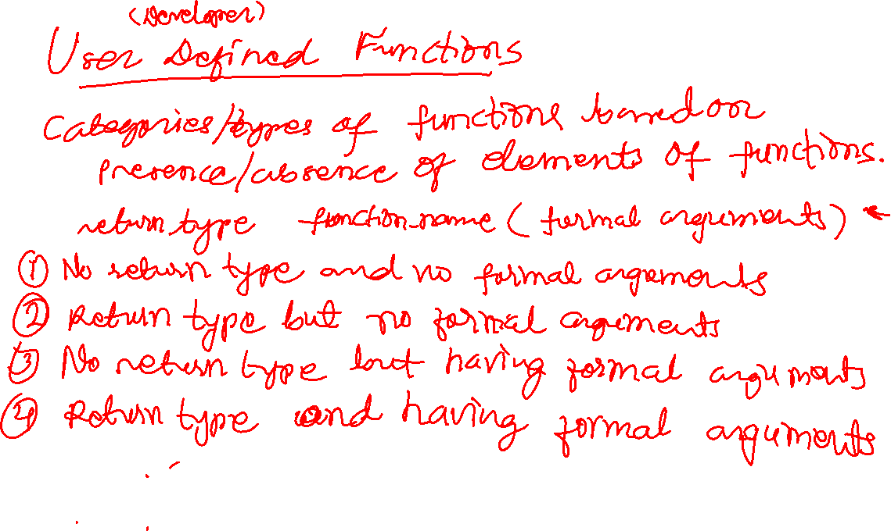

Slide 3
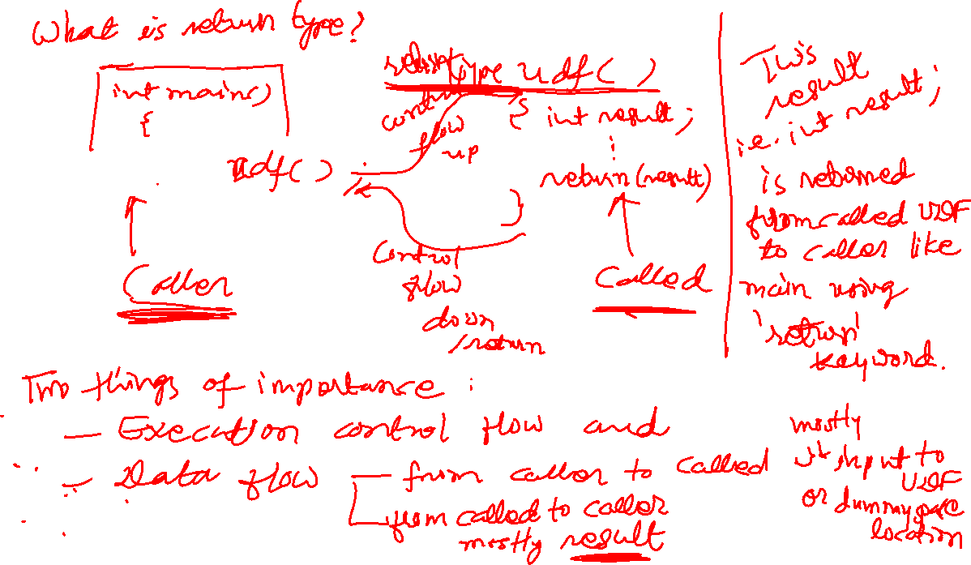

Slide 4





















































Slide 5
















































Slide 6























































Slide 7




















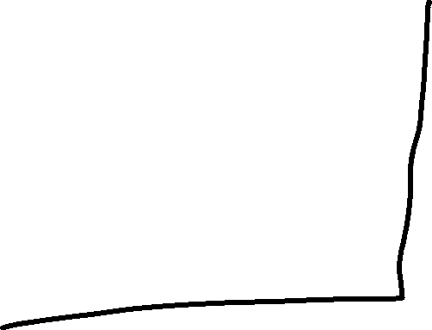





















Slide 8



































































Slide 9



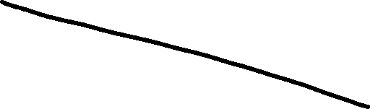




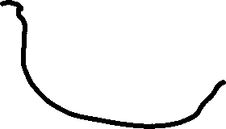



































Slide 10







































Slide 11























































Slide 12



















































