Slide 1
Discrete Maths

Slide 11
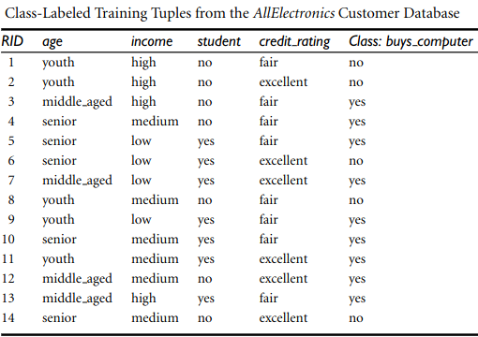
The-Morgan-Kaufmann-Series-in-Data-Management-Systems
-Jiawei-Han-Micheline-Kamber-Jian-Pei-Data-Mining.
Concepts-and-Techniques-3rd-Edition-Morgan-Kaufmann-2011

