Slide 1
Python
Overview

Slide 2
Introduction
Two things determine time to solution:
How long it takes to write a program (human time)
How long it takes that program to run (machine time)
Different languages make different tradeoffs
between these
High-level languages let programmers express their thoughts more quickly…
…but the more abstract the language, the more slowly it runs

Slide 3
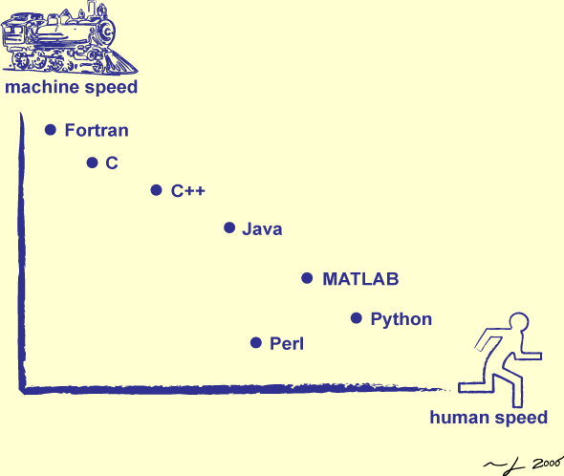
Where Python Stands?

Slide 4
Still why Python?
Scripting languages are increasingly popular
because they optimize human time
Which is now more expensive than machine time in all but a handful of cases
Object Oriented. Design Patterns.
As flexible as the shell, but with real data structures.
A world is not made of just lists
Sets (Implemented using Hash Table) , Dictionaries (Key-Value), tuples, etc. are also there to achieve required task in easy manner.

Slide 5
Unsuccessful attempt with Shell Script
#Removing all numbers from file names to deceipt secret message from sorted names of directories/files.
for original_name in `ls`
do
echo $original_name
new_name=`echo $original_name | sed 's/[0-9]*//g'`
mv $original_name $new_name
done;
** Here, shell script is failing for names having spaces in directory names. i.e. “New York2100”
Note that Python Udacity course shows very accurate python script to achieve the same quickly. **
https://www.udacity.com/course/programming-foundations-with-python--ud036
[jigar.pandya@localhost shellscripts]$ ls
123Alibi
New York2100
renscript.sh
[jigar.pandya@localhost shellscripts]$ ./renscript.sh
123Alibi
New
mv: cannot stat ‘New’: No such file or directory
York2100
mv: cannot stat ‘York2100’: No such file or directory
renscript.sh
mv: ‘renscript.sh’ and ‘renscript.sh’ are the same file
[jigar.pandya@localhost shellscripts]$ ls
Alibi
New York2100
renscript.sh
[jigar.pandya@localhost shellscripts]$

Slide 6
Execution Cycle
Sturdy languages use a two-step execution cycle
Compile source code, putting machine-oriented form in file
Run the contents of that file on top of an operating system or virtual machine
Nimble languages combine these two steps
Compiler and virtual machine are the same program
Load source code, translate into more compact form if necessary, and execute

Slide 7
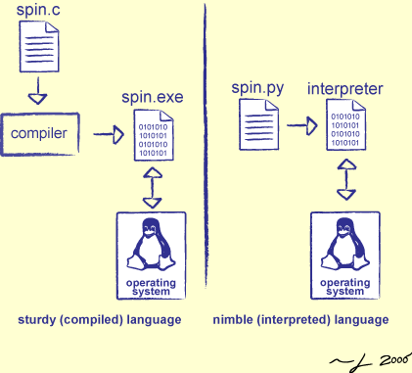
Sturdy vs. Nimble Execution

Slide 8
…
Compiling gives the computer a chance to optimize that is why sturdy programs run faster
But nimble programs are faster to write as Load-and-go makes human turnaround faster

Slide 9
Highlights
Python doesn’t use begin/end or {…}
Not really needed because indentation is what everyone actually pays attention to.
use colon and indentation to show nesting
num_moons = 3
while num_moons > 0:
print num_moons
num_moons -=1
Python borrows C's comparison operators, too
But allows you to chain comparisons together, just as in mathematics “3 < 5 <= 7 is True”
Immediate string comparison “‘abc’ < ‘Abc’ is False”

Slide 10
Highlights…
The built-in function str converts things to strings
print "Diameter: " + str(1280) + "-" + str(1760) + " km"
Diameter: 1280-1760 km
Use int, float, etc. to convert values to other types
print int(12.3)
print float(4)
12
4.0
Expression ‘Py’ * 2 produces ‘PyPy’

Slide 11
Highlights…
There is no separate data type for characters
A character is simply a string of length 1
Negative indices count backward from the end of the string
x[-1] is the last character
x[-2] is the second-to-last character
Python always does an out-of-bounds check when you
index a single item
But it truncates out-of-range indices when you take a slice
$ python
>>> element = 'helium'
>>> print element[1:22]
elium
>>> x = element[22]
IndexError: string index out of range
Allows multi-valued assignment
left, right = "gold", "lead" assigns "gold" to left, and "lead” to right

Slide 12
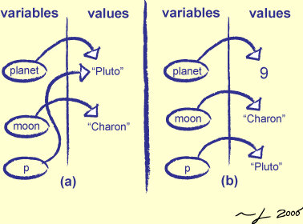
No variable types
No types: a variable is just a name, and can refer to different types of values at different times
planet = "Pluto"
moon = "Charon"
p = planet
planet = 9

Slide 13
No variable types! What’s the trick?
Variables don't have types, but values do
Python complains if you try to operate on incompatible values
x = "two" # "two" is a string
y = 2 # 2 is an integer
print x * y # multiplying a string concatenates it repeatedly
twotwo
print x + y # but you can't add an integer and a string

Slide 14
Experience(die) hard!
I just wanted to experience it hard!
Which all packages do use python in my Linux???
$>Yum remove python
$>More than 855 packages
$>Are you sure (y/n)? Y
Dooooooom.
My Linux is now almost having nothing. I will have to reinstall everything. Even the entry from grub is removed. See the heights of dependency on Python.
Google brands python from years then decide yourself which is the brand.
Many of mundane operations are automated using python by many engineers who know it. i.e. File/Text processing.

Slide 15
Broader Idea by an application developed using Python
Introduction
What if your server program listening at LOOPBACK?
You are serving...........JUST YOURSELF!
What if your server program listening at interface, which, has NOT got any worldwide IP?
You are serving........... JUST INTRANET.
Can your server program still serve THE INTERNET, without having a worldwide IP?
The answer is, YES!

Slide 16
Use Port Forwarding (IP Tunneling related)
Demo Application
Developed to understand/use port forwarding
SCENARIO
Networks in a college campus.
Local hosts of one network need to provide services to external world, can be local hosts of another network.
BUT, not all local hosts are having worldwide IP.
Only Head Nodes of networks having worldwide IP.

Slide 17
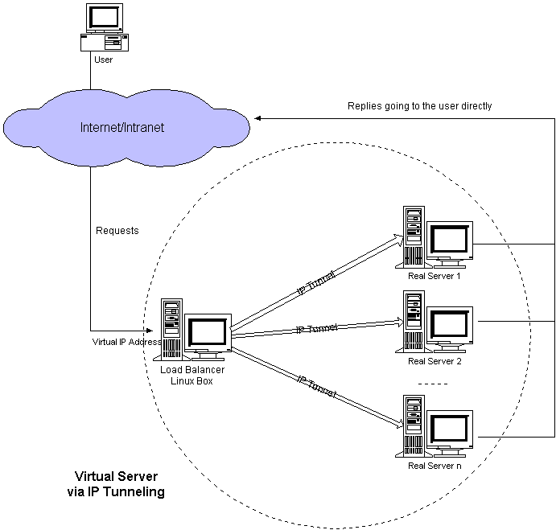
…
... Applications
Internet Connection Sharing
Traffic balancing to multiple servers
Helping to save IP as limited IPV4 addresses worldwide. Talking about when IPV6 was just a theory.

Slide 18
Summary
Python is one of the cleanest scripting languages around
A good tool in its own right
An excellent way to build other tools
*Courtesy *
Prof. Derek Harter, TAMU-C. U.S.A
Attendee: Jigar M. Pandya
Spring 2008

