Slide 1
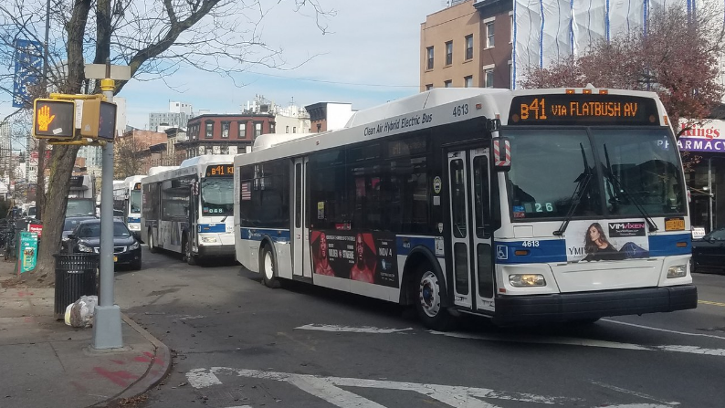
Bus Bunching Cross Agency Comparison
ECO 590
Ahmad Alexander

Slide 2

Motivation
Have you ever waited a long time for the bus, then three buses arrive at once? This is known as bus bunching.
Bus bunching is one of the most common and costly reliability failures in urban transit systems.
It increases passenger wait times and overcrowds some buses while others run empty.
Research question: What route-level and temporal factors predict bus bunching, and do these relationships vary across agencies?

Slide 3
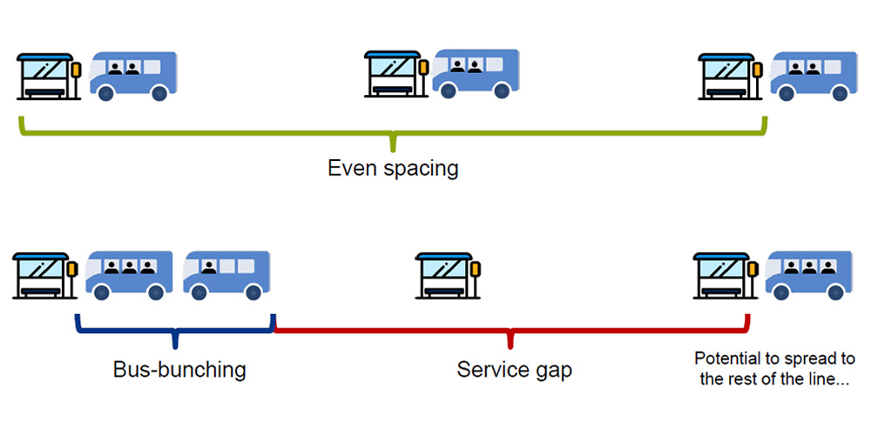
Data Collection
GTFS is a universal standard for transit data, every agency uses the same language
Real-time feeds (GTFS-RT) give live vehicle positions, that's where deviation and bunching come from
Main difference across agencies: how nested the data is
WMATA was the cleanest and least nested

Slide 4
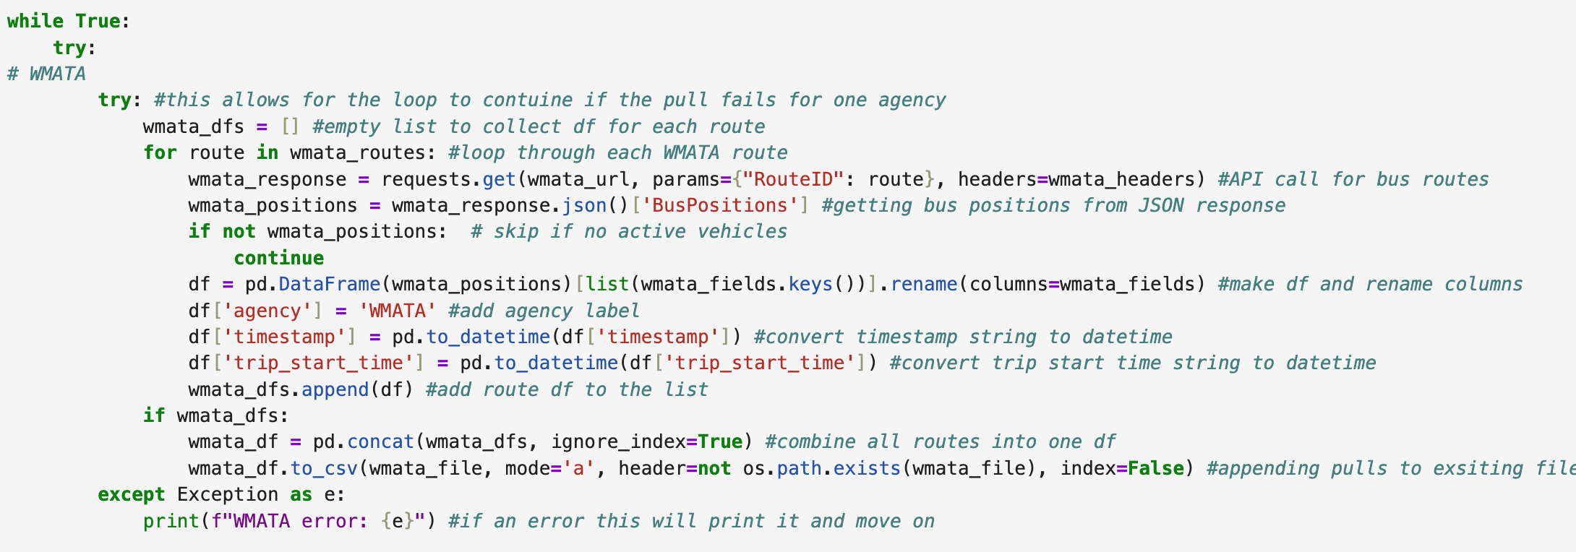
Outer main loop hold all 3 agencies
Loops through the the specified routes
API call
Where vehicle data lived, not very nested
Pulled only the fields I needed and renamed them
Appended each pull to the same CSV
If WMATA fails, the loop doesn't crash, it just prints the error and moves on to the next agency.

Slide 5
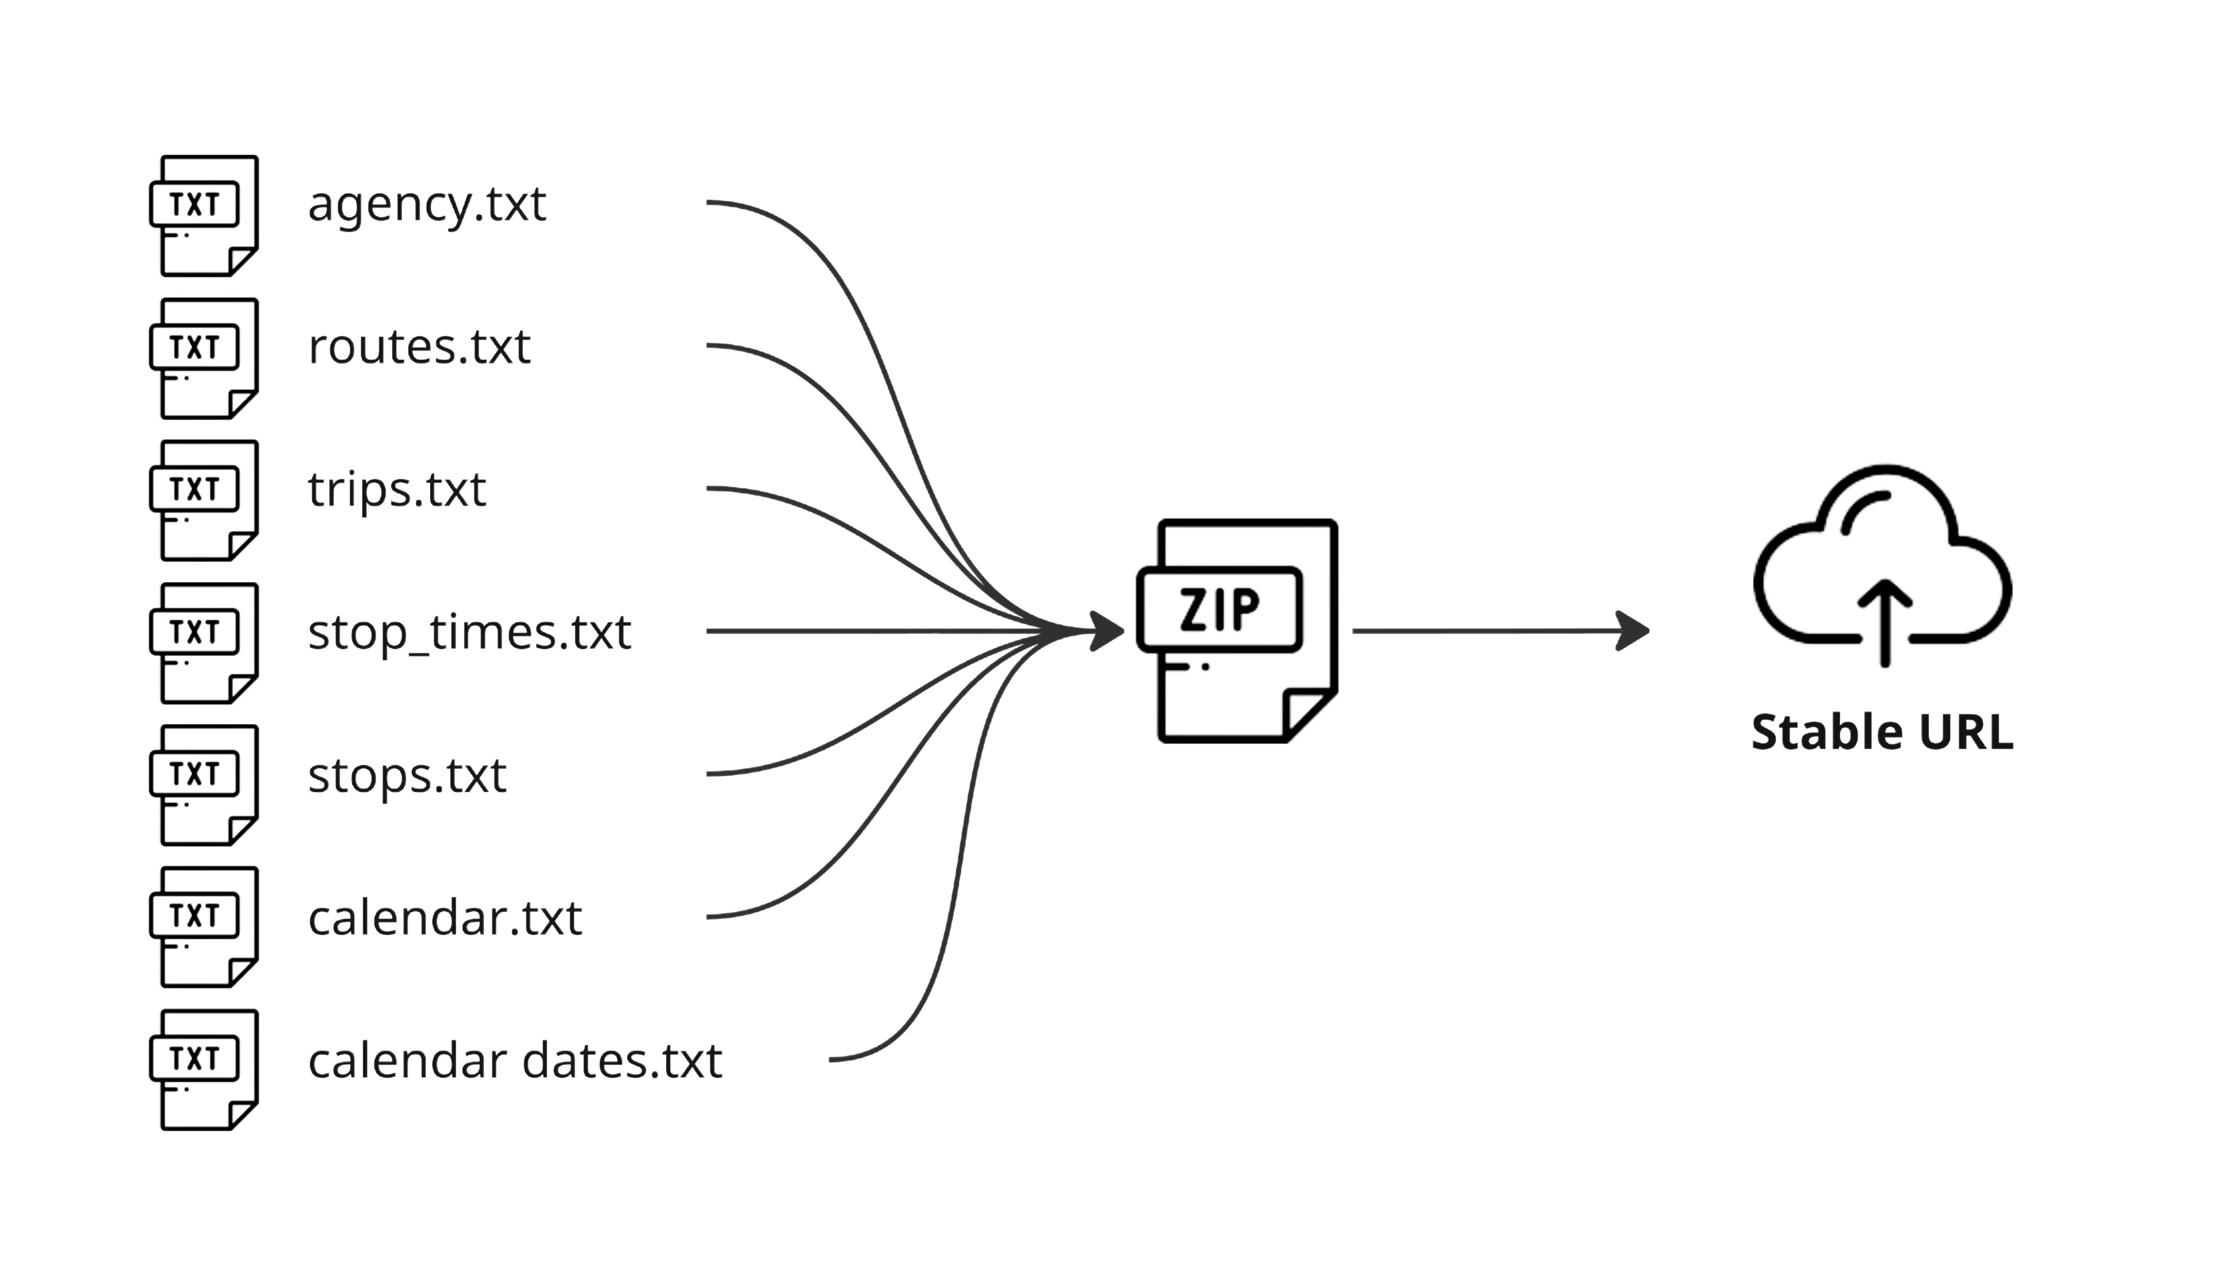
GTFS static is the scheduled timetable
Stop times, trip IDs, headway, deviation
Needed it to compute: scheduled headway, schedule deviation, timepoint rate, headway CV
MTA was the hardest, GTFS split across four borough zip files, route ID prefix mismatch

Slide 6
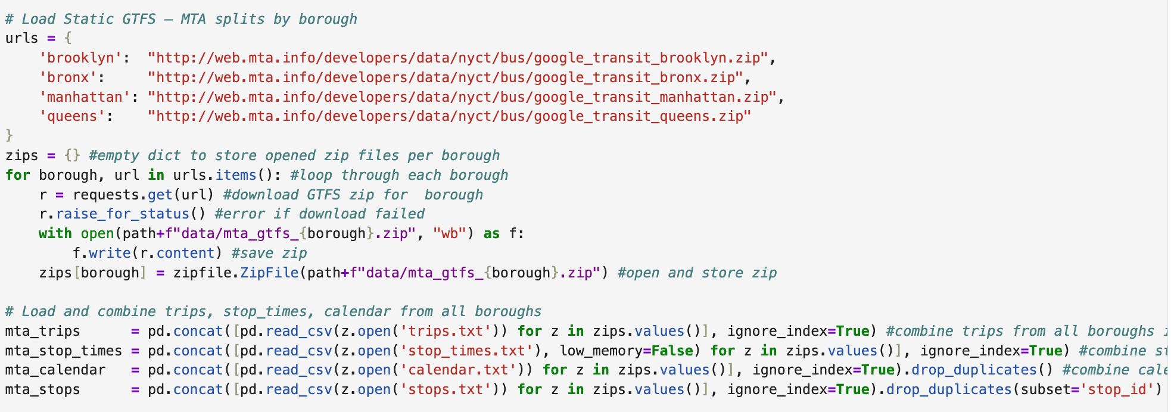
MTA splits their static schedule across four separate files by borough
Loops through each borough, downloads the zip, saves it, and stores it in a dictionary
Fail/safe - makes sure the download actually went through
Where the actual schedule data lives, combine from each borough for each field
Used to map each trip ID to which days of the week it runs
Has scheduled arrival time at each stop for every trip, which is what I used to compute scheduled headway and schedule deviation.

Slide 7
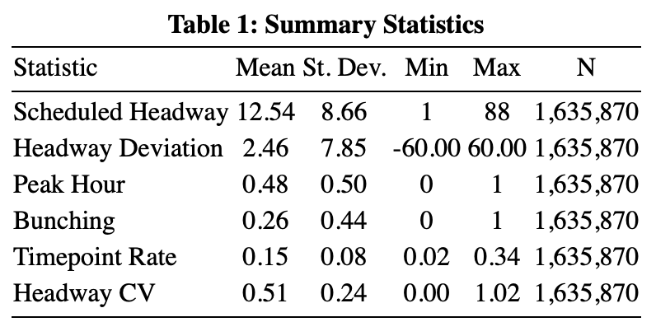
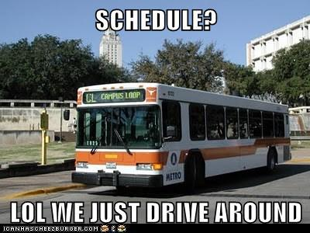
Scheduled Headway — Planned time between consecutive trips on the same route, averages 12 minutes.
Headway Deviation — How many minutes early or late per vehicle obs. Diff between scheduled and live stop times.
Peak Hour — Binary flag for morning/evening peak. About half of obs in peak periods.
Bunching — Binary variable equal to 1 when two buses are less than half the scheduled headway apart in time, meaning they are too close together. About 26% of observations are bunching events.
Timepoint Rate — Timepoints are designated stops where buses must hit exact scheduled times. This variable measures the share of a route's stops that are timepoints.
Headway CV — Standard deviation of headway divided by the mean. Measures how consistent trip spacing is throughout the day.

Slide 8
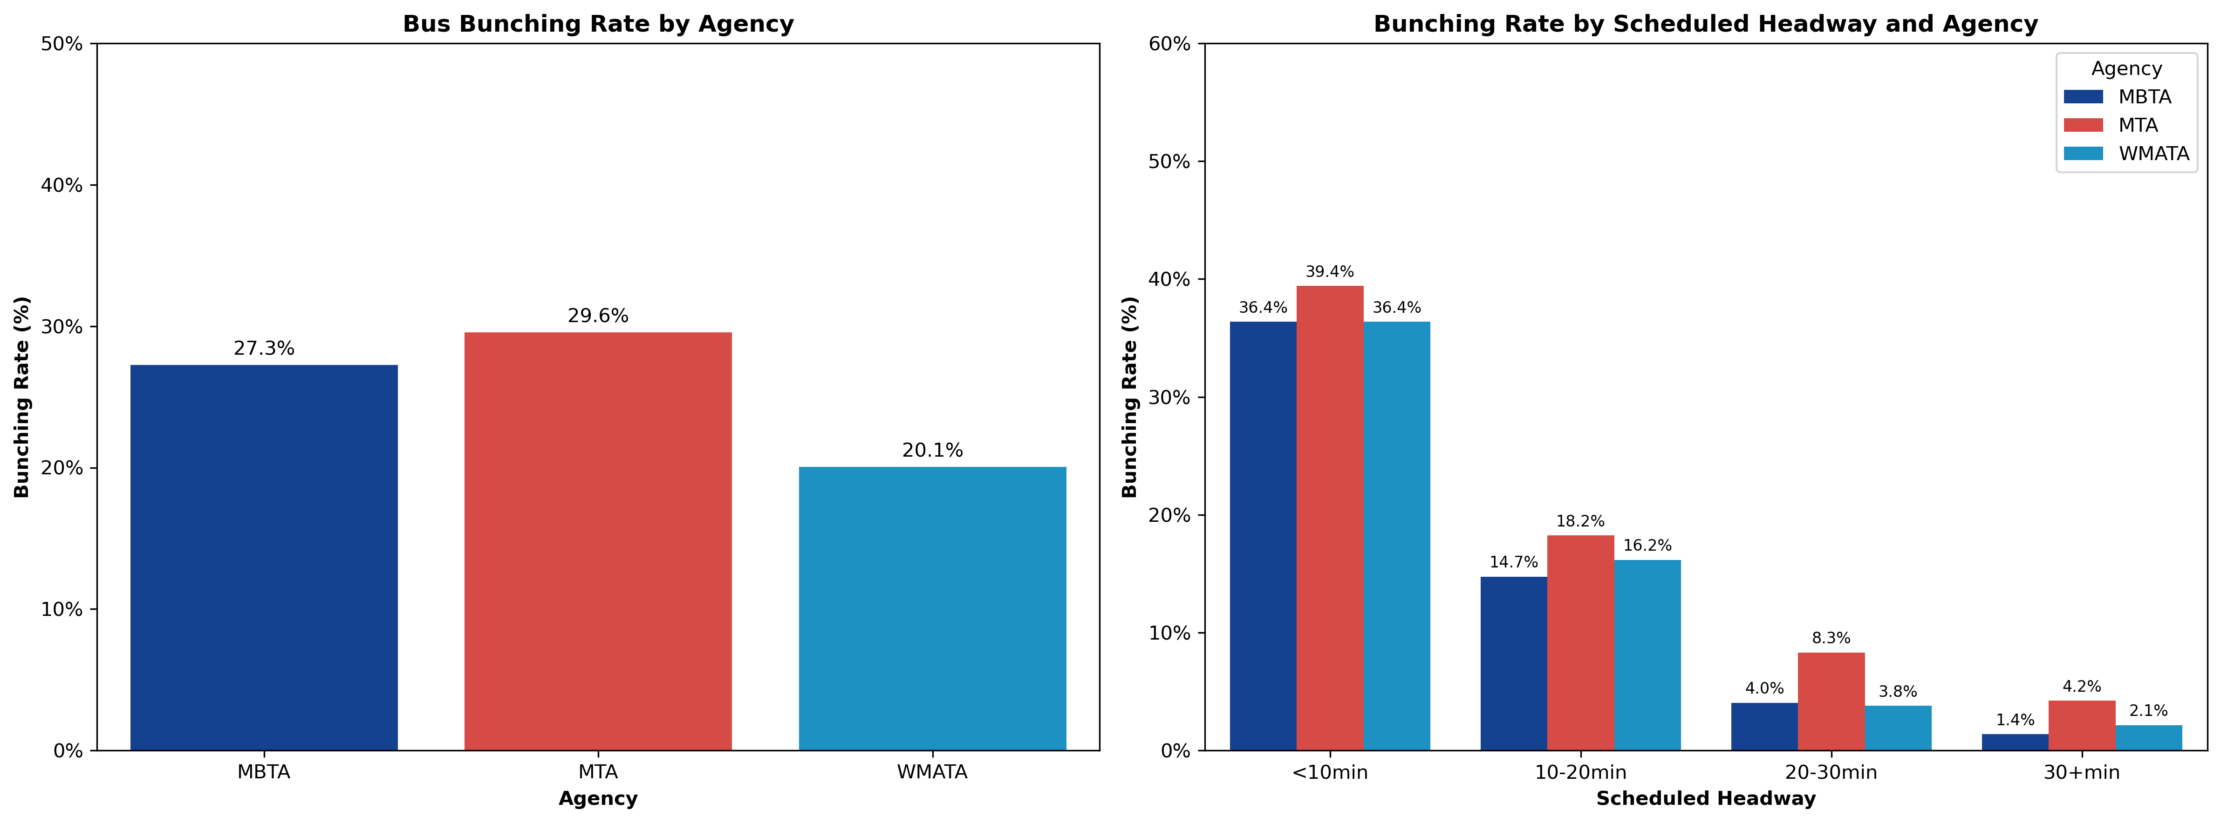
MTA has the highest bunching rate at 29.6%, followed by MBTA at 27.3% and WMATA at 20.1%, meaningful variation across agencies
Bunching drops from 36–39% on high-frequency routes to under 5% on low frequency routes, consistent across all three agencies, suggesting scheduled headway is a structural predictor of bunching.

Slide 9
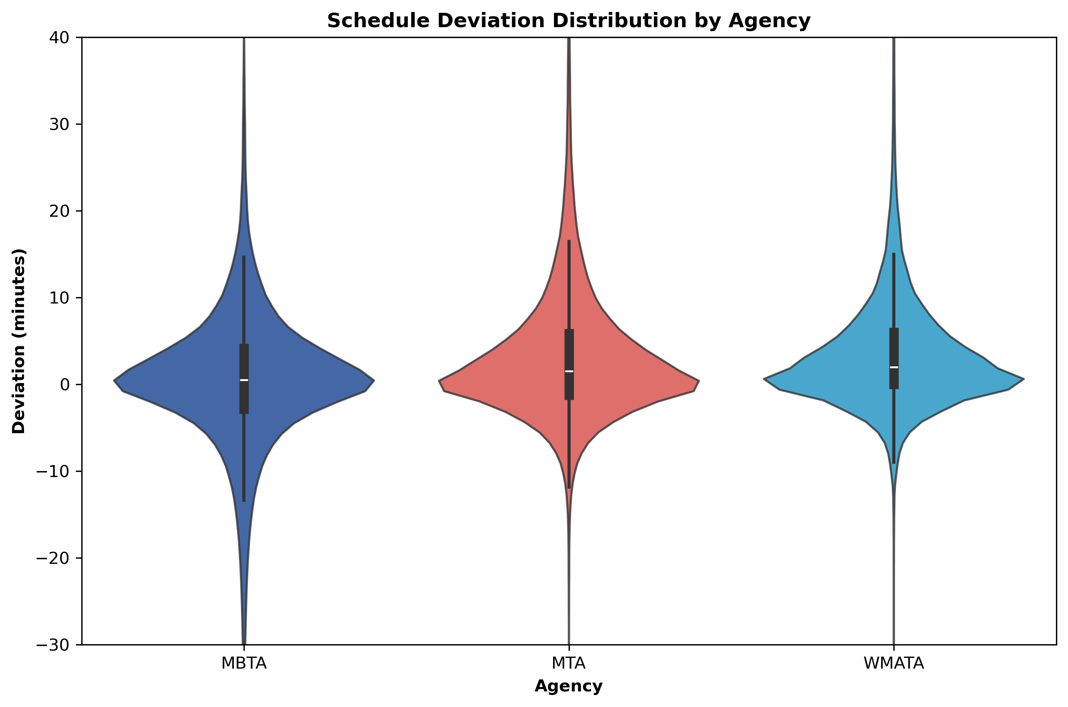
MBTA: Widest spread extending into negative territory, more early buses than the other two agencies
MTA: Bulges most on the positive side, latest on average with the highest variance
WMATA: Narrowest and most centered, buses run consistently close to on time with the least variance

Slide 10
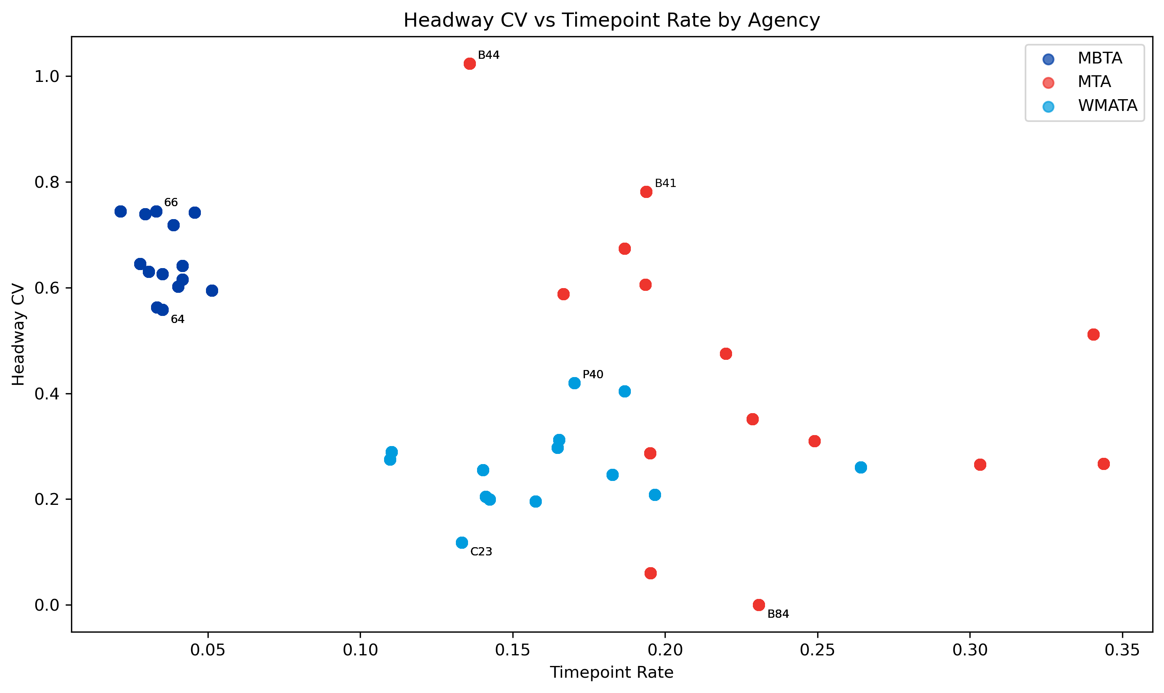
- MBTA has low timepoint rates but high CV
- WMATA clusters at the bottom, more consistent headways - suggesting more timepoints does correlate with better spacing
- MTA has the widest spread, bunching is route specific, not system wide
- Overall: Higher timepoint rates are associated with more consistent headways

Slide 11
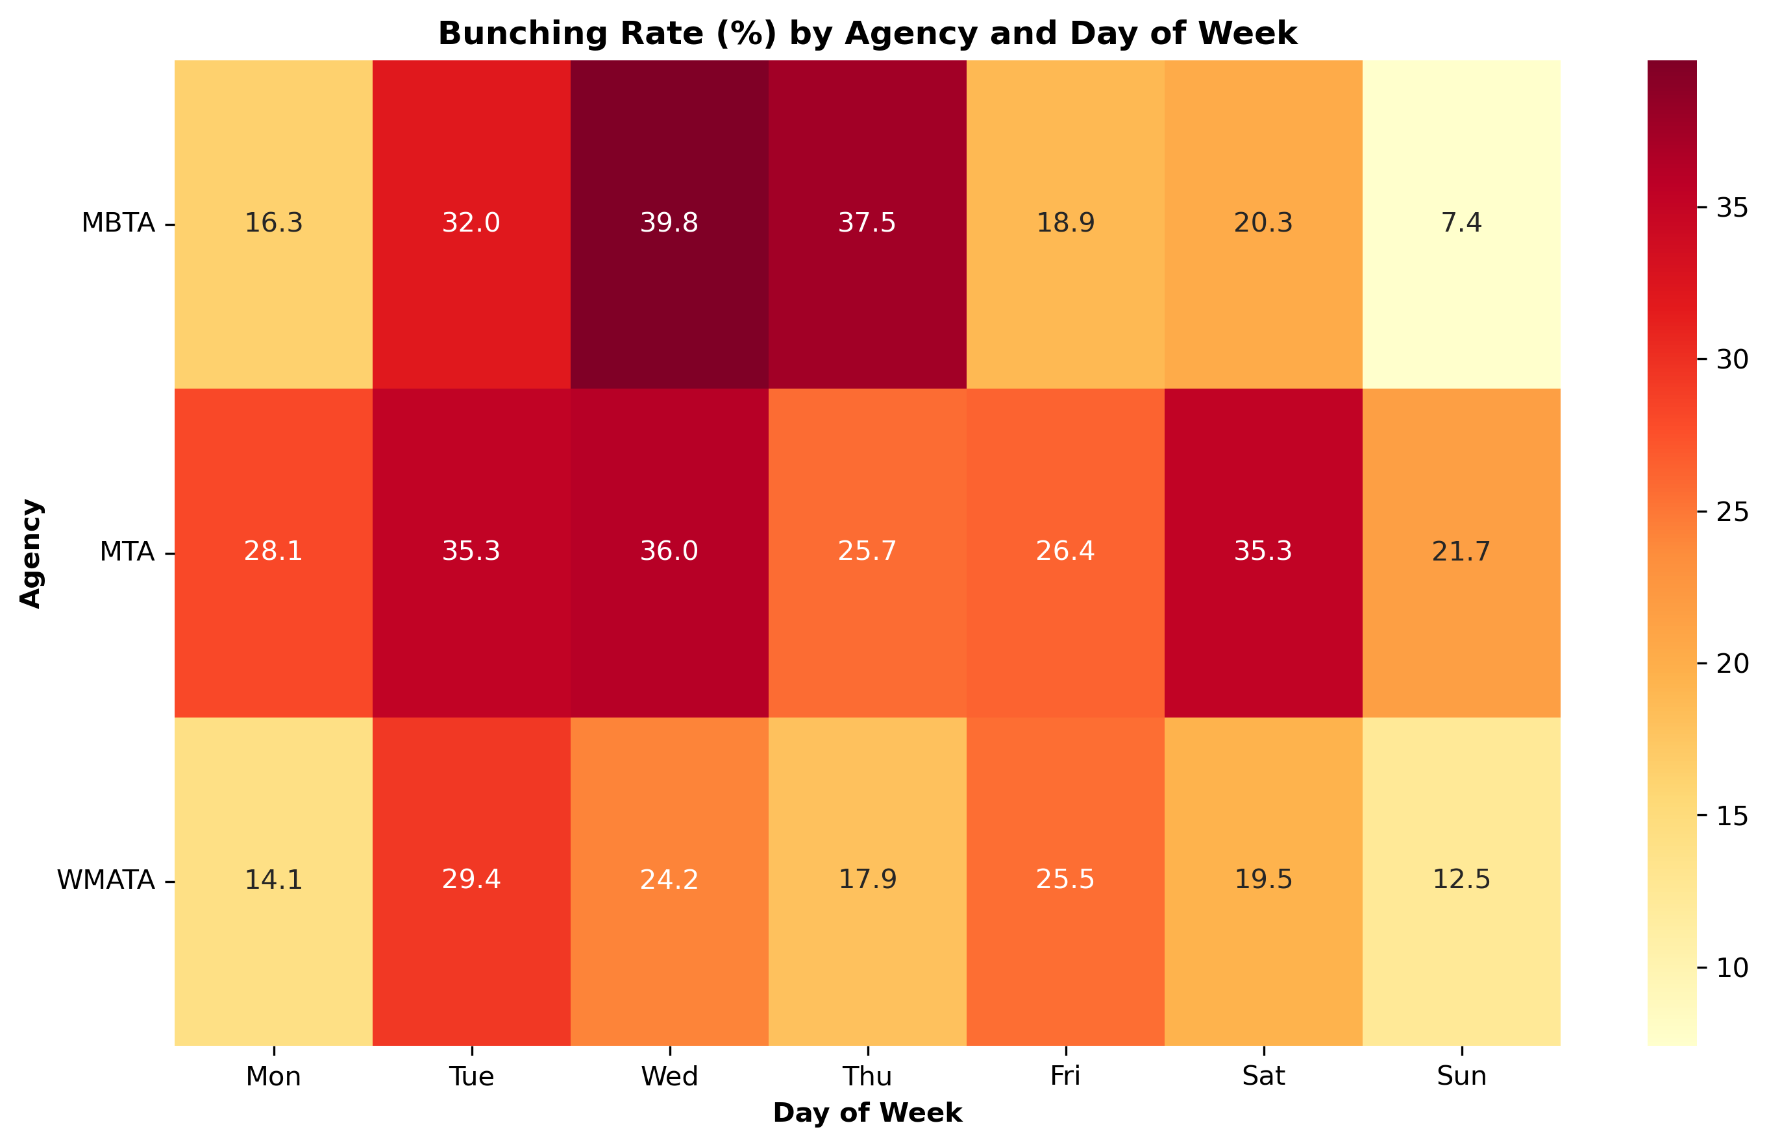
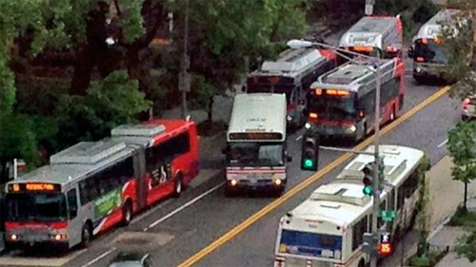
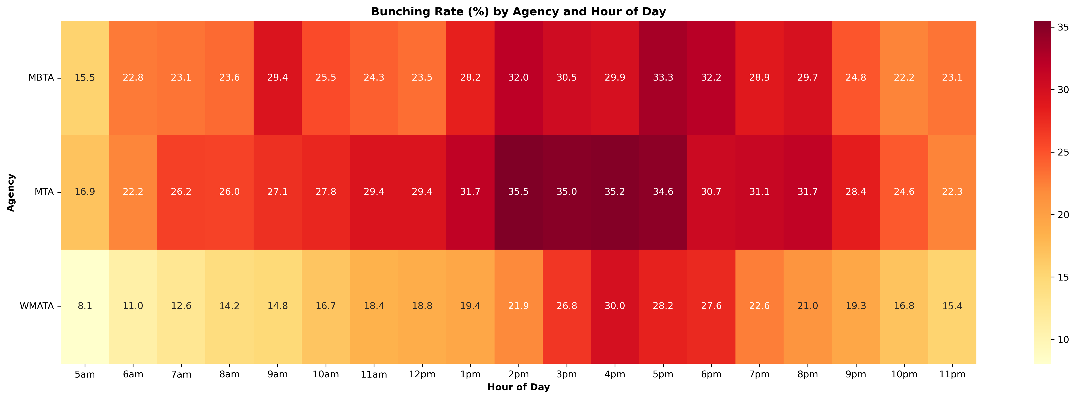
When is Bunching the Worst?

Slide 12
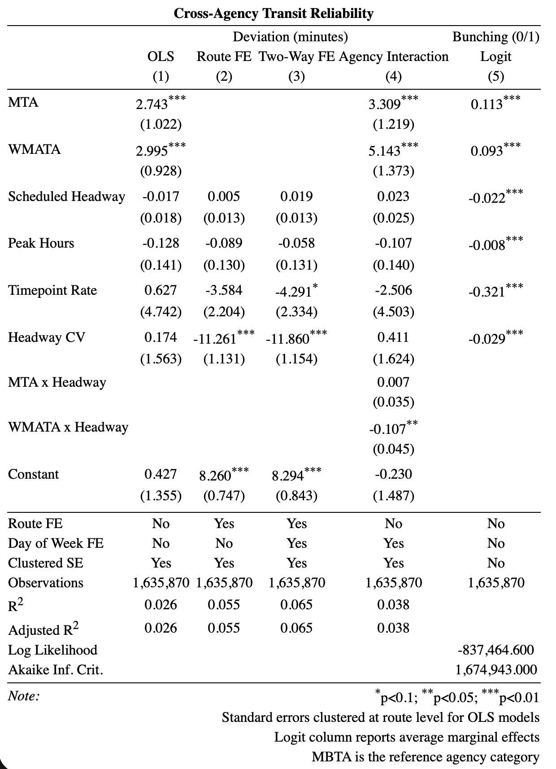
Models (1-4)
MTA and WMATA run 2.75–3.0 min late relative to MBTA (significant at 1%)
Adding Route FE: Headway CV, a 0.1 increase → 1.12 min less deviation
Adding Two-way FE: timepoint rate significant at 10%, 10pp increase → 0.42 min less deviation
WMATA interaction: each additional headway minute → 0.106 min less deviation (opposite of MTA/MBTA)
Logit Model (5)
MTA and WMATA +11.3pp and +9.3pp more likely to bunch than MBTA
Each additional headway minute → 2.2pp lower bunching probability
10pp increase in timepoint rate → 3.25pp lower bunching probability
Peak hours → 0.8pp lower bunching (counterintuitive)
0.1 increase in headway CV → 0.31pp lower bunching probability

Slide 13

Questions?

