Slide 1
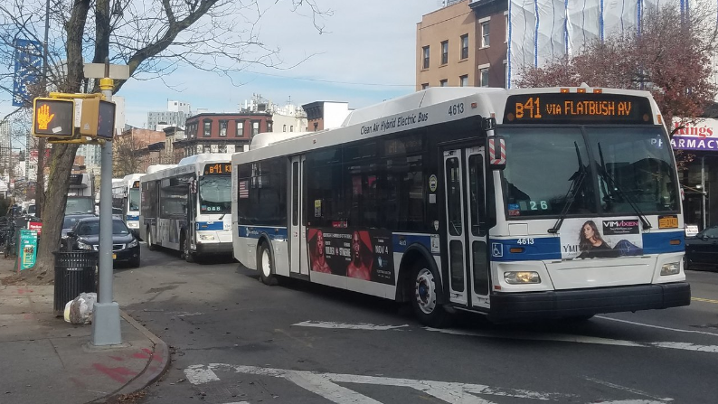
Bus Bunching Cross Agency Comparison
ECO 590
Ahmad Alexander

Slide 2

Motivation
Have you ever waited a long time for the bus, then three buses arrive at once? This is known as bus bunching.
Bus bunching is one of the most common and costly reliability failures in urban transit systems.
It increases passenger wait times and overcrowds some buses while others run empty.
Research question: What route-level and temporal factors predict bus bunching, and do these relationships vary across agencies?

Slide 3
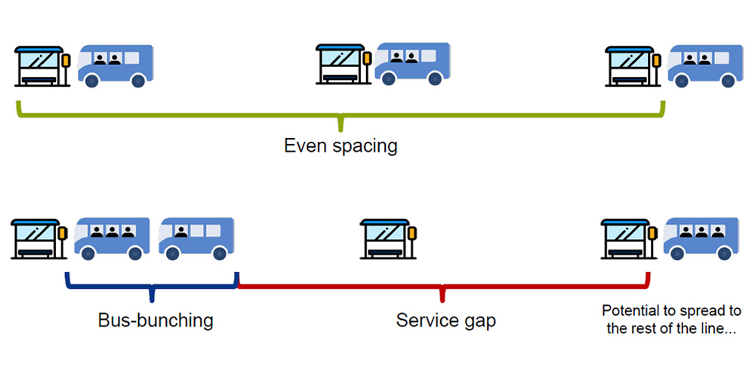
Data Collection
GTFS is a universal standard for transit data, every agency uses the same language
Real-time feeds (GTFS-RT) give live vehicle positions, that's where deviation and bunching come from
Main difference across agencies: how nested the data is
WMATA was the cleanest and least nested

Slide 4
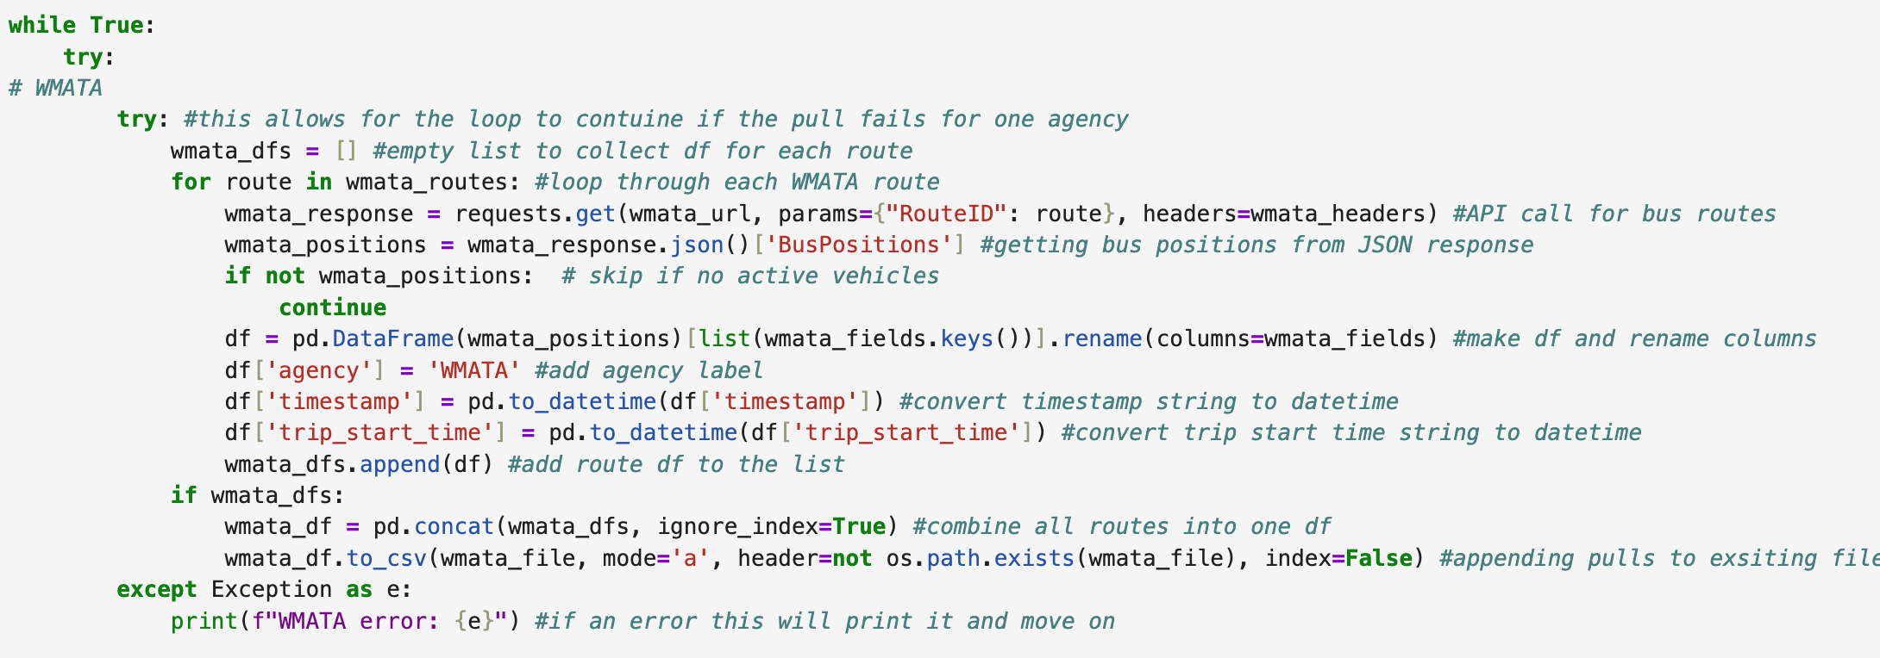
Outer main loop hold all 3 agencies
Loops through the the specified routes
API call
Where vehicle data lived, not very nested
Pulled only the fields I needed and renamed them
Appended each pull to the same CSV
If WMATA fails, the loop doesn't crash, it just prints the error and moves on to the next agency.

Slide 5
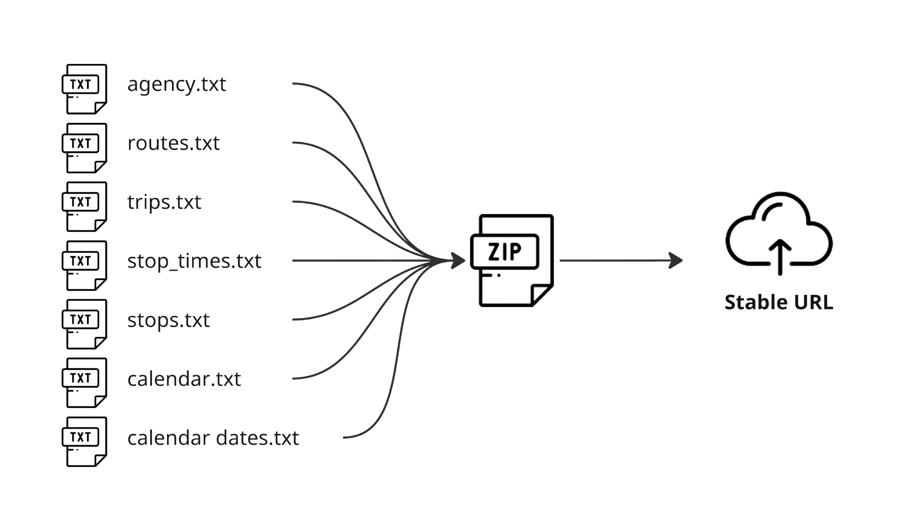
GTFS static is the scheduled timetable
Stop times, trip IDs, headway, deviation
Needed it to compute: scheduled headway, schedule deviation, timepoint rate, headway CV
MTA was the hardest, GTFS split across four borough zip files, route ID prefix mismatch

Slide 6
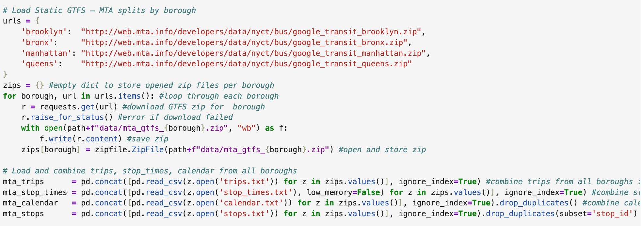
MTA splits their static schedule across four separate files by borough
Loops through each borough, downloads the zip, saves it, and stores it in a dictionary
Fail/safe - makes sure the download actually went through
Where the actual schedule data lives, combine from each borough for each field
Used to map each trip ID to which days of the week it runs
Has scheduled arrival time at each stop for every trip, which is what I used to compute scheduled headway and schedule deviation.

Slide 7
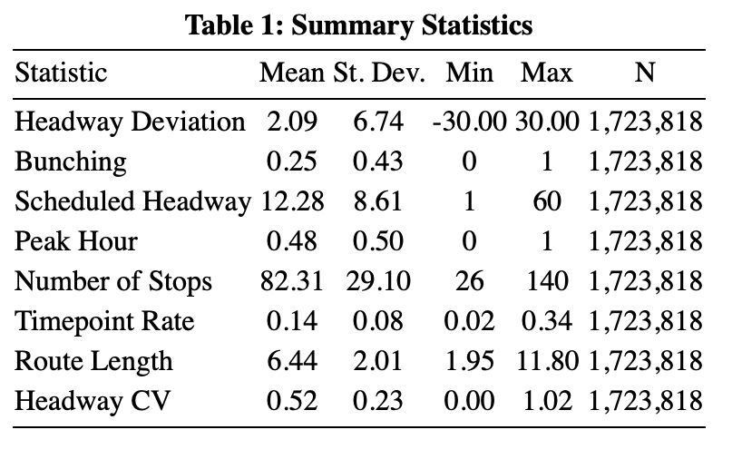
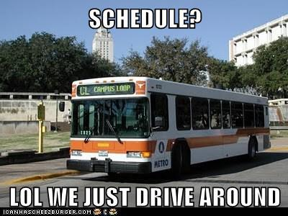
Headway Deviation — How many minutes early or late per vehicle obs. Diff between scheduled and live stop times.
Bunching — Binary variable equal to 1 when two buses are less than half the scheduled headway apart in time, meaning they are too close together. About 25% of observations are bunching events.
Scheduled Headway — Planned time between consecutive trips on the same route, averages 12 minutes.
Peak Hour — Binary flag for morning/evening peak. About half of observations fall in peak periods.
Timepoint Rate — Timepoints are designated stops where buses must hit exact scheduled times. This variable measures the share of a route's stops that are timepoints.
Headway CV — Standard deviation of headway divided by the mean. Measures how consistent trip spacing is throughout the day.

Slide 8
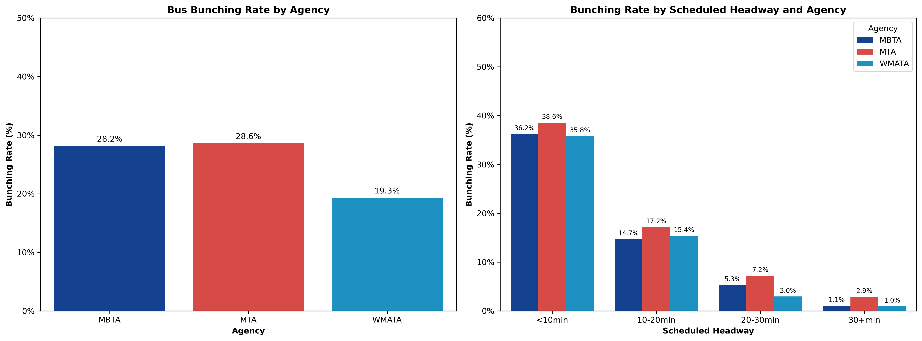
MTA has the highest bunching rate at 35%, followed by MBTA at 28% and WMATA at 20%, meaningful variation across agencies
Bunching drops from 36–45% on high-frequency routes to under 5% on low frequency routes, consistent across all three agencies, suggesting scheduled headway is a structural predictor of bunching.

Slide 9
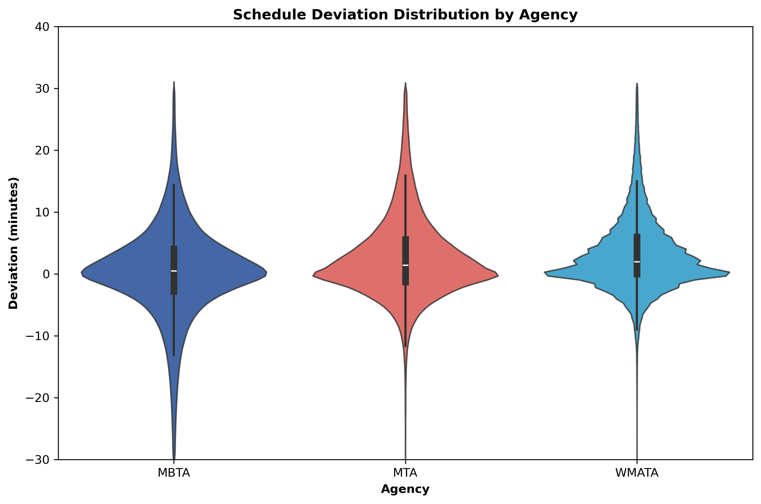
- MBTA: Wider spread and extending further into negative territory meaning early buses (routes run ahead of schedule).
- MTA: The widest shape overall, bulges more on the positive side (meaning late), confirming MTA buses run the latest on average with the most variance
- WMATA: More narrow and shape centered just above 0, meaning most buses are close to on time with a relatively low variance; showing a much tighter distribution.

Slide 10
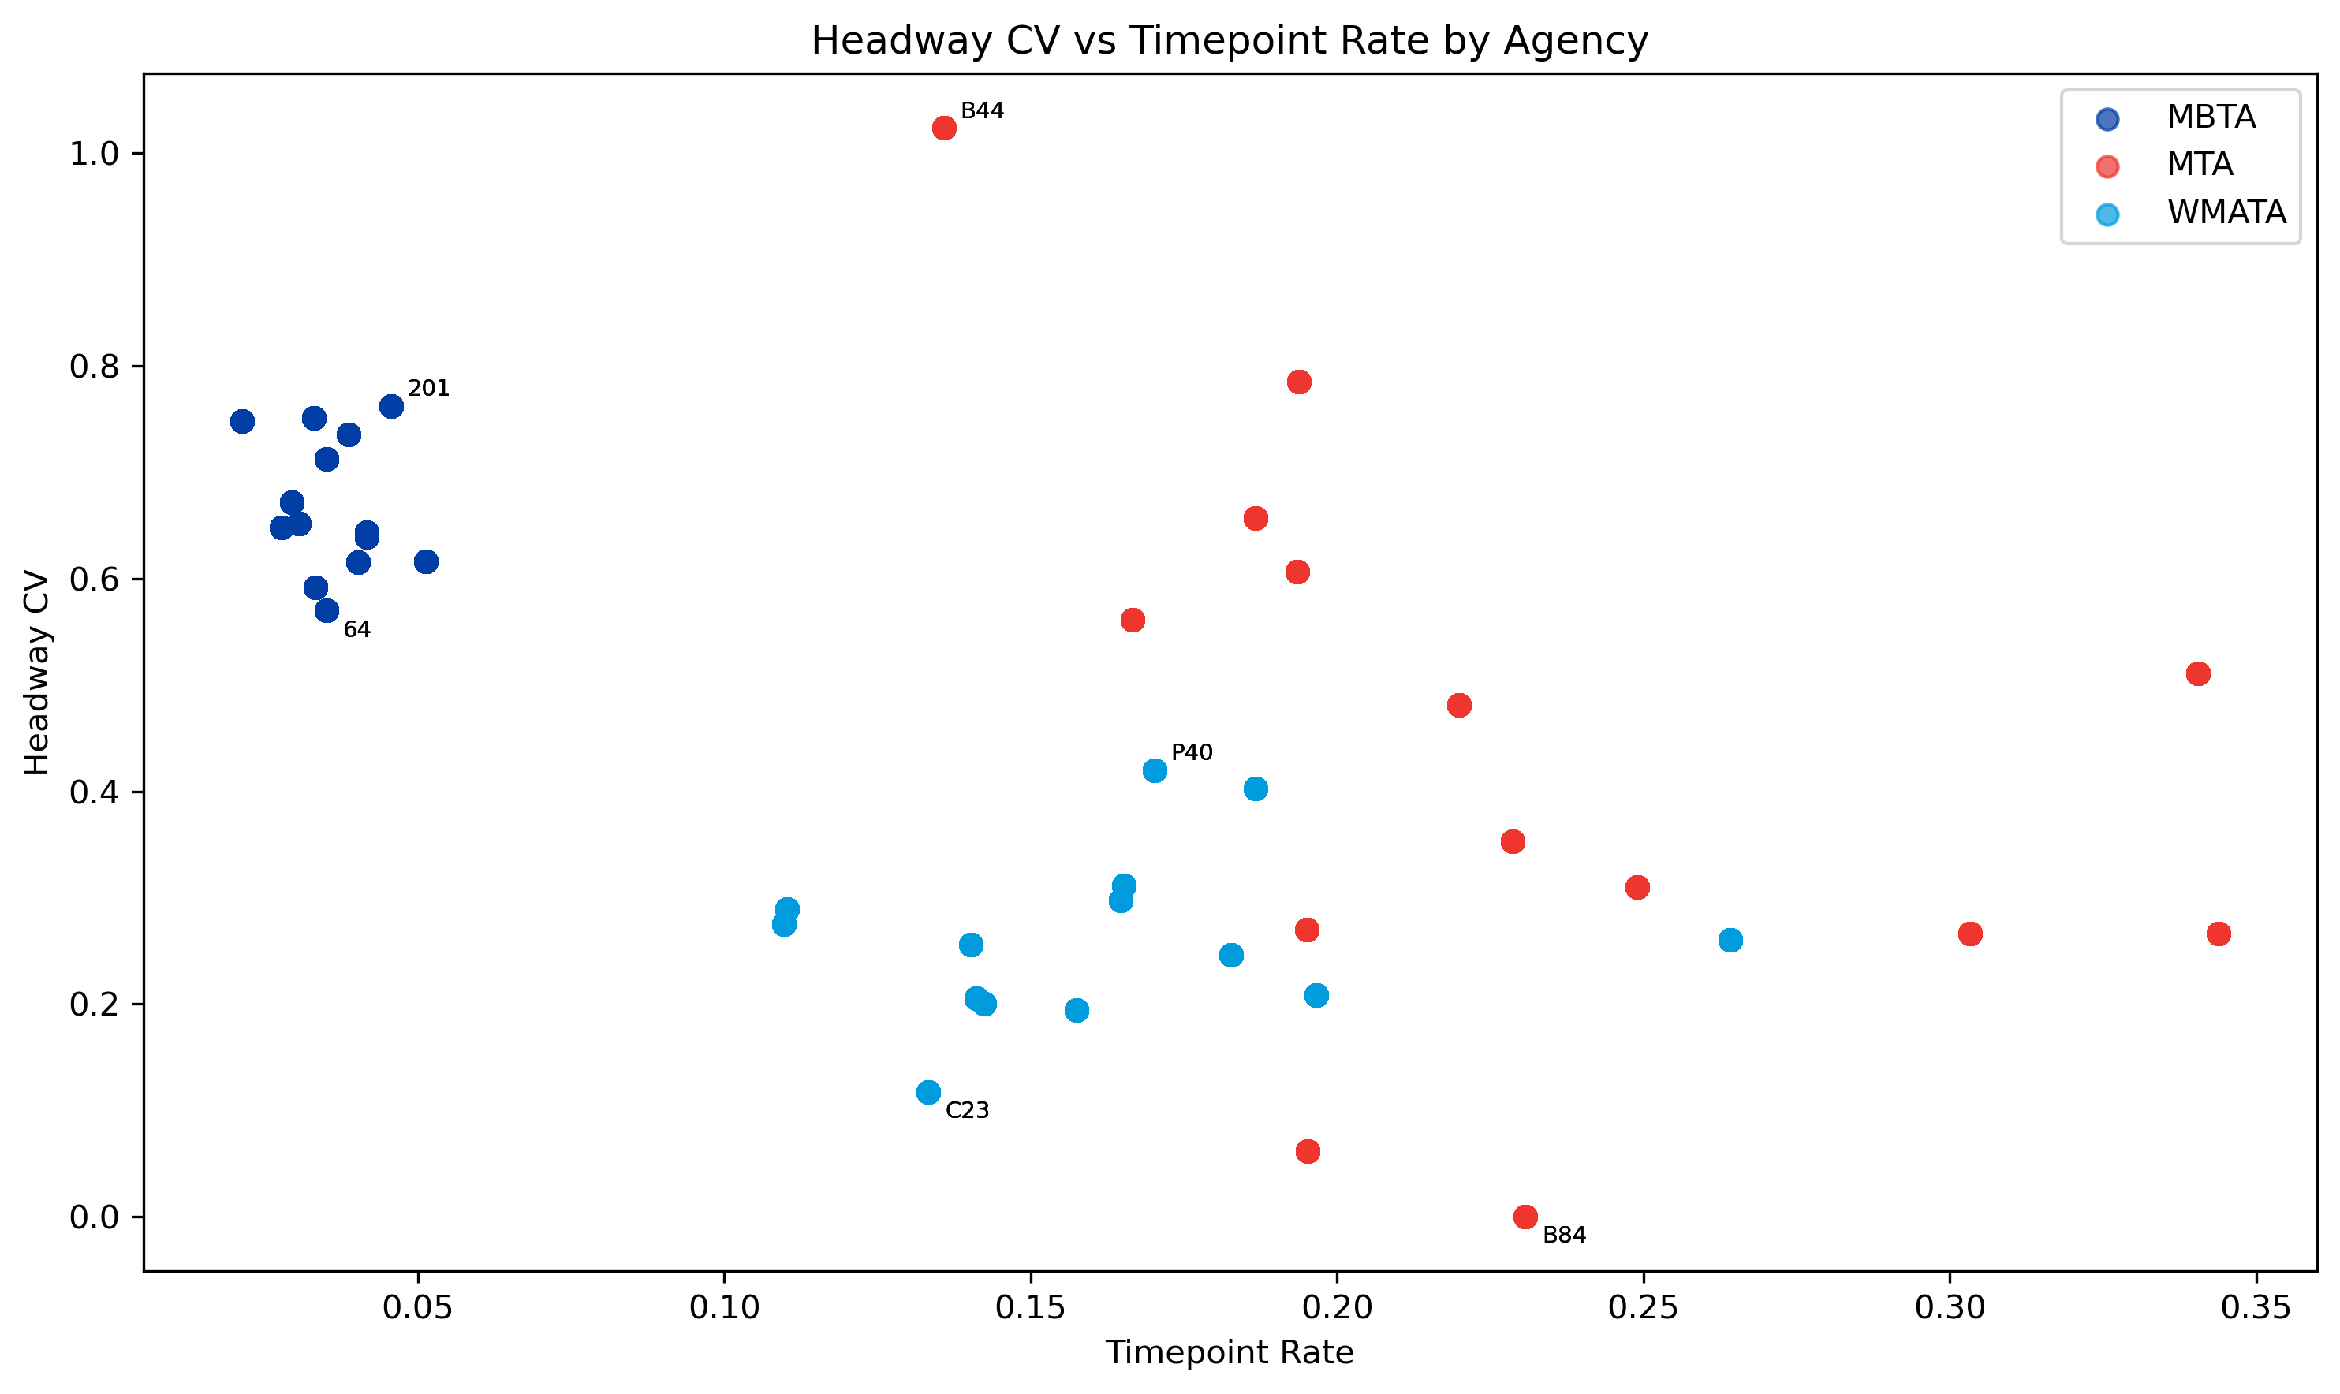
- MBTA has low timepoint rates but high CV
- WMATA clusters at the bottom, more consistent headways - suggesting more timepoints does correlate with better spacing
- MTA has the widest spread, bunching is route specific, not system wide
- Overall: Higher timepoint rates are associated with more consistent headways

Slide 11
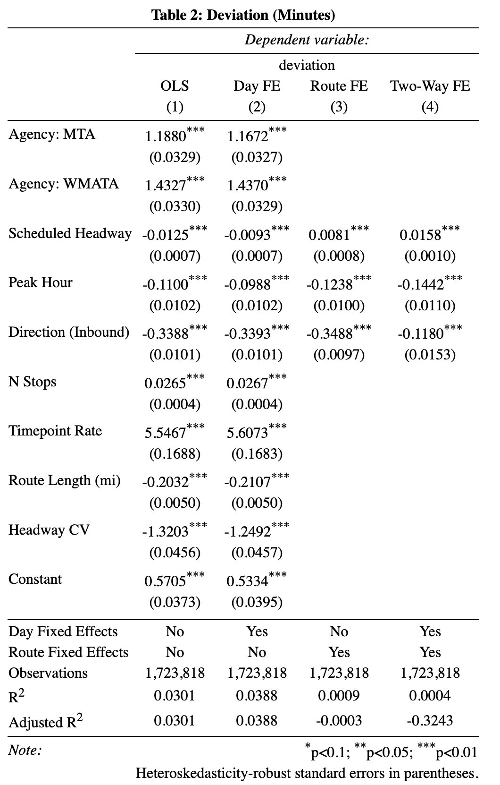
Agency: MTA & WMATA — Both show significantly higher deviation than MBTA. WMATA averages 1.43 minutes more deviation, MTA 1.19 minutes more.
Scheduled Headway — Sign flips between models. Pooled: longer headways mean less deviation.
- Add route fixed effects: longer headways mean more deviation. The cross-sectional and within-route stories are opposite.
Timepoint Rate — A 10 percentage point increase in timepoint rate is associated with 0.55 more minutes of deviation. Buses are being held at timepoints, which inflates deviation.
Headway CV — A 10 percentage point increase in headway CV is associated with 0.13 fewer minutes of deviation. Routes with more variable spacing throughout the day tend to have lower deviation, likely reflecting active schedule management.

Slide 12
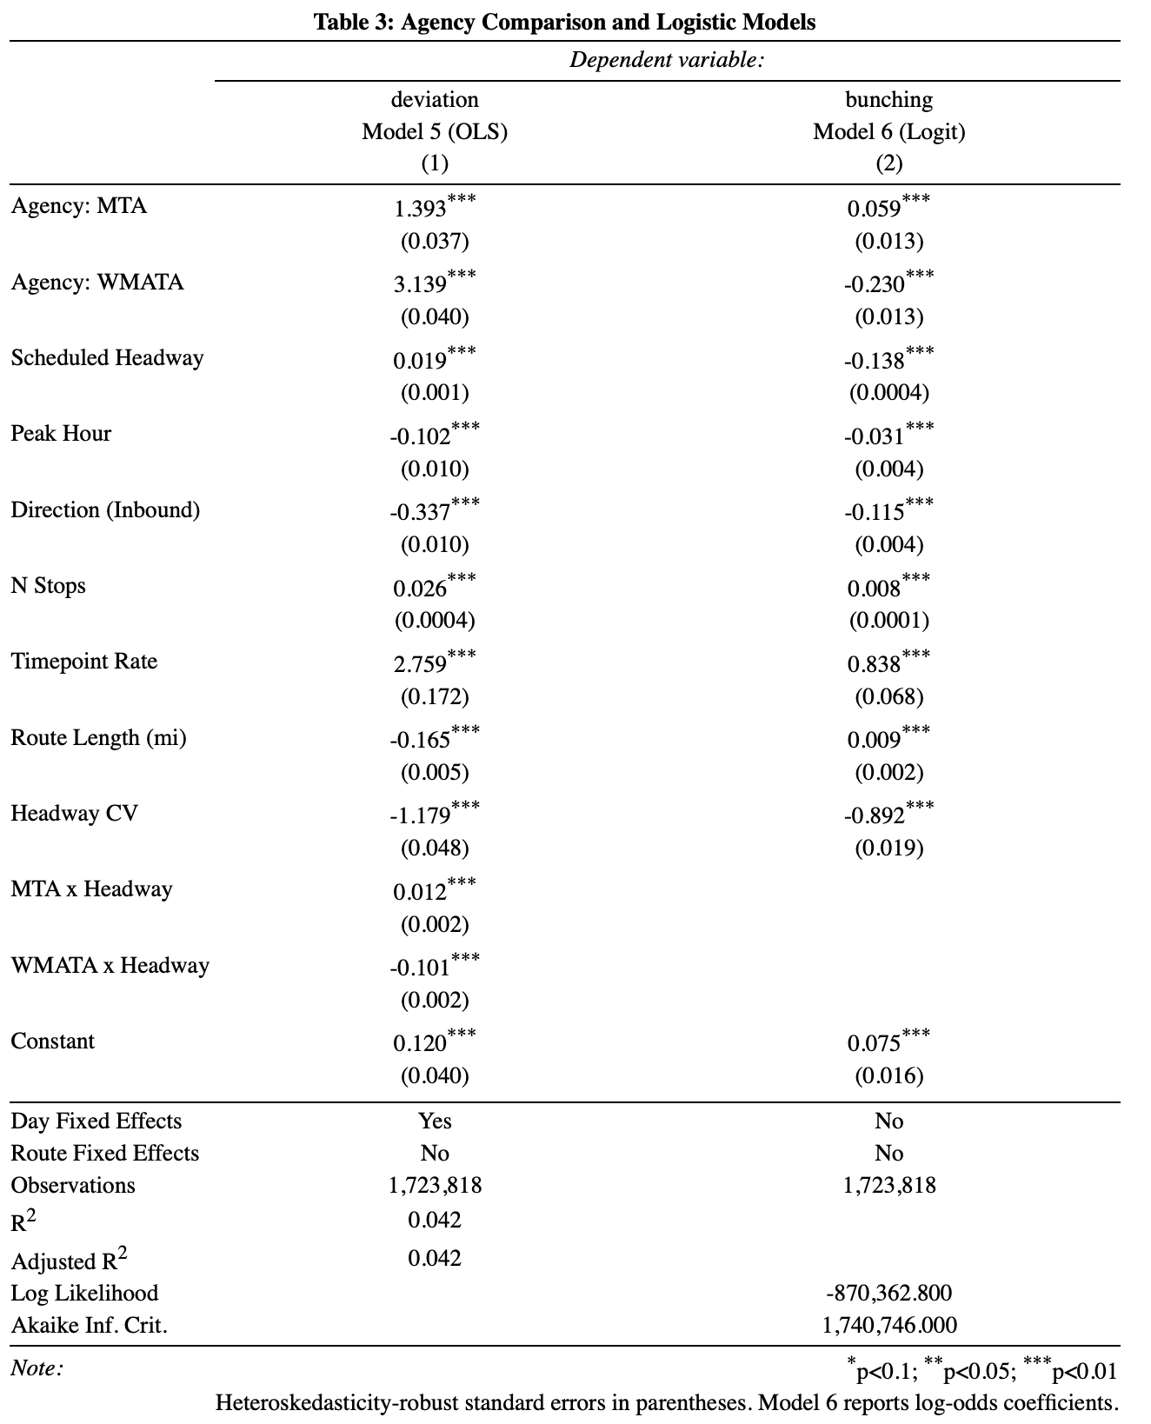
MTA × Headway (Model 5) — For every additional minute of scheduled headway, MTA's deviation increases by 0.012 minutes more than MBTA's. Headway spacing offers slightly less protection against deviation for MTA.
WMATA × Headway — For every additional minute of scheduled headway, WMATA's deviation is 0.101 minutes lower than MBTA's. Longer headways are far more protective against deviation at WMATA than at MBTA.
Agency: MTA & WMATA (Model 6) — Compared to MBTA, MTA routes are 1 percentage point more likely to be bunching. WMATA routes are 3.8 percentage points less likely,
Peak Hour — Observations during peak hours are 0.5 percentage points less likely to be bunching, this is counterintuitive.
Timepoint Rate — A 10 percentage point increase in timepoint rate is associated with a 1.4 percentage point higher probability of bunching, holding behavior at timepoints may actually contribute to buses clustering.
Headway CV — A 10 percentage point increase in headway CV is associated with a 1.5 percentage point lower probability of bunching, routes with more variable spacing throughout the day bunch less.

Slide 13

Questions?

