Slide 1
Tensorflow model pruning
Daniel Silveira – a22404597

Slide 2
Index
Harvesting Hyperparameters, Kernels, and Matrices
Magnitude-Based Pruning (Slide 2.6)
Structured pruning on Filters (Slide 2.5)
Global Unstructured Pruning (Slide 2.5)
Structured Filter Pruning (Slide 2.5)
Pruning entire layers (Slide 2.11 AutoML?)
Pruning by Layer (individual weights)
Random pruning
Layer-wise Pruning
Importance based pruning

Slide 3
Harvesting Hyperparameters, Kernels, and Matrices
This project the MNIST dataset for digit recognition was used
Motivation is to upgrade to a full OCR dataset
The requested harvesting was executed
Then several pruning techniques were applied to analyze what are the most accurate

Slide 4
Model: CNN with fully connected layers
Input Shape: (64, 64, 3)
Total Layers: 5
1 Convolutional Layer
1 MaxPooling Layer
1 Flatten Layer
2 Dense Layers (Fully Connected)
Key Parameters:
Conv Layer 1: 32 filters, kernel size (3, 3), ReLU activation
Dense Layer 1: 128 units, ReLU activation
Dense Layer 2: 10 units, Softmax activation for classification

Slide 5
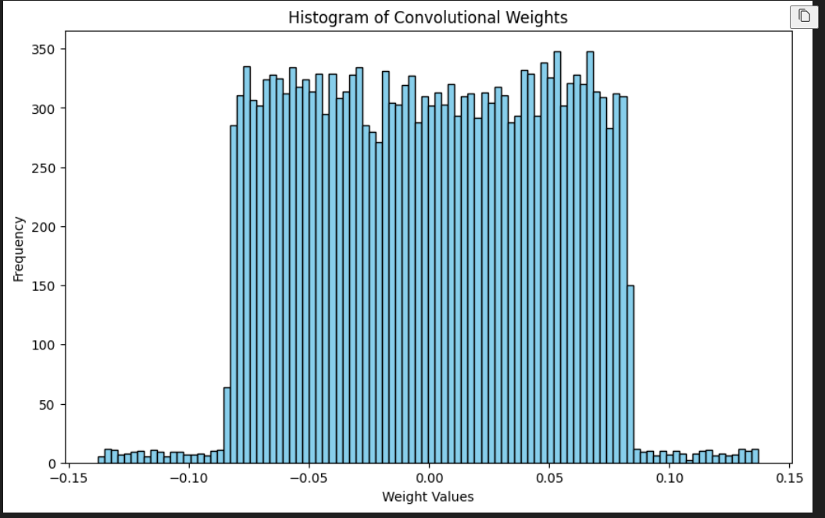
Histogram of Conv Weights

Slide 6
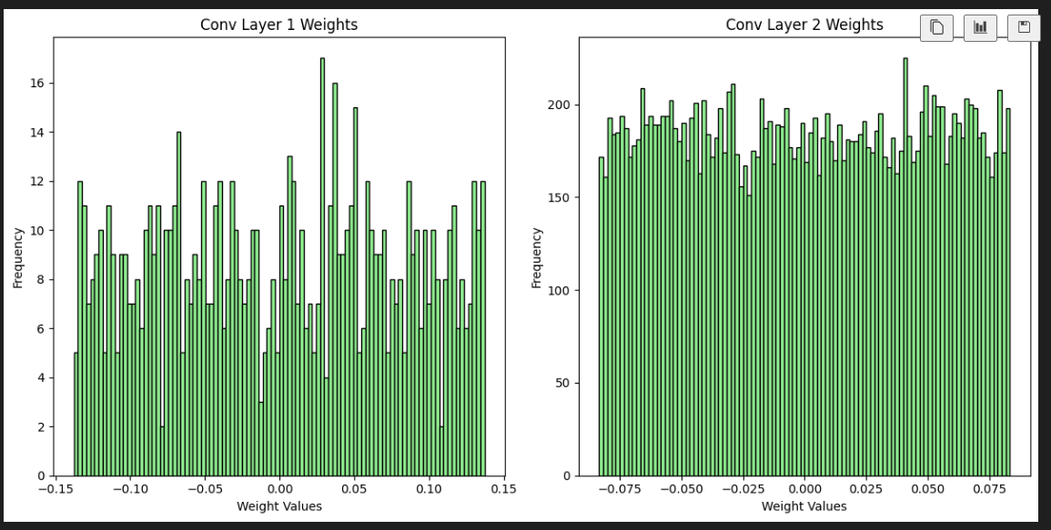
Histogram of Conv Weights Per Layer

Slide 7
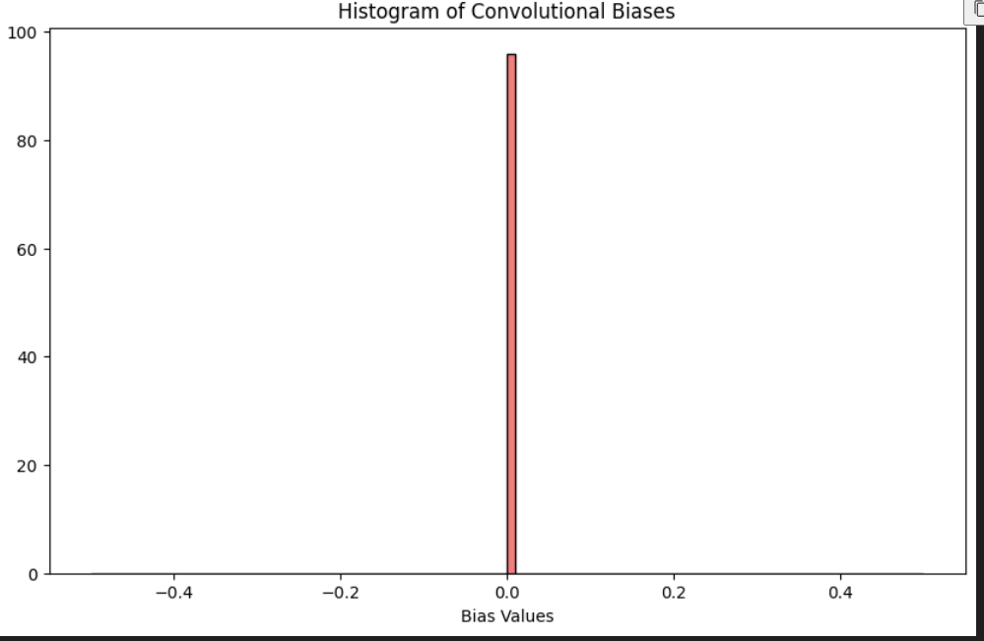
Convolutional bias(contrary to ResNet)

Slide 8
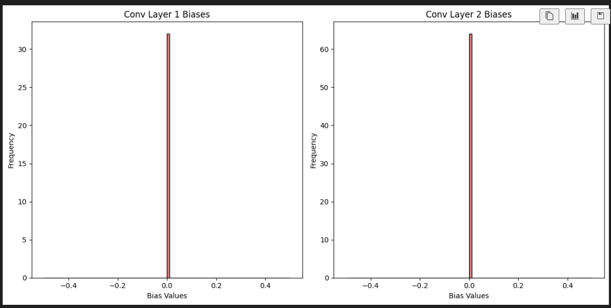
Convulotional bias

Slide 9
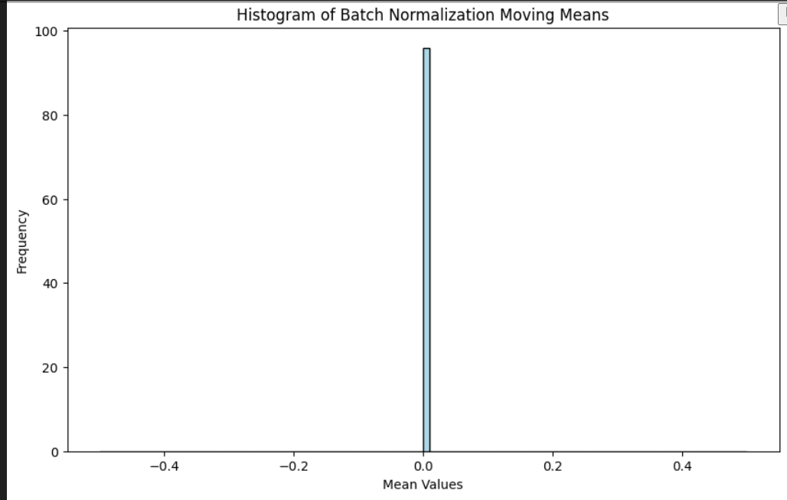
Batch Normalization Trained Mean (Variance)

Slide 10
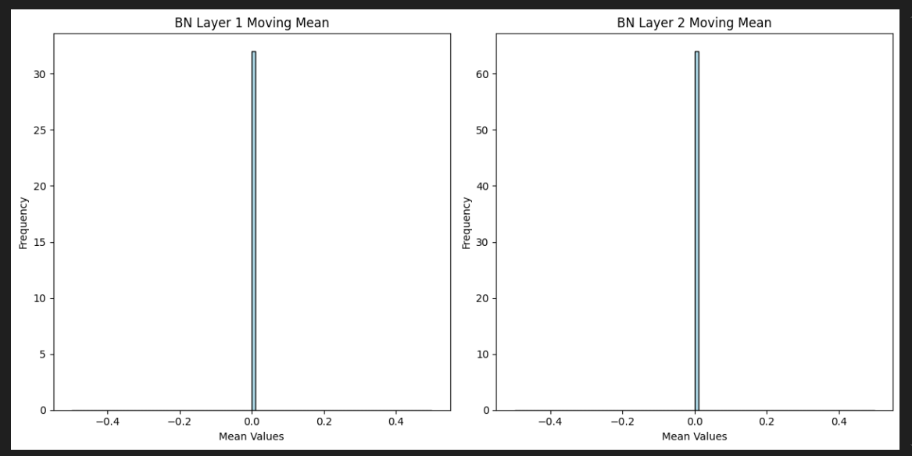
Batch Normalization Trained Mean (Variance)

Slide 11
Batch Normalization Trained Variance

Slide 12
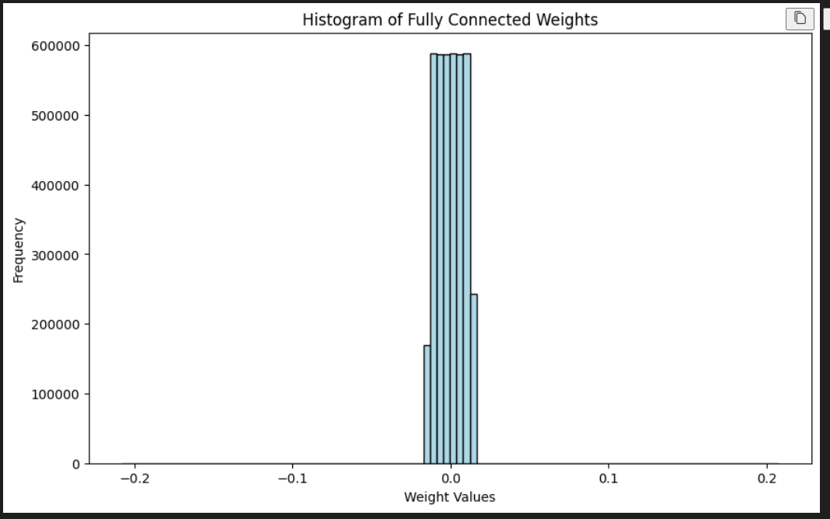
Fully connected weights

Slide 13
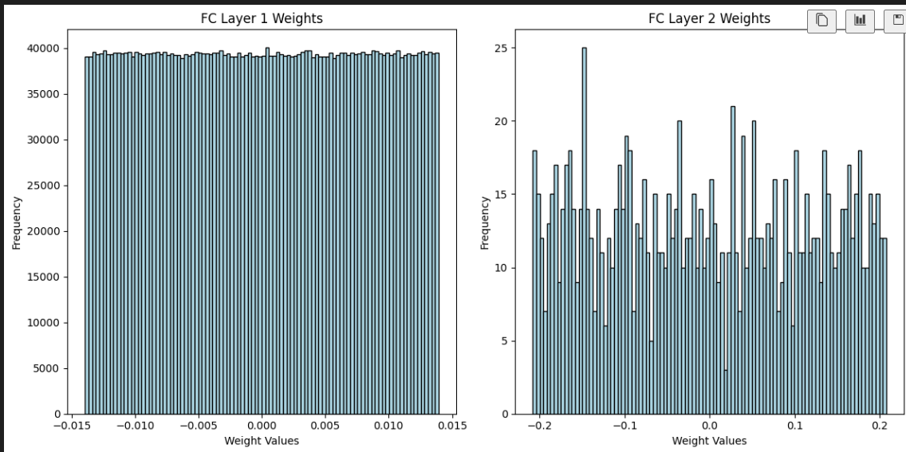
Fully connected weights

Slide 14
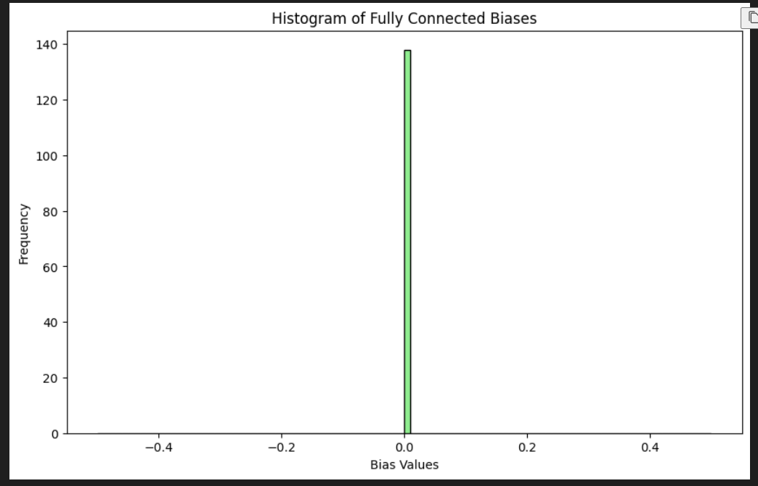
Fully connected Bias

Slide 15
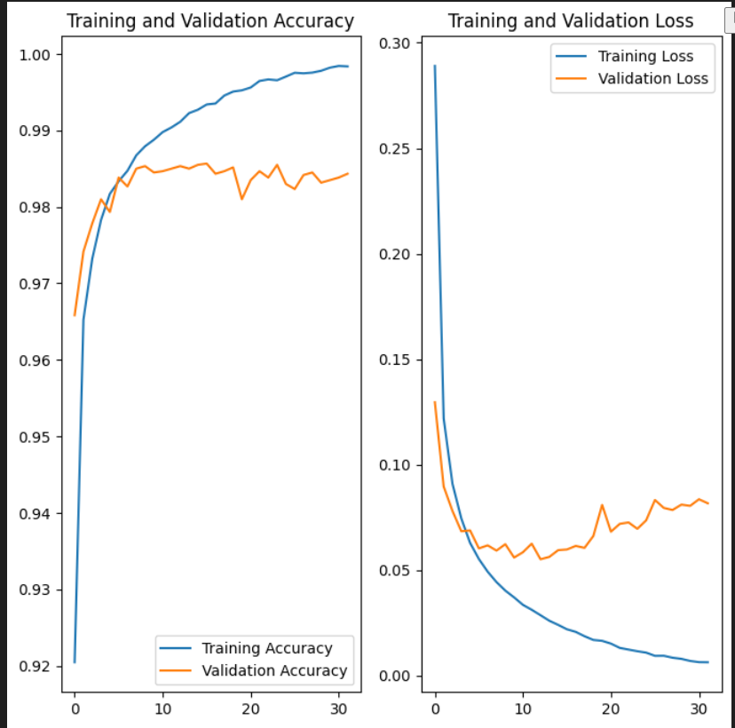
Model training and its accuracy

Slide 16
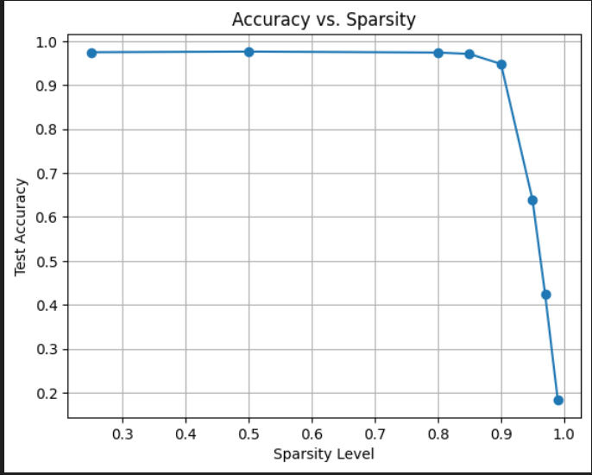
Magnitude-Based Pruning

Slide 17
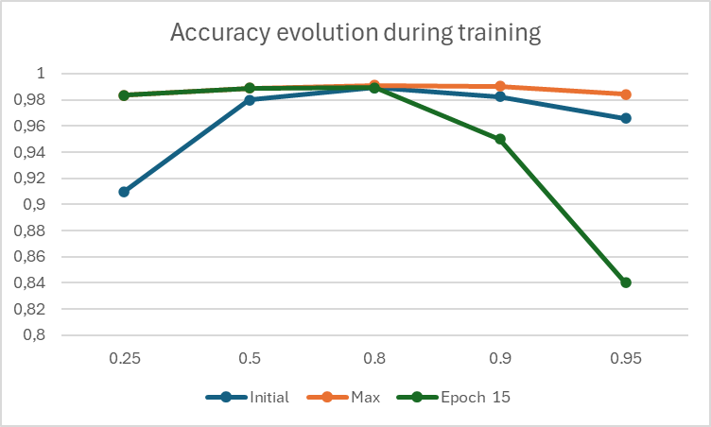
Magnitude-Based Pruning (accuracy)

Slide 18
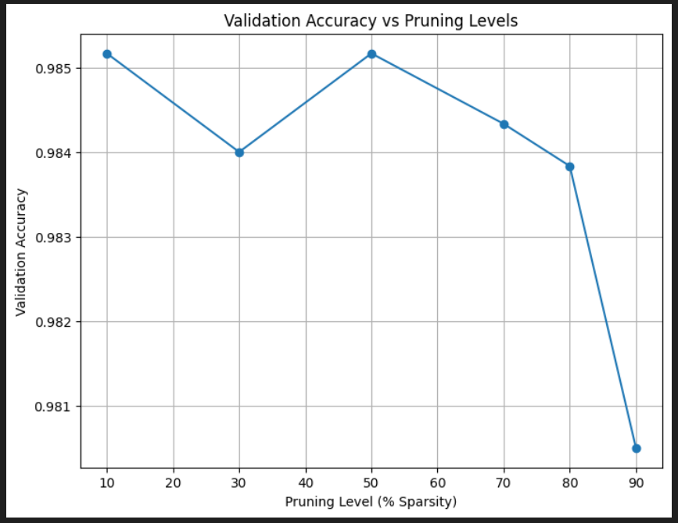
Structured Pruning on filters (accuracy)

Slide 19
Structured Pruning on filters (accuracy)

Slide 20
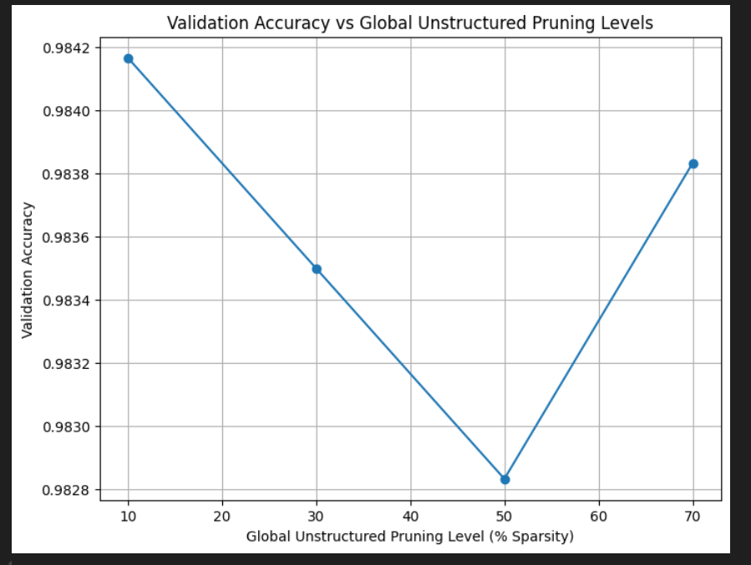
Unstructured Pruning Global (accuracy)

Slide 21
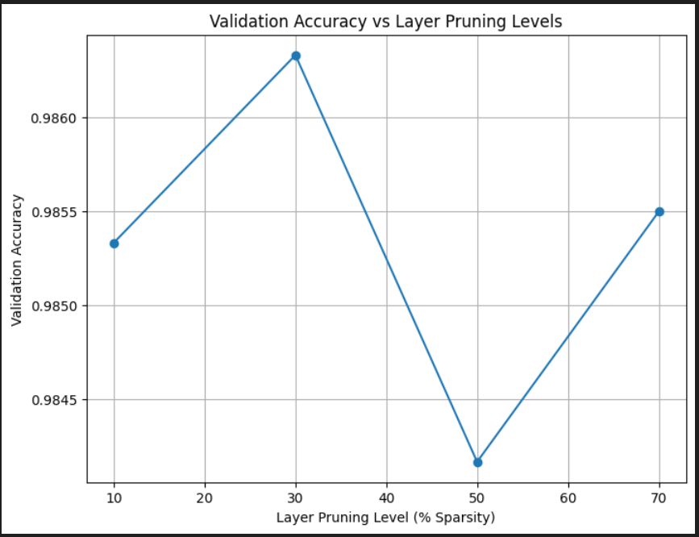
Prune layers (Conv2D and Dense) by individual weights

Slide 22
Prune entire layers(AutoML?) by Layer Level

Slide 23
Prune layer by importance
(Conv2D more important)

