Slide 1
Blazor
Extending the Microsoft Demos

Slide 2
Abstract
Blazor lets you build interactive web UIs using C# instead of JavaScript. Blazor apps are composed of reusable web UI components implemented using C#, HTML, and CSS. Both client and server code is written in C#, allowing you to share code and libraries.
Developers with experience in Web Forms or MVC will find Blazer to provide an integrated full-stack solution to mobile development. Blazer is the next generation moving away from frameworks such as JavaScript, Angular, or React.

Slide 3
Compiled vs Interpreted Software
Advantages of Compiled Code
Advantages of JavaScript / Angular
2x - 10x faster
Moves away from text editors
Developmental errors intercepted by the compiler
Modular targeted libraries with concealed code
Dynamic and interactive activities on web pages
Develop code with text editor
May be executed on multiple platforms

Slide 4
Advantages of Object Oriented Programming - SOLID
Single-responsibility Principle
A class should have only one job
Open-closed Principle
Objects or entities should be open for extension, but closed for modification
Liskov substitution principle
Properties of one type work for inherited types
Interface segregation principle
No superfluous interfaces or methods imposed
Dependency Inversion principle
The high level module must not depend on the low level module

Slide 5
With Blazor …
With Blazor …
build interactive web UIs using C# instead of JavaScript
composed of reusable web UI components
implemented using C#, HTML, and CSS
client and server code is written in C#
run your client-side C# code directly in the browser
using WebAssembly
run your client logic on the server
using SignalR - a real-time messaging framework
Source: https://dotnet.microsoft.com/apps/aspnet/web-apps/blazor

Slide 6
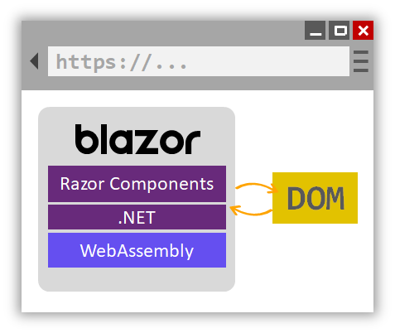
Blazor Client-Side
Blazor client-side is a single-page app framework for building interactive client-side web apps with .NET.
C# code files and Razor files are compiled into .NET assemblies
assemblies and the .NET runtime are downloaded to the browser
Blazor client-side runtime uses JavaScript interop to handle DOM manipulation and browser API calls
Source: https://docs.microsoft.com/en-us/aspnet/core/blazor/?view=aspnetcore-3.0

Slide 7
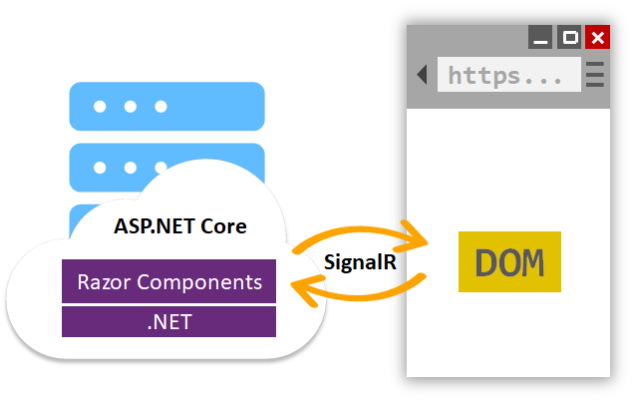
Blazor Server-Side
Blazor server-side provides support for hosting Razor components on the server in an ASP.NET Core app. UI updates are handled over a SignalR connection.
runtime handles sending UI events from the browser to the server and applies UI updates sent by the server back to the browser
connection used to communicate with the browser is also used to handle JavaScript interop calls
Source: https://docs.microsoft.com/en-us/aspnet/core/blazor/?view=aspnetcore-3.0

Slide 8
Technologies Related to Blazor
Razor
ASP.NET programming syntax used to create dynamic web pages with the C# or VB.NET programming languages
WebAssembly or Web Assembly Modules (WASM)
open standard that defines a portable binary code format for executable programs, and a corresponding textual assembly language, as well as interfaces for facilitating interactions between such programs and their host environment
SignalR
software library for ASP.NET that allows server code to send asynchronous notifications to client-side web applications
Source: WikiPedia

Slide 9
History in Review – .NET Core 3.0 and Blazor
VS 2019 Preview
@attribute, @code, @key, @namespace, @functions
Directives
Authentication
Json.NET
SignalR reconnect
gRPC
Preview 7 07-23-2019
VS 2019 Preview 1 (incl Core 3.0)
VS Templates
Web Templates
More Binding
Clarified directives
EventCounters
gRPC improvements
Preview 8 08-13-2019
VS 2019 Preview 2
Template updates
Preview 9 09-04-2019
VS 2019 Preview 3
Preview 6 06-12-2019
Case sensitive binding
Improved reconnect
Razor support for @attribute
gRPC improvements
Routing improvements
Render multiple Blazor components
Smarter reconnection
Improved DI management
Razor Unit Test framework prototype
gRPC improvements
“the entire .NET Core 3.0 platform hits general availability in about three weeks”
~ Visual Studio Magazine September 4, 2019

Slide 10
Blazor Preview 8
Renaming
Other changes in Preview 8
ASP.NET Core's Blazor project -- for Web development with WebAssembly and C# → Visual Studio templates
“Blazor Class Library” → Razor Class Library
"Blazor (server-side)“ → "Blazor Server App“
"Blazor“ → "Blazor WebAssembly App“
Angular Template updated to Angular 8
Case-sensitive component binding
Improved reconnection logic for Blazor Server apps
NavLink component updated to handle additional attributes
Culture aware data binding
Automatic generation of backing fields for @ref
Razor Pages support for @attribute
New networking primitives for non-HTTP Servers
Unix domain socket support for the Kestrel Sockets transport
gRPC support for CallCredentials
ServiceReference tooling in Visual Studio
Diagnostics improvements for gRPC
Source: Blazor Visual Studio Templates Renamed as .NET Core 3.0 Finish Line Nears, David Ramel, 08/13/2019 https://visualstudiomagazine.com/articles/2019/08/13/aspnet-core-preview-8.aspx

Slide 11
Blazor Preview 9
Routing Improvements
Other improvements in Preview 9
Render content using a specific layout
Routing decoupled from authorization
Route to components from multiple assemblies
Blazor event handlers and data binding attributes moved to Microsoft.AspNetCore.Components.Web:
moved bindings and event handlers available for HTML elements into the Microsoft.AspNetCore.Components.Web.dll assembly & Microsoft.AspNetCore.Components.Web namespace."
Render multiple Blazor components from MVC views or pages:
reenabled support for rendering multiple components from a view or page in a Blazor Server app
use the Html.RenderComponentAsync(RenderMode renderMode, object parameters) HTML helper method with the desired RenderMode."
Smarter reconnection for Blazor Server apps:
will now recommend the user to refresh the browser instead of retrying to connect
Utility base component classes for managing a dependency injection scope:
in ASP.NET Core apps, scoped services are typically scoped to the current request. After the request completes, any scoped or transient services are disposed by the dependency injection (DI) system
in Blazor Server apps, the request scope lasts for the duration of the client connection, which can result in transient and scoped services living much longer than expected
Razor component unit test framework prototype:
started experimenting with building a unit test framework for Razor components
Helper methods for returning Problem Details from controllers:
problem Details is a standardized format for returning error information from an HTTP endpoint
added new Problem and ValidationProblem method overloads to controllers that use optional parameters to simplify returning Problem Detail responses
Source: What's New for ASP.NET Core and Blazor in Final Preview of .NET Core 3.0, David Ramel, 09/04/2019 https://visualstudiomagazine.com/articles/2019/09/04/aspnet-core-updates.aspx

Slide 12
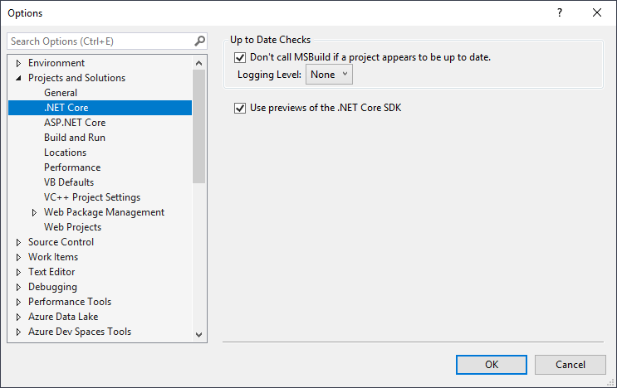
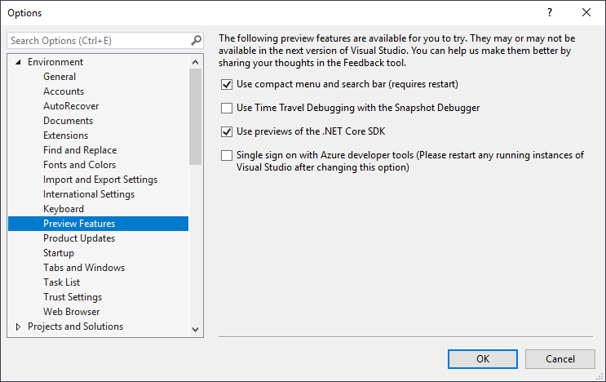
Enabling .NET Core 3.0 in VS 2017 and VS 2019
Not recommended

Slide 13
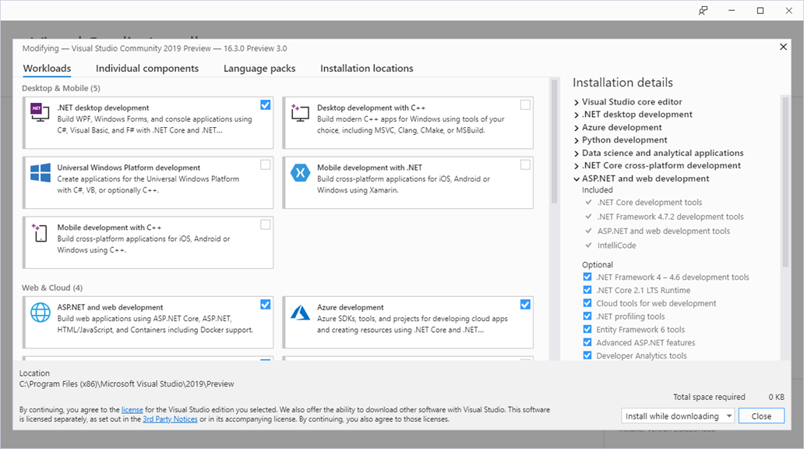
Installer Settings in VS 2019 (Community and Preview)

Slide 14
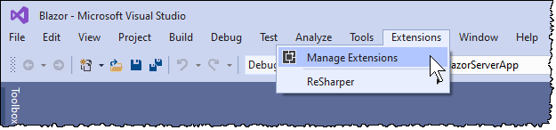
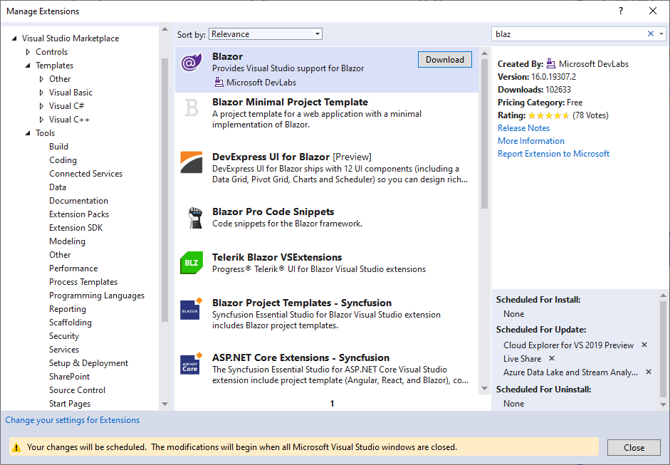
Blazor Extension (VSIX Extensions) in VS 2019
NOTE: This Blazor Visual Studio extension is obsolete and no longer required to use Blazor
To get the latest Blazor templates simply install them from the command-line. Visual Studio (16.3 or later) will detect that the templates have been installed and surface them to you without the need for any additional extensions. If you already have this extension installed, you can go ahead and uninstall it.

Slide 15
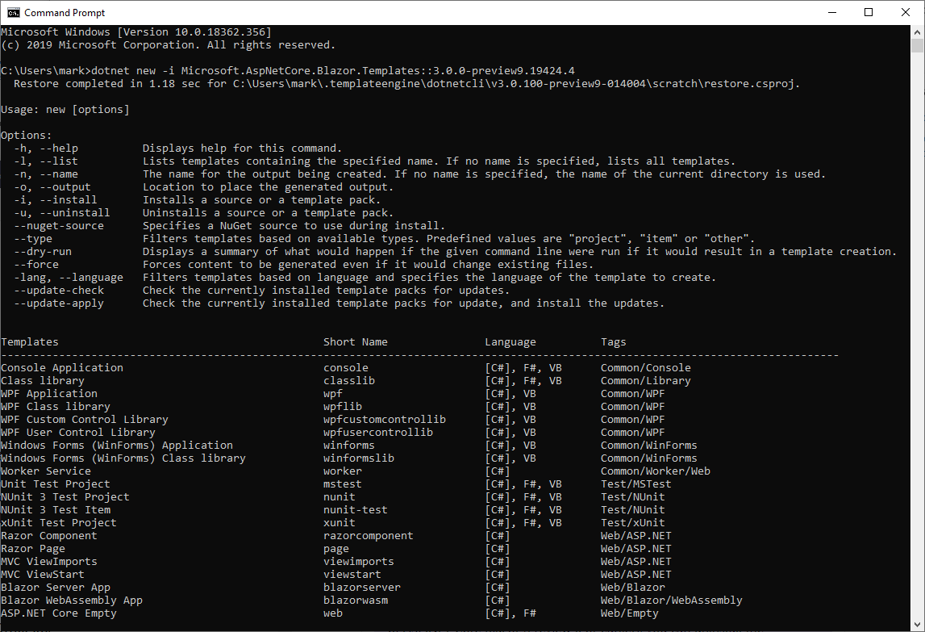
dotnet new -i Microsoft.AspNetCore.Blazor.Templates::3.0.0-preview9.19424.4

Slide 16
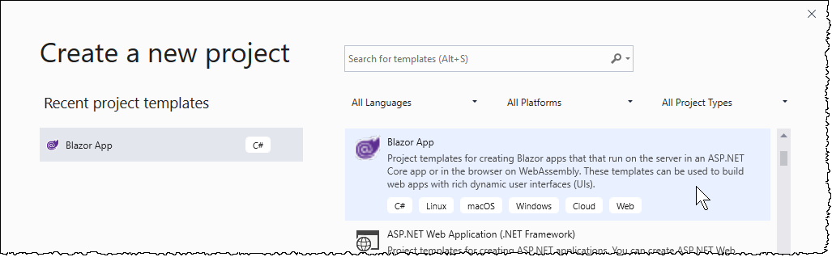
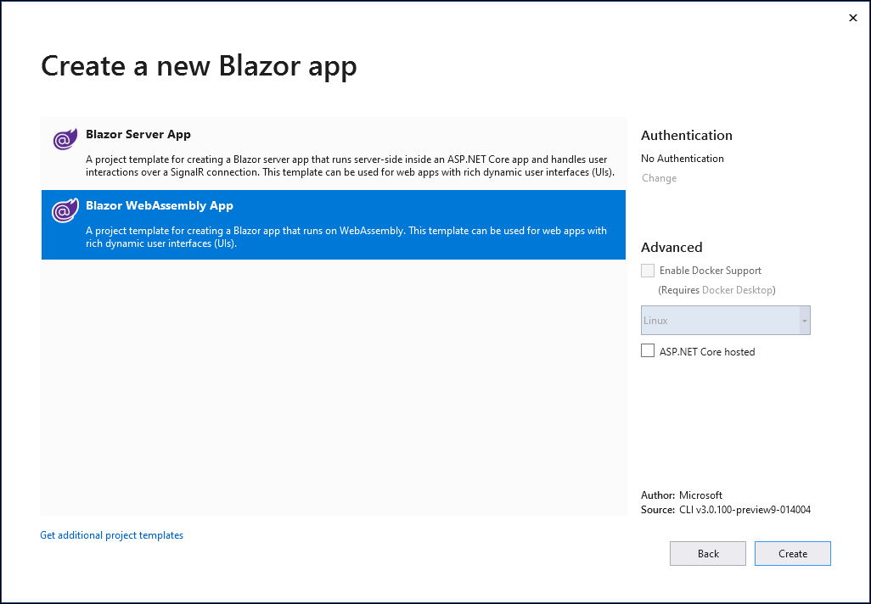
Create Project: DemoClientSideSpa

Slide 17
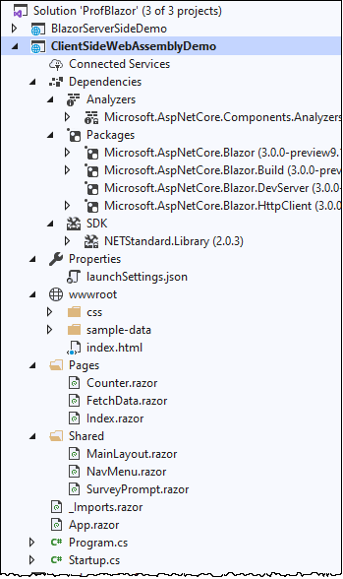
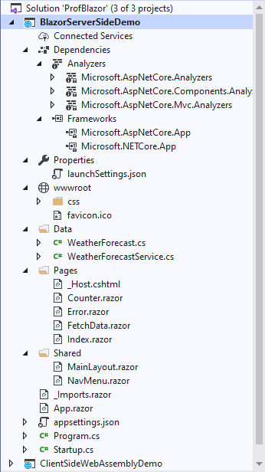
Client-Side vs Server-Side

Slide 18
Blazor Frustrations
Most Information Says
Found to Work
<RazorView>.cshtml
@functions
string aStr {get;set;}
UIKeyboardEventArgs
bind=“@Text" onkeypress=“@KeyPress"
<RazorView>.razor
@code
[Property] public string aStr {get;set;}
KeyboardEventArgs
@bind=“Text" @onkeypress="KeyPress"

Slide 19

Blazor Demo
ClientSideWebAssemblyDemo
BlazorServerSideDemo
IntroductorySpaDemo

Slide 20
Top 10 Blazor Tools (via NuGet)
Microsoft.AspNetCore.Blazor.Templates
Templates for ASP.NET Core Blazor
Coming from Microsoft, this is pretty much a must-have no-brainer, speaking for itself.
Blazor.Extensions.SignalR
SignalR Core support for ASP.NET Core Blazor
It implements all public features of SignalR Typescript client, but it doesn't implement Streaming APIs, which are to be added soon.
BlazorStrap
Blazor BootStrap, a bootstrap4 component library for Blazor
Blazor.Extensions.Canvas
Blazor Extensions Canvas -- HTML5 Canvas API implementation for ASP.NET Core Blazor
Tewr.Blazor.FileReader
Read-Only File streams in Blazor
Blazor.Extensions.Logging
Microsoft Extension Logging implementation for ASP.NET Core Blazor
Blazor.Fluxor
A zero-boilerplate Flux/Redux state library for Blazor
Blazor.ContextMenu
Context menu component for Blazor
Sotsera.Blazor.Toaster
Toastr.js port to Blazor - no JavaScript involved
Blazor-State
MediatR pipeline for Blazor state management
State Management architecture utilizing the MediatR pipeline.
Source: https://visualstudiomagazine.com/articles/2019/06/04/blazor-nuget.aspx

Slide 21

About Mark Reynolds
Mark Reynolds Vitae
TBD
Southwestern Energy
Lone Star College
Intent Driven Designs
Scan Systems
Sikorsky Aircraft
General Dynamics
Personal Email: mark@ProfReynolds.com
Linkedin: www.linkedin.com/in/ProfReynolds
Twitter: @Prof_Reynolds
Blog: http://ProfReynolds.com

