Slide 1
CPD-4414 Java Development II
Github,
Organizations, Teams, & Collaborators

Slide 2
Organizations & Teams
Organizations are great for creating distinct groups of users within a company, such as groups working on similar projects
Teams give organizations the ability to create groups of members and control access to repositories
Team members can be granted read, write, or admin permissions to specific repositories

Slide 3

Organization
Log into Github
Join the LambtonCollege organization
Join the team CPD-4414-s2015

Slide 4


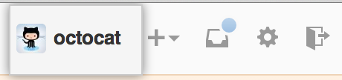
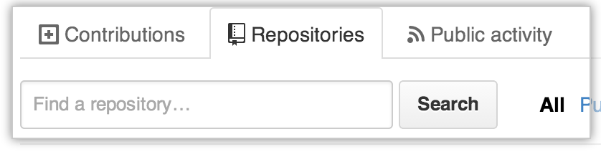
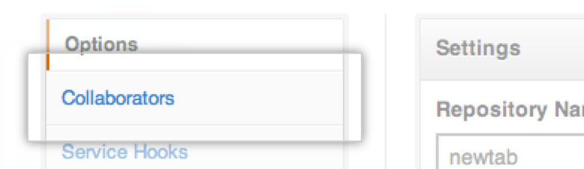
Adding Collaborators
Ask for the username of the person you're adding as a collaborator. If they don't have one, they can sign up for GitHub.
In the top right corner of any page, click your username
On you Profile page, click the Repositories tab, then click the name of your repository
In your repository’s right sidebar, click
Click the “Collaborators” tab
Select the user from the drop-down menu
Click Add

Slide 5
Github API - Teams
How to perform any team actions from the GitBash command line
https://developer.github.com/v3/orgs/teams/

Slide 6
The Canonical Resource
The canonical resource (sometimes called git-flow) is Vincent Driessen's blog post from 2010: A successful Git branching model
Do yourself a favour and read this on your own time
It should take about fifteen minutes, even with the code examples

Slide 7

The Model
Several branches are created, with various purposes
master
only used for major releases
develop
the "work in progress" that sees all major changes before they go into production
release
the "we're almost ready" branches where panic sets in
feature
a series of branches each used for a different new feature to add
hotfixes
a series of branches each used for a different emergency fix

Slide 8
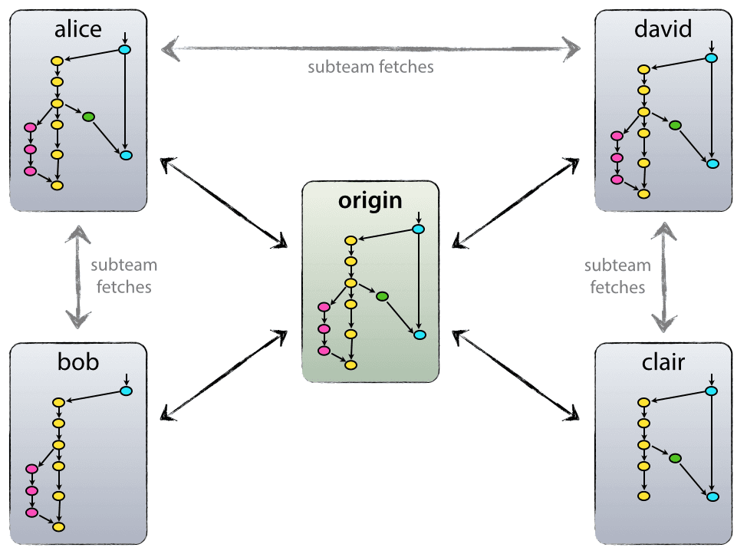
Centralized but Decentralized

Slide 9
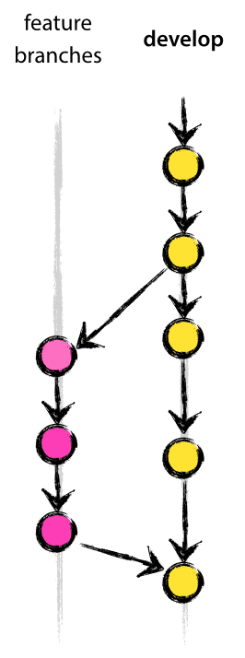
Feature Branching
The goal of feature-branching is to allow several people to be working on different features at the same time
This allows the workflow of:
Branch off a fairly stable version
Add a new feature to the code
Merge back with the original (possibly updated) branch

Slide 10
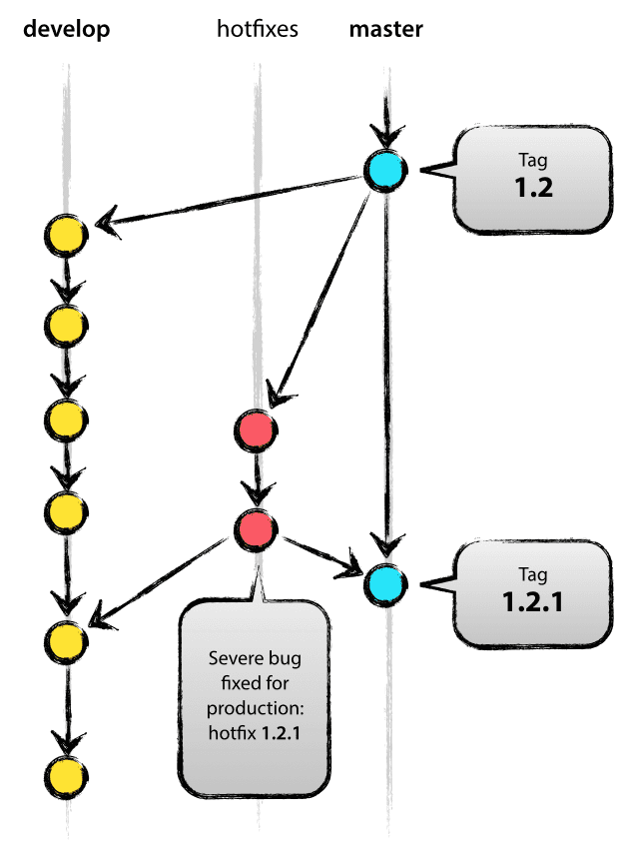
Issue Tracking
There are many issue trackers (GitHub Issues, BugZilla, etc…), and there are many task management suites (Trello, etc…)
When you start your first job, you will be thrown into something, and it will be something you pick up as you go
Coordinating an issue tracker with a branching model allows for a very easy workflow of:
Build a branch from the broken code
Address the issue
Merge the fix wherever it will be useful

Slide 11
Conflict Management in Git
One major issue with Git is that it only solves trivial conflicts during merges (eg- two people add lines to the same spot in a file, but they add completely different lines)
If there's any cross-over, Git punts and says "It's your problem now!"
This is widely seen as both the best and worst feature of Git. Other systems do more, for better or for worse

Slide 12
A Quick Conflict Example
When you cause a conflict (ie- changing the same three lines in two different branches) when you try to merge them, Git will tell you "Automatic merge failed"
You need to look at the file, and identify the conflicts, then find out what the right version is (it may be a combination)
Sometimes the answer isn't obvious, and needs to be discussed with the team
a
b
c
Branch, Change, Commit
d
e
f
Change and Commit
A
B
C
Merge
<<<<<<< HEAD
A
B
C
=======
d
e
f
>>>>>>> def

Slide 13
GitHub Encourages a Different Workflow
GitHub is like the Twitter or Facebook of code
So it has a "Follow" button: Watch
A "Like" or "Favourite" button: Star
It also has a "Share" button: Fork
Fork uses GitHub's systems to make a duplicate (similar to clone, or branch)
To get your changes sent back to the original (upstream) you need to build a Pull Request
This says, "I changed this! Please incorporate these changes!"
This is not bad. It's just different. It removes "push" from the remote system and introduces "pull request"
As an open source maintainer, it's up to the project owner to review your code and verify if a) it works and b) it fits the style of the existing code

