Slide 1
INDUSTRIAL INTERNSHIP
TVS SENSING SOLUTIONS PRIVATE LIMITED

Slide 2
CONTENT
About the company ………………………………………………………………………………………… 3
Internship details …………………………………………………………..................................... 4
Project details …………………………………………………………………………………………………. 5
Benefits ………………………………………………………………………………………………………….. 6
Project Workflow ……………………………………………………………………………………………. 7
Software …………………………………………………………………………………………………………. 8
Hardware ……………………………………………………………………………………………………..... 19
Vote of thanks ………………………………………………………………………………………………… 23
Project link ……………………………………………………………………………………………………… 24

Slide 3
ABOUT TVSSS
TVS Sensing Solutions offers value added solutions to industrial, consumer durable, automotive, IT Segments besides offering quality precision micro switches and application support to our customers, from our manufacturing facility in Vellaripatti, Madurai.
TVS Sensing Solutions emerges as key player in Sensor Products and Solutions that serves Automotive, Industrial and Appliance markets in standalone products and in IOT products. TVS Sensing solutions also serves the end to end solutions of IIOT through ecosystem partnerships. TVS Sensing Solutions make it headway in niche markets by adaptation of emerging technologies through enduring partnerships.
They produce the following products:
Sensors
Switches and Controls
Solenoids
Electro Mechanical Assemblies
Computer Input Devices

Slide 4
ABOUT INTERNSHIP
Industry visited – TVS Sensing Solutions Private Limited, Vellaripatti, Madurai
Human Resource Manager – Mr. Muthu Pandi
Field of work – IoT development
Staff in charge – Mr. Muthalagar, Assistant Manager of Process Engineering
Mr. Sunil Aravind, Process Engineer, TVSSS Pvt. Ltd.
Duration – November 30, 2020 (Monday) to December 25, 2020 (Friday)
Work Timings – 09:00 to 17:00, Monday through Friday every week
Total work count – Days: 26(19)
Hours: 152

Slide 5
PROJECT DETAILS
DIGITAL PRODUCTION MONITORING SYSTEM in Turbo Actuator Assembly, TVSSS Pvt. Ltd.
Assembly line name – Turbo Actuator Assembly
Total machine count – 8 different machines
Hardware required – Omron PLCs, EXOR HMIs
Software required – Django as a web framework
MySQL for database

Slide 6
BENEFITS
The growth rate of a company is dependent on the Overall Equipment Efficiency (OEE) of the company. In short, OEE identifies the percentage of manufacturing time that is truly productive. OEE is dependent on 3 factors – Availability, Performance, and Quality
OEE = Availability x Performance x Quality
Availability = Planned Production Time / Run Time
Performance = (Ideal Cycle Time × Total Count) / Run Time
Quality = Good Count / Total Count
Having track of the production and its rate, is easier when it is automated than as a manual process. To get things automated, IoT is employed.

Slide 7
PROJECT WORKFLOW
Studying the assembly line
Knowing the existing system
Requirement sheet
Design of the HMI, Database and Display charts
Connecting with PLCs
Error/Damage control

Slide 8



BRIEF INTRO
The HMI is an interfacing tool for the worker and the machine. Along with a better display service and a perfect database for rendering/storing information from the HMI proves worth the effort. A detailed analysis of the data is required for growth of the company. A flowchart for the work done is shown below.
HMI 1
HMI 2
HMI 3
DISPLAY SCREEN
DATABASE SERVER
EDGE SERVER

Slide 9
DJANGO BRIEFING
The Django works on Model Template View architecture.
models.py – It is where different models are stored. In my case I’ve 3 models – Worker, Task, Machine models
templates – It’s a folder that stores the HTML files for each webpage
views.py – It acts as a place of rendering different web pages with the allocated templates and passing the required arguments for the web page
Other files used are urls.py – which acts as a domain allocator for each webpage,
forms.py – place for storing different kinds of forms that are to passed on for obtaining data

Slide 10
HMI
The Human Interface Machine (HMI) is an user interface that interlinks the worker with the machine. The HMI improves the company’s OEE (Overall Equipment Effectiveness) and has adverse effects on a company’s production rate and quality. The HMI gets us posted with the work done, the duration of the work, quality circle passed product quantity, etc. These data are read by data analyst for further improvement of OEE of the company.
HMIs communicate with Programmable Logic Controllers (PLCs) and input/output sensors to get and display information for users to view. HMI screens can be used for a single function, like monitoring and tracking, or for performing more sophisticated operations, like switching machines off or increasing production speed, depending on how they are implemented.
A replica of the HMI software was built using Django, a web framework based on python, along side with MySQL, for a database system, and XAMPP server.

Slide 11
HMI
A total of 3 HMI pages were created, each for each machine. A login page is the opening page. Upon a correct username and password entry the page is redirected to a production count page. Else a message is prompted, asking for correct username and password. The production page is brought up on the screen only if the entered worker has work on that machine.
The production page renders out the job ID, worker name, machine name, and the production target. Timer is turned on as soon as the login is authorized. The form contains the quantities of production and the ones passed the quality circle.
Once the form gets submitted the duration of work gets updated onto the server. The time of work is in terms of minutes. Similarly the production count and QC passed count is also updated for the particular task.

Slide 12
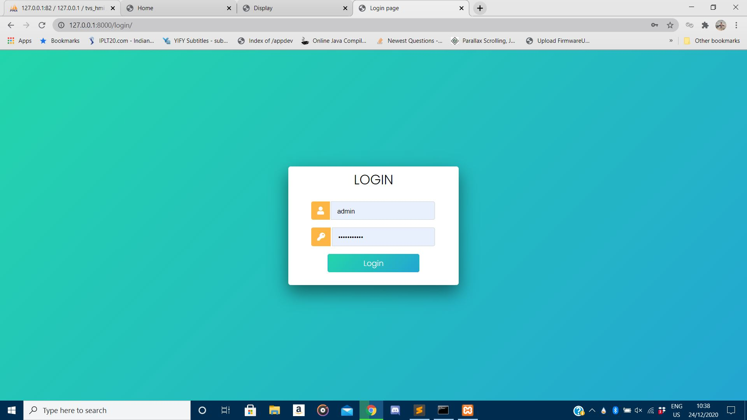
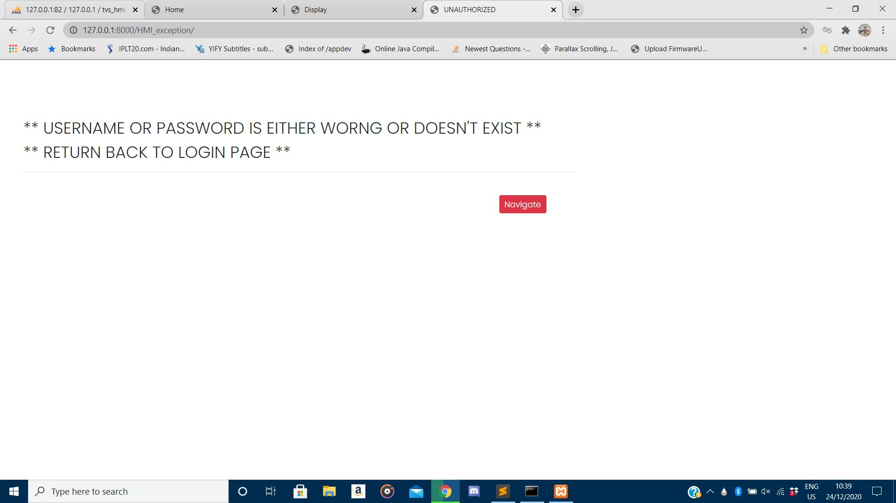
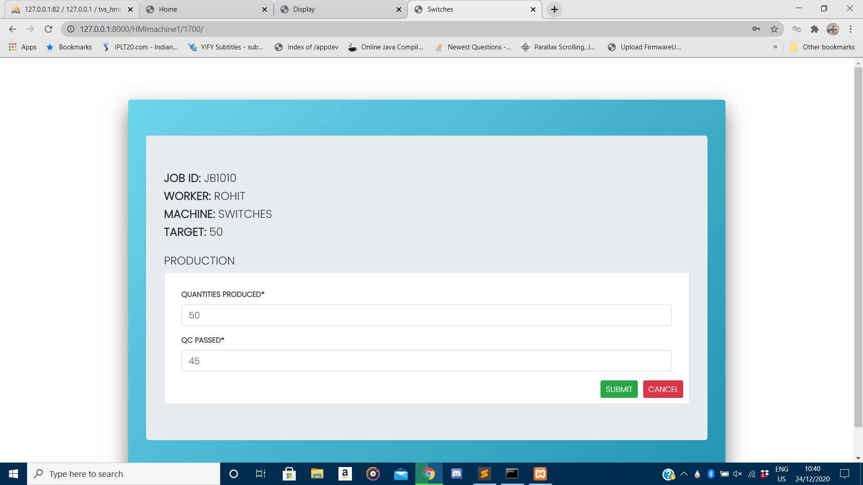
LOGIN PAGE
UNAUTHORIZED USER
PRODUCTION PAGE

Slide 13
EDGE SERVER
The edge server provides as a centre for allocating and monitoring data. It renders out the different workers and their individual task attributes, different machines and their individual task attributes.
It provides brief as well as detailed data about the tasks and monitors the quality of production.
Forms related to adding workers and allocation of tasks to workers and the respective machines is done through this system. Error control is done too. If a worker is found absent, task allocation for that worker is removed or redistributed to others.

Slide 14
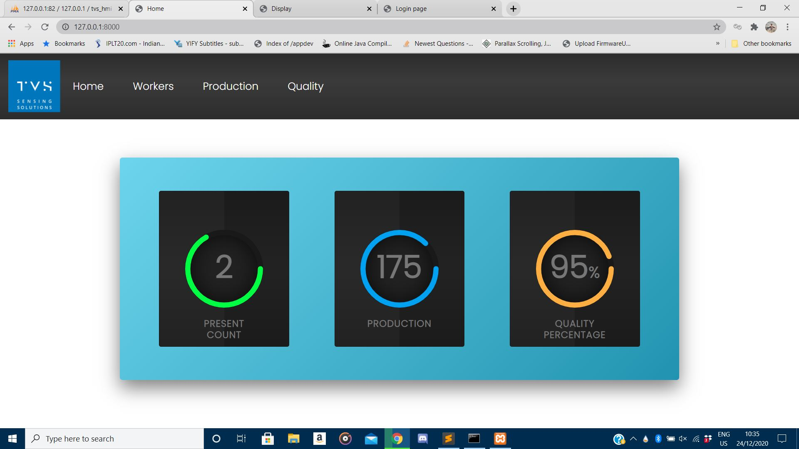
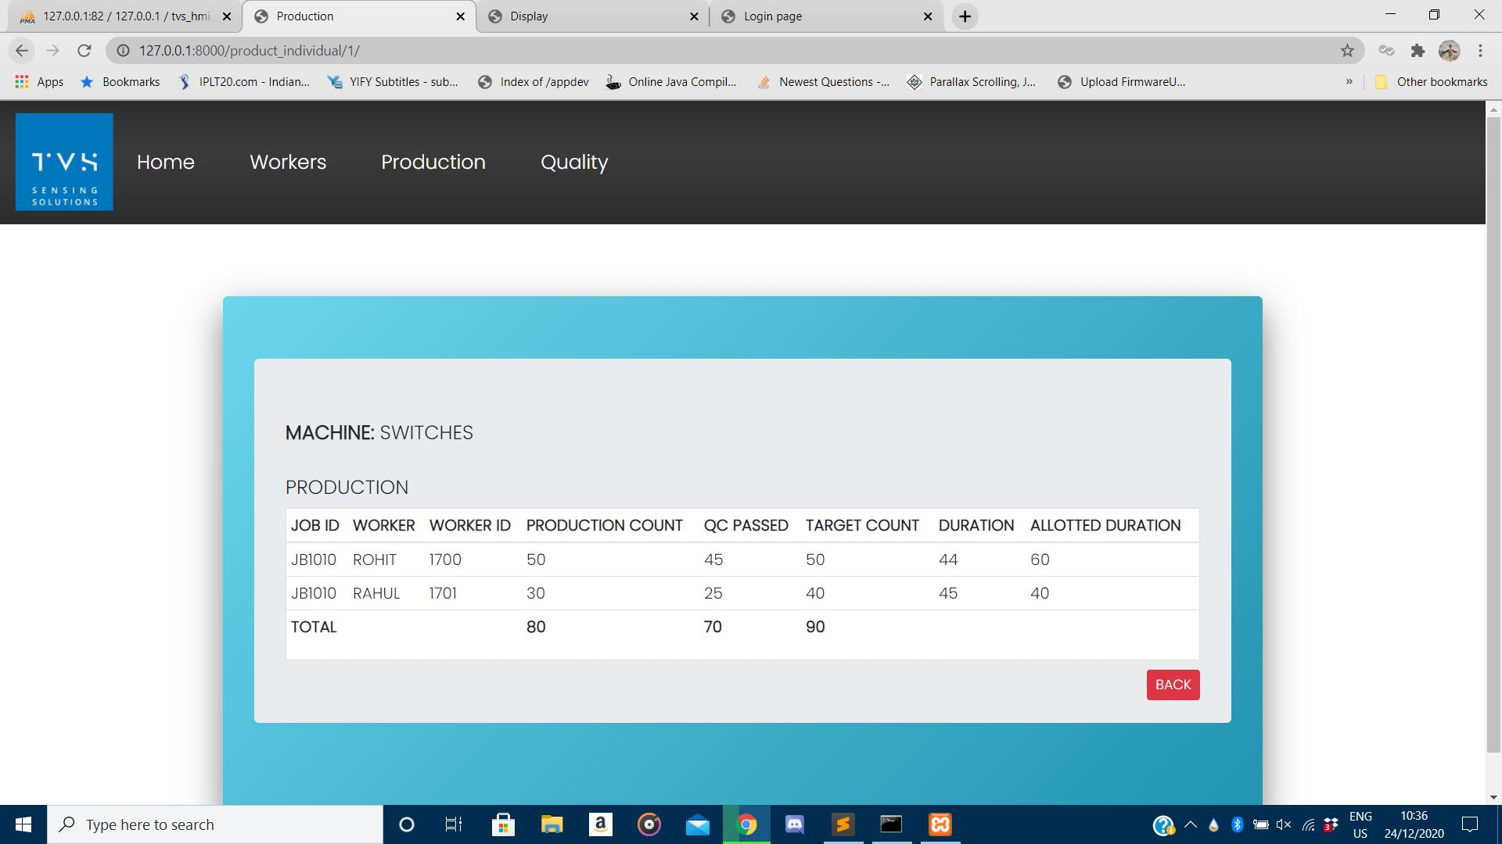
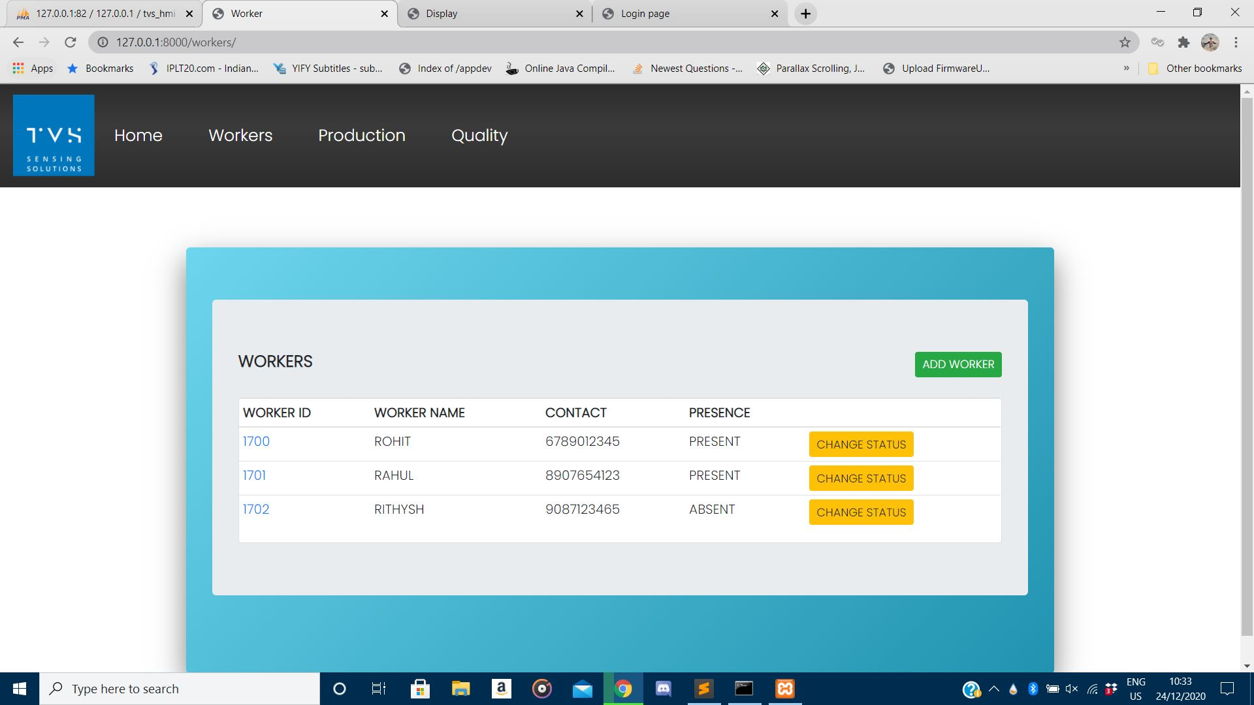
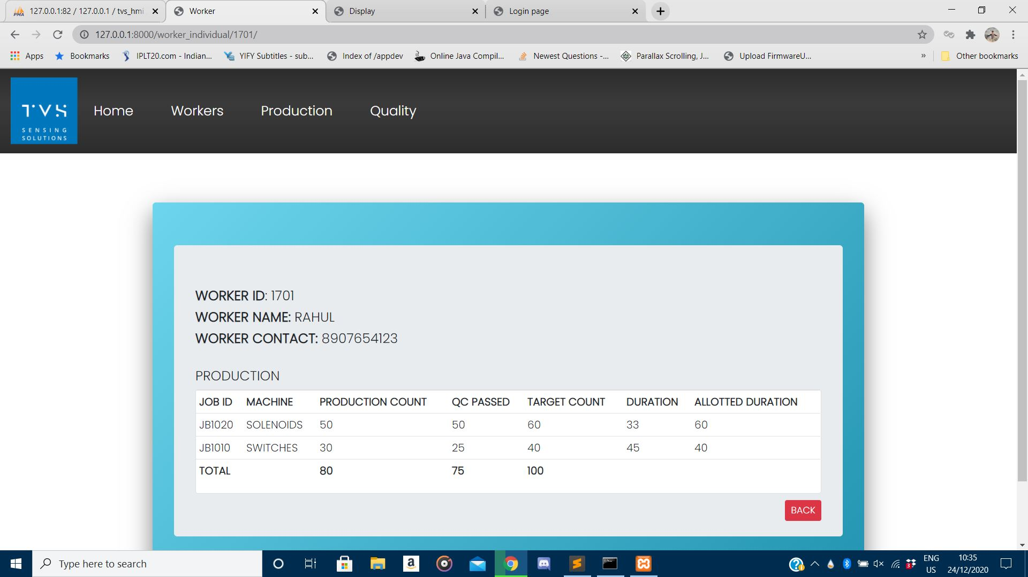
HOME PAGE
PRODUCTION OF EACH MACHINE
WORKER PAGE
PRODUCTION OF EACH WORKER

Slide 15
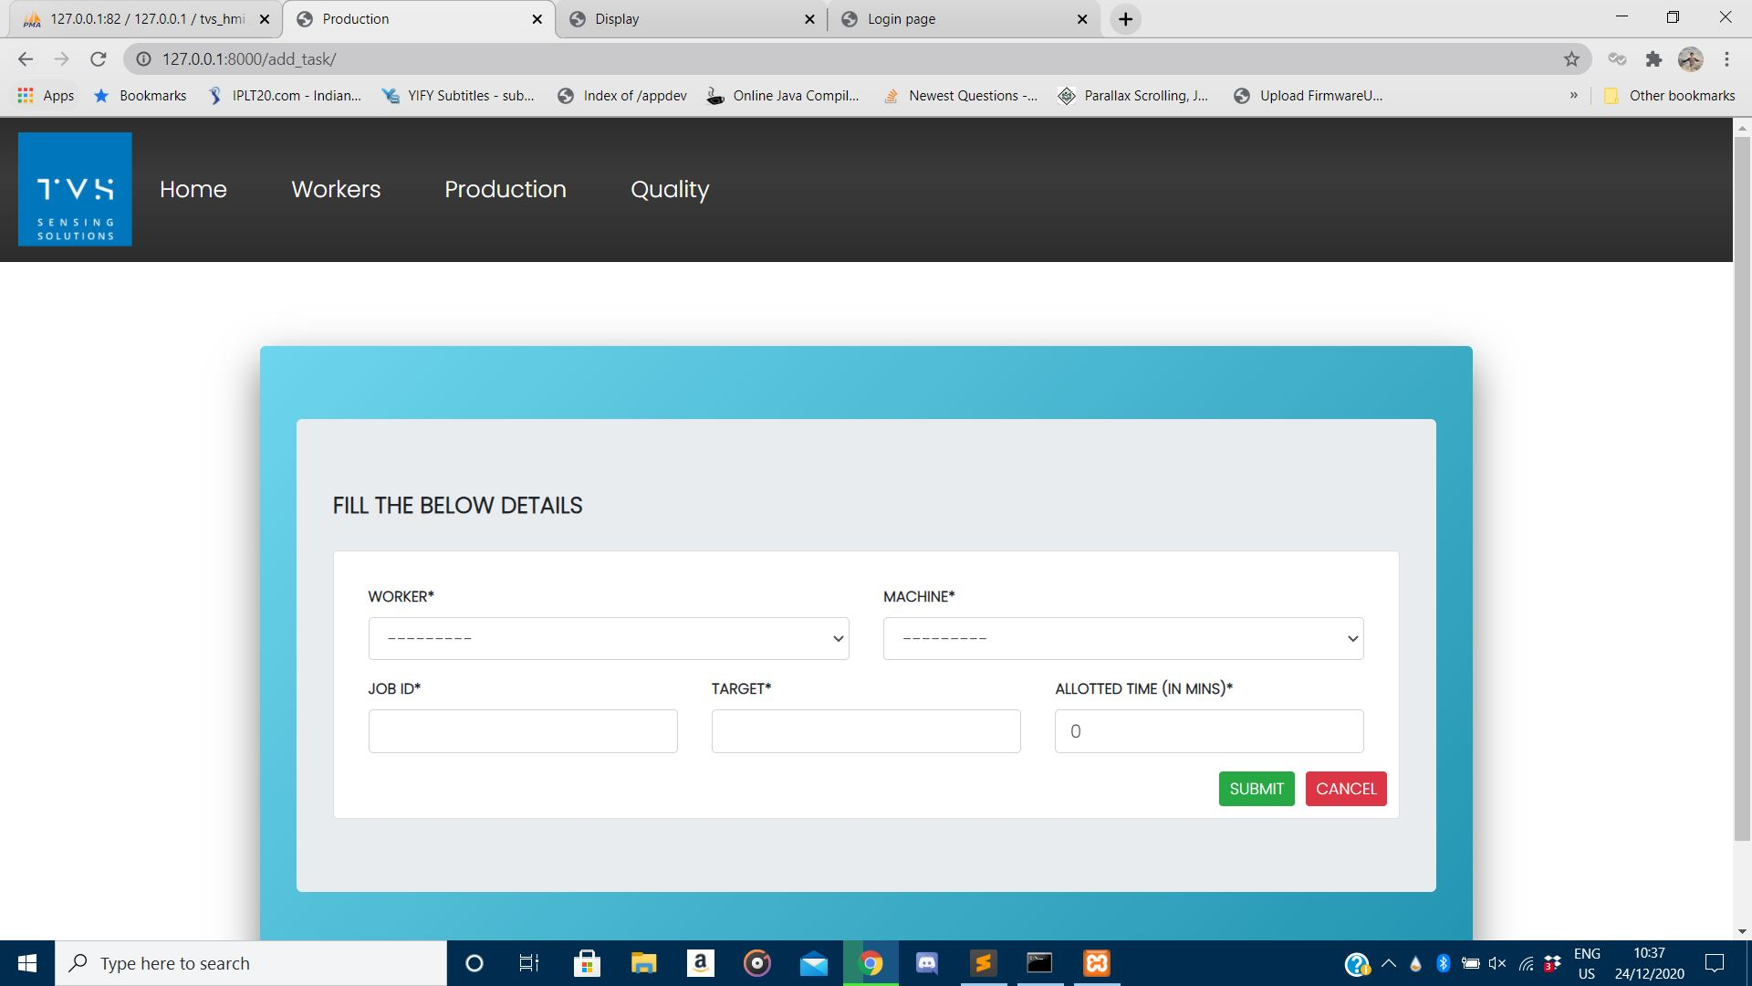
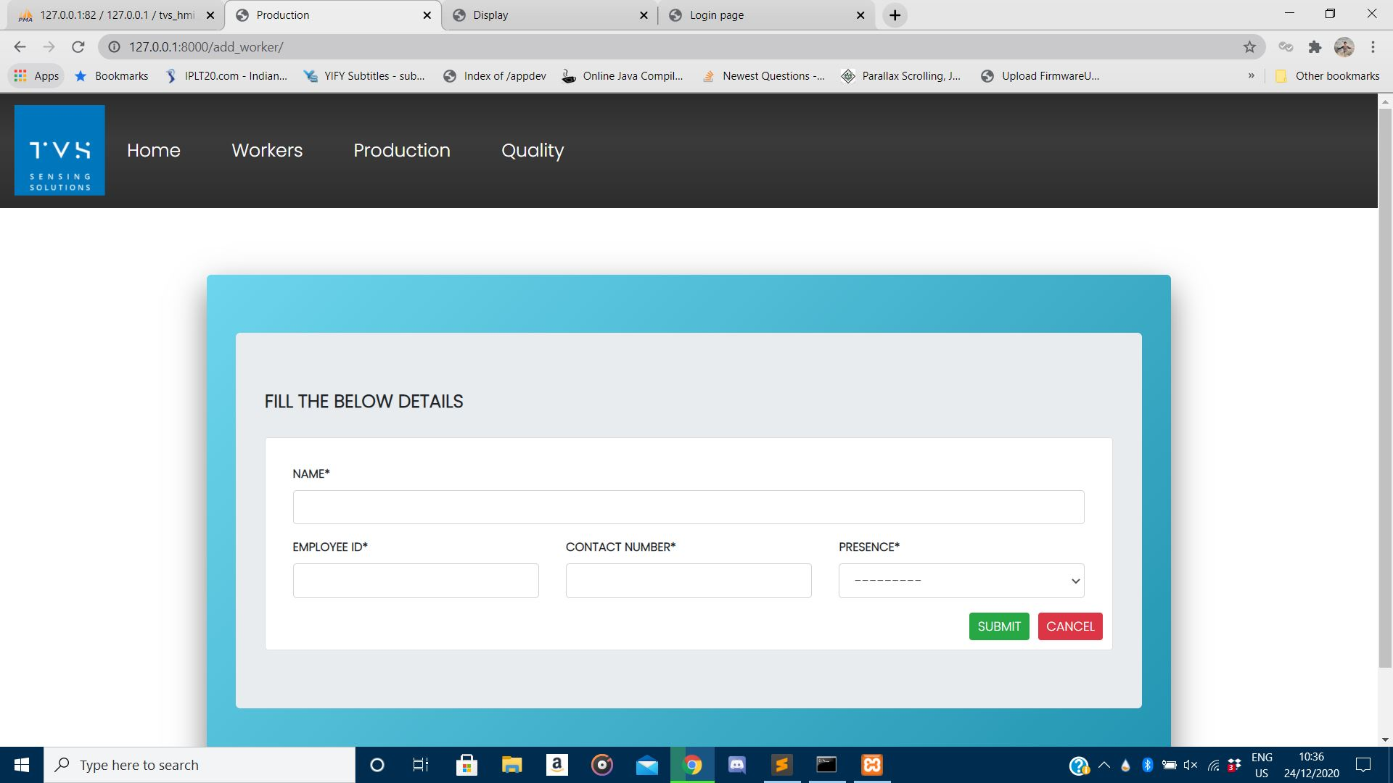
PAGE TO ADD WORKER
PAGE TO ADD TASK

Slide 16
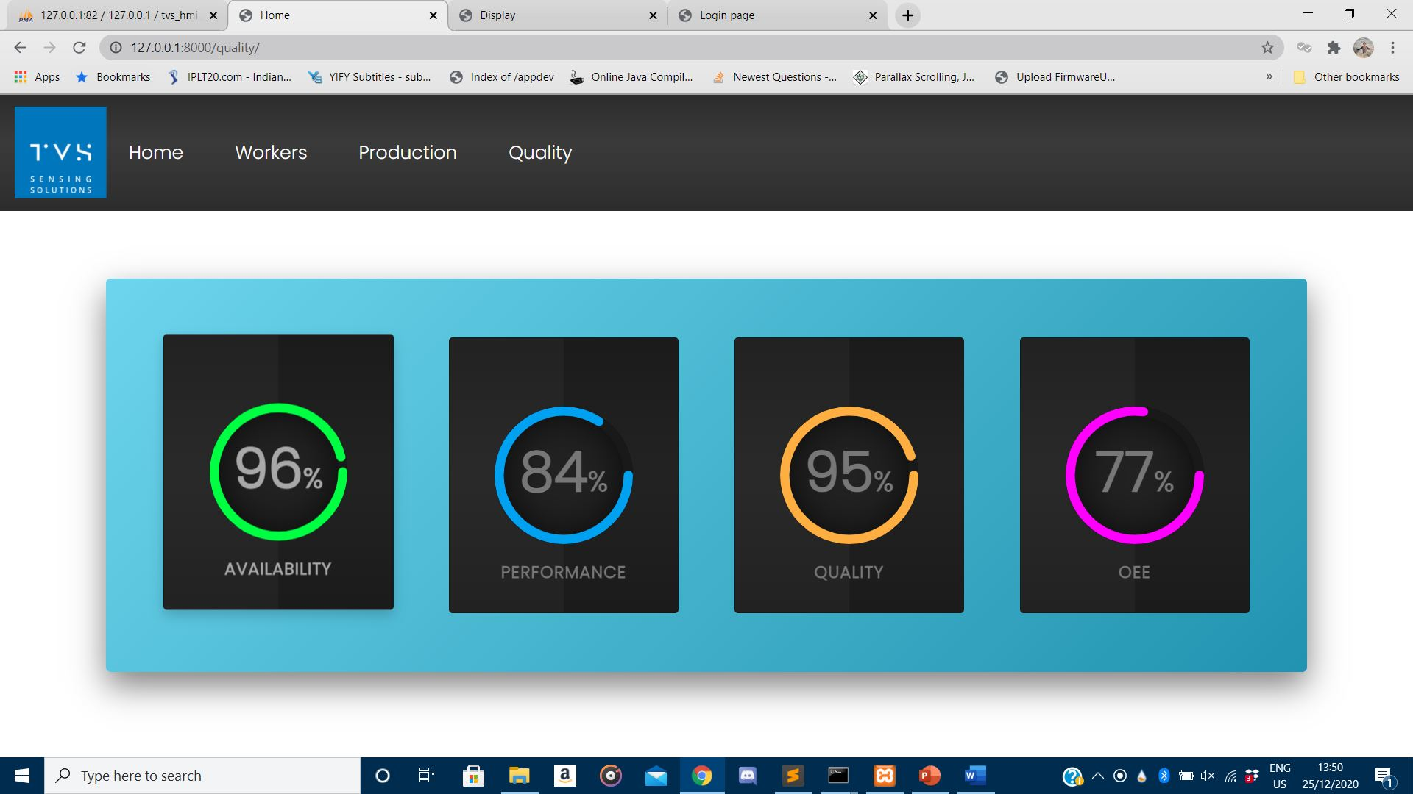
QUALITY PAGE

Slide 17
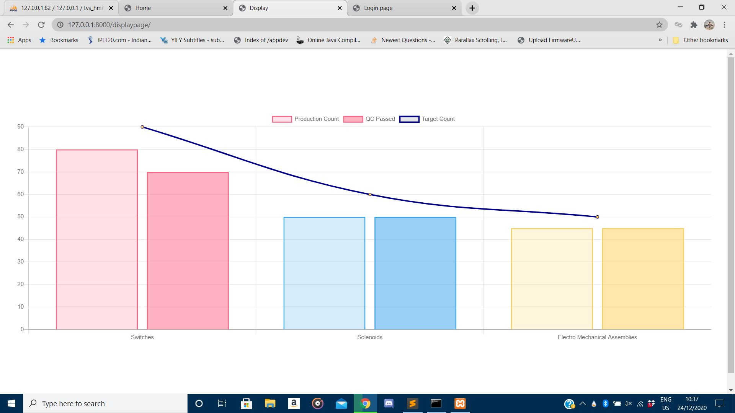
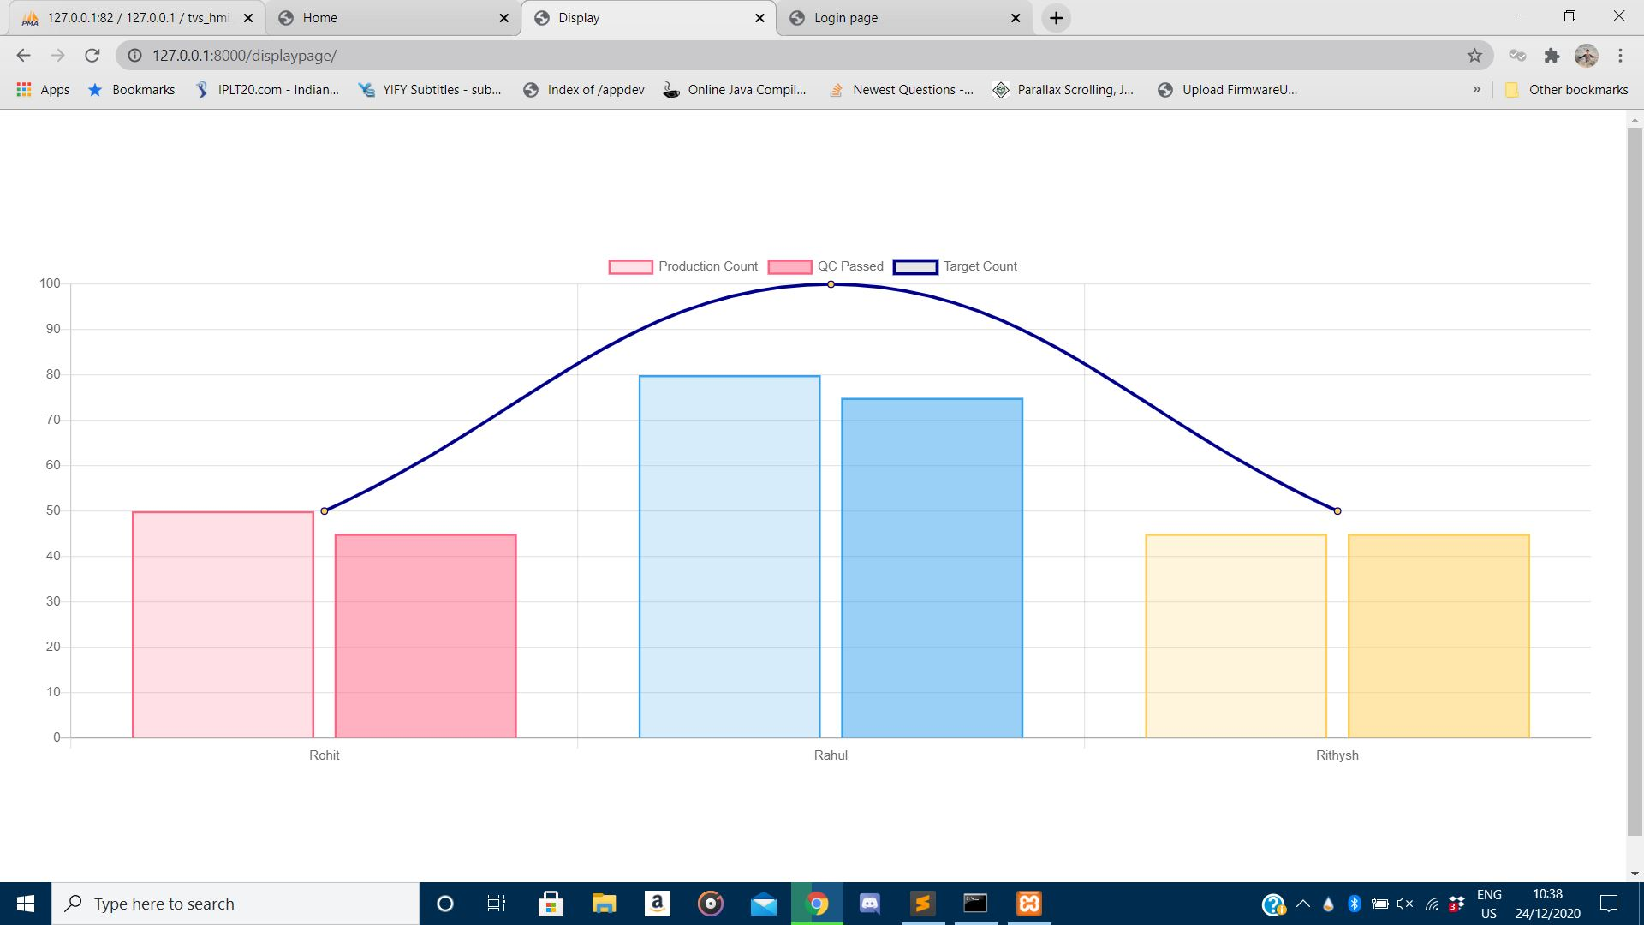
DISPLAY SCREEN
The display screen provides a graphical data to the worker main board to keep them informed about their productivity and machine production values and also to boost their production skills. These values are dynamic and gets updated as values get updated in the server. These pages are in the form of carousel and gets shifted every 5 sec.
DISPLAY SCREEN OF MACHINES
DISPLAY SCREEN OF WORKERS

Slide 18
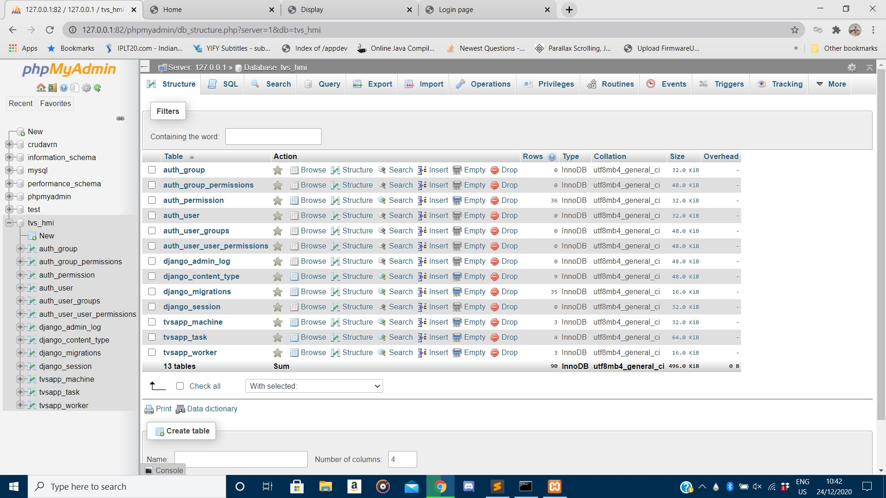
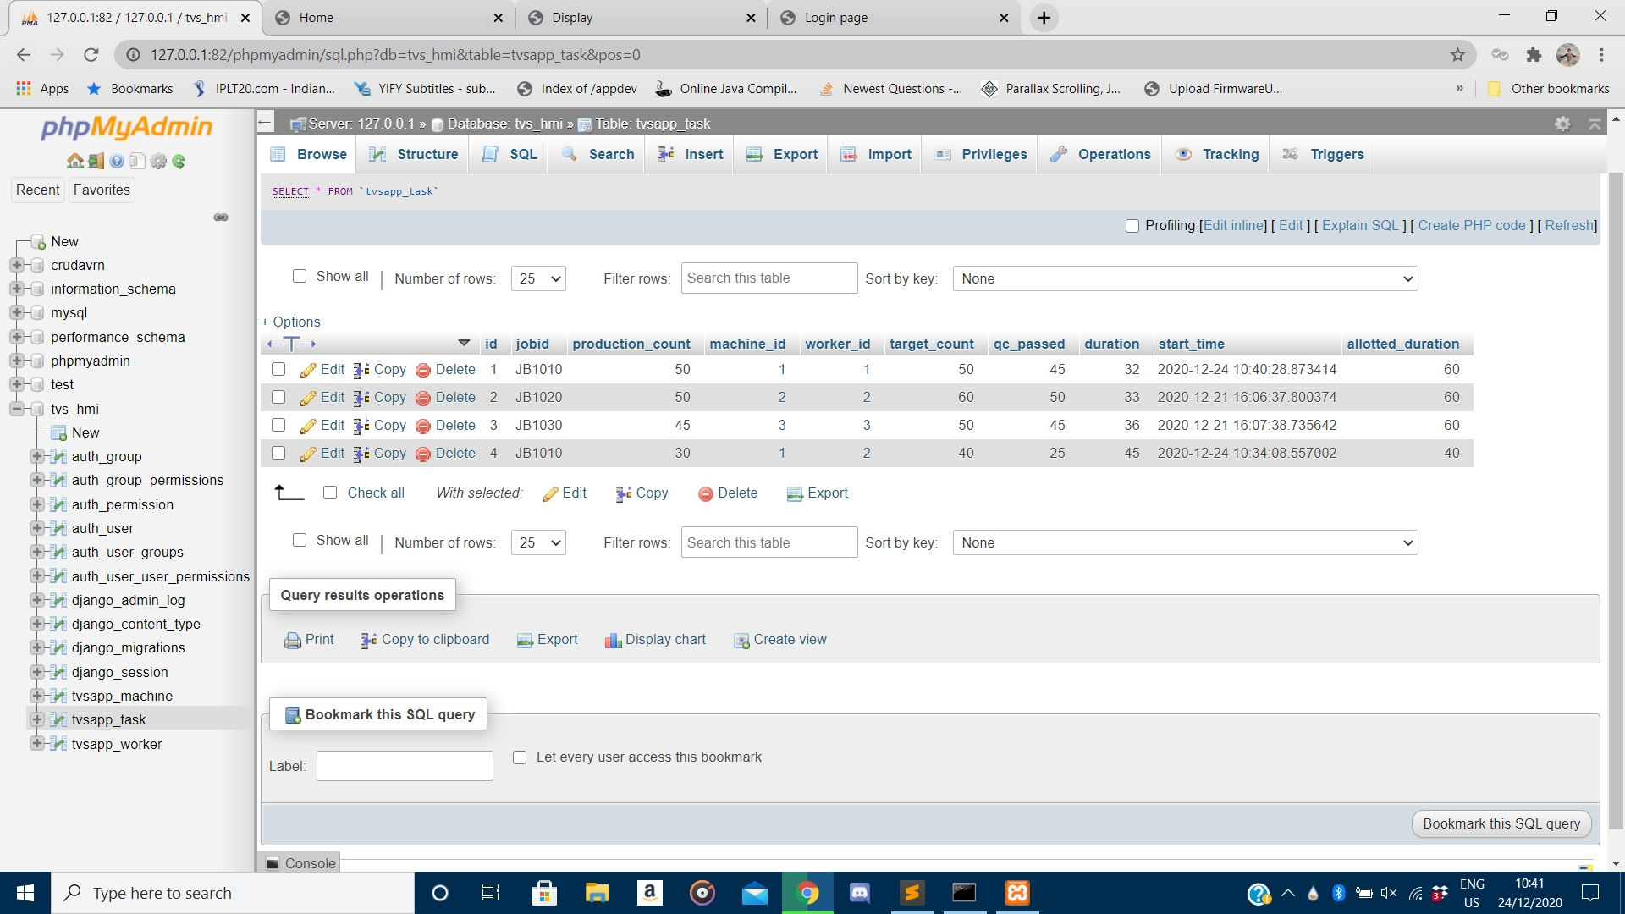
DATABASE SERVER
For database MySQL on a XAMPP server was used. All the default tables and the models created (Worker, Task, and Machine) were also migrated in form of a table. Django comes along with a default database system called SQLite, but in a longer and larger storage external database systems prove exceptional.
MySQL SERVER PAGE
TABLE OF TASK MODEL

Slide 19
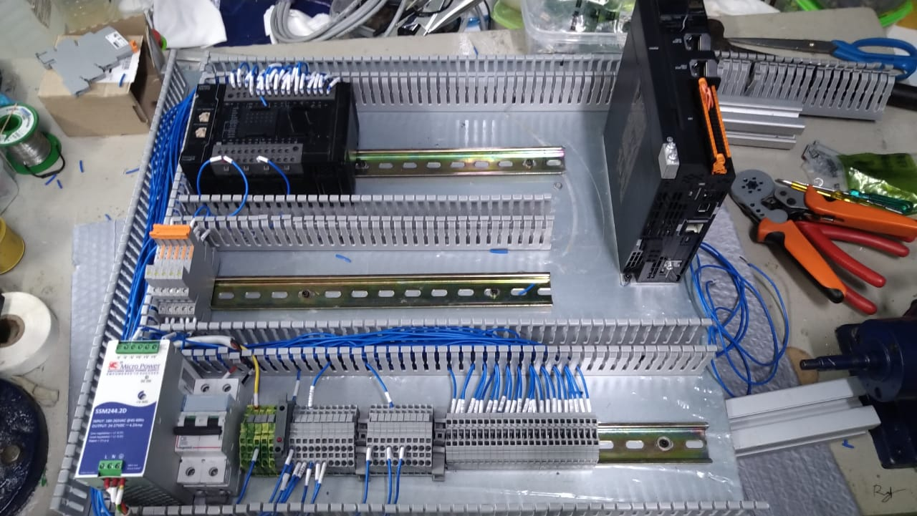
HARDWARE
Designed and connected circuits with Programmable Logic Controller (PLC), Switch Mode Power Supply (SMPS) and relays for an upcoming IC shaping machine. Learnt about PLCs and their usages in industrial places. Programming for the PLC is done with Ladder Logic Programming and learnt the basics of ladder logic programming.

Slide 20
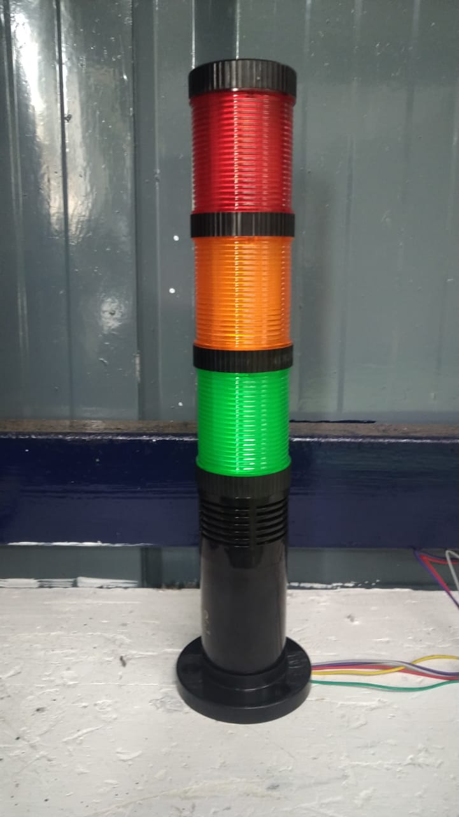
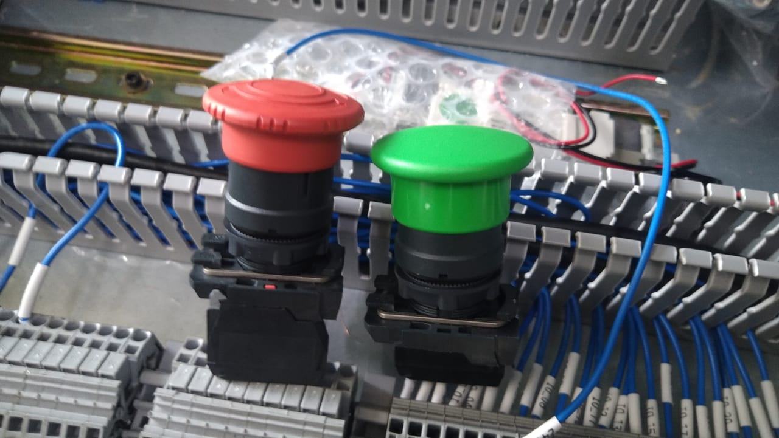
HARDWARE
2. Learnt about different sensors and their applications in industries. Knew how to sense them and also tried connecting them and tested. Some of the sensors used were – Photoelectric sensor, Proximity sensor, Solenoid, etc. Other stuffs (indicators) like push buttons, buzzer, tower lamps, etc were also tested.
TOWER LAMP
PUSH BUTTON

Slide 21
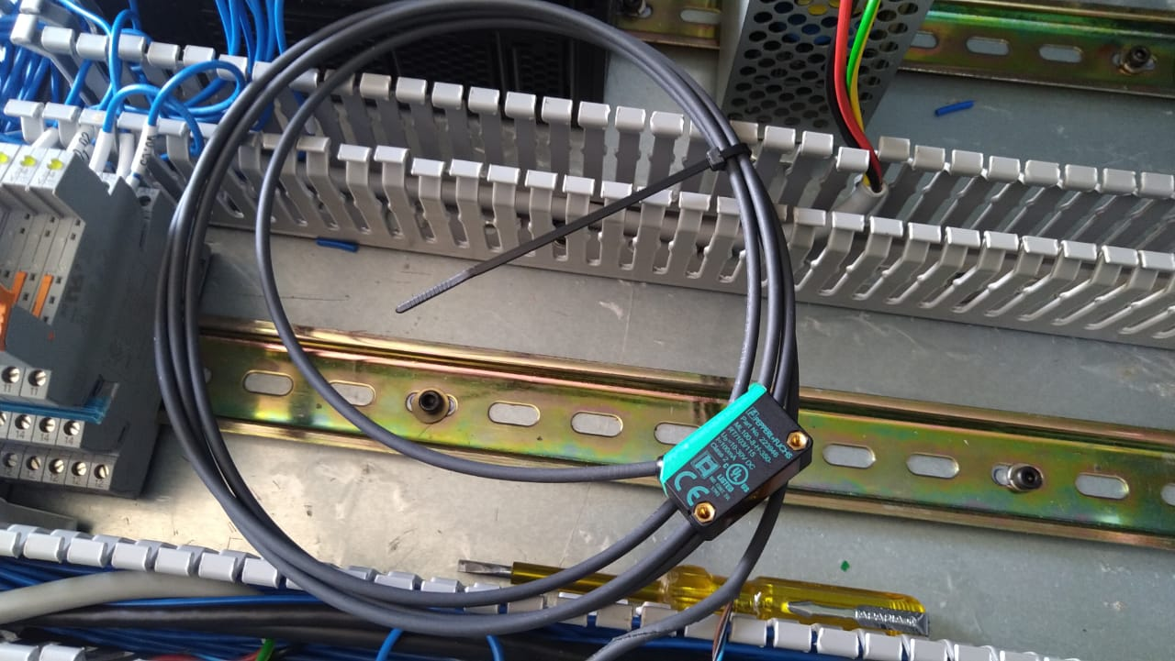
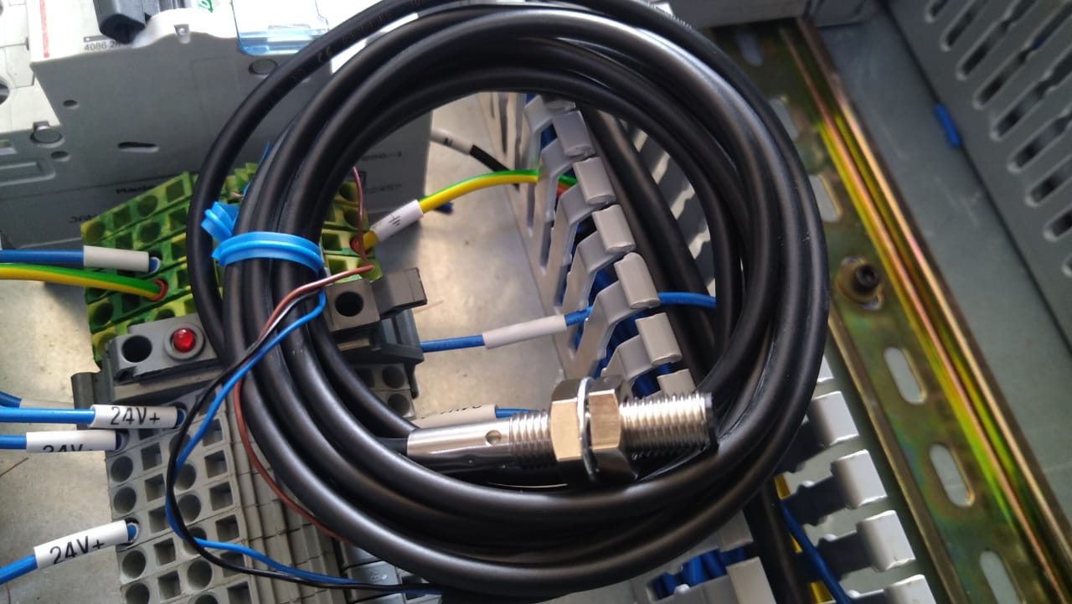
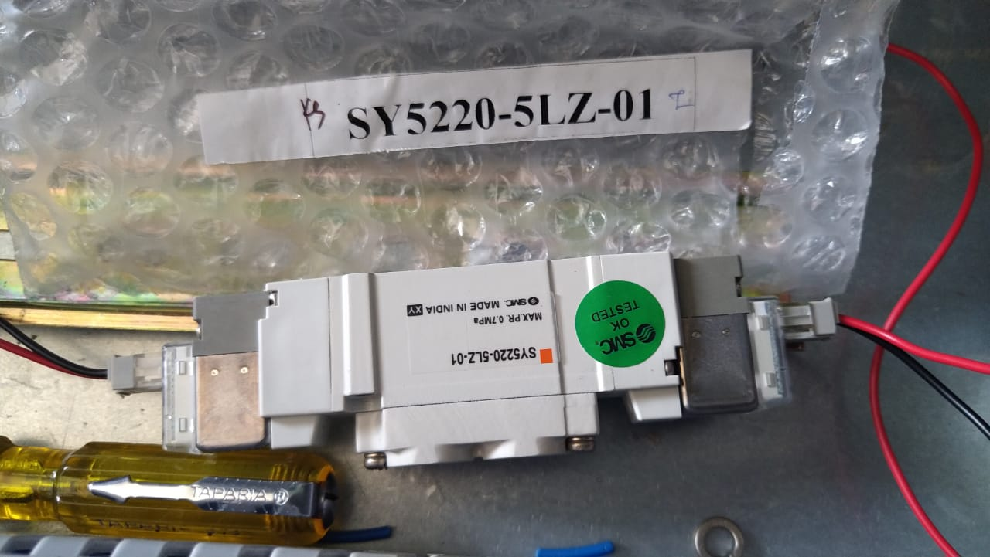
PHOTOELECTRIC SENSOR
PROXIMITY SENSOR
SOLENOID

Slide 22
HARDWARE
3. Learnt and tested the working/communication between PLC and the HMI. Soldering the communication lines between the HMI and PLC was done and tested. This was done using a RS 232 9-pin cable. The ethernet connection used follows TCP/IP protocol.
4. Learnt how Local Area Network helps in IIoT sectors. Connected all the HMI of a region to a master PC using LAN connection. Learnt command prompt codes for connecting different LAN nodes and accessing them from the edge server.

Slide 23
VOTE OF THANKS
I would like to propose a vote of thanks to
Mr. Balaji V, President of TVSSS Pvt Ltd
Mr. Muthu Pandi, Human Resource manager of TVSSS Pvt Ltd
Mr. Muthalagar, Assistant Manager of Process Engineering
Mr. Sunil Aravind, Process Engineer, TVSSS Pvt. Ltd.
and other staff members in helping to execute my internship in a perfect and exciting manner.
I’m sure this internship period was a learning experience and has really carved a path for my future.
Thanking you,
SABARI MATHAVAN R B

Slide 24
LINK TO THE PROJECT
Google drive link:
https://drive.google.com/drive/folders/1WDGMsk0FJbCT2gd-iCrAa-yHfjhkK-Gt?usp=sharing

