Slide 1

Python Environment Setup
From Zero to Ready-to-Code
Install Python, pick your editor, and get comfortable with the interactive shell—everything you need before writing your first program.
Shivank Pandey
Assistant Professor, Department of CSE
RIMT, Bareilly

Slide 2
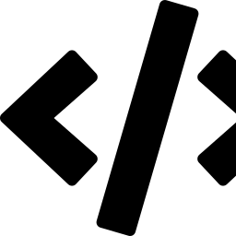

Setup Roadmap
Three steps to a working Python environment
01
Install Python
Download and install Python from the official source, and verify it from your terminal.
02
Choose an Editor
Set up VS Code or PyCharm — the two most popular choices for writing Python code, else you may opt any editor of your own choice.
03
Explore IDLE
Get hands-on with Python's built-in interactive shell to test code instantly.
02

Slide 3
Installing Python
Get up and running in under five minutes
1
Download the installer
Visit python.org/downloads and grab the latest stable release for your OS (Windows, macOS, or Linux).
2
Run the installer
On Windows, check “Add Python to PATH” before clicking Install — this lets you run Python from any terminal.
3
Verify the install
Open a terminal or command prompt and type: python --version (or python3 --version on macOS/Linux).
4
Confirm pip is ready
Python ships with pip, its package manager. Check with: pip --version
03

Slide 4
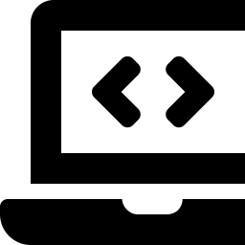
Choosing an Editor
VS Code and PyCharm are the two most popular choices
VS Code
PyCharm
Lightweight, general-purpose editor
Full-featured Python-only IDE
Free & open source
Fast startup, low resource use
Huge extension marketplace
Great for multi-language projects
Free Community edition available
Built-in debugger & test runner
Smart code completion & refactoring
Best for larger Python-only projects
04

Slide 5
The Interactive Shell (IDLE)
Test small snippets of code instantly, without saving a file
What is IDLE?
Python 3.12 Shell
IDLE is Python's built-in editor and interactive shell — it installs automatically with Python. The shell lets you type one line of code at a time and see the result immediately.
>>> 5 + 7
12
>>> name = "Ada"
>>> print(f"Hi, {name}!")
Hi, Ada!
>>> len("Python")
6
>>> _
Great for:
Quick experiments & math checks
Learning syntax step by step
Debugging small pieces of logic
05

Slide 6



Setup Checklist & Fixes
Confirm everything works before moving on
Quick Checklist
Common Issues
python --version prints a version number
“python” not recognized
Re-run installer and check “Add to PATH,” or use python3 instead.
pip --version runs without error
Wrong Python version runs
Multiple installs can conflict — use py --version (Windows) to check which one runs.
Your editor (VS Code / PyCharm) opens correctly
pip command not found
A .py file can be created and saved
Try python -m pip --version as an alternative invocation.
Editor doesn't detect Python
IDLE launches and accepts commands at >>>
In VS Code/PyCharm, manually set the interpreter path in settings.
06

Slide 7

You're Ready to Code!
Python installed. Editor configured. IDLE tested.
Next up: writing your first script — print("Hello, World!")
For Queries:
Mail to: ershivank2012@gmail.com

