Slide 1
Scripting for Network Professionals
National Convergence Technology Center
Working Connections Five Fridays
February 24, 2023
Professors Pamela Brauda & David Singletary
Florida State College at Jacksonville

Slide 2
Hands-on Labs
Day 4

Slide 3
Coding a Dog Class
Identify the attributes and methods
class Dog:
def __init__(self, name, age):
self.name = name
self.age = age
def sit(self):
print(f"{self.name} is now sitting.")
def roll_over(self):
print(f"{self.name} rolled over!")

Slide 4
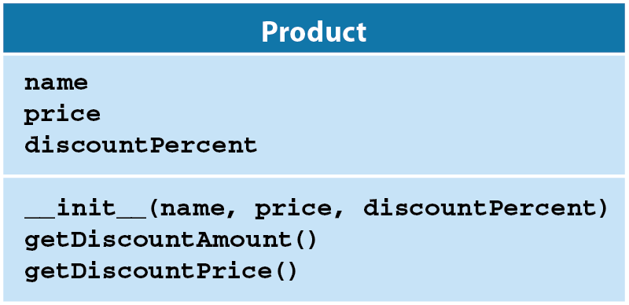
Coding the Product Class
Use the Product UML class diagram included below to implement a Product class which is used by the inventory.py.
Do not modify the inventory.py program.
Your class must use getter/setter decorators for all attributes.
Do not display any output in your class except for error handling
Your setters must validate data print errors for invalid values:
name must not be empty ("")
price must be >= 0
discountPercent must be >= 0.0 and <= 100.0

Slide 5
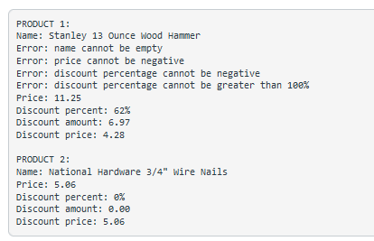
Expected Output:
note the validation checks in the inventory.py file

Slide 6
Coding the Product Class
class Product:
# an initialization method ("constructor")
def __init__(self, name, price, discountPercent): # self.name, self.price, and
# self.discountPercent are attributes
self.name = name
self.price = price
self.discountPercent = discountPercent
# a method that uses two attributes
def getDiscountAmount(self):
return self.price * self.discountPercent / 100
# a method that calls another method
def getDiscountPrice(self):
return self.price - self.getDiscountAmount()

Slide 7
Solution
See the GitHub repo for completed files
product.py and inventory.py

Slide 8
Car Class Using Decorators
Full file available for download in GitHub repo ("car.py")
#!/usr/bin/env python3
# car.py
# class representing a Car
# adapted from "Python Crash Course", Matthes 2019
class Car:
"""A simple attempt to represent a car."""
def __init__(self, make, model, year):
"""Initialize attributes to describe a car."""
self.__make = make # read-only
self.__model = model # read-only
self.__year = year # read-only
self.__odometer_reading = 0

Slide 9
Car Class Using Decorators
# getters
@property
def make(self):
return self.__make
@property
def model(self):
return self.__model
@property
def year(self):
return self.__year
@property
def odometer_reading(self):
return self.__odometer_reading

Slide 10
Car Class Using Decorators
# setter (only one needed, other attributes are read-only)
@odometer_reading.setter
def odometer_reading(self, odometer_reading):
if odometer_reading >= self.__odometer_reading:
self.__odometer_reading = odometer_reading
else:
print("You can't roll back an odometer!")
# utility methods
def get_descriptive_name(self):
"""Construct a full name from the car attributes."""
long_name = f"{self.year} {self.make} {self.model}"
return long_name.title()

Slide 11
Car Class Using Decorators
def read_odometer(self):
"""Print a message which indicates the car odometer value."""
print(f"This car has {self.odometer_reading} miles on it.")
def increment_odometer(self, miles):
"""Increment the odometer using value of miles argument."""
self.odometer_reading = self.odometer_reading + miles

Slide 12
Car Class Using Decorators
# unit test
def main():
car = Car("Dodge", "Viper SRT-10", 2010)
print(car.get_descriptive_name())
car.read_odometer()
car.odometer_reading = 1000
car.read_odometer()
car.increment_odometer(100)
car.read_odometer()
car.odometer_reading = 500
if __name__ == "__main__":
main()

Slide 13
Grouping Getters and Setters
There are two general alternatives for grouping getters and setters
# constructors
# all getters
# all setters
or
# constructors
# getter/setter for field 1
# getter/setter for field 2
# more pairs of getter/setter as necessary
Ultimately it is a personal preference (note constructors are first for both)
Some IDEs provide options to group them (and generate them!) for you

Slide 14
Design a class named Customer which contains 3 private members:
name (first name/lastname e.g. "John Smith")
street address (e.g. 1 Oak St.)
creation date (date/timestamp when an object is created)
include a constructor / initializer, and accessors and mutators (with decorators)
Note: the creation date should not include a mutator, it is a read-only attribute that is set once in the constructor and can only be accessed using an accessor from that point
Creation date accessor returns a formatted datetime string
Write a program which uses your Customer class to create two customers and print their member values
John Smith, 1 Oak St., 2017-06-21 21:34:23.525175
Sally Brown, 3 Elm St., 2017-06-21 21:34:23.525175

Slide 15
# customer.py
# represents a Customer class
import datetime
from datetime import datetime
class Customer:
# constructor
def __init__(self, name, strAddr):
self.__name = name
self.__strAddr = strAddr
self.__creationDate = datetime.now()

Slide 16
# accessor/mutator for name
@property
def name(self):
# print("in name getter") # debug
return self.__name
@name.setter
def name(self, name):
# print("in name setter, param=" + name) # debug
self.__name = name

Slide 17
# accessor/mutator for strAddr
@property
def strAddr(self):
# print("in strAddr getter") # debug
return self.__strAddr
@strAddr.setter
def strAddr(self, strAddr):
# print("in strAddr, param=" + strAddr) # debug
self.__strAddr = strAddr
# accessor (no mutator) for creationDate
@property
def creationDate(self):
return self.__creationDate

Slide 18
# customer_list.py
from customer import Customer
# create and print two customers
cust1 = Customer("John Smith", "1 Oak St.")
cust2 = Customer("Sally Brown", "3 Elm St.")
print(cust1.name + ", " + cust1.strAddr + ", " + str(cust1.creationDate))
print(cust2.name + ", " + cust2.strAddr + ", " + str(cust2.creationDate))

Slide 19
Objects Programming Assignment
Modify the Product class from the by adding a quantity member. Include a getter and setter, using decorators, and modify the appropriate constructor to also accept a quantity parameter. Write a totalCost method to calculate the total cost of the item (price * quantity).
Then modify the inventory.py file to include quantity values in the constructor calls with a quantity of 100 for product1 (hammers) and 3000 for product2 (nails). Add print statements to display the quantity values and the total cost values as shown in the Expected Output included below.

Slide 20
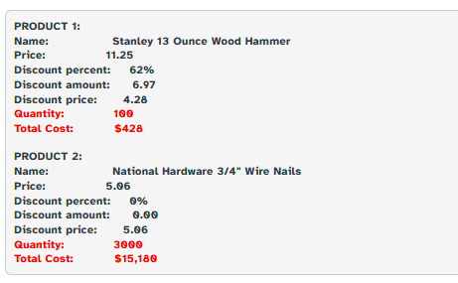
Expected Output

Slide 21
Inheritance in Python
#!/usr/bin/env python3
# electric_car.py
# class representing an electric car
from car import Car # import our base class
class ElectricCar(Car):
"""Represent aspects of a car, specific to electric vehicles."""
def __init__(self, make, model, year):
"""Initialize attributes of the parent class."""
super().__init__(make, model, year) # "pass-through" arguments to base class
def main():
my_tesla = ElectricCar('tesla', 'model s', 2019)
print(my_tesla.get_descriptive_name()) # get_descriptive_name resides in the base class
if __name__ == "__main__":
main()
2019 Tesla Model S

Slide 22
Inheritance in Python: Exercises
If pythons, vipers, and cobras are subclasses of the same superclass, what would you call the superclass?
class Snake:
Name some python subclasses (hint: google some different python types)
class BallPython(Snake): class AfricanPython(Snake): … and more
What is wrong with this class declaration:
class class: class is a reserved keyword
What is missing from the following class declaration?
class Snake:
def __init__(self):
self.sound = 'Sssssss'
What needs to change in the code shown below so venomous is private?
class Snake:
def __init__(self):
self.__venomous = True

Slide 23
Adding an Attribute to a Subclass
class ElectricCar(Car):
"""Represent aspects of a car, specific to electric vehicles."""
def __init__(self, make, model, year, batteryVolts = 0):
"""Initialize attributes of the parent class."""
super().__init__(make, model, year)
self.__batteryVolts = batteryVolts # read-only
# getter
def batteryVolts(self):
return self.__batteryVolts
# utility methods
# concat super's string with subclass info
def get_descriptive_name(self):
supStr = super().get_descriptive_name()
return supStr + "\nbattery voltage = " + str(self.__batteryVolts)

Slide 24
Overriding Methods
def main():
my_tesla = ElectricCar('tesla', 'model s', 2019)
print(my_tesla.get_descriptive_name())
my_tesla2 = ElectricCar('tesla', 'model s', 2019, 375)
print(my_tesla2.get_descriptive_name())
2019 Tesla Model S
battery voltage = 0
2019 Tesla Model S
battery voltage = 375

Slide 25
Objects in Networking Assignment
The attached files contain a class definition for a NetworkDevice and a class definition for a Router. Your assignment is to create a class definition for a Switch in a separate file.
Test the networkdevice.py file first. It has a testing main after the class definition. Ordinarily, you won't create a generic network device; this is just to test the code.
Run the router.py file second. It also has a testing main after the class definition.
Use the code examples in these files and from the slides to develop the class definition for a switch. The Switch class will inherit from the NetworkDevice class, just like the Router class does. In addition to the IP address and MAC address, the switch will have a hostname and default gateway; all variables are private. The Switch class also needs a variable that will count the number of switches created.
Use the same method to verify the default gateway is a valid IP address that you do with the IP address. Create a __str__ method for the Switch that displays appropriate information like the router examples.

Slide 26
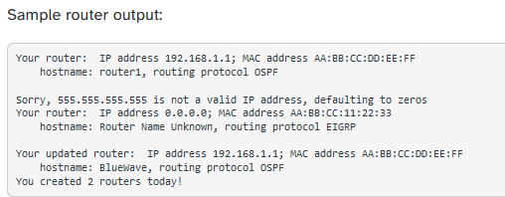
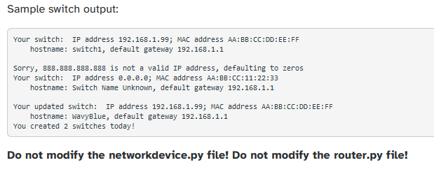

Slide 27
Reading an Entire File
#!/usr/bin/env python3
# file_reader.py
# opens, reads, and prints a file
# which contains digits of pi
FILENAME = 'pi_digits.txt'
with open(FILENAME) as f:
contents = f.read()
print(contents)
3.1415926535
8979323846
2643383279

Slide 28
Reading Line by Line with readline( )
FILENAME = "C:/temp/test.txt"
with open(FILENAME, "w") as outfile:
outfile.write("aaa\n")
outfile.write("bbb\n")
outfile.write("ccc\n")
with open(FILENAME) as infile:
line = infile.readline() # priming read
while line:
print(line, end="") # end="" to prevent extra newline
line = infile.readline()
aaa
bbb
ccc

Slide 29
Appending to a File
Opening a file in write ('w') mode truncates the file if it exists
To append to a file without truncating, open it in append ('a') mode
Python will append any content to the end of the file
If the file doesn't exist, it will be created
#!/usr/bin/env python3
# simplefileops.py
FILENAME='d:/cop2034c/simplefileops.txt'
with open(FILENAME, 'w') as f:
f.write('I love programming.\n')
f.write('I love creating new games.\n')
with open(FILENAME, 'a') as f:
f.write('I also find meaning in large datasets.\n')
with open(FILENAME) as f: # 'r' is implied
for line in f:
print(line.replace("\n","")) # replace also removes newlines
I love programming.
I love creating new games.
I also find meaning in large datasets.

Slide 30
Write and Read a Binary File
#!/usr/bin/env python3
# picklecats.py
# write and read data to a binary file
import pickle # module for working with binary files
FILENAME = "d:/COP2034C/kittens.bin"
# 3x2 list of kittens and ages (in years)
kittens = [["Snowball", 5],
["Mr. Snuffles", 3],
["Fluffy", 7]]
# write the list to a file
with open(FILENAME, "wb") as file: # write binary
pickle.dump(kittens, file)
# read the file into a list and print
with open(FILENAME , "rb") as file: # read binary
kitten_list = pickle.load(file)
print(kitten_list)
[['Snowball', 5], ['Mr. Snuffles', 3], ['Fluffy', 7]]

Slide 31
Reading CSV files
#!/usr/bin/env python3
# read_csv.py
# read a CSV file
import csv
CSV_FILE = "averages.csv"
def main():
avg_list = []
with open(CSV_FILE) as file:
reader = csv.reader(file) # create a CSV reader
for row in reader: # read each row
avg_list.append(row) # append to list
for row in avg_list: # display list
print(row)
main()
['Smith', 'John', '89']
['Jones', 'Sally', '98']
['Green', 'Rashad', '93']

Slide 32
Writing JSON Data
The Python JSON module uses the dump( ) function to create and write JSON data from Python data structures
#!/usr/bin/env python3
# json_number_writer.py
# JSON number writer, from Matthes Crash Course 2e
import json
numbers = [2, 3, 5, 7, 11, 13]
filename = 'numbers.json'
with open(filename, 'w') as f:
json.dump(numbers, f)
file content
[2, 3, 5, 7, 11, 13]

Slide 33
Reading JSON Data
The load( ) function reads JSON data into Python data structures
#!/usr/bin/env python3
# json_number_reader.py
# JSON number reader, from Matthes Crash Course 2e
import json
filename = 'numbers.json'
with open(filename) as f:
numbers = json.load(f)
print(numbers)
[2, 3, 5, 7, 11, 13]

