Slide 1
Scripting for Network Professionals
National Convergence Technology Center
Working Connections Five Fridays
February 3, 2023
Professors Pamela Brauda & David Singletary
Florida State College at Jacksonville

Slide 2
Module 1 Introduction to Python Statements, Data Types, and Variables

Slide 3
Ch. 1 Getting Started

Slide 4

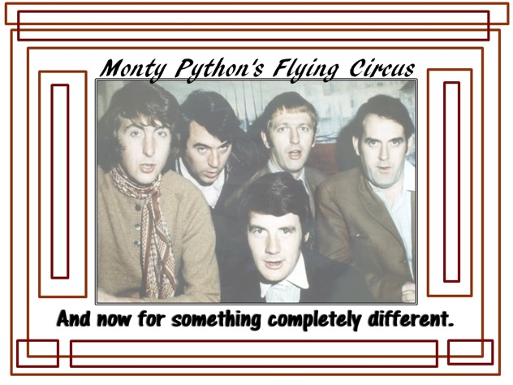
The Python Programming Language
Why is it called Python?
When he began implementing Python, Guido van Rossum was also reading the published scripts from “Monty Python’s Flying Circus”, a BBC comedy series from the 1970s. Van Rossum thought he needed a name that was short, unique, and slightly mysterious, so he decided to call the language Python.

Slide 5
Characteristics of the Python Language
Simple syntax
Many features of traditional programming languages.
Open source
Support for different types of applications
Console (text-based)
scripting and small utilities
not necessarily interactive
GUI (Graphical User Interface)
Web applications

Slide 6
Characteristics of the Python Language
Python can be used as a scripting language or compiled to bytecode for larger projects
Python supports dynamic data types and dynamic type-checking
Python provides automatic garbage collection
Python can be integrated with other languages such as C, C++, and Java

Slide 7
Python Resources
Main website:
www.python.org/
Books, Websites, and Tutorials:
wiki.python.org/moin/BeginnersGuide/Programmers
Hitchhiker's Guide to Python:
docs.python-guide.org/en/latest/intro/learning/
Downloading the software:
www.python.org/downloads/

Slide 8
Applications of Python
Scripting
Data science
Machine learning
Scientific programming
Game development
GUI development
Web application development
Mobile development

Slide 9
A Simple Python Program
#!/usr/bin/env python3
# display a welcome message
print("Welcome to Python!")
print()
# get input from the user
name = input("Please enter your name: ")
print("Hello,", name)
Welcome to Python!
Please enter your name: Python User
Hello, Python User

Slide 10
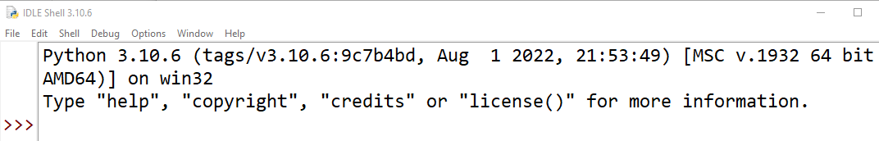
Python Versions
As of February 2023, the most recent version of Python is 3.11.1
Some systems may contain an installation of Python 2.X
This may be to support older programs
No harm in leaving it alone
Be sure you are working with a relatively recent version (3.x)
Run the following from the command line
python --version
Or run IDLE (see next slide) and note the version on the banner:
C:\Users>python --version
Python 3.10.6
C:\Users>

Slide 11
IDLE interactive shell
IDLE (Integrated Development and Learning Environment) is an IDE for Python development that is included in the Python installation package
Lightweight and easy to use
Not ideal for larger projects
Adequate for this course
Always available (useful for supporting code at external sites)
There are many useful and powerful Python IDE packages
Choice is personal, try them and pick for yourself
Sublime Text (used in the current course textbook)
Adam
PyCharm
Microsoft VS Code
Spyder
Jupyter Notebook

Slide 12
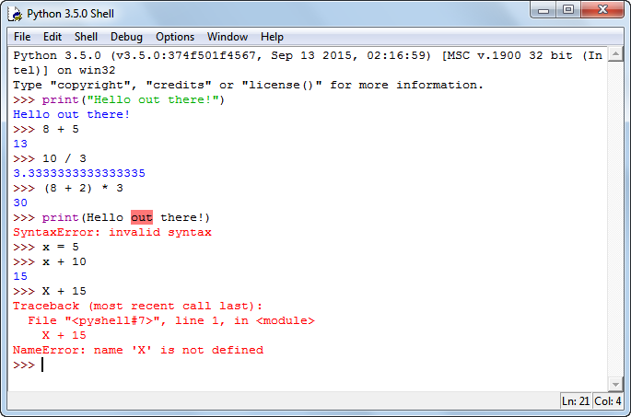
IDLE Interactive Shell
Commands and programs can be entered and executed interactively

Slide 13
Python is an interpreted language
The IDLE shell can be used as an interpreter
Python code is executed line-by-line instead of compiling the entire program
Each code statement can be executed immediately ☺
The Windows IDLE shell does not have a command to clear the interpreter window; things can get messy ☹
To create a clear IDLE shell, exit and restart ☹ ☹

Slide 14
To test a statement, type it at the prompt and press the Enter key. Try typing "x = 5" (minus the quotes)
You can also type the name of a variable at the prompt to see what its value is (after typing "x = 5", just type "x")
Any variables that you create remain active for the current session.
As a result, you can use them in statements that you enter later in the same session.
To retype the previous statement on Windows, press Alt+p.
To cycle through all of the previous statements, continue pressing Alt+p.

Slide 15
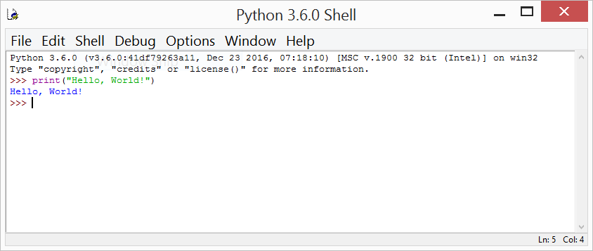
Enter a command in the shell and examine the results:
print("Hello, World!")

Slide 16
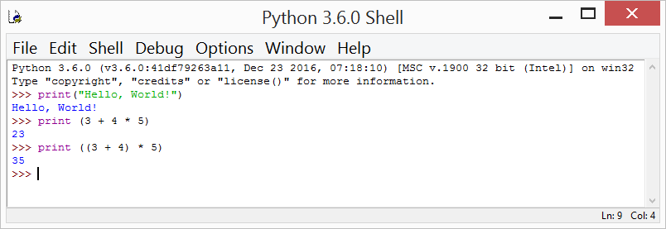
print(3 + 4 * 5)
print((3 + 4) * 5)

Slide 17
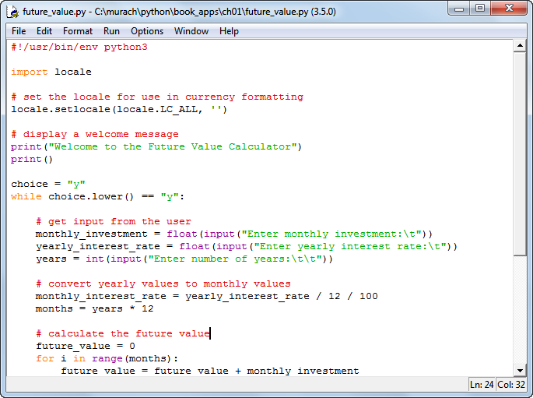
IDLE Editor with Source File Displayed

Slide 18
Running a Source File from IDLE
From the editor window, press the F5 key or select Run→Run Module.
If IDLE displays a dialog box that indicates that you must save the program first, click Yes to save it. Then, if the program doesn’t have any errors, IDLE runs the program in the interactive shell.

Slide 19
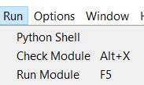

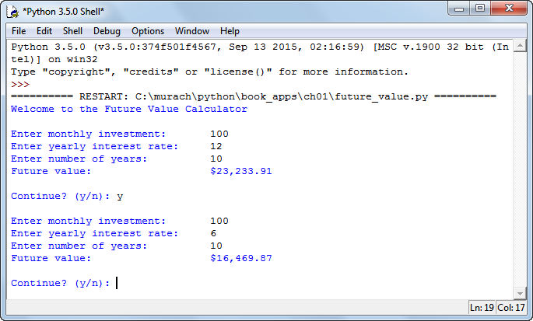
Running a Source File from IDLE
Select Run / Run Module from Menu Bar

Slide 20
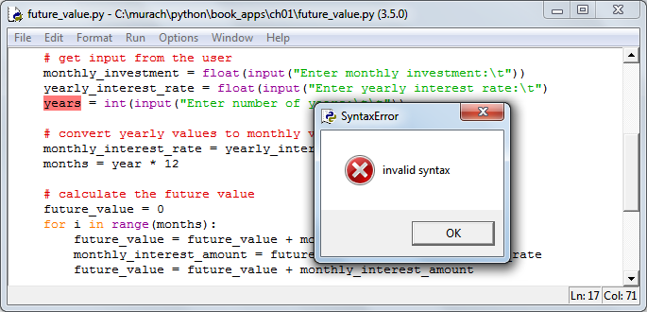
Syntax Errors
Syntax errors prevent code from building
spelling errors, incorrect punctuation, missing parentheses are examples of causes

Slide 21
Handling Syntax Errors
IDLE will highlight where it thinks a syntax error has occurred
Sometimes the highlighted location will be correct, but sometimes it will be elsewhere (e.g. in the previous statement)

Slide 22
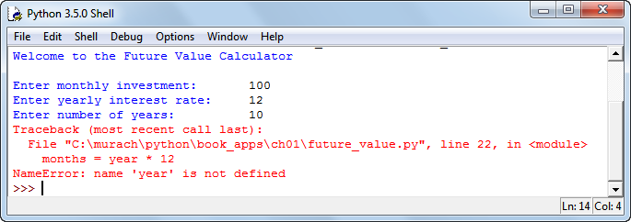
Runtime Errors
Runtime errors can crash your program
There are ways to handle these errors (exceptions) to prevent the crash, but for now we will have to find and fix the code that is causing the crash.

Slide 23
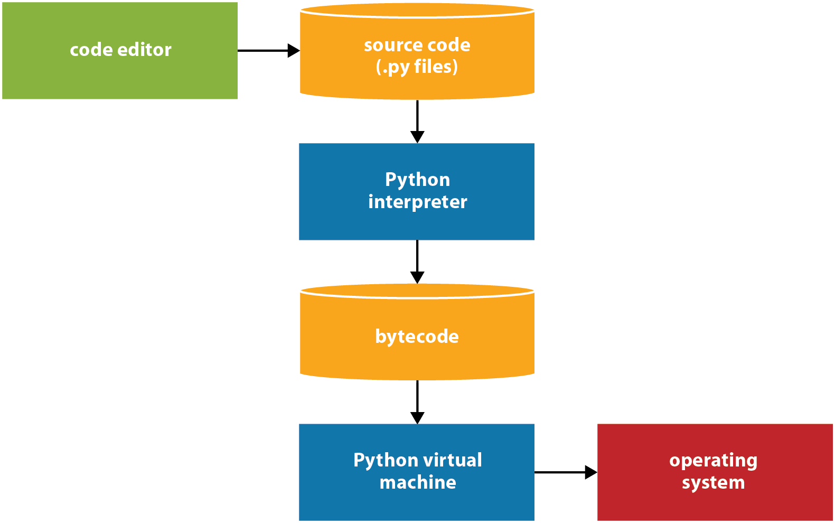
How Python compiles and runs source code
Python's implementation is "byte-code interpreted".
Step 1. The programmer uses a text editor or IDE to enter and edit the source code. Then, the programmer saves the source code to a file with a .py extension.
Step 2. The source code is compiled by the Python interpreter into bytecode.
Step 3. The bytecode is translated by the Python virtual machine into instructions that can interact with the operating system of the computer.

Slide 24
Python Statements
A line of Python code is known as a statement
print("Total score = " + str(score_total))
Indentation matters! Some statements must be indented, others must not be. Typical indentation is 4 spaces:
if test_score >= 0:
score_total = score_total + test_score

Slide 25
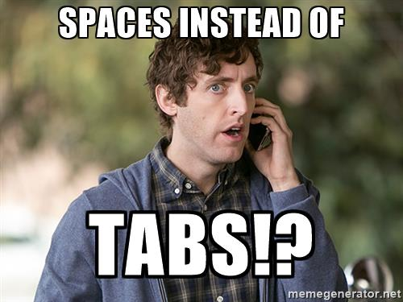
Python Coding Style (1/2)
A PEP is a Python Enhancement Proposal, which provides technical specifications for various language features and conventions and should be considered authoritative.
PEP 8 -- Style Guide for Python Code
Use 4-space indentation, and no tabs.
4 spaces are a good compromise between small indentation (allows greater nesting depth) and large indentation (easier to read). Tabs introduce confusion, and are best left out.
Wrap lines so that they don’t exceed 79 characters. This helps users with small displays and makes it possible to have several code files side-by-side on larger displays.

Slide 26
Python Coding Style 2/2
Use blank lines to separate functions and classes, and larger blocks of code inside functions.
When possible, put comments on a line of their own.
Use spaces around operators and after commas, but not directly inside bracketing constructs: a = f(1, 2) + g(3, 4).
Name your classes, variables, and functions consistently; the convention is to use PascalCase for classes and lower_case_with_underscores or camelCase for variables, functions and methods. Always use self as the name for the first method argument (classes and methods in a later module).

Slide 27
The "shebang" Line
#!/usr/bin/env python3
Tells some operating systems (e.g. Unix) how to run the program
can indicate which version of python to use (e.g. 3)
Not required for Windows
Not required when using IDLE
Good practice to include it so programs can be run on other (non-Windows) systems
Also known as the "sha-bang", "hashbang", "pound-bang", or "hash-pling"

Slide 28
Comments
Use the pound sign (hashtag) '#' to comment code
# this is a block comment
print("Total Score: " + score) # this is an inline comment
Comments have no effect on program operation

Slide 29
Functions
A function is a group of statements that perform a specific task
Python includes many built-in functions
print is a built-in function
print("Hello out there!")
print()
print("Goodbye!")
argument
Hello out there!
Goodbye!

Slide 30
Ch. 2 Variables and Simple Data Types

Slide 31
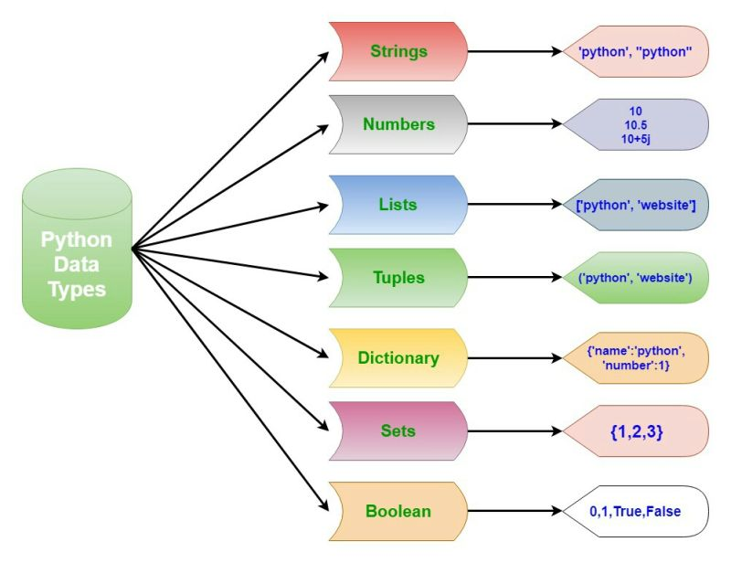
Python Data Types

Slide 32
Variables
A variable is an identifier made up of letters, numbers, and underscores _
Variables store values that are used in a program
Variable's values can change during a program's execution
Variable names must start with a letter or underscore
Variable names cannot contain spaces, punctuation (other than underscores), or other special characters
A variable name cannot be a Python keyword (e.g. while, or continue)

Slide 33
Constants
A constant is a value that will not change for the life of the program.
Constants make programs more maintainable and source code less error-prone
Python does not provide a built-in constant modifier, but we can use naming conventions to "simulate" them
"Constants are usually defined on a module level and written in all capital letters with underscores separating words.
http://legacy.python.org/dev/peps/pep-0008/#constants
THIS_IS_A_CONSTANT
this_is_a_variable
thisIsAlsoAVariable

Slide 34
Basic Data Types and Variables
Data type | Name | Examples
str | String | "Hello" "50" "Enter a name: "
int | Integer | 21 -25 450 0
float | Floating point | 21.9 450.65 -92.0 3.14159

Slide 35
Variable names are case sensitive
Variable names should start with a lower-case letter
Use underscore_notation or camelCase
but not both!
Legal Names | Illegal Names
first_name | 10counters
quantity1 | notALegal%Name
totalSales | _cannot do this
_systemType | #oneMoreNope

Slide 36
Assigning Values to Variables
An assignment statement is made up of a variable name, followed by an equal sign, followed by an expression
first_name = "Mike" # set variable first_name to "Mike"
quantity1 = 3 # set variable quantity1 to 3
list_price = 19.99 # set variable list_price to 19.99
An expression can be a literal (a "hardcoded" value)
A literal can be a string ("Mike") or numeric value (3, 19.99)

Slide 37
Numeric Types
int
the integer type. Has "unlimited precision" (no theoretical maximum value). You may hit a MemoryError exception if you test this (larger than available memory).
float
floating point numbers, usually implemented using double in C; information about the internal representation is available in sys.float_info (be sure to import the sys module first!)
complex
complex numbers with a real and imaginary part, which are each a floating point number.

Slide 38
Floating Point Values
Floating point values are represented using the IEEE-754, as with most languages.
https://docs.python.org/3/tutorial/floatingpoint.html
not as precise as we might expect
can result in inaccurate calculations
there are ways we can work around this (to be covered later in this course)
sub_total = 74.95
tax = sub_total * .1 # tax = 7.495000000000001

Slide 39
Working With Numbers in Python
An arithmetic expression consists of two or more operands (numeric variables or numeric literals) that are operated on by arithmetic operators.
Operator | Name
+ | Addition
- | Subtraction
* | Multiplication
/ | Division
// | Integer Division
% | Modulo / Remainder
** | Exponentiation

Slide 40
Examples of Arithmetic Expressions
Spaces around operators are not required, but they make code more readable
Example | Result
5 + 4 | 9
total + fee | depends on variable values
25 / 4 | 6.25
25 // 4 | 6
25 % 4 | 1
3 ** 2 | 9
Statically-typed languages (e.g. Java, C++) do integer division with '/' based on operand types

Slide 41
Order of Precedence (PEMDAS)
Order | Operators | Direction
(P)arentheses | () | Left to Right
(E)xponent | ** | Right to Left
(M)ultiplication (D)ivision | * / // % | Left to Right
(A)ddition (S)ubtraction | + - | Left to Right

Slide 42
Precedence Examples
Example | Result
6 * 2 + 5 * 3 | 27
3 + 2 ** 3 | 11
3 ** 2 ** 3 | 6561

Slide 43
Changing Precedence With Parentheses
Example | Result
3 + 4 * 5 | 23 (multiplication is first)
(3 + 4) * 5 | 35 (addition is first)
(subtotal + fee) * tax | result depends on variable values, but addition is first

Slide 44
Arithmetic Expressions, Variables, and Assignment Statements
Calculating Sales Tax
subtotal = 200.0
tax_percent = 0.05
tax_amount = subtotal * tax_percent # 10.0
grand_total = subtotal + tax_amount # 210.0

Slide 45
Mixing Integers and Floating Point Values
Dividing two numbers will always result in a floating point value, even if both numbers are integers
4/2
If an arithmetic operation includes integers both and floating point numbers, the result will always be a floating point number
2 * 3
2.0 * 3
2.0
6
6.0

Slide 46
Underscores in Numbers
Commas cannot be used to group numbers (in almost all programming languages)
Python allows the use of underscores to group large numbers to make them more readable
x = 1000943563
y = 1_000_943_563 # same value
print(x, y)
z = 10_00_943_563 # weird, but same value
print(z)
1000943563 1000943563
1000943563

Slide 47
Built-In Functions and Type Conversion
Type conversions are done by using built-in functions
str(1234) # convert 1234 to a string
value = 58.6
print(value)
print(str(value)) # convert to string
num_string = "1234"
num = int(num_string)
print(num)
58.6
58.6
1234

Slide 48
Built-In Functions and Type Conversion
Output can be concatenated using the '+' concatenation operator
num_string = "1234"
num = int(num_string)
print(num)
# print("concatenation error: " + num)
print("concatenation success: " + str(num))
num_string2 = "77.888"
num2 = float(num_string2)
print(num2)
#num_error_string = "hello1234"
#num_error = int(num_error_string)
1234
concatenation success: 1234
77.888

Slide 49
Built-in Functions
abs() | dict() | help() | min() | setattr()
all() | dir() | hex() | next() | slice()
any() | divmod() | id() | object() | sorted()
ascii() | enumerate() | input() | oct() | staticmethod()
bin() | eval() | int() | open() | str()
bool() | exec() | isinstance() | ord() | sum()
bytearray() | filter() | issubclass() | pow() | super()
bytes() | float() | iter() | print() | tuple()
callable() | format() | len() | property() | type()
chr() | frozenset() | list() | range() | vars()
classmethod() | getattr() | locals() | repr() | zip()
compile() | globals() | map() | reversed() | __import__()
complex() | hasattr() | max() | round()
delattr() | hash() | memoryview() | set()
https://docs.python.org/3/library/functions.html

Slide 50
More Built-In Function Examples
Functions use 0 or more arguments, some accept different numbers of arguments
function() # 0 arguments
function(x) # 1 argument
function(x, y) # 2 arguments
function("my value is " + str(x)) # concatenated string is one argument
print(round(1234.5678))
print(round(1234.5678, 3))
print(float(25))
print(int(1234.5678))
print(complex(5,10))
print(hex(255))
1235
1234.568
25.0
1234
(5+10j)
0xff

Slide 51
Compound Assignment Operators
Compound assignment operators (aka augmented assignment operators) are shorthand for common assignment operations
Operator | Description
+= | adds the right side to the variable's value and assigns the result to the variable (can also be used for string concatenation)
-= | subtracts the right side from the variable's value and assigns the result to the variable
*= | multiplies the variable's value by the right side and assigns the result to the variable
/= | divides the variable's value by the right side and assigns the result to the variable
%= | performs remainder division on the variable's value (by the right side) and assigns the result to the variable

Slide 52
Using Compound Assignment Operators
counter = 0
counter = counter + 1 # counter = 1
counter += 1 # counter = 2
score_total = 10
score_total *= 2 # score_total = 20
score_total /= 5 # score_total = 4
x = 10
x += " # this number is 10" # TypeError: unsupported operand type(s)
s = "This number is 10: "
s += 10 # TypeError: unsupported operand type(s)
s += str(10)
print(s) # This number is 10: 10

Slide 53
Assigning Strings to Variables
string literals are sequences of characters (including special characters and digits) enclosed in quotes. Use the '=' symbol to assign them to variables.
first_name = "Bob"
last_name = 'Smith' # Python accepts single quotes
empty_string = ""
singleSpace = " " # hard to see, but there is a space
anExcitedString = "Hello!!!“
first_name = 10

Slide 54
Concatenating Strings
"concatenation" joins two or more strings together using the '+' symbol:
first_name = "Bob"
last_name = 'Smith'
full_name = first_name + " " + last_name
# result is "Bob Smith"
lastNameFirst = last_name + ", " + first_name
# result is "Smith, Bob"

Slide 55
The str() Function
The str() function converts numeric data to string data so you can use concatenation
print("Total Score: "
+ str(score_total)
+ "\nAverage Score: "
+ str(average_score))

Slide 56
Implicit Continuation of a String
A long string can be continued over multiple lines
The interpreter looks for continuations on subsequent lines if it doesn't find a complete statement
print("Total Score: " # continued
+ str(score_total) # continued
+ "\nAverage Score: " # continued
+ str(average_score)) # done!

Slide 57
Using Special Characters in Strings
An escape sequence is a character combined with a backslash to give it special meaning
Common Escape Sequences

Slide 61
f-strings
Python 3.6 introduced "Literal String Interpretation", or "f-strings"
f-strings provide a way to embed expressions inside string literals, using a minimal syntax
an f-string is a literal string, prefixed with 'f', which contains expressions inside braces
any variable found within braces is replaced with its value

Slide 62
f-strings (example)
first_name = "john"
last_name = "smith"
full_name = f"{first_name} {last_name}"
print(full_name)
print(full_name.title()) # convert to "Title" case
john smith
John Smith

Slide 63
Examining the print() function
print accepts arguments in many different forms
A comma is used as the argument separator
print(19.99) # 19.99
print("Price:", 19.99) # Price: 19.99
print(1, 2, 3, 4) # 1 2 3 4

Slide 64
There are different ways to get the same result
A print() function that receives four arguments
print("Total Score:", score_total,
"\nAverage Score:", average_score)
A print() function that receives one string as the argument
print("Total Score: " + str(score_total) +
"\nAverage Score: " + str(average_score))
If score_total is 240 and average_score is 80, this is what is displayed:
Total Score: 240
Average Score: 80

Slide 65
print also allows "sep" and "end" arguments
defaults to a space character
print(1, 2, 3, 4, sep=' | ') # 1 | 2 | 3 | 4
print('foo', 'bar', sep=' -> ') # foo -> bar
print('eggs', 'ham', sep='\t') # eggs ham
using "end"
print(1, 2, 3, 4, end='!!!') # 1 2 3 4!!!
print('ham', 'eggs', 'toast', sep=' & ', end=': Yum!')
# ham & eggs & toast: Yum!

Slide 66
Getting User Input
The input function prompts the user and reads input from the keyboard
A prompt provides a 'hint' to the user that they must take an action
The program waits until the <Enter> key is pressed
The user's keyboard entry is saved in a variable
first_name = input("Enter your first name: ")
print("Hello, " + first_name + "!")
At the prompt, the user types "Mike" and the <Enter> key
Enter your first name: Mike
Hello, Mike!

Slide 67
The prompt can be displayed separately from the input function by calling input() with no arguments:
print("What is your first name?")
first_name = input()
print("Hello, " + first_name + "!")
What is your first name?
Mike
Hello, Mike!
Notice the difference? The prompt is on a separate line

Slide 68
We cannot use the input function directly to obtain numeric data from the user
We have to convert the input from a string to a number type
score_total = 0
score = input("Enter your score: ") # score is a string
score_total += score # causes an error

Slide 69
Numeric Conversion Functions
int(data) # converts a string to an integer type
float(data) # converts a string to a floating point type
This code causes an exception:
x = 15
y = "5"
z = x + y # TypeError: can't add an int to a str
Using the int() function fixes it:
x = 15
y = "5"
z = x + int(y) # z is 20

Slide 70
The following code reads a string from the user and converts it to an integer
Notice that we use the same variable name; we are dynamically changing the type of the variable
quantity = input("Enter the quantity: ") # get str type
quantity = int(quantity) # convert to int type
How to use chaining to get the value in one statement
quantity = int(input("Enter the quantity: "))

Slide 71
The following code reads a string from the user and converts it to an float
price = input("Enter the price: ") # get str type
price = float(price) # convert to float type
How to use chaining to get the value in one statement
price = float(input("Enter the price: "))

Slide 72
The Round Function
round() takes a numeric argument and rounds it to the specified number of significant digits
num1 = 3.14159
num2 = round(num1, 2)
print(num1, num2, sep=',')
displays
3.14159,3.14

Slide 73
If the number of digits (the second argument) is omitted, it defaults to 0
print(round(7.59))
displays 8 – an integer

Slide 74
Rounding behavior as of Python 3.x:
The return value is an integer if called with one argument, otherwise of the same type as x."
x = round(3.14) # returns an int
x = round(3.0, 0) # returns a float
"round(x[, n]): … values are rounded to the closest multiple of 10 to the power minus n; if two multiples are equally close, rounding is done toward the even choice (so, for example, both round(0.5) and round(-0.5) are 0, and round(1.5) is 2).
https://docs.python.org/release/3.1.5/library/functions.html#round

Slide 75
>>>print(round(0.5))
0
>>>print(round(1.5))
2
>>>print(round(2.5))
2
>>>print(round(3.5))
4

Slide 76
Remember that floating point values are not always precise:
print(round(2.675, 2))
displays
2.67
because internally 2.675 is represented as 2.67499999999999

Slide 77
Python Source Code File
Enter code in file editor
Save with ".py" extension.
Run from command line via
"python filename.py"
or open file in IDE (e.g. IDLE) and execute.
#!/usr/bin/env python3
# miles_per_gallon
# D. Singletary
# 6/12/17
# calculates miles per gallon
print("The Miles Per Gallon program")
print()
# get input from the user
miles_driven= float(input("Enter miles driven:\t\t"))
gallons_used = float(input("Enter gallons of gas used:\t"))
# calculate and round miles per gallon
mpg = miles_driven / gallons_used
mpg = round(mpg, 2)
# display the result
print()
print("Miles Per Gallon:\t\t" + str(mpg))
print()
print("Bye")

Slide 78
Selection Statements

Slide 79
Ch. 5 If Statements

Slide 80
Selection Statements
Selection statements control the execution of a program
“IF (there is plenty of money) THEN go out to eat”
“WHILE (there is not enough money) stay home and cook”
Boolean expressions evaluate to True or False and are evaluated in selection statements
(there is plenty of money) is a Boolean expression which evaluates to True or False
(there is not enough money) is a Boolean expression which evaluates to True or False

Slide 81
Relational Operators
Relational Operators are used in Python to construct Boolean expressions
Operator | Name | Description
== | Equal to | Returns True if both operands are equal
!= | Not equal to | Returns True if the operands are not equal
> | Greater than | Returns True if the left operand is greater than the right operand
< | Less than | Returns True if the left operand is less than the right operand
>= | Greater than or equal to | Returns True if the left operand is greater than or equal to the right operand
<= | Less than or equal to | Returns True if the left operand is less than or equal to the right operand

Slide 82
Examples of Boolean Expressions
Operands should be based on similar types
All of the following examples evaluate to True or False
age == 5
first_name == "John"
quantity != 0
distance > 5.6
fuel_req < fuel_cap
distance >= limit
stock <= reorder_point
rate / 100 >= 0.1
Don't use = to test for equality, this is for assignment!

Slide 83
Assigning Values to Boolean Variables
A Boolean variable is either True or False
The literal values True and False can be assigned
isActive = activity != 0
rentIsTooHigh = True

Slide 84
Logical Operators
Logical operators are used to combine Boolean expressions
The combined expressions also evaluate to True or False
Name | Description
and | Evaluates to True only if all expressions are True
or | Evaluates to True if any expression is True
not | Reverses the value of the expression
Order of Precedence
not operator
and operator
or operator

Slide 85
Logical Operator Examples
# The and operator
age >= 65 and city == "Chicago"
# The or operator
city == "Greenville" or age >= 65
# The not operator
not age >= 65
# Two and operators
age >= 65 and city == "Greenville" and state == "SC"
# Two or operators
age >= 65 or age <= 18 or status == "retired"

Slide 86
Logical Operator Examples, cont.
# and and or operators with parens to clarify sequence of operations
(age >= 65 and status == "retired") or age < 18
# and and or operators with parens to change sequence of operations
age >= 65 and (status == "retired" or state == "SC")

Slide 87
Short-Circuiting
Short-circuit evaluation uses the behavior of logical operators to avoid unnecessary expression evaluation
Can improve performance
and operations evaluate to True only if all expressions are True
age >= 65 and city == "Greenville" and state == "SC"
If age >= 65 is False, evaluation stops there and result is False
If city == “Greenville” is False, evaluation stops there and result is False

Slide 88
More Short-Circuiting
or operations evaluate to True if any expression is True
age >= 65 or age <= 18 or status == "retired"
If age >= 65, evaluation stops there and result is True
If age <= 18, evaluation stops there and result is True
Evaluate more complex expressions last
# if flag is False, time_consuming operation won't need to execute
if flag == False and time_consuming_operation() == SUCCESS:
# if flag is True, time_consuming_operation won't need to execute
if flag == True or time_consuming_operation() == SUCCESS:

Slide 89
Comparing Strings
Numbers are compared based on their numeric values
Strings are compared on a character-by-character basis
Character comparisons are based on a numeric encoding called Unicode
Each character has an associated numeric value, or code point
Python uses an 8-bit Unicode representation known as UTF-8
"A character in UTF8 can be from 1 to 4 bytes long. UTF-8 can represent any character in the Unicode standard. UTF-8 is backwards compatible with ASCII."
https://www.w3schools.com/charsets/ref_html_utf8.asp

Slide 90
UTF-8 Code Point Examples
https://unicode.org/charts/PDF/U0000.pdf
These values are equivalent to ASCII symbol values
http://www.asciitable.com/
Character | UTF-8 Value
! | 33
“ | 34
# | 35
$ | 36
Character | UTF-8 Value
0 | 48
1 | 49
2 | 50
3 | 51
… | …
9 | 57
Character | UTF-8 Value
A | 65
B | 66
C | 67
D | 68
… | …
Z | 90
Character | UTF-8 Value
a | 97
b | 98
c | 99
d | 100
… | …
z | 122

Slide 91
String Comparison Examples
Expression | Boolean Result
"apple" < "Apple" | False
"App" < "Apple" | True
"1" < "5" | True
"10" < "5" | True
Characters are evaluated from left-to-right
First characters of both strings are compared, then the second, and so on

Slide 92
Converting Strings
lower() and upper() are methods which convert characters in a string to lower (or upper) case
A method is associated with an object (e.g. a string).
Methods are called using the dot operator
>>> string1 = "Mary"
>>> string2 = "mary"
>>> string1 == string2
False
>>> string1.lower() == string2
True
>>> string1.upper() == string2.upper()
True

Slide 93
Simplifying User Input Validation
entry = input("Enter x to exit: ")
entry == "x" or entry == "X" # this works, but
entry.lower() == "x" # this is more efficient
>>> entry = input("Enter x to exit: ")
Enter x to exit: x
>>> entry == "x" or entry == "X" # this works, but
True
>>> entry.lower() == "x" # this is more efficient
True
>>>

Slide 94
Selection Statements: The if Statement
Boolean expressions by themselves aren’t very useful or interesting; we need to associate them with some behavior in our code
The if statement controls the execution path based on the results of a boolean expression:
if boolean_expression:
statements… # this is a suite of statements

Slide 95

The boolean expression in the if statement must be terminated with a colon ‘:’
The statements in the if block* must be indented.
* - Python officially refers to a block as a “suite”

Slide 96


Slide 97
Alternative Paths Using the else Statement
What if we want to take an alternative action when the if statement fails?
Use the else statement:
if boolean_expression:
statements…
else:
statements…

Slide 98
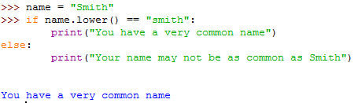
else uses the same rules as if:
terminate with colon
use indentation for block

Slide 99
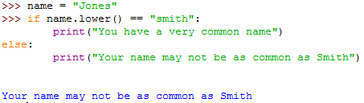

Slide 100
Multiple Paths Using an elif Chain
If we have multiple expressions to evaluate, use elif:
if boolean_expression:
statements…
elif boolean_expression2:
statements…
elif boolean_expression3:
statements…
else: # not required, but use if necessary
statements…

Slide 101
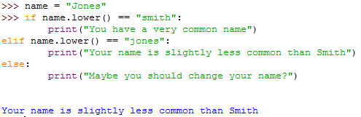

Slide 102
#!/usr/bin/env python3
# discount calculator
invoice_total = 375.79
if invoice_total >= 500.0:
discount = .2
elif invoice_total >= 250.0:
discount = .1
elif invoice_total >= 100.0:
discount = 0.05
else:
discount = 0.0
print("discount =", str(discount))
Watch the order!
What would happen if
invoice_total >= 100.0 was evaluated first?

Slide 103
Nested IF Statements
We sometimes need to make a secondary decision within a primary one. We can use a nested if for this:
if a customer chose an apple
if they chose a Red Delicious
show Red Delicious price
else if they chose a Granny Smith
show Granny Smith price
else if they chose a McIntosh
show McIntosh price
else if a customer chose an orange
if they chose a Valencia
show Valencia price
else if they chose a Maltese
show Maltese price

Slide 104
#!/usr/bin/env python3
# nested-if.py
#
fruit = "apple"
appleType = "McIntosh"
orangeType = "Unknown"
#
if fruit == "apple":
if appleType == "Red Delicious":
print("price is $1.49")
elif appleType == "Granny Smith":
print("price is $1.79")
elif appleType == "McIntosh":
print("price is $2.11")
else:
print("unknown apple type")
elif fruit == "orange":
if orangeType == "Valencia":
print("price is $1.19")
elif orangeType == "Maltese":
print("price is $1.29")
else:
print("unknown orange type")
else:
print("unknown fruit type")

Slide 105
Write a program which applies customer discounts based on a customer type code and the total sales (invoice) amount
Type code | Invoice total | Discount percentage
r (retail) | < 100 | 0
 | >= 100 and < 250 | 0.1
 | >= 250 | 0.2
w (wholesale) | < 500 | 0.4
 | >= 500 | 0.5
customer_type = "w"
invoice_total = 125
…
Total cost with discount is 75.0

Slide 106
#!/usr/bin/env python3
# nested-if-discounts.py
#
customer_type = "w"
invoice_total = 125
if customer_type.lower() == "r":
if invoice_total < 100:
discount_percent = 0
elif invoice_total >= 100 and invoice_total < 250:
discount_percent = .1
elif invoice_total >= 250:
discount_percent = .2
elif customer_type.lower() == "w":
if invoice_total < 500:
discount_percent = .4
elif invoice_total >= 500:
discount_percent = .5
else:
discount_percent = 0
print("Total cost with discount is " +
str(invoice_total - (invoice_total * discount_percent)))

Slide 107
To Nest Your Ifs … or Not …
# determine the discounts for Retail customers
if customer_type.lower() == "r" and invoice_total < 100:
discount_percent = 0
elif customer_type.lower() == "r" and (
invoice_total >= 100 and invoice_total < 250):
discount_percent = .1
elif customer_type.lower() == "r" and invoice_total >= 250:
discount_percent = .2
# determine the discounts for Wholesale customers
elif customer_type.lower() == "w" and invoice_total < 500:
discount_percent = .4
elif customer_type.lower() == "w" and invoice_total >= 500:
discount_percent = .5
# all other customers
else:
discount_percent = 0
This code gives the same results, without using nested If statements.
Which approach is preferable?

Slide 108
# determine the discounts for Retail customers
if customer_type.lower() == "r" and invoice_total < 100:
discount_percent = 0
elif customer_type.lower() == "r" and (
invoice_total >= 100 and invoice_total < 250):
discount_percent = .1
elif customer_type.lower() == "r" and invoice_total >= 250:
discount_percent = .2
# determine the discounts for Wholesale customers
elif customer_type.lower() == "w" and invoice_total < 500:
discount_percent = .4
elif customer_type.lower() == "w" and invoice_total >= 500:
discount_percent = .5
# all other customers
else:
discount_percent = 0
Note the duplicated checks for customer type.
This code is harder to maintain; if we needed to change to something other than “r”, what if we miss one of the “r” literals in the elif statements?

Slide 109
Coding Style for Selection Statements
PEP-8 recommends a single space around comparison operators
if age < 4:
is preferable to
if age<4:
if x == y and y <= 10:
is preferable to
if x==y and y<=10:

Slide 110
Loops: The while Loop
A loop is an iteration structure
Lines of code are executed repeatedly until a condition is met
# loop until counter == 5
counter = 0
while counter < 5:
print(counter, end=" ")
counter += 1
print("\nThe loop has ended.")
0 1 2 3 4
The loop has ended.

Slide 111
While Loops and Sentinel Values
The while loop is a pre-test loop, which means the condition is evaluated before the loop statements are executed
A post-test loop, e.g. a "do-while" loop evaluates the condition after the loop statements are executed, but Python doesn't support do-while
A sentinel value is used in a loop to indicate a termination condition
Sentinel values should be assigned so they are not interpreted as valid data
Identify the sentinel values in the following examples:
print("Please enter a positive integer or 0 to exit: ")
print("Please enter a name or "x" to exit: ")
print("Continue? (y or n): ")

Slide 112
While Loops and Sentinel Values (cont)
choice = "y" # "seed" the loop for initial entry
while choice.lower() != "n":
print("Hello!")
choice = input("Say Hello again? (y/n): ")
print("Bye!")
Hello!
Say Hello again? (y/n): y
Hello!
Say Hello again? (y/n): Y
Hello!
Say Hello again? (y/n): n
Bye!

Slide 113
Infinite Loops
If a loop condition is never met, a loop can run “forever”
This is known as an infinite loop
Infinite loops are frequently the result of programming errors
while True:
# any statements here will run forever

Slide 114
While Loops and Accumulators
An accumulator is a variable which "collects", or accumulates, values in a loop
Accumulators an be numeric (e.g. add or multiply values to a numeric accumulator) or string-based (concatenate to an accumulator string variable)
Always initialize the accumulator!
Never initialize an accumulator inside a loop where it is modified
When using an accumulator inside a nested loop, initialize the accumulator outside of the nested loop
When using a sentinel value, don't include the sentinel value when modifying the accumulator
total = 0 # initialize accumulator
while total < some_value:
// get input
//add input to accumulator variable

Slide 115
While Loops and Input Validation
While loops are well-suited for input validation
Number of iterations is unknown, loop until input is valid
Use logical expressions if number of iterations must be limited
input_val = "" # seed to an invalid value, either with
# an input operation or initialization
while is_not_valid(input_val):
input_val = input("Please enter some data: ")
if is_not_valid(input_val):
print("Invalid value, please try again.")
# if we get here the input value must be valid

Slide 116
While Loops, Accumulators, and Input Validation
# loop and add to accumulator until total >= MAX
total = 0 # accumulator variable
MAX = 20
while total < MAX:
num = input("Please enter a number less than " + str(MAX) + ": ")
num = int(num)
# validate the input
while num >= MAX:
print("That number is too large.")
num = int(input("Enter a number less than " + str(MAX) + ": "))
total += num # add to accumulator _after_ validation
if total >= MAX:
print("Your total is ", total)
print("You have reached or exceeded the maximum value of", MAX)

Slide 117
The for Loop
A for loop runs once for each value in a collection
The range() function produces a collection of integers
for number in range(5):
print(number, end=" ")
print("\nThe loop has ended.")
The for loop in Python is also known as a collection-controlled loop (also known as a "count-controlled loop")
The colon : is required
Indentation of the loop body is required
Give the temporary variable a meaningful name (e.g. "number")
0 1 2 3 4
The loop has ended.

Slide 118
An optional stop value can be included in the range function
range(start, stop)
The for loop will iterate from the start value to, but not including, the stop value
for number in range(1, 12):
print(number, end=" ")
print("\nThe loop has ended.")
1 2 3 4 5 6 7 8 9 10 11
The loop has ended.

Slide 119
An optional step value can also be included in the range function (but this requires start and stop)
range(start, stop, step)
The step value specifies an increment for each loop iteration
for number in range(2, 12, 3):
print(number, end=" ")
print("\nThe loop has ended.")
2 5 8 11
The loop has ended.

Slide 120
Write a program which uses a for loop to calculate the sum of the values 1 through 5 and prints the final sum
The sum of 1 to 5 is 15

Slide 121
#!/usr/bin/env python3
# sum.py
#
sum_nums = 0 # accumulator
for number in range(1, 6) # range requires 6 to include 5
sum_nums = sum_nums + number
print("The sum of 1 to 5 is " + str(sum_nums))
print statement is not indented, not part of the loop body
The sum of 1 to 5 is 15

Slide 122
Nested Loops
While loops can be nested (and for loops inside of while loops, and while loops inside of for loops…)
total_score = 0
for i in range(3):
while True:
score = int(input("Enter test score: "))
if score >= 0 and score <= 100:
total_score += score
break
else:
print("Test score must be from 0 - 100.")
print("Total score:", total_score)
Enter test score: 90
Enter test score: 85
Enter test score: 73
Total score: 248

Slide 123
The break Statement
The break statement breaks out of a loop by causing execution to jump to the statement following the loop
while True:
data = input("Enter a number to square, 'exit' when done: ")
if data == "exit":
break # while True
i = int(data)
print(i, "squared is", i * i)
print("Exiting")
Enter a number to square, 'exit' when done: 1
1 squared is 1
Enter a number to square, 'exit' when done: 2
2 squared is 4
Enter a number to square, 'exit' when done: 3
3 squared is 9
Enter a number to square, 'exit' when done: 4
4 squared is 16
Enter a number to square, 'exit' when done: exit
Exiting

Slide 124
The continue Statement
The continue statement causes execution to jump to the top of the loop (causing the condition to be reevaluated)
more = "y"
while more.lower() == "y":
miles_driven = float(input("Enter miles driven: "))
gallons_used = float(input("Enter gallons of gas used: "))
# validate input
if miles_driven <= 0 or gallons_used <= 0:
print("Both entries must be greater than zero. Try again.")
continue # while more.lower() == "y":
mpg = round(miles_driven / gallons_used, 2)
print("Miles Per Gallon:", mpg)
more = input("Continue? (y/n): ")
print()
print("Okay, bye!")
Enter miles driven: 500
Enter gallons of gas used: 23
Miles Per Gallon: 21.74
Continue? (y/n): y
Enter miles driven: 400
Enter gallons of gas used: -2
Both entries must be greater than zero. Try again.
Enter miles driven: 400
Enter gallons of gas used: 18
Miles Per Gallon: 22.22
Continue? (y/n): n
Okay, bye!

Slide 125
Use Break and Continue With Discretion
break and continue are acceptable if not over-used
writing clean and efficient (short and to the point) loops is critical
long, complex loops are difficult to read and maintain
break and continue exacerbate problems here
break and continue apply to the inner-most loop when nested loops are used
It is always helpful to add a comment indicating which loop you are breaking

Slide 126
An else for a Loop
While loops and for loops support an else statement associated with the loop
for loop behavior: the else statement is executed when the loop has exhausted the iteration values
while loop behavior: the else statement is executed when the while condition becomes false
An else verifies that the loop has completed its iteration, i.e. the loop did not end prematurely
counter = 1
while counter <= 5:
print("counter is", counter)
counter = counter + 1
else:
print("counter reached maximum value")
counter is 1
counter is 2
counter is 3
counter is 4
counter is 5
counter reached maximum value
counter = 1
while counter <= 5:
print("counter is", counter)
counter = counter + 1
if counter == 3:
break
else:
print("counter reached maximum value")
counter is 1
counter is 2

