Slide 1
Scripting for Network Professionals
National Convergence Technology Center
Working Connections Five Fridays
February 9, 2023
Professors Pamela Brauda & David Singletary
Florida State College at Jacksonville

Slide 2
Hands-on Labs
Day 2

Slide 3
Lists Programming Assignment
Use three separate lists to hold the symbols, names, and values of at least five cryptocurrencies (see the expected output below).
Create an empty list to hold the names of the currency purchased. Use a variable to accumulate the total value of the purchase.
Display a content of the three lists as a text-based menu. Prompt the user to enter a currency symbol from the list. Display the Name of the currency in a response message to the user that they have purchased one unit of Currency.
Add the value of the currency to the accumulator variable.
Continue to prompt and input the user's choice until they enter an 'x' to exit.
Your program must validate the input; if an invalid symbol is entered, display an error message and redisplay the menu.
Sample output on next slide:
(currency types and values obtained from www.bankrate.com/investing/types-of-cryptocurrency, feel free to change and customize for your own preferences).

Slide 4
Currently Available Currencies Symbol Name Value BTC Bitcoin $44340.0 ETH Ethereum $3224.0 USDT Tether $1.0 BNB Binance Coin $424.51 USDC USD Coin $1.0 ADA Cardano $1.2 SOL Solana $114.18 Please enter your choice (symbol), or x to exit: btc You have purchased one unit of Bitcoin BTC Bitcoin $44340.0 ETH Ethereum $3224.0 USDT Tether $1.0 BNB Binance Coin $424.51 USDC USD Coin $1.0 ADA Cardano $1.2 SOL Solana $114.18 Please enter your choice (symbol), or x to exit: sol You have purchased one unit of Solana

Slide 5
BTC Bitcoin $44340.0 ETH Ethereum $3224.0 USDT Tether $1.0 BNB Binance Coin $424.51 USDC USD Coin $1.0 ADA Cardano $1.2 SOL Solana $114.18 Please enter your choice (symbol), or x to exit: sdl Sorry, that is not a valid symbol BTC Bitcoin $44340.0 ETH Ethereum $3224.0 USDT Tether $1.0 BNB Binance Coin $424.51 USDC USD Coin $1.0 ADA Cardano $1.2 SOL Solana $114.18 Please enter your choice (symbol), or x to exit: x Here are your purchased coins: ['Bitcoin', 'Solana'] The total value of your purchases is $44454.18

Slide 6
#!/usr/bin/env python3
# cryptos.py # 6/20/22 # menu-driven crypto purchases
# prompt constants PROMPT = "Please enter your choice (symbol), or x to exit: " SORRY = "Sorry, that is not a valid symbol"
# currency lists # https://www.bankrate.com/investing/types-of-cryptocurrency/ SYMBOLS = ['BTC', 'ETH', 'USDT', 'BNB', 'USDC', 'ADA', 'SOL'] NAMES = ['Bitcoin', 'Ethereum', 'Tether', 'Binance Coin', 'USD Coin', 'Cardano', 'Solana'] VALUES = [44340, 3224, 1, 424.51, 1, 1.2, 114.18] purchased = []
# accumulator variable totalValue= 0
# quitnow flag will be True when the exit option is chosen quitNow = False
# how many are available numCurrs = len(SYMBOLS)

Slide 7
print("Currently Available Currencies\n")
while not quitNow: # show the menu, start with a header print('{:12} {:12} {:>12}'.format('Symbol', 'Name', 'Value')) for index in range(0, numCurrs): menuLine = '{:12} {:12} {:>12}'.format( SYMBOLS[index], NAMES[index], '$' + str(float(VALUES[index]))) print(menuLine) # get the choice, if exiting set the quitNow flag choice = input(PROMPT).upper() if (choice == 'X'): quitNow = True # check for a valid symbol elif not choice in SYMBOLS: print(SORRY) # got one, add it to the purchased list and accumulator else: print("You have purchased one unit of", NAMES[SYMBOLS.index(choice)]) purchased.append(NAMES[SYMBOLS.index(choice)]) totalValue += VALUES[SYMBOLS.index(choice)] print() # blank line before next menu
print("Here are your purchased coins:") print(purchased) print("The total value of your purchases is $", round(totalValue,2), sep="")

Slide 8
Lab 4: Functions
Write a modular Python program which creates a list of customers identified by first name, last name, and phone number. The program should contain the following functions:
a main function with an associated top level scope check
a function which generates the customer data and returns it to the main function
Sample output:
Here are the customers: Galadriel Amakir 555-1212 Elrond Amaadon 556-1313 Lúthien Amastacia 557-1414 Fingolfin Amamion 557-1515

Slide 9
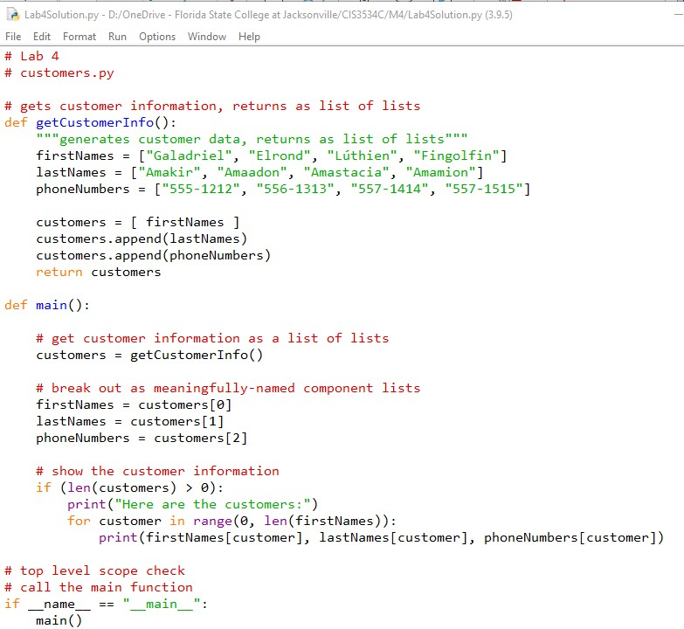
Using this help file, type the solution and add your name to the customer list.

Slide 10
Programming Assignment 4: Dictionaries and Lists
Using the information from Table 1: GPA 4 Routers and Switches Download Table 1: GPA 4 Routers and Switches, create a dictionary of routers and a separate dictionary of switches.
You will need to create another empty dictionary that will contain all the updated devices (device name, new ip address).
Create two accumulator variables to keep track of the number of valid updates and the number of invalid addresses. Create an empty list to record invalid IP addresses entered by the user, just the address, not the device.
router1 | 10.10.10.1 | switch1 | 10.10.10.2
 |  | switch2 | 10.10.10.3
 |  | switch3 | 10.10.10.4
 |  | switch4 | 10.10.10.5
router2 | 20.20.20.1 | switch5 | 20.20.20.2
 |  | switch6 | 20.20.20.3
router3 | 30.30.30.1 | switch7 | 30.30.30.2
 |  | switch8 | 30.30.30.3
 |  | switch9 | 30.30.30.4

Slide 11
This is how your program should flow:
Display the routers and switches as shown, below.
Prompt the user for a device to update.
Use a while loop to validate the IP address is a valid address; all the octets are between 0 and 255. See the HINT for code examples.
If it is not valid, increment the counter, keeping track of the number of invalid IP addresses entered, and append the invalid address to the invalidIPAddress list.
If the IP address is valid, update the IP address for the device in the dictionary and display a message to the user that the device was updated and to what, as shown below. Add the device and new IP address to a dictionary to keep track of updates. Increment the counter, keeping track of the number of valid updates.
Display the number of updates, the dictionary of updates, the number of invalid IPs, the list of invalid IP addresses, and the updated routers and switches dictionaries.
Please make your output look like the expected output, no extra prompts, questions, inputs, or outputs.

Slide 12
Hint: A code example for validating the IP address
#validate IP address while not validIP: ipAddress = input("What is the new IP address(111.111.111.111)?") octets = ipAddress.split('.') for byte in octets: byte = int(byte) if byte < 0 or byte > 255: #put your code here to add one to the invalid IP counter #put your code here to append the ipAddress to the invalid IP Addresses list print("Sorry, that is not a valid IP Address\n") break #breaks out of for loop else: #executes after for loop is done, meaning no errors found validIP = True

Slide 13
Programming Assignment 4: Expected Output
Network Equipment Inventory equipment name IP address router1 10.10.10.1 router2 20.20.20.1 router3 30.30.30.1 switch1 10.10.10.2 switch2 10.10.10.3 switch3 10.10.10.4 switch4 10.10.10.5 switch5 20.20.20.2 switch6 20.20.20.3 switch7 30.30.30.2 switch8 30.30.30.3 switch9 30.30.30.4 Which device would you like to update (enter x to quit)? switch3 What is the new IP address (111.111.111.111) 10.10.300.4 Sorry, that is not a valid IP address What is the new IP address (111.111.111.111) 10.10.30.4 switch3 was updated; the new IP address is 10.10.30.4 Which device would you like to update (enter x to quit)? router4 What is the new IP address (111.111.111.111) 400.400.4 Sorry, that is not a valid IP address What is the new IP address (111.111.111.111) 40.40.40.1 router4 was updated; the new IP address is 40.40.40.1

Slide 14
Expected Output cont.
Which device would you like to update (enter x to quit)? x Summary: Number of devices updated: 2 Updated equipment {'switch3': '10.10.30.4', 'router4': '40.40.40.1'} Number of invalid addresses attempted: 2 List of invalid addresses: ['10.10.300.4', '400.400.4'] The updated router dictionary: {'router1': '10.10.10.1', 'router2': '20.20.20.1', 'router3': '30.30.30.1', 'router4': '40.40.40.1'} The updated switches dictionary: {'switch1': '10.10.10.2', 'switch2': '10.10.10.3', 'switch3': '10.10.30.4', 'switch4': '10.10.10.5', 'switch5': '20.20.20.2', 'switch6': '20.20.20.3',
'switch7': '30.30.30.2', 'switch8': '30.30.30.3', 'switch9': '30.30.30.4'}

Slide 15
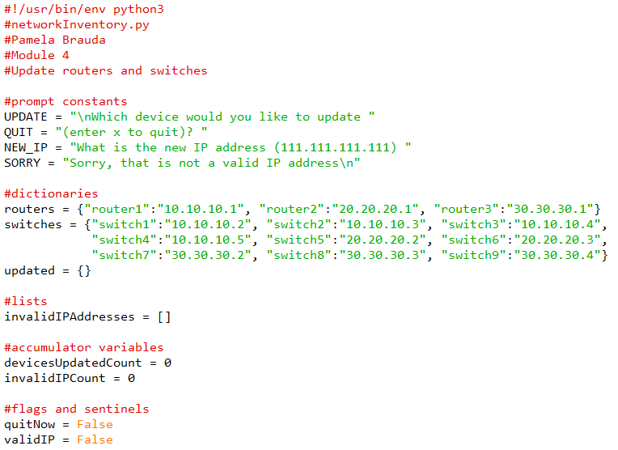
Programming Assignment 4 Solution

Slide 16
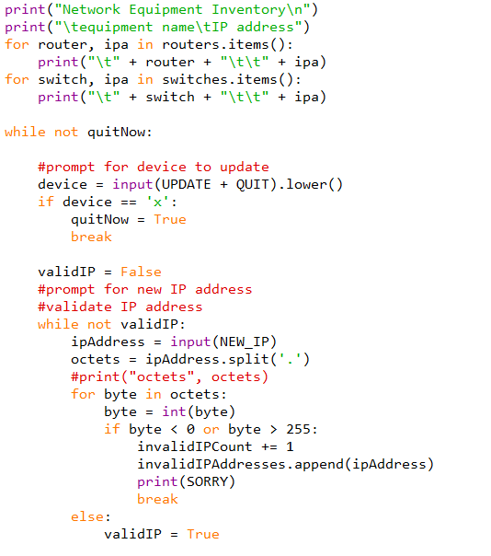
Programming Assignment 4 Solution cont.

Slide 17
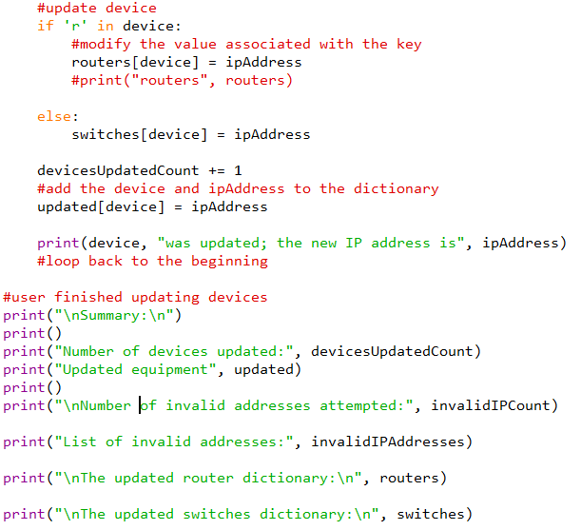
Programming Assignment 4 Solution cont.

