Slide 1
Scripting for Network Professionals
National Convergence Technology Center
Working Connections Five Fridays
March 3, 2023
Professors Pamela Brauda & David Singletary
Florida State College at Jacksonville

Slide 2
Application Programming Interfaces (APIs)
Python Crash Course: Chapter 17 -- Working with APIs
Mastering Python Networking: Chapter 3 -- APIs and Intent-Driven Networking

Slide 3
Objectives
Identify and describe an application programming interface (API).
Identify and list the components of a Representational State Transfer (REST) API.
Create a Python virtual environment.
Install Python packages.
Use pip freeze to create a list of installed modules to recreate a configuration in a new virtual environment.

Slide 4
APIs
Application Programming Interfaces (APIs) are frequently provided that allow data to be accessed programmatically in various formats
APIs can be accessed through Uniform Resource Locators (URLs), using a programming language with associated software libraries (Java, Python, JavaScript, R, etc), or using an application which has embedded the API in its feature set (e.g. Excel and PowerQuery)
Data is retrieved in a payload which packages the data in a standard format, usually either JSON (JavaScript Object Notation) or XML (Extensible Markup Language)

Slide 5
REST Web Service APIs
There are various types of APIs available; one of the most commonly used API architectures for web applications is REST ("Representational State Transfer") which uses common HTTP web operations to obtain data
REST API requests consist of the following components:
URI (Uniform Resource Identifier) (aka URL)
HTTP Method (e.g. GET, POST)
Header
Body
Client
Request (HTTP)
API Server
Response (HTTP)

Slide 6
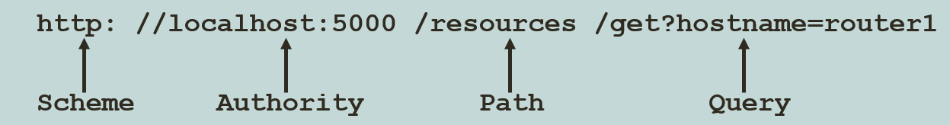
REST API Requests
The URI identifies which resource the client wants to access.
URI components are:
Scheme: the HTTP protocol (http or https)
Authority: host and port
Path: resource location on the server
Query: additional details for scope, clarity, or filtering

Slide 7
REST API Responses
HTTP status codes are used to determine the success or failure of requests
1xx – Informational
2xx – Success
3xx – Redirect
4xx – Client Error
5xx – Server Error

Slide 8
REST API Authentication
REST APIs can require authentication to access data in order to prevent exposure of sensitive information or to prevent malicious behavior
Authentication proves the client's identity
Basic authentication: credentials are transmitted as username/password pairs
Bearer authentication: uses a bearer token, a string generated by an identity service
API Key: a unique alphanumeric string generated by a server and assigned to a user
Authorization determines the client's level of access

Slide 9
Flask and Flask_API
Flask is a "micro web framework" written in Python
Here's an example of a simple Flask application:
from flask import Flask
app = Flask(__name__)
@app.route("/")
def hello_world():
return "<p>Hello, World!</p>"
The @app.route() decorator tells Flask what URL should "trigger" the hello_world function
Flask_API is an add-on module which provides API access to Flask

Slide 10
The Python requests Module
The requests module allows you to send client-side HTTP requests using Python
Requests can be sent as HTTP GET or POST requests
GET requests include parameters appended in the URL, e.g.
response = requests.get('http://localhost:5000/get?hostname=router1')
POST requests include parameters in the message body, e.g.
api_url = 'http://127.0.0.1:5000/set'
pload = {'token':token,
'hostname':'router1',
'attribute': 'ipaddr',
'value':'127.10.10.1'}
r = requests.post(api_url,data = pload)
Requests return a Response Object containing the response data

Slide 11
Python Virtual Environments
Python 3 provides a virtual environment feature which allows a non-admin user to control their configuration without installing modules in obscure locations (e.g. a "roaming" folder)
The venv module is included in the standard Python library on Windows (it has to be installed on the Linux version)
C:\>cd \Users\<userid>\Documents
C:\Users\<userid>\Documents>python -m venv myenv
This creates a local folder named "myenv" which is used to store configuration information and packages as they are installed

Slide 12
Python Virtual Environments
The virtual environment must be activated after creating it by calling the activate script:
C:\Users\<userid>\Documents>myenv\scripts\activate
(myenv) C:\Users\<userid>\Documents>
When you are done with the virtual environment, deactivate it by calling the deactivate script:
(myenv) C:\Users\<userid>\Documents>myenv\Scripts\deactivate

Slide 13
Python Virtual Environments
The (myenv) prompt prefix indicates the virtual environment is active
We can activate the environment in multiple windows
Other resources can be modified without activating the environment
Use pip to list the installed packages (by default you will get pip and setuptools)
(myenv) C:\Users\<userid>\Documents>pip list
Package Version
---------- -------
pip 20.2.3
setuptools 49.2.1
WARNING: You are using pip version 20.2.3; however, version 22.3.1 is available.

Slide 14
Python Virtual Environments
We can update pip (and install/update any other package) in the virtual environment without touching the system installation
(myenv) C:\Users\<userid>\Documents>python -m pip install --upgrade pip
Collecting pip
Downloading pip-22.3.1-py3-none-any.whl (2.1 MB)
Installing collected packages: pip
...
Successfully installed pip-22.3.1
(myenv) C:\Users\<userid>\Documents>pip list Package Version ---------- ------- pip 22.3.1 setuptools 49.2.1

Slide 15
Installing Required Packages
Now we can install the necessary packages in the virtual environment to run Flask
(myenv) C:\Users\<userid>\Documents>pip install flask
Collecting flask
Downloading Flask-2.2.2-py3-none-any.whl (101 kB)
(myenv) C:\Users\<userid>\Documents>pip install flask_api
Collecting flask_api
Downloading Flask_API-3.0.post1-py3-none-any.whl (139 kB)
(myenv) C:\Users\<userid>\Documents>pip install requests
Collecting requests
Downloading requests-2.28.1-py3-none-any.whl (62 kB)

Slide 16
Installing Required Packages
Run pip list again to verify (you will also see the dependencies that were installed):
(myenv) C:\Users\<userid>\Documents>pip list
Package Version
------------------ ---------
certifi 2022.9.24
charset-normalizer 2.1.1
click 8.1.3
colorama 0.4.6
Flask 2.2.2
Flask-API 3.0.post1
idna 3.4
importlib-metadata 5.0.0
itsdangerous 2.1.2
Jinja2 3.1.2
MarkupSafe 2.1.1
pip 22.3.1
requests 2.28.1
setuptools 49.2.1
urllib3 1.26.12
Werkzeug 2.2.2
zipp 3.10.0

Slide 17
pip freeze
pip freeze also lists installed modules
(myenv) C:\Users\<userid>\Documents>pip freeze
certifi==2022.9.24
charset-normalizer==2.1.1
click==8.1.3
colorama==0.4.6
Flask==2.2.2
Flask-API==3.0.post1
idna==3.4
importlib-metadata==5.0.0
itsdangerous==2.1.2
Jinja2==3.1.2
MarkupSafe==2.1.1
requests==2.28.1
urllib3==1.26.12
Werkzeug==2.2.2
zipp==3.10.0

Slide 18
pip freeze
pip freeze can be used to create a list of installed modules to recreate the configuration in a new virtual environment
Record the current venv and deactivate:
(myenv) C:\Users\<userid>\Documents>pip freeze >requirements.txt
(myenv) C:\Users\<userid>\Documents>myenv\Scripts\deactivate
Create a new venv and install packages from saved list
C:\Users\<userid>\Downloads>python -m venv newenv
C:\Users\<userid>\Documents>newenv\Scripts\activate
(newenv) C:\Users\<userid>\Documents> pip install -r requirements.txt

Slide 19
pip freeze
Run pip freeze in the new environment to verify
(newenv) C:\Users\<userid>\Documents>pip freeze
...
Flask==2.2.2
Flask-API==3.0.post1
...
requests==2.28.1
...
WARNING: You are using pip version 20.2.3; however, version 22.3.1 is available.
(notice that pip does not install the newer version from the original environment, it must be updated separately)

Slide 20
Lab for Using APIs to Manipulate a Network Device

Slide 21
Automation with Ansible
Mastering Python Networking:
Chapter 4: The Python Automation Framework -- Ansible Basics

Slide 22
Objectives
Describe the benefits of automation in networking.
Install Ansible in a Python virtual environment.
Create Ansible Inventory and Playbook files using Yet Another Markup Language (YAML).
Using a simulation, run the Ansible Playbooks to update network equipment.

Slide 23
Automation
Automation uses code to configure, deploy, and manage applications with the compute, storage, and network infrastructures on which they run.
Automation tools include Ansible, Puppet, and Chef.
Platforms can integrate with these tools or provide direct API access to the infrastructure.
Enterprises compete and control costs by operating quickly and being able to scale operations.
Speed and agility enable a business to explore, experiment, and exploit opportunities ahead of their competition.
Scaling operations lets a business capture market share efficiently and match capacity to demand.
Developers need to accelerate every phase of software building: coding and iterating, testing, and staging.
DevOps (Development + IT Operations) practices require developers to deploy and manage apps in production, which are enhanced by automation.

Slide 24
More Benefits of Automation
Automation offers speed, repeatability, and the ability to work at scale, with reduced risk.
Automation using software-defined infrastructure (cloud computing) lets developers and operators use software to requisition, configure, deploy, and manage bare-metal and virtualized resources.
Automation allows large-scale enterprises to manage heavy and variable loads of traffic, computation, and storage.

Slide 25
Categories of Automation
Information gathering: answers basic questions such as "What changed?"
Using GET requests for read-only data collection minimizes the risk of breaking a network environment minimize risk of causing a change that could break your network environment and supports auditing configurations.
Policy activation: safely enables users to provision their own network updates.
Automating on-boarding workflows and day-to-day configuration management.
CI/CD (Continuous Integration/Continuous Deployment: for complex automation tasks,
monitor and proactively manage users and devices while also gaining insights with telemetry data.

Slide 26
Ansible
Ansible is one of the most popular automation solutions.
It is available as open source.
Ansible's basic architecture is very simple and lightweight.
Ansible's control node runs on Linux using Python 3
All system updates are performed on the control node.
The control node connects to managed resources over SSH. Through this connection, Ansible can:
Run shell commands on a remote server, or transact with a remote router, or other network entity, via its REST interface.
Inject Python scripts into targets and remove them after they run.
Install Python on target machines if required.
Plugins enable Ansible to gather facts from and perform operations on infrastructure that cannot run Python locally, such as cloud provider REST interfaces.
Ansible is primarily managed from the Bash command line, with automation code developed and maintained using any standard text editor.

Slide 27
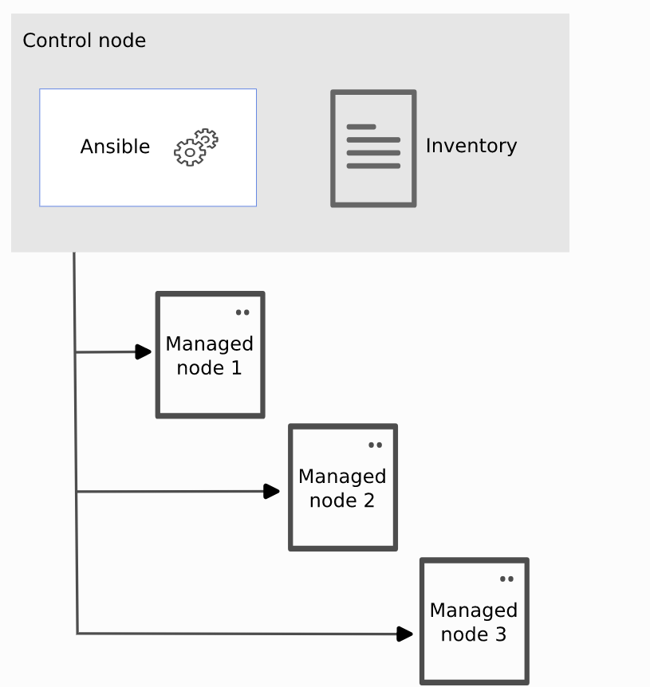
Ansible Architecture
https://docs.ansible.com/ansible-core/devel/getting_started

Slide 28
Installing Ansible
Ansible is installed using pip
Ansible Core is a "no-frills" version of ansible which provides significantly fewer Ansible plugins and modules than the full-featured Ansible Engine (Ansible Engine contains around 3,387 modules compared to Ansible Core which contains approximately 127 modules)
Ansible Core is primarily for developers and users who want to install only the collections they need
We can install ansible (or ansible-core) using a Python virtual environment (venv)
venv provides independence and flexibility vs. using a system-wide Python configuration

Slide 29
Installing Ansible
We can install ansible (or ansible-core) using a Python virtual environment (venv)
venv provides independence and flexibility vs. using a system-wide Python configuration
Ansible is not supported in Windows, so we need to run on a Linux system (e.g. Ubuntu)
Create a work folder in the user's home directory and make that the current folder
mkdir work
cd work

Slide 30
Installing Ansible
On Ubuntu v22, Python 3.10 is the default Python version; we have to install the virtual environment package before we can use the feature
/home/user/work% sudo apt install python3.10-venv
Create the virtual environment in the working folder
/home/user/work% python3 –m venv env
Activate the environment
/home/user/work% source env/bin/activate
(env) /home/user/work%
Any Python modules we install in the virtual environment are siloed and will not impact the system configuration
Install the ansible-core module in the virtual environment using pip
(env) /home/user/work% pip3 install ansible-core

Slide 31
Inventory and Playbook Files
At this point we can create an inventory file if desired, or proceed directly to creating a playbook file
The Ansible inventory file defines the hosts and groups of hosts upon which commands, modules, and tasks in a playbook operate
An Ansible playbook is a list of tasks that automatically executed either independently or against hosts in the inventory file
Ansible inventory files and playbooks are written in YAML
Originally YAML was "Yet Another Markup Language" (https://yaml.org/spec/history/2001-08-01.html) but it was later repurposed as a data-oriented language expanding to "YAML Ain't Markup Language" (a recursive acronym)

Slide 32
Playbook Files
Playbooks are divided into a list of plays that define the order in which Ansible performs operations, from top to bottom, to achieve an overall goal
A play is an ordered list of tasks that maps to managed nodes in an inventory
A task is a list of one or more modules that defines the operations that Ansible performs
A module is a unit of code or binary that Ansible runs on managed nodes
Ansible modules are grouped in collections with a Fully Qualified Collection Name (FQCN) for each module

Slide 33
Inventory Example: inventory.yaml
--- # three dashes = YAML
virtualmachines:
hosts:
vm01:
ansible_host: 192.0.2.50
vm02:
ansible_host: 192.0.2.51
vm03:
ansible_host: 192.0.2.52

Slide 34
Playbook Example: playbook.yaml
--- # three dashes = YAML
- name: My first play # name the play
hosts: virtualmachines # which hosts?
tasks: # list of tasks
- name: Ping my hosts # first module
ansible.builtin.ping:
- name: Print message # second module
ansible.builtin.debug:
msg: Hello world

Slide 35
Labs for Runing Playbooks with Ansible

