Slide 1
Constructing a Virtual Lab
Scripting for Network Professionals
Professor Brauda

Slide 2
VMware Workstation Pro (or Player)
We need to create a Linux environment for Ansible
Install VMware Workstation Pro (preferred) or Player (has limits)
You can download the software from WMWare and use it for free for 30 days.
https://www.vmware.com/products/workstation-pro.html

Slide 3
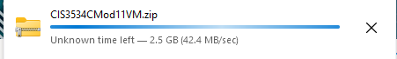

Download Ubuntu Image folder
You should be able to click on the link above or use the link in the email you should have received today.
OneDrive will zip up the folder
It’s pretty big! (It took about 5 minutes at school in our classroom)
Link to Ubuntu VM on Prof. Brauda's OneDrive

Slide 4
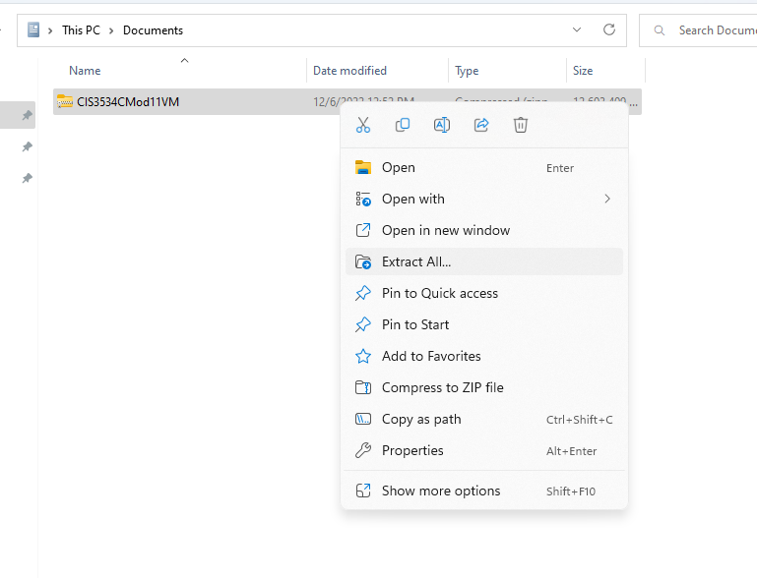
Move zip file and extract
My zipped file went to the downloads folder, so I moved it to the Documents folder – you can leave it there or move wherever you want
Right-click -> Extract All

Slide 5
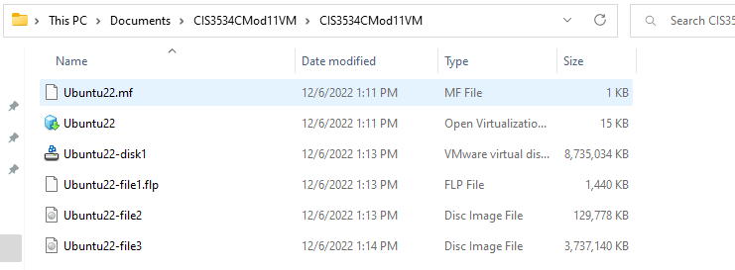
Files in the folder

Slide 6
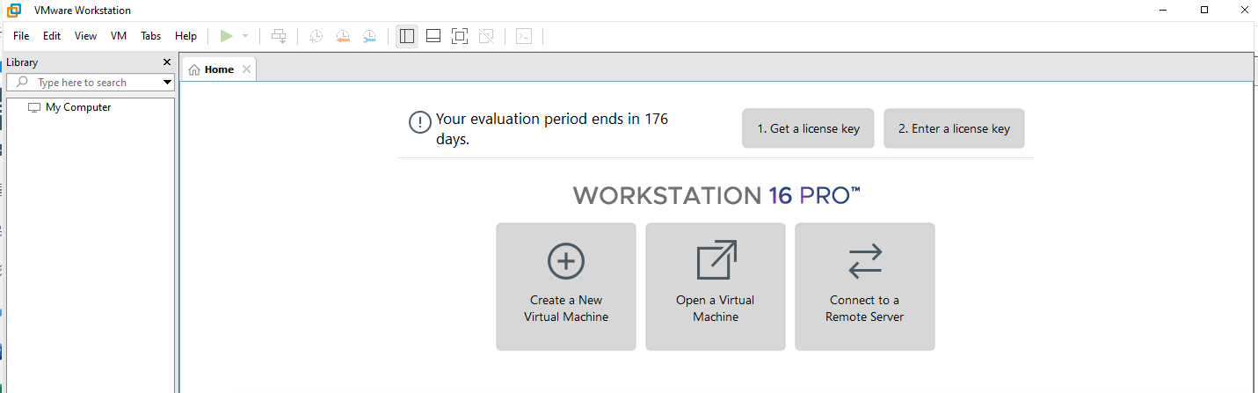
Open VMware Workstation Pro
VMmware Player should work
OPEN a Virtual Machine

Slide 7
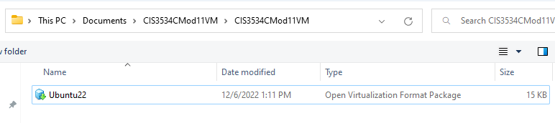
Click OPEN

Slide 8
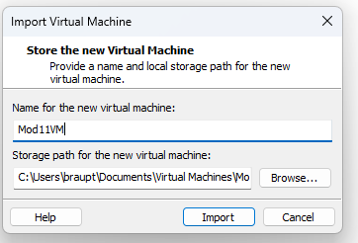
Name and Path
The name is whatever you want to call it, I used Mod11VM
I accepted the default path
Click Import

Slide 9
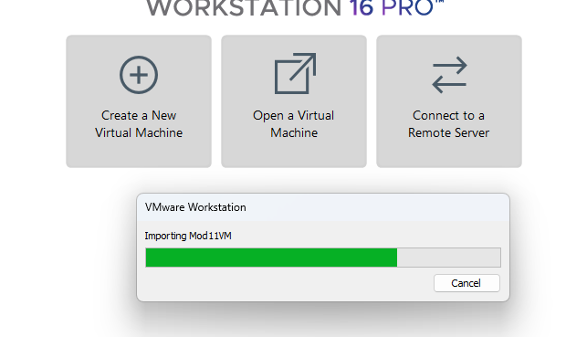
Import seems slow

Slide 10
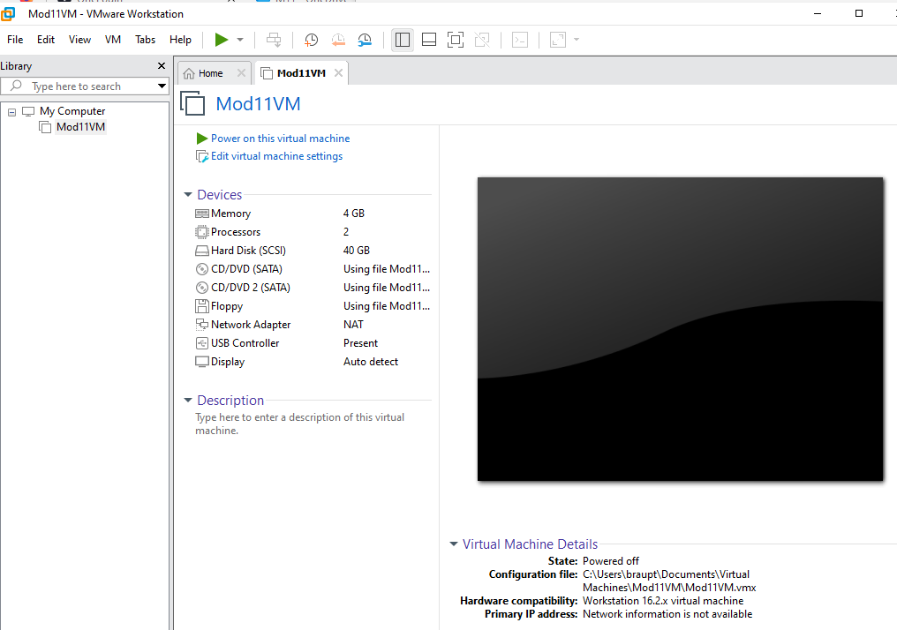
Click to start

Slide 11
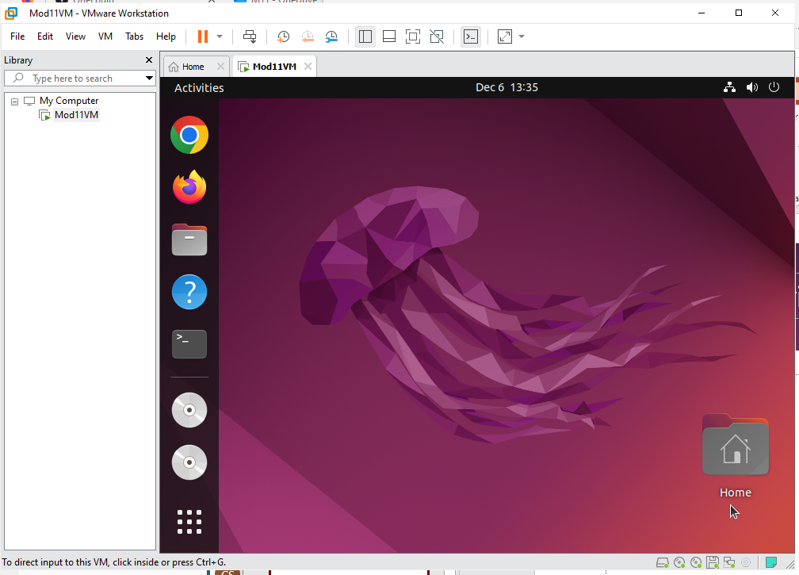
Ta da!

Slide 12
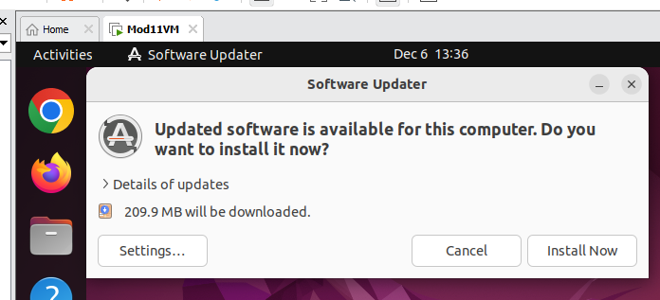
NO! Click Cancel
Make the screen as large as you can

Slide 13
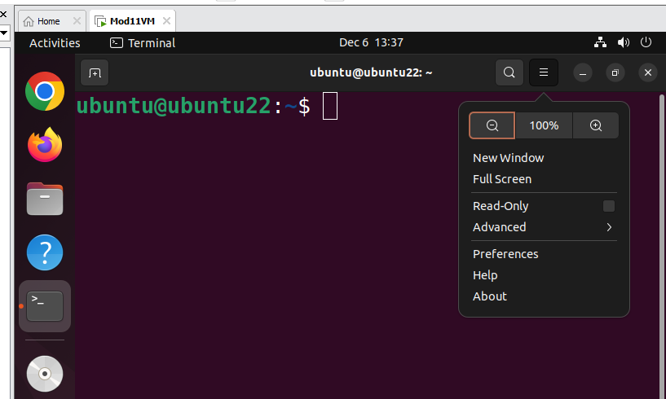
To change the font size
Click the hamburger icon, select Preferences

Slide 14
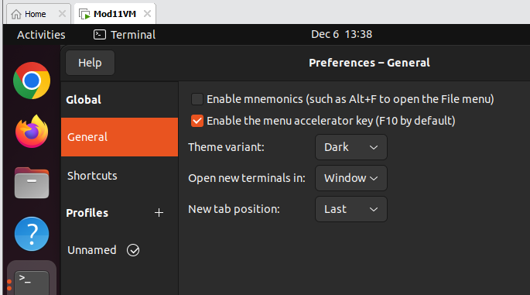
Click Unnamed at the end of the list

Slide 15
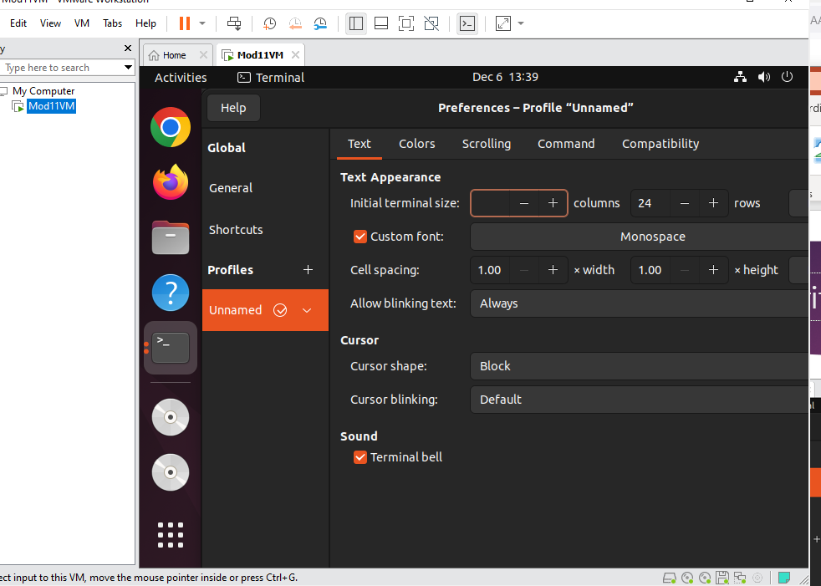
Click the custom font bar (Monospace)
Change the font size to your preference and click the green Select button.

