Slide 1
Scripting for Network Professionals
National Convergence Technology Center
Working Connections Five Fridays
March 3, 2023
Professors Pamela Brauda & David Singletary
Florida State College at Jacksonville

Slide 2
Hands-on Labs
Day 5

Slide 3
Python Virtual Environments
Python 3 provides a virtual environment feature which allows a non-admin user to control their configuration without installing modules in obscure locations (e.g. a "roaming" folder)
The venv module is included in the standard Python library on Windows (it has to be installed on the Linux version)
C:\>cd \Users\<userid>\Documents
C:\Users\<userid>\Documents>python -m venv myenv
This creates a local folder named "myenv" which is used to store configuration information and packages as they are installed

Slide 4
Python Virtual Environments
The virtual environment must be activated after creating it by calling the activate script:
C:\Users\<userid>\Documents>myenv\scripts\activate
(myenv) C:\Users\<userid>\Documents>
When you are done with the virtual environment, deactivate it by calling the deactivate script:
(myenv) C:\Users\<userid>\Documents>myenv\Scripts\deactivate

Slide 5
Python Virtual Environments
The (myenv) prompt prefix indicates the virtual environment is active
We can activate the environment in multiple windows
Other resources can be modified without activating the environment
Use pip to list the installed packages (by default you will get pip and setuptools)
(myenv) C:\Users\<userid>\Documents>pip list
Package Version
---------- -------
pip 20.2.3
setuptools 49.2.1
WARNING: You are using pip version 20.2.3; however, version 22.3.1 is available.

Slide 6
Python Virtual Environments
We can update pip (and install/update any other package) in the virtual environment without touching the system installation
(myenv) C:\Users\<userid>\Documents>python -m pip install --upgrade pip
Collecting pip
Downloading pip-22.3.1-py3-none-any.whl (2.1 MB)
Installing collected packages: pip
...
Successfully installed pip-22.3.1
(myenv) C:\Users\<userid>\Documents>pip list Package Version ---------- ------- pip 22.3.1 setuptools 49.2.1

Slide 7
Installing Required Packages
Now we can install the necessary packages in the virtual environment to run Flask
(myenv) C:\Users\<userid>\Documents>pip install flask
Collecting flask
Downloading Flask-2.2.2-py3-none-any.whl (101 kB)
(myenv) C:\Users\<userid>\Documents>pip install flask_api
Collecting flask_api
Downloading Flask_API-3.0.post1-py3-none-any.whl (139 kB)
(myenv) C:\Users\<userid>\Documents>pip install requests
Collecting requests
Downloading requests-2.28.1-py3-none-any.whl (62 kB)

Slide 8
Installing Required Packages
Run pip list again to verify (you will also see the dependencies that were installed):
(myenv) C:\Users\<userid>\Documents>pip list
Package Version
------------------ ---------
certifi 2022.9.24
charset-normalizer 2.1.1
click 8.1.3
colorama 0.4.6
Flask 2.2.2
Flask-API 3.0.post1
idna 3.4
importlib-metadata 5.0.0
itsdangerous 2.1.2
Jinja2 3.1.2
MarkupSafe 2.1.1
pip 22.3.1
requests 2.28.1
setuptools 49.2.1
urllib3 1.26.12
Werkzeug 2.2.2
zipp 3.10.0

Slide 9
pip freeze
pip freeze also lists installed modules
(myenv) C:\Users\<userid>\Documents>pip freeze
certifi==2022.9.24
charset-normalizer==2.1.1
click==8.1.3
colorama==0.4.6
Flask==2.2.2
Flask-API==3.0.post1
idna==3.4
importlib-metadata==5.0.0
itsdangerous==2.1.2
Jinja2==3.1.2
MarkupSafe==2.1.1
requests==2.28.1
urllib3==1.26.12
Werkzeug==2.2.2
zipp==3.10.0

Slide 10
pip freeze
pip freeze can be used to create a list of installed modules to recreate the configuration in a new virtual environment
Record the current venv and deactivate:
(myenv) C:\Users\<userid>\Documents>pip freeze >requirements.txt
(myenv) C:\Users\<userid>\Documents>myenv\Scripts\deactivate
Create a new venv and install packages from saved list
C:\Users\<userid>\Downloads>python -m venv newenv
C:\Users\<userid>\Documents>newenv\Scripts\activate
(newenv) C:\Users\<userid>\Documents> pip install -r requirements.txt

Slide 11
pip freeze
Run pip freeze in the new environment to verify
(newenv) C:\Users\<userid>\Documents>pip freeze
...
Flask==2.2.2
Flask-API==3.0.post1
...
requests==2.28.1
...
WARNING: You are using pip version 20.2.3; however, version 22.3.1 is available.
(notice that pip does not install the newer version from the original environment, it must be updated separately)

Slide 12
Create a Virtual Python Environment
Required:
A Windows system with a recent version of Python 3 installed (the Horizon system can be usedhere)
Internet access to github.com
Instructions:
Open a command tool window and navigate to your Documents folder (or any other folder where you have write permissions).
Use Python to create a virtual environment.
Activate the environment.
Use pip to install the Flask, Flask_API, and requests packages in the venv.

Slide 13
Use an API to Modify a Network Device
Use the GitHub repos provided by your instructor to clone the FishNet server and sample client applications to your folder. The FishNet server is a proxy Flask-based server which provides access to two simulated network devices: a router named router1 and a switch named switch1. Each device has the following attributes: a hostname, an IP address, a MAC address, and an nports attribute which indicates the number of ports available on the device. The sample client manipulates the router1 device.
Start the FishNet server from the command line by running "python FishNetServer.py".
Open a second command tool window and activate the venv created in step 2, above.
Open the client source code file with IDLE and examine the code. You will be modifying this code for the graded programming assignment in this module. Note the formatting of the API requests and the use of GET and POST for different requests.
Run the FishNet client from the second command tool's command line by running "python FishNet-SampleClient.py".
Observe the output of the client and server. As you execute your client, be sure to monitor the output of the FishNet server; if it crashes, you will need to restart it. Please report crash information(including stack trace(s) and the version number, displayed in the banner at the top of the application with it starts) to your instructor.

Slide 14
Modify Another Network Device
In this assignment we will modify the practice exercise's client program to access and manipulate a device in the FishNet simulated network environment.
Required
A Python 3.x virtual environment with the following packages installed:
Flask
Flask_api
requests
Internet access to github.com
Instructions
1. Create a virtual environment using Python
2. Use the GitHub repo provided by your instructor to clone the FishNet server and client applications to your local system.

Slide 15
Modify Another Network Device, cont.
Modify the client to access and manipulate the switch1 device instead of router1. There should be no references to router1 in your solution. Your modified client should perform the following tasks:
login
obtain a token
list the full device inventory
list the configuration of the switch1 device
modify the IP address of switch1
Verify the IP address was modified by obtaining the configuration of switch1 again and comparing the new IP address with the new address that was sent to the server.
Activate your virtual environment in two separate command tool windows.
Run the FishNet server from the command line.
Execute your modified client and observer the output. As you execute your client, be sure to monitor the output of the FishNet server; if it crashes, you will need to restart it. Please report crash information (including stack trace(s) and the version number, displayed in the banner at the top of the application with it starts) to your instructor.

Slide 16
Use Ansible to Modify a Network Device 1
In this lab we will use Ansible to run playbooks against the FishNet server application. As with the client program created in module 10, the playbooks will use APIs to access and manipulate the devices in the simulated network environment via the FishNet proxy.
Assignment Prerequisites
A VM Workstation Pro machine image will be provided by your instructor. This image contains an Ubuntu 22 image with Python 3.10 preinstalled.
Instructions:
Start the Ubuntu VM and log in as ubuntu (password ubuntu).
After logging in you will be in the ubuntu user's home folder.
Clone the Module 10 (CIS3534CMod10) and Module 11 (CIS3534CMod11) GitHub repositories provided by your instructor to the current folder.
Create a virtual environment:
ubuntu@ubuntu22:~$ python3 -m venv env

Slide 17
Use Ansible to Modify a Network Device 2
Open two terminal windows and activate the virtual environment in both:
ubuntu@ubuntu22:~$ source env/bin/activate
When activated, the terminal prompt will change to include (env) at the beginning, this is how you can tell you are in the virtual environment.
Use pip3 to install the following packages in the virtual environment:
ansible-core
Flask
Flask-API
requests
The CIS3534CMod10 folder contains the FishNet server; in one terminal window cd into that folder and start the server using python3
(env)ubuntu@ubuntu22:~$ python3 FishNetServer.py
In the second terminal window, cd into the CIS3534CMod11 folder and note the files contained in that folder:
(env)ubuntu@ubuntu22:~$ cd CIS3534CMod11
(env)ubuntu@ubuntu22:~$ ls -l

Slide 18
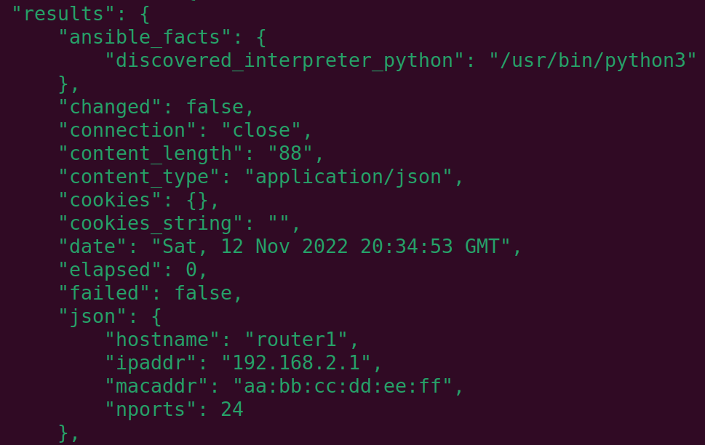
Use Ansible to Modify a Network Device 3
Execute the getipaddr.yaml Ansible playbook using the following command.
Be sure to include the -c local option, this will prevent ansible from attempting to use SSH.
(env)ubuntu@ubuntu22:~$ ansible-playbook -c local getipaddr.yaml
Note the current configuration of router1 as displayed by the playbook results, we will compare it to a modified configuration below.

Slide 19
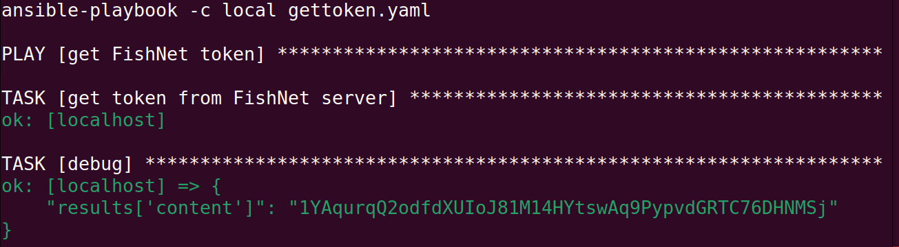
Use Ansible to Modify a Network Device 4
Execute the Ansible playbook gettoken.yaml using the ansible-playbook command. Again, be sure to include the -c local option.
(env) ubuntu@ubuntu22:~$ ansible-playbook -c local gettoken.yaml
Use the mouse to highlight, right-click and copy the token from the [debug] output as highlighted below:

Slide 20
Use Ansible to Modify a Network Device 5
Find the POST form body in the setipaddr.yaml file and replace the token in that file with your token (note that if your FishNetServer application restarts for any reason you will have to obtain a new token).
Execute the setipaddr.yaml playbook with the -c local option to modify the IP address of router1.
Execute the getipaddr.yaml playbook again to verify the new configuration.
After completing the assignment, Ctrl-C to exit the FishNet server application, then deactivate the virtual environment in both windows by typing deactivate.
(env) ubuntu@ubuntu22:~$ deactivate

