Slide 1
Scripting for Network Professionals
National Convergence Technology Center
Working Connections Five Fridays
February 17, 2023
Professors Pamela Brauda & David Singletary
Florida State College at Jacksonville

Slide 2
Objectives
Import an existing Python module into a program.
Create a Python module.
Import a user-defined module into a Python program.
Create a user-defined package with one or more modules.
Describe the installation of pip (preferred installer program).
Use pip to install a specific package.
Distinguish between characters and strings.
Describe the similarities and differences between strings and lists.
Use string and list methods in a Python program.
Write a Python program that utilizes try and except to handle errors and exceptions.

Slide 3
Modules & Packages

Slide 4
Modules
Large software applications are divided into parts so they are easier to understand, easier to maintain, and allow multiple developers to work on them
For example, a project could be divided into two main parts:
the user interface (for interaction with the user)
the business logic (for processing data and producing results)
Each of these parts can be divided into smaller ones; this is known as decomposition
Modules are used to divide a piece of software into separate but cooperating parts

Slide 5
Storing Functions in Modules
Storing functions in a separate file supports code reuse
Other programmers can share your functions without having to share the entire program
Import modules and functions allows you to use libraries of functions that other programmers have written

Slide 6
Modules in Python
A Python module is a file containing reusable code (which can include functions)
e.g. temperature.py is a Python module containing two functions and a main function to test them
The main function is only used to test the functions
The module is imported using the import statement
import temperature

Slide 7
# !/usr/bin/env python3
# temperature.py
# a module to be imported into another program.
def to_celsius(fahrenheit):
celsius = (fahrenheit - 32) * 5/9
return celsius
def to_fahrenheit(celsius):
fahrenheit = celsius * 9/5 + 32
return fahrenheit
# the main function is used to unit test the other functions
# this code isn't run if this module isn't the "main module"
def main():
for temp in range(0, 212, 40):
print(temp, "Fahrenheit =", round(to_celsius(temp), 2),
"Celsius")
for temp in range(0, 100, 20):
print(temp, "Celsius =", round(to_fahrenheit(temp), 2),
"Fahrenheit")
# if this module is the main module, call the main function
# to unit test the local functions
if __name__ == "__main__":
main()

Slide 8
0 Fahrenheit = -17.78 Celsius
40 Fahrenheit = 4.44 Celsius
80 Fahrenheit = 26.67 Celsius
120 Fahrenheit = 48.89 Celsius
160 Fahrenheit = 71.11 Celsius
200 Fahrenheit = 93.33 Celsius
0 Celsius = 32.0 Fahrenheit
20 Celsius = 68.0 Fahrenheit
40 Celsius = 104.0 Fahrenheit
60 Celsius = 140.0 Fahrenheit
80 Celsius = 176.0 Fahrenheit

Slide 9
To use a module with other programs, store the module file in the same folder as other Python programs
…or
Store the module file in a central location and add that location to your search path (varies based on operating system)
To help Python distinguish between an executable Python program and an imported module, the top level scope is used at the bottom of a file:
if __name__ == “ __main__”:
main()
__name__ is a special variable used by Python
If a file is run explicitly (the file's main function in the current file is in scope), __name__ will be set to "__main__" and that main function will be executed; otherwise only the code outside of the main function will be available to another program
This is an effective way to include unit tests in a module!

Slide 10
Built-In Functions and Modules
Many modules are included in the Python language installation
All these modules, along with the built-in functions, form the Python standard library
Here is a list of all of the standard library functions and modules that are included:
https://docs.python.org/3/library/index.html

Slide 11
Standard Modules
Standard modules are included with the Python language.
Import and call the functions as with custom modules.
>>> import math
>>> help(math)
Help on built-in module math:
NAME
math
DESCRIPTION
This module is always available. It provides access to the
mathematical functions defined by the C standard.
FUNCTIONS
acos(...)
acos(x)
Return the arc cosine (measured in radians) of x.
…
DATA
e = 2.718281828459045
inf = inf
nan = nan
pi = 3.141592653589793
tau = 6.283185307179586
FILE
(built-in)
>>>
Standard Python Module Examples | Description
math | math operations
random | random numbers
decimal | decimal numbers
csv | comma-separated-value file operations
pickle | persistent storage

Slide 12
Using the Standard Random Module: Guess A Number
#/usr/bin/env python3
# guess_a_number.py
import random
LIMIT = 10
def display_title():
print("Guess a number!")
print()
def play_game():
number = random.randint(1, LIMIT)
print("I'm thinking of a number between 1 and " + str(LIMIT) + "\n")
count = 1

Slide 13
Using a Standard Module: Guess A Number
while True:
guess = int(input("Your guess: "))
if guess < number:
print("Too low.")
count += 1
elif guess > number:
print("Too high.")
count += 1
else:
print("You guessed it in " + str(count) + " tries.\n")
return

Slide 14
def main():
display_title()
while input("Would you like to play? (y or n): ").lower() == "y":
play_game()
print()
print("Bye!")
# call the main function
if __name__ == "__main__":
main()

Slide 15
Guess a number!
Would you like to play? (y or n): y
I'm thinking of a number between 1 and 10
Your guess: 5
Too low.
Your guess: 7
Too low.
Your guess: 8
You guessed it in 3 tries.
Would you like to play? (y or n): y
I'm thinking of a number between 1 and 10
Your guess: 2
Too low.
Your guess: 8
You guessed it in 2 tries.
Would you like to play? (y or n): n
Bye!

Slide 16
Notes on the random Module
The random module provides pseudo-random numbers
Numbers generated by the module may look random in the sense that you cannot predict their subsequent values, but they all are calculated using algorithms that are not random
A random number generator takes a value called a seed, treats it as an input value, and calculates a "random" number sequence based on it
Sooner or later the generated values will repeat
The initial seed value, set during the program start, determines the order in which the generated values will appear
The seed is frequently set using a number representing the current time, which will help ensure that each program launch will start from a different seed value and produce a sequence of numbers
Seed initialization is done by Python during module import

Slide 17
The random( ) function
The most general function in the random module is named random() (not to be confused with the module's name); it produces a float value in the range (0.0, 1.0) - in other words: (0.0 <= x < 1.0)
The example program below will produce five pseudorandom values - as their values are determined by the current (unpredictable) seed value, you can't guess them.
Run the program more than once to observe this behavior
from random import random
for i in range(5):
print(random())

Slide 18
The seed( ) function
The seed() function is able to directly set the random number generator's seed; there are two variants:
seed() sets the seed with the current time
because this approach is commonly used in real-world programs, Python provides it as a convenience
seed(int_value) sets the seed with the integer value int_value
Change the previous program as shown here, then run the program multiple times again.
from random import random, seed
seed(0)
for i in range(5):
print(random())
Since the seed is always set with the same value, the sequence of generated values will be the same

Slide 19
The randrange( ) and randint() Functions
randrange() generates an integer taken from the specified range, using the normal range parameters that we have used previously (end – 1)
randrange(end)
randrange(beg, end)
randrange(beg, end, step)
print(random.randrange(0, 5))
randint( ) generates an integer taken from the specified range inclusive of the end value, i.e. range(left, right + 1)
randint(left, right)
print(random.randint(0,5))

Slide 20
The choice( ) and select( ) Functions
The choice( ) function chooses a random value from a list
from random import choice, sample
my_list = [1, 2, 3, 4, 5, 6, 7, 8, 9, 10]
print(choice(my_list))
Using the standard random functions can result in repeated values
The select() function selects a unique sequence from a list of values (think about choosing lottery numbers – there is no repetition)
from random import choice, sample
my_list = [1, 2, 3, 4, 5, 6, 7, 8, 9, 10]
print(sample(my_list, 5))
print(sample(my_list, 10))

Slide 21
Importing Modules
import temperature
Python imports modules into a namespace
A namespace is a virtual space in which some names exist and the names don't conflict with each other (i.e., there are not two different objects of the same name)
By default the namespace has the same name as the module
To use the functions from a different file, prefix the function name with the namespace name and a dot
import temperature
c = temperature.to_celsius(f)
f = temperature.to_fahrenheit(c)

Slide 22
The import clause contains the import keyword and the name of the module which is subject to import.
The instruction may be located anywhere in your code, but it must be placed before the first use of any of the module's entities.
We can specify a different (shorter) name for the name space using “as”
import temperature as temp
c = temp.to_celsius(f)
f = temp.to_fahrenheit(c)

Slide 23
We can import a single function into the “global” namespace to avoid the need to use the namespace (qualified) name when using the functions:
We can rename individual entities, and use "as" multiple times:
# import one function
from temperature import to_celsius
c = to_celsius(f)
f = to_fahrenheit(c) # error: not imported
from math import pi as PI, sin as sine
print(sine(PI/2) # PI is now spelled as a constant

Slide 24
Import everything:
Importing into the global namespace can cause problems if two functions from different modules have the same name
name collisions can be difficult to debug
# import everything from temperature
from temperature import *
c = to_celsius(f)
f = to_fahrenheit(c)

Slide 25
Namespaces Can Coexist
Two namespaces can coexist
This code imports the math module and also declares functions and variables that conflict
The local namespace takes precedence; the imported module components can be accessed by qualifying their names when used
import math
def sin(x):
if 2 * x == pi:
return 0.99999999
else:
return None
pi = 3.14
print(sin(pi/2))
print(math.sin(math.pi/2))

Slide 26
Import Behavior: Local Namespace
Redefining a symbol in the local namespace supercedes imported definitions
from math import sin, pi # selective import
print(sin(pi / 2)) # use imported entities
pi = 3.14 # this redefines pi
# and will now supercede the
# imported symbol's value
def sin(x): # this redefines the sin function
if 2 * x == pi: # and will now supercede the
return 0.99999999 # imported function's behavior
else:
return None
print(sin(pi / 2))

Slide 27
Import Behavior: Local Namespace
Similarly, importing a module can supercede previous local namespace definitions
pi = 3.14
def sin(x):
if 2 * x == pi:
return 0.99999999
else:
return None
print(sin(pi / 2))
from math import sin, pi # this will supercede the locals
print(sin(pi / 2))

Slide 28
Import Behavior: __pycache__
When you run a program in Python, the interpreter compiles it to bytecode and stores it in the __pycache__ folder
If you look in that folder you will find files sharing the names of the .py files in your project's folder, but their extension will be .pyc
This is a bytecode-compiled (called "semi-compiled") version of your program's files
Python is able to check if the module's source file has been modified (in this case, the pyc file will be rebuilt) or not
This process is fully automatic and transparent
As a programmer, you can largely just ignore this folder, all it does is make your program start a little faster

Slide 29
Import Behavior: Multiple Imports
When a module is imported, its content is implicitly executed by Python
It gives the module the chance to initialize some of its internal components (e.g., it may assign some variables with useful values)
Note: this initialization takes place only once, when the first import occurs, so the assignments done by the module aren't repeated unnecessarily.
Imagine the following context
there is a module named mod1
there is a module named mod2 which imports mod1
there is a main file which imports mod1 and mod2
At first glance, you may think that mod1 will be imported twice, but only the first import occurs; Python remembers the imported modules and silently omits all subsequent imports
main.py
import mod1
import mod2
mod1.py
mod2.py
import mod1

Slide 30
Import Behavior: Variable Access
Unlike many other programming languages, Python has no means of allowing you to hide variables from a module's users.
You can only inform users that access to a variable is restricted and it should not be modified
By convention, this is done by preceding the variable's name with _ (one underscore) or __ (two underscores), but the module's users may choose not to follow this rule

Slide 31
Import Behavior: Searching for Modules
There is a special variable named path which is a list that stores all locations (folders/directories) that are searched in order to find a module which has been requested by an import instruction
Python browses these folders in the order in which they are listed in the list - if the module cannot be found in any of these directories, the import fails.
Otherwise, the first folder containing a module with the desired name will be taken into consideration (if any of the remaining folders contains a module of that name, it will be ignored)
The path variable can be modified inside a Python program for non-standard imports
The path variable is accessible through the sys module:
import sys
for p in sys.path:
print(p)

Slide 32
Modules and the dir() Function
dir() will list all the components of a module
import math
for name in dir(math):
print(name, end="\t")

Slide 33
More Modules: The platform Module
The platform module provides functions which allow you to get information about your platform (i.e. the hardware and operating system you are running Python on)
The platform() function returns a string describing the environment
platform(aliased = False, terse = False)
aliased → when set to True (or any non-zero value) it may cause the function to present alternative underlying names instead of the common ones
terse → when set to True (or any non-zero value) it may convince the function to present a briefer form of the result (if possible)
from platform import platform
print(platform())
print(platform(1))
print(platform(0, 1))

Slide 34
platform.machine( ) and platform.processor( )
machine() returns the generic name of the processor which runs your OS together with Python and your code as a string
from platform import machine
print(machine())
processor() returns a string filled with the real processor name (if possible)
from platform import processor
print(processor())

Slide 35
platform.system( ) and platform.version( )
system() returns the generic OS name as a string
from platform import system
print(system())
version() returns a string containing the OS version
from platform import version
print(version())

Slide 36
platform.python_implementation ( ) and platform.python_version_tuple ( )
If you need to know what version of Python is running your code, python_implementation() and python_version_tuple() provide this information
python_implementation() returns a string denoting the Python implementation
expect Cpython here, unless you are using a non-canonical ("non-official") Python branch
python_version_tuple() returns a three-element tuple filled with:
the major part of Python's version
the minor part
the patch level number
from platform import python_implementation, python_version_tuple
print(python_implementation())
for atr in python_version_tuple():
print(atr)

Slide 37
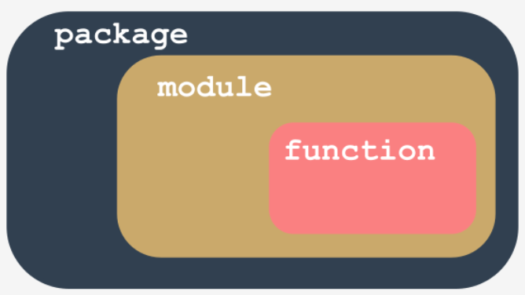
Packages
A module is a container filled with functions - you can pack as many functions as you want into one module and distribute it
Functions are logically grouped in modules based on their purpose, and named in a clear and intuitive way
Modules can also be logically grouped into packages

Slide 38
Packages
Packages are oriented toward larger software releases, e.g. the Linux OS
Installing packages usually requires the ability to run Python and the associated "pip" utility from the command line
PyPI (https://pypi.org) (short for Python Package Index) is the primary central repository for Python packages
It is maintained by a group named the Packaging Working Group, a part of the Python Software Foundation, whose main task is to support Python developers in efficient code dissemination.
Numbers as of Aug 10,2022:
393,213 projects 3,688,002 releases 6,525,180 files 614,162 users

Slide 39
Package Initialization
Packages, like modules, may require initialization.
The initialization of a module is done by an unbound code (not a part of any function) located inside the module's file.
A package is not a file, but a structure of multiple files and folders, so this technique does not work for packages
Python expects that there is a file with a unique name inside a package's folders: __init__.py
The contents of this file are executed when any of the package's modules is imported.
If there are no special initializations, the file is left empty, but cannot be omitted
Search for __init__.py in your Python install folder – there are a lot of them!
Open open one with IDLE and take a look, but don't modify it!

Slide 40
PyPI
PyPI is completely free, although there are licensing terms that apply
The PyPI repo is sometimes referred to as The Cheese Shop
The Cheese Shop is one of the most famous Monty Python sketches where an Englishman tries to buy some cheese from "Ye National Cheese Emporium" which, it turns out, has no cheese in stock at all

Slide 41
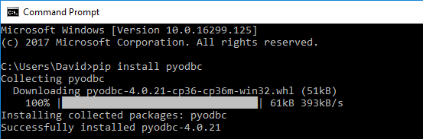
Packing: Managing Packages with pip
pip is a package management system used to install and manage software packages written in Python.
pip stands for "Pip Installs Packages", which is a recursive definition
Note: administrator privileges may be required to run pip
Usage: pip install packageName

Slide 42
User vs. Administrator
There are wwo possible scenarios for installing packages with pip:
You want to install a new package for yourself so it won't be available for any other user account on your computer; this is the only option available if you don't have administrator rights
You want to install a new package system-wide – you have administrative rights and you're not afraid to use them
To distinguish between these two actions, pip provides a --user option (note the double dash) which tells pip to act locally on behalf of your (non-administrative) user ID
pip install --user packagename
If you don’t use this option, pip assumes that you are a system administrator and will do nothing to correct you if you’re not

Slide 43
Other pip Commands
displays the version of pip:
pip --version
displays general help information for pip
pip help
displays help information for a specific operation
pip help operation
displays Python packages that have been installed
pip list
displays information about a package
pip show package_name
searches PyPI package names and summary strings of all install packages for string
pip search string

Slide 44
Other pip Commands
The pip install command has two important additional abilities
It is able to update a locally installed package:
pip install -U package_name
where -U means update
It is able to install a specific version of a package (pip installs the newest available version by default):
pip install package_name==package_version
(note the double equals sign)
pip install pygame==1.9.2

Slide 45
Other pip Commands
To uninstall a package:
pip uninstall package_name

Slide 46
Packaging: Creating Packages
Packaging an application for distribution requires consideration of many factors
Target users (developers, power users, end users)
Target environment (standalone, server, enterprise, web, mobile)
Tools include PyPI, setup.py, wheel files
Refer to https://packaging.python.org/overview/ and https://packaging.python.org/tutorials/packaging-projects/ for an overview of this process

Slide 47
Strings

Slide 48
Characters vs. Strings
Computers store characters as numbers; every character used by a computer corresponds to a unique number, and vice versa.
Some characters are "invisible"; some of these are known as whitespace, while others are known as control characters because their purpose is to control input/output devices.
An example of whitespace that is completely invisible to the naked eye is a special code known as a "newline" used to mark the ends of the lines inside text files.
People do not see this sign (or these signs), but are able to observe the effect of their application where the lines are broken.

Slide 49
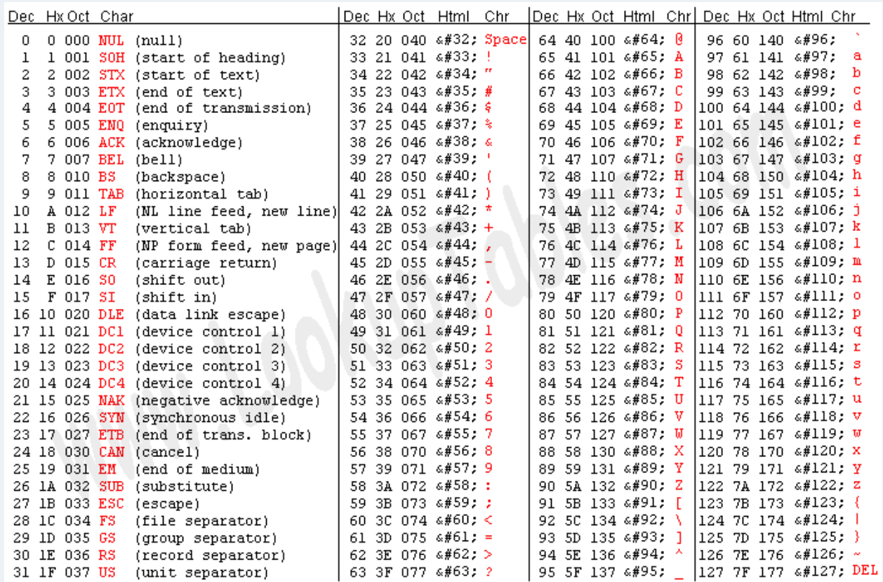
ASCII
Computers use a universal and widely accepted encoding standard implemented by (almost) all computers and operating systems all over the world.
The original form of this encoding is ASCII (short for American Standard Code for Information Interchange) which uses a single byte to represent up to 256 different characters (we only use 128)
https://www.asciitable.com/

Slide 50
I18N
ASCII is sufficient to represent the Latin alphabet, but does not suffice for the rest of the world.
Our code needs to support other languages and dialects, including numbers, punctuation, and other non-alphabetic symbols (in other words it needs to be internationalized).
In programming the word internationalization is commonly shortened to I18N
Internationalization start with an I, ends with an N, and has 18 letters.
To internationalize our code, we use an encoding known as Unicode.
Unicode supports many languages, and by design it includes the ASCII encoding.
This is known as backward compatibility – older programs that use ASCII will not break when they start using Unicode.

Slide 51
Unicode and Code Points
Unicode uses code points.
A code point is a number which represents a character.
For example, 32 is a code point which represents a space character in ASCII encoding.
ASCII consists of 128 code points.
Unicode assigns unique (unambiguous) characters (letters, hyphens, ideograms, etc.) to more than a million code points.
The first 128 Unicode code points are identical to ASCII
The first 256 Unicode code points are identical to the ISO/IEC 8859-1 code page (a code page designed for western European languages, which includes the ASCII code points).

Slide 52
UTF-8
UTF-8 (Unicode Transformation Format) is one of the most commonly used encoding standards for Unicode code points.
UTF-8 uses as many bits for each of the code points as it really needs to represent them.
For example:
all Latin characters (and all standard ASCII characters) occupy eight bits;
non-Latin characters occupy 16 bits;
CJK (China-Japan-Korea) ideographs occupy 24 bits.
Python 3 fully supports Unicode and UTF-8:
you can use Unicode/UTF-8 encoded characters to name variables and other entities
you can also use them during all input and output.

Slide 53
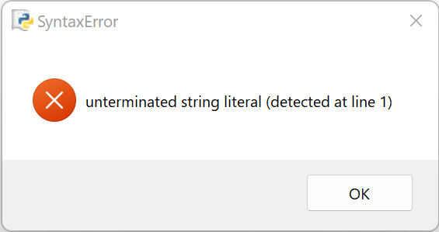
Multiline Strings
The following statement is broken up over multiple lines; it produces an error when we try to run it
multiline = 'Line #1
Line #2'
print(len(multiline))
Python supports the syntax which allows multiline strings:
multiline = '''Line #1
Line #2'''
print(len(multiline))
The multiline string starts with three single quotes, not one. The triple quotes are also used to terminate it (double quotes also work here).
The number of text lines that can be included inside this triple-quoted string is arbitrary.
Note that the output of this code is 15.
Count the characters in the string and see if this is correct; if it isn't, how do you account for the difference?

Slide 54
Operations on Strings
Like other kinds of data, strings have their own set of permissible operations, although they're rather limited compared to numbers.
Strings can be concatenated (joined), and replicated.
Concatenation is performed by the + operator while replication is performed by the * operator (note that these are not arithmetic addition and multiplication operations, although their behavior is roughly similar)
The ability to use the same operator against completely different kinds of data (like numbers vs. strings) is called overloading (the operator is overloaded with different behavior).
str1 = 'a'
str2 = 'b'
print(str1 + str2)
print(str2 + str1)
print(5 * 'a')
print('b' * 4)
The + operator used against two or more strings produces a new string containing all the characters from its arguments (note that he order matters - this overloaded +, in contrast to the arithmetic version, is not commutative)
The * operator needs a string and a number as arguments; in this case, the order doesn't matter - you can put the number before the string, or vice versa, the result will be the same - a new string is created by the nth replication of the argument's string.

Slide 55
Operations on Strings
The combined/shortcut assignment operators also work for concatenation and replication: (+= and *=); in these examples a new string is produced
str1 = 'a'
str2 = 'b'
str1 += 'd'
str2 *= 2
print(str1)
print(str2)

Slide 56
Operations on strings: ord()
If you want to know a specific character's ASCII/UNICODE code point value, you can use the ord() function (short for ordinal)
The function receives a one-character string as its argument and returns a number representing the argument's code point.
char_1 = 'a'
char_2 = ' ' # space
print(ord(char_1))
print(ord(char_2))
Try different values for char_1 and char_2, e.g., α (Greek alpha), and ę (a letter in the Polish alphabet).

Slide 57
Operations on strings: chr()
If you know the code point (number) and want to get the corresponding character, you can use the chr() function, which takes a code point and returns its character.
Invoking it with an invalid argument (e.g., a negative or invalid code point) causes ValueError or TypeError exceptions.
print(chr(97))
print(chr(945))
Note that
chr(ord(x)) == x
ord(chr(x)) == x

Slide 58
Strings as sequences: indexing
Python strings are sequences. They are not lists, but you can treat them like lists in many cases.
To access any of a string's characters, you can use indexing:
the_string = 'silly walks'
for ix in range(len(the_string)):
print(the_string[ix], end=' ')
print()
Don't try to index a string outside of its boundaries - it will cause an exception:
print(the_string[len(the_string)])
Negative indices behave as expected.
the_string = 'silly walks'
for ix in range(-1, -len(the_string), -1):
print(the_string[ix], end=' ')
print()

Slide 59
Strings and slicing
Slicing works with strings as it does with lists.
alpha = "abdefg"
print(alpha[1:3])
print(alpha[3:])
print(alpha[:3])
print(alpha[3:-2])
print(alpha[-3:4])
print(alpha[::2])
print(alpha[1::2])

Slide 60
The in and not in operators
The in operator checks if its left argument (a string) can be found anywhere within the right argument (another string).
The result of the check is simply True or False.
alphabet = "abcdefghijklmnopqrstuvwxyz"
print("f" in alphabet)
print("F" in alphabet)
print("1" in alphabet)
print("ghi" in alphabet)
print("Xyz" in alphabet)

Slide 61
Strings are immutable
Not everything you can do with a list may be done with a string.
The del operator cannot be used to remove anything from a string.
alphabet = "abcdefghijklmnopqrstuvwxyz"
del alphabet[0] # TypeError: 'str' object doesn't support item deletion
The only thing you can do with del and a string is to remove the string in its entirety.
del alphabet
Python strings also can't use the append() method - you cannot use append to expand them in any way (remember that concatenation creates an entirely new string).
alphabet = "abcdefghijklmnopqrstuvwxyz"
alphabet.append("A") # AttributeError: 'str' object has no attribute 'append'

Slide 62
Operations on strings: min()
Since they are sequences, strings and lists can both use the min() function.
min() finds the minimum element of the sequence passed as an argument.
There is one condition - the sequence (string or list) cannot be empty, or else you'll get a ValueError exception.
print(min("aAbByYzZ"))
Note: The output of the above statement is an upper-case A. Why?
t = 'The Knights Who Say "Ni!"'
print('[' + min(t) + ']')
t = [0, 1, 2]
print(min(t))

Slide 63
Operations on strings: max()
max() inds the maximum element of the sequence.
print(max("aAbByYzZ"))
t = 'The Knights Who Say "Ni!"'
print('[' + max(t) + ']')
t = [0, 1, 2]
print(max(t))

Slide 64
Operations on strings: the index method
The index() method (not a function) searches a sequence from the beginning, in order to find the first element of the value specified in its argument.
The element searched for must occur in the sequence, otherwise it will cause a ValueError exception.
The method returns the index of the first occurrence of the argument, which means that the lowest possible result is 0, and the highest is the length of argument decremented by 1.
print("aAbByYzZaA".index("b"))
print("aAbByYzZaA".index("Z"))
print("aAbByYzZaA".index("A"))

Slide 65
Operations on strings: the list function
The list() function takes its argument (a string) and creates a new list containing all the string's characters, one per list element.
Note: it's not strictly a string function - list() is able to create a new list from many other entities (e.g., from tuples and dictionaries).
print(list("abcabc"))

Slide 66
Operations on strings: the count method
The count() method counts all occurrences of the element inside the sequence.
The absence of such elements doesn't cause any problems.
print("abcabc".count("b"))
print('abcabc'.count("d"))

Slide 67
Operations on strings: the split method
The split() method splits a string and builds a list of substrings.
The method assumes that the substrings are delimited by whitespaces; the spaces don't take part in the operation, and aren't copied into the resulting list.
print("phi chi\npsi".split())
Note: the reverse operation can be performed by the join() method.

Slide 68
Operations on strings: the join method
The join() method performs a join; it expects one argument as a list with only string elements (it raises a TypeError exception otherwise)
all the list's elements will be joined into one string but the string from which the method has been invoked is used as a separator
A new string is returned
print(",".join(["omicron", "pi", "rho"]))

Slide 69
Operations on strings: the "is" methods
The "is" methods are a family of methods which return True or False to characterize the string that is being examined
Any character in the string which does not meet the requirement causes the method to return False, as does the empty string
# islower()
print("Moooo".islower())
print('moooo'.islower())
# isspace()
print(' \n '.isspace())
print(" ".isspace())
print("mooo mooo mooo".isspace())
# isupper()
print("Moooo".isupper())
print('moooo'.isupper())
print('MOOOO'.isupper())
# isalnum()
print('lambda30'.isalnum())

Slide 70
More String Methods
There are many more String methods available (too many to cover here), some of the more common ones are listed below
Read the documentation to understand how these work
https://docs.python.org/3/library/stdtypes.html#string-methods
capitalize()
center()
endswith()
find()
lower()
lstrip()
replace()
rfind()
rstrip()
startswith()
strip()
swapcase()
title()
upper()

Slide 71
Slicing Strings
Slicing works with strings just as it does with lists:
str = 'abcdefg'
print(str[0:3])
print(str[0:6:2])
print(str[6:3:-1])
print(str[::-1])

Slide 72
Comparing Strings
Python strings can be compared using the same set of operators used in numeric comparisons
==
!=
>
>=
<
<=
An important distinction is that the results compare code point values, character by character
'alpha' == 'alpha'
'alpha' != 'Alpha'

Slide 73
Comparing Strings
Comparisons between strings compares the first different character in both strings using ASCII/Unicode values
When you compare two strings of different lengths with identical characters, the longer string is considered greater
String comparisons are always case-sensitive
upper-case letters are "less than" than lower-case letters based on their numeric representation
'alpha' < 'alphabet'
'beta' > 'Beta'

Slide 74
Comparing Strings
Even if a string contains digits, it is not a number; its potential numeric value is not taken into consideration in any way
'10' == '010'
'10' > '010'
'10' > '8'
'20' < '8'
'20' < '80'

Slide 75
Comparing Strings With Numbers
The only comparisons you can perform between strings and numbers are == and !=.
== always gives False, while != always produces True.
Using any of the remaining comparison operators will raise a TypeError exception.
'10' == 10
'10' != 10
'10' == 1
'10' != 1
'10' > 10

Slide 76
Sorting Lists of Strings: sorted function
Comparing is closely related to sorting (sorting is actually a sophisticated type of comparing).
There are two possible ways to sort lists containing strings
The sorted function creates a new list:
greek = ['omega', 'alpha', 'pi', 'gamma']
# sorted function creates a new list
sorted_greek = sorted(greek)
print(greek)
print(sorted_greek)

Slide 77
Sorting Lists of Strings: sort method
The sort method sorts the list in place (does not create a new list):
greek = ['omega', 'alpha', 'pi', 'gamma']
# sort method sorts in place
greek.sort()
print(greek)

Slide 78
Exceptions

Slide 79
Exceptions
Exceptions are objects that are thrown by Python when an error occurs in a program
If exceptions are not handled ("caught"), the program crashes when they occur
Handling exceptions prevents your programs from crashing!
number = int(input("Enter an integer: "))
print("You entered a valid integer of " + str(number) + ".")
print("Thanks!")
Enter an integer: five
Traceback (most recent call last):
File "exceptions.py", line 3, in <module>
number = int(input("Enter an integer: "))
ValueError: invalid literal for int() with base 10: 'five'

Slide 80
Exception Context: Stack Traces
#!/usr/bin/env python3
# calculator program which demonstrates exceptions
def get_price():
price = float(input("Enter price: "))
return price
#end get_price
def get_quantity():
quantity = int(input("Enter quantity: "))
return quantity
#end get_quantity
continues on next slide

Slide 81
Exception Context: Stack Traces
def main():
print("The Total Calculator program\n")
# get the price and quantity
price = get_price()
quantity = get_quantity()
# calculate the total
total = price * quantity
# display the results
print()
print("PRICE: ", price)
print("QUANTITY: ", quantity)
print("TOTAL: ", total)
if __name__ == "__main__":
main()
Sample run without exceptions
Enter price: 5.99
Enter quantity: 3
PRICE: 5.99
QUANTITY: 3
TOTAL: 17.97

Slide 82
Exception Context: Stack Traces
Unhandled exceptions display a stack trace
The stack is a special structure in memory dedicated to storing function information
stack frames are stored on the stack
each frame contains information about an active function
Sample run with exceptions
Enter price: five ninety-nine
Traceback (most recent call last):
File "C:/Users/dasingle/Documents/pricecalc.py", line 31, in <module> # stack frame 1 main()
File "C:/Users/dasingle/Documents/pricecalc.py", line 18, in main # stack frame 2 price = get_price()
File "C:/Users/dasingle/Documents/pricecalc.py", line 5, in get_price # stack frame 3 price = float(input("Enter price: "))
ValueError: could not convert string to float: 'five ninety-nine'

Slide 83
Exception Context: Stack Traces
Memory
Code
Globals
Stack
Heap
Stack Frame | Memory Address | Contents
3 | STACK_BASE - 2048 | get_price()
2 | STACK_BASE - 1024 | main()
1 | STACK_BASE + 0 | __main__
Assumes a 1K stack frame size
Notice the first frame starts at the bottom of the stack

Slide 84
Exception Context: Stack Traces
Stack frames are added to the stack from the “bottom up”
Each time a method is called, a frame is added (pushed) on the stack
Stack frames are removed (popped) from the stack when a module exits in LIFO (last in, first out) order
Stack frames contain information about the module:
module name
local variables
instruction counter
return address
The Python inspect module provides traceback and frame functions which allow information about stack frames to be accessed
https://docs.python.org/3/library/inspect.html

Slide 85
The try Statement
The int and float functions can cause ValueError exceptions if invalid data is passed
Adding a try statement (with an except clause) allows the program to handle the exceptions
If an exception occurs, Python skips all remaining statements in the try clause and passes control to the except clause (the exception handler)
try:
number = int(input("Enter an integer: "))
print("You entered a valid integer of " + str(number) + ".")
print("Thanks!")
except ValueError:
print("You entered an invalid value!")

Slide 86
#!/usr/bin/env python3
# demonstrate exception handling
try:
number = int(input("Enter an integer: "))
print("You entered a valid integer of " + str(number) + ".")
print("Thanks!")
except ValueError:
print("You entered an invalid value!")
Enter an integer: 5
You entered a valid integer of 5.
Thanks!
Enter an integer: five
You entered an invalid value!

Slide 87
This except catches a specific exception:
except ValueError:
print("You entered an invalid value!")
This "anonymous except" catches any exception:
except:
print("You entered an invalid value!")
You can only have one anonymous except in a try statement
If an exception is raised inside a function, it can be handled inside the function or outside the function

Slide 88
The Calculator Program
#!/usr/bin/env python3
# calcexcept.py
# calculator program which handles exceptions
def get_price():
while True:
try:
price = float(input("Enter price: "))
return price
except ValueError:
print("Invalid decimal number. Please try again.")
def get_quantity():
while True:
try:
quantity = int(input("Enter quantity: "))
return quantity
except ValueError:
print("Invalid integer. Please try again.")

Slide 89
def main():
print("The Total Calculator program\n")
# get the price and quantity
price = get_price()
quantity = get_quantity()
# calculate the total
total = price * quantity
# display the results
print()
print("PRICE: ", price)
print("QUANTITY: ", quantity)
print("TOTAL: ", total)
if __name__ == "__main__":
main()
The Total Calculator program
Enter price: 5.99
Enter quantity: 3
PRICE: 5.99
QUANTITY: 3
TOTAL: 17.97
>>>
The Total Calculator program
Enter price: help!
Invalid decimal number. Please try again.
Enter price: 3.75
Enter quantity: hello!
Invalid integer. Please try again.
Enter quantity: 5
PRICE: 3.75
QUANTITY: 5
TOTAL: 18.75

Slide 90
Multiple Except Branches
Using a generic except can make it hard to diagnose a problem:
try:
x = int(input("Enter a number: "))
y = 1 / x
except:
print("Oh dear, something went wrong...")
print("THE END.")
We can use a variant of the except statement to provide more information

Slide 91
Multiple Except Branches
try:
:
except exc1:
:
except exc2:
:
except:
:
if the try branch raises the exc1 exception, it will be handled by the except exc1: block;
if the try branch raises the exc2 exception, it will be handled by the except exc2: block;
if the try branch raises any other exception, it will be handled by the unnamed except block.

Slide 92
Multiple Except Branches
Compare this version to the previous one:
try:
x = int(input("Enter a number: "))
y = 1 / x
print(y)
except ZeroDivisionError:
print("You cannot divide by zero, sorry.")
except ValueError:
print("You must enter an integer value.")
except:
print("Oh dear, something went wrong...")
print("THE END.")

Slide 93
Multiple Except Branches
Rules for multiple except branches:
the except branches are searched in the same order in which they appear in the code
you cannot use more than one except with the same exception name
the number of different except branches is arbitrary - the only condition is that if you use try, you must put at least one except (named or not) after it
the except keyword must not be used without a preceding try
if any of the except branches is executed, no other branches will be executed
if none of the specified except branches matches the raised exception, the exception remains unhandled
if an unnamed except branch exists (one without an exception name), it has to be specified as the last

Slide 94
List of Exceptions
AssertionError
AttributeError
EOFError
FloatingPointError
GeneratorExit
ImportError
ModuleNotFoundError
IndexError
KeyError
KeyboardInterrupt
MemoryError
NameError
NotImplementedError
OSError([arg])
OSError(errno, strerror[, filename[, winerror[, filename2]]])
OverflowError
RecursionError
ReferenceError
RuntimeError
StopIteration
StopAsyncIteration
SyntaxError
IndentationError
TabError
SystemError
SystemExit
TypeError
UnboundLocalError
UnicodeError
UnicodeEncodeError
UnicodeDecodeError
UnicodeTranslateError
ValueError
ZeroDivisionError
EnvironmentError
IOError
WindowsError
BlockingIOError
ChildProcessError
ConnectionError
BrokenPipeError
ConnectionAbortedError
ConnectionRefusedError
ConnectionResetError
FileExistsError
FileNotFoundError
InterruptedError
IsADirectoryError
NotADirectoryError
PermissionError
ProcessLookupError
TimeoutError
Warning
UserWarning
DeprecationWarning
PendingDeprecationWarning
SyntaxWarning
RuntimeWarning
FutureWarning
ImportWarning
UnicodeWarning
BytesWarning
ResourceWarning
https://docs.python.org/3/library/exceptions.html

Slide 95
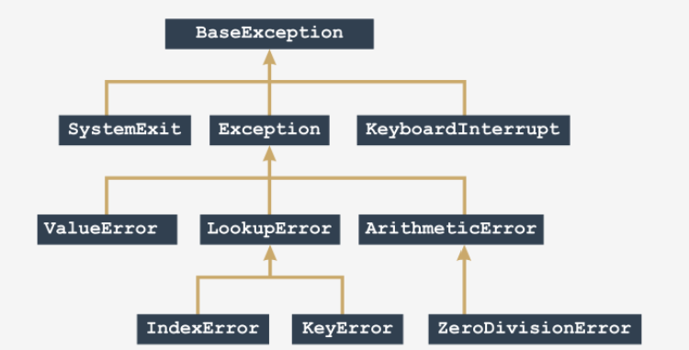
The Exception Hierarchy
Python defines many built-in exceptions which form a reversed tree-shaped hierarchy
Some are more general (they include other exceptions) while others only epresent themselves.
The closer to the root (top) of the tree that an exception is located, the more general (abstract) it is.
The exceptions located at the branches' ends (we can call them leaves) are concrete.
This diagram shows a small section of the tree, starting at the root:

Slide 96
The Exception Hierarchy
ZeroDivisionError is a special case of more a general exception named ArithmeticError
ArithmeticError is a special case of a more general exception named Exception
Exception is a special case of a more general exception named BaseException
We can describe the hierarchy in the following way (note the direction of the arrows - they always point to the more general exception):
BaseException
↑
Exception
↑
ArithmeticError
↑
ZeroDivisionError

Slide 97
The Exception Hierarchy
The following code snippets both work; why?
try:
y = 1 / 0
except ZeroDivisionError:
print("Oooppsss...")
print("THE END.")
# ----- this also works -----
try:
y = 1 / 0
except ArithmeticError:
print("Oooppsss...")
print("THE END.")
We could also use Exception or BaseException
This is an example of inheritance, which we will discuss in more detail in the object-oriented module.

Slide 98
The Exception Hierarchy
The except clauses should be ordered from more specific to less (working in bottom-up in the tree)
The following snippets do not behave the same:
try:
y = 1 / 0
except ZeroDivisionError:
print("Zero Division!")
except ArithmeticError:
print("Arithmetic problem!")
print("THE END.")
try:
y = 1 / 0
except ArithmeticError:
print("Arithmetic problem!")
except ZeroDivisionError:
print("Zero Division!")
print("THE END.")

Slide 99
Multiple Exception Types in One Except
To handle two or more exceptions in the same way, use the following syntax:
try:
:
except (exc1, exc2):
:
Put all the expected exceptions into a comma-separated list and enclose in parentheses

Slide 100
Catching Import Exceptions
#!/usr/bin/env python3
# demonstrates catching an import exception
try:
import blahblah
except ImportError:
print("could not find module blahblah!")
could not find module blahblah!

Slide 101
Raising Exceptions
Programs can raise (or throw) their own exceptions, for instance when a function you've written has been passed invalid parameters
def get_movies(filename):
if len(filename) == 0:
raise ValueError(
"The filename argument is required.")
with open(filename, newline="") as file:
…
def main():
try:
get_movies()
except ValueError as ve: # ve is the exception object
print(ve)

Slide 102
Raising Exceptions
Raise can be used without an exception to "re-raise" the same exception being handled.
This can be used to distribute the exception handling to multiple parts of the code.
def bad_fun(n):
try:
return n / 0
except:
print("I did it again!")
raise
try:
bad_fun(0)
except ArithmeticError:
print("I see!")
print("THE END.")

Slide 103
Assert
assert can be used to intentionally raise an exception based on a test expression
It is frequently used in unit testing and for debugging, usually not used in deployed code
Assert evaluates an expression
if the expression evaluates to True, or a non-zero numerical value, or a non-empty string, or any other value different than None, it won't do anything else
otherwise, it automatically and immediately raises an exception named AssertionError (we say "the assertion has failed")
import math
x = float(input("Enter a number: "))
assert x >= 0.0
x = math.sqrt(x)
print(x)
Assertions should not be used in place of exceptions or data validation, they are supplements

Slide 104
Try with else
The try statement has an optional else clause, which, when used, must follow all except clauses.
It is useful for code that must be executed if the try clause does not raise an exception.
for arg in sys.argv[1:]:
try:
f = open(arg, 'r')
except OSError:
print('cannot open', arg)
else:
print(arg, 'has', len(f.readlines()), 'lines')
f.close()

Slide 105
Optional: try with finally
The try statement also has an optional finally clause which is intended to define clean-up actions that must be executed under all circumstances.
try:
x = y / z
except ZeroDivisionError:
print("Error!")
finally:
print('Goodbye, world!') # executes either way

Slide 106
More try with finally
A finally clause is always executed before leaving the try statement, whether an exception has occurred or not.
In real world applications, the finally clause is useful for releasing external resources (such as files or network connections), regardless of whether the use of the resource was successful.
def divide(x, y):
try:
result = x / y
except ZeroDivisionError:
print("division by zero!")
else:
print("result is", result)
finally:
print("executing finally clause")

