Slide 1
Scripting for Network Professionals
National Convergence Technology Center
Working Connections Five Fridays
February 24, 2023
Professors Pamela Brauda & David Singletary
Florida State College at Jacksonville

Slide 2
Object-Oriented Programming in Python
Chapter 9: Classes

Slide 3
Objectives
Create a class, define the attributes, and design constructors and methods of the class.
Use the Unified Modeling Language (UML) to diagram a class and the objects instantiated.
Instantiate objects from a class and access members using dot notation.
Use encapsulation to protect private members.
Use decorators to implement accessors and mutators.
Use inheritance to design base and subclasses.
Use methods for introspection.
Demonstrate polymorphism.
Define the Garbage Collection in Python.

Slide 4
Objects and Python
Procedural programming (separate data and code) was the dominant approach to software development for decades, and is still in use today
It works very well for specific types of simpler and smaller projects
Object-oriented programming (encapsulated data and code) is relatively recent and is particularly useful when applied to larger and more complex projects carried out by teams of many developers
Many modern programs (e.g. graphical user interfaces) require knowledge of object-oriented programming
Objects are Python’s abstraction for data; all data in a Python program is represented by objects or by relations between objects
https://docs.python.org/3/reference/datamodel.html#objects-values-and-types

Slide 5
Creating and Using a Class
To use object-oriented programming in Python, you create classes that represent real-world things and situations, and you create objects based on these classes
Example:
a Product class represents a product which might be purchased in a retail store or online
The class includes attributes (properties) for the name, price, and a discount percentage rate
Another name for the attributes is instance variables
The class also includes methods ("special functions") which allow a program to perform operations with (or on) it

Slide 6
Lab for coding the Dog Class

Slide 7
The __init__ method
The __init__() method is a special method that Python runs automatically whenever a new instance of a class is created.
Two leading and two trailing underscores are used to prevent default Python method names from conflicting with your customized method names
__init__() acts like a constructor in other OOP languages, but the Python documentation rarely uses that term explicitly
As with regular functions, we can declare parameters in methods, including in __init__() method

Slide 8
The __init__ method
The constructor:
is obliged to have a self parameter
may (but doesn't need to) have more parameters than just self; if this happens, the way in which the class is instantiated must reflect the __init__ definition
can be used to set up the object, i.e., properly initialize its internal state, create instance variables, instantiate any other objects if their existence is needed, etc.

Slide 9
The self Parameter
self is the "self-referential" name of an object instance
it identifies the object for which the method is invoked
self is always listed as the first parameter to a constructor or method.
there is nothing special about the name "self", but it is a convention which should be followed.
self is never passed as an argument in a function call; Python sets it for you

Slide 10
Instantiating an Object from a Class
We assign a variable using the class name
The __init__() method is implicitly called
Note that we do not pass self, we only pass two arguments
def main():
my_dog = Dog('Willie', 6)
print(f"My dog's name is {my_dog.name}.")
print(f"My dog is {my_dog.age} years old.")
My dog's name is Willie.
My dog is 6 years old.

Slide 11
Accessing Attributes
dot notation is used to access attributes using the instantiated object name (variable)
def main():
my_dog = Dog('Willie', 6)
print(f"My dog's name is {my_dog.name}.")
print(f"My dog is {my_dog.age} years old.")
My dog's name is Willie.
My dog is 6 years old.

Slide 12
Calling Methods
dot notation is also used to call methods using the instantiated object name (variable)
def main():
my_dog = Dog('Willie', 6)
my_dog.sit()
my_dog.roll_over()
Willie is now sitting.
Willie rolled over!

Slide 13
Creating Multiple Instances
You can create as many instances from a class as needed.
my_dog = Dog('Willie', 6)
your_dog = Dog('Lucy', 3)
my_dog.sit()
your_dog.sit()
Willie is now sitting.
Lucy is now sitting.

Slide 14
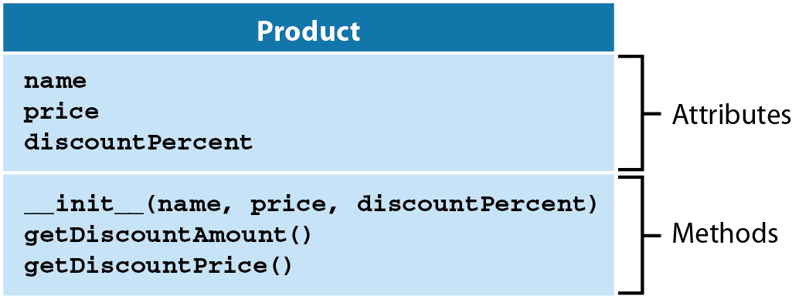
The Product Class
Unified Modeling Language (UML) is used to diagram classes and objects
By convention, class names are capitalized

Slide 15
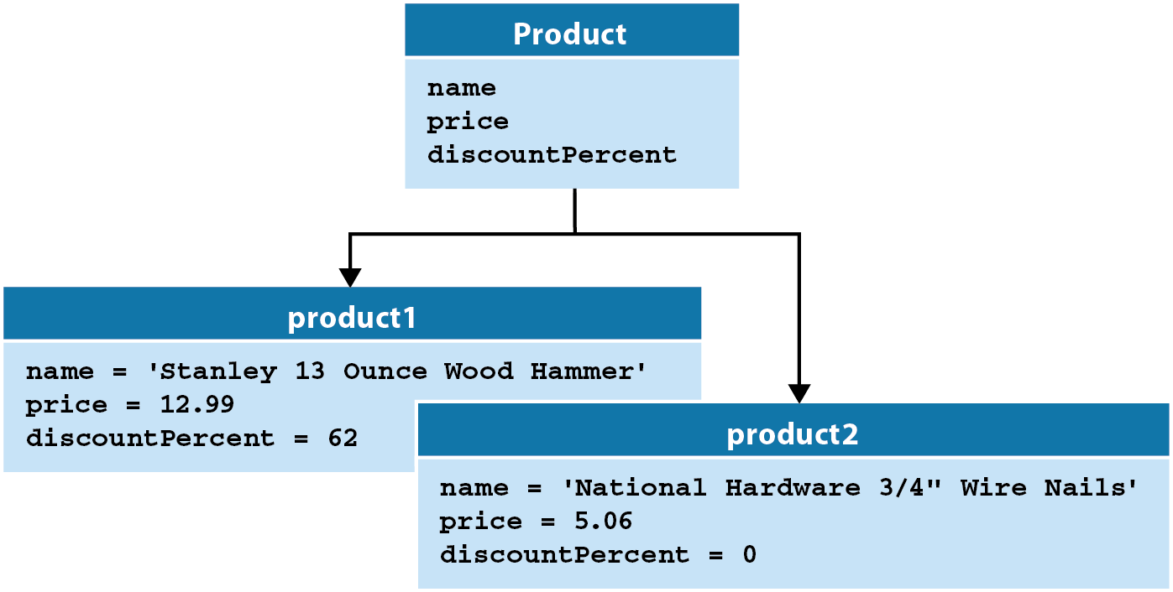
We can use UML to diagram classes and the objects instantiated (created) from them:
product1 and product2 are instances of the Product class

Slide 16
Lab for coding the Product Class

Slide 17
Calling Methods with self
The self parameter can be used to invoke other object/class methods from inside the class.
class Classy:
def other(self):
print("other")
def method(self):
print("method")
self.other()
obj = Classy()
obj.method()

Slide 18
Encapsulation
An attribute is made private in Python by prefixing the name with two underscores
__name
__price
__discountPercent
__age
Using private attributes enables data hiding, or encapsulation. We want to prevent direct modification of data; for instance, the following statements should not be allowed:
product1.price = 11.25 # change the price!
my_dog.name = 'Alf' # Alf is an alien, not a dog
Encapsulation prevents direct access and direct modification of your class's data…(this is a good thing).
Python doesn't formally support private variables, this is actually just a convention that should be followed.

Slide 19
Accessors and Mutators
In order to make the private data available to users of our class, we code accessors (getters) and mutators (setters) for each private attribute
An accessor is a method which returns the attribute's value
def getPrice(self):
return self.__price
A mutator is a method which takes a value parameter and assigns that value to the attribute (can also implement validation of the value)
def setPrice(self, price):
self.__price = price

Slide 20
# inventory.py
…
print("Name:\t\t\t{:s}".format(product1.name))
product1.setPrice(11.25) # use mutator
# use accessor print("Price:\t\t\t{:.2f}".format(product1.getPrice()))
print("Discount percent:\t{:d}%".format(product1.discountPercent))
print("Discount amount:\t{:.2f}".format(product1.getDiscountAmount()))
print("Discount price:\t\t{:.2f}".format(product1.getDiscountPrice()))
PRODUCT DATA
Name: Stanley 13 Ounce Wood Hammer
Price: 11.25
Discount percent: 62%
Discount amount: 6.97
Discount price: 4.28

Slide 21
Decorators
Python provides @-based decorators which will transparently implement accessors and mutators whenever the attribute is accessed:
# accessor/mutator for price using decorators
@property
def price(self):
# print("in price getter") # debug
return self.__price
@price.setter
def price(self, price):
# print("in price setter") # debug
self.__price = price
Decorators allow us to access the data normally, without special methods, but still take advantage of encapsulation.

Slide 22
The highlighted statements below appear to directly use the Product class attributes, but are actually using the underlying accessor and mutator.
# enabled debugging statements in Product class
# print data for product1 to console
print("PRODUCT DATA")
print("Name:\t\t\t{:s}".format(product1.name))
product1.price = 11.25 # change the price!
print("Price:\t\t\t{:.2f}".format(product1.price))
print("Discount percent:\t{:d}%".format(product1.discountPercent))
print("Discount amount:\t{:.2f}".format(product1.getDiscountAmount()))
print("Discount price:\t\t{:.2f}".format(product1.getDiscountPrice()))
PRODUCT DATA
Name: Stanley 13 Ounce Wood Hammer
in price setter
in price getter
Price: 11.25
Discount percent: 62%
Discount amount: 6.97
Discount price: 4.28

Slide 23
Lab for Using Decorators

Slide 24
More on Instance Variables
class ExampleClass:
def __init__(self, val = 1):
self.__first = val
def set_second(self, val):
self.__second = val
example_object_1 = ExampleClass()
example_object_2 = ExampleClass(2)
example_object_2.set_second(3)
example_object_3 = ExampleClass(4)
example_object_3.__third = 5
print(example_object_1.__dict__)
print(example_object_2.__dict__)
print(example_object_3.__dict__)
Python objects include predefined attributes and methods
One of these attributes is a variable named __dict__ (a dictionary)
The variable contains the names and values of all the properties (variables) the object is currently carrying

Slide 25
More on Instance Variables
The class named ExampleClass has a constructor, which unconditionally creates an instance variable named first, and sets it with the value passed through the first argument (ignoring the "self" argument)
Note that default values for parameters can be used in methods and constructors
The class also has a method which creates another instance variable, named second
Three objects of the class ExampleClass are created as follows:
example_object_1 only has a property named first
example_object_2 has two properties: first and second
example_object_3 has been modified "on the fly" with a property named third, outside of the class's code - this is fully permissible
Note that modifying an instance variable of any object has no impact on any other objects

Slide 26
More on Instance Variables
Adding two underscores makes the instance variables "private"
When Python sees the underscores it mangles the operation in the following way:
it puts a class name before the name;
it puts an additional underscore at the beginning.
__first becomes _ExampleClass__first
The name can now be accessed from outside the class, e.g.
print(example_object_1._ExampleClass__first)
Making a property private is limited; the mangling doesn't happen if you add a private instance variable outside the class code (as demonstrated by the __third variable in ExampleClass)

Slide 27
More on Predefined Attributes
Note how __dict__ deals with methods:
class Classy:
varia = 1
def __init__(self):
self.var = 2
def method(self):
pass
def __hidden(self):
pass
obj = Classy()
print("obj.__dict__ = \n", obj.__dict__)
print()
print("Classy.__dict__ = \n", Classy.__dict__)

Slide 28
More on Predefined Attributes: __name__
Another built-in property worth mentioning is __name__, which is a string
The property contains the name of the class represented by a string
Note: the __name__ attribute belongs to the class, not the objects represented by the class (see "Class Variables" in the next section)
class Classy:
pass
print(Classy.__name__)
obj = Classy()
print(obj.__name__)

Slide 29
The type() Function
If you want to find the class of a particular object, you can use a function named type(), which is will provide the class name which has been used to instantiate any object
class Classy:
pass
print(Classy.__name__)
obj = Classy()
print(type(obj).__name__)

Slide 30
More on Predefined Attributes: __module__
__module__ is also a string; it stores the name of the module which contains the definition of the class
class Classy:
pass
print(Classy.__module__)
obj = Classy()
print(obj.__module__)
Remember than any module named __main__ is actually not a module, but the file currently being run

Slide 31
More on Predefined Attributes: __bases__
__bases__ is a tuple which contains classes that are direct superclasses for a class
The order is the same as that used inside the class definition.
Note: only classes have this attribute - objects don't.
A class without explicit superclasses points to object (a predefined Python class) as its direct ancestor.

Slide 32
More on Predefined Attributes: __bases__
class SuperOne:
pass
class SuperTwo:
pass
class Sub(SuperOne, SuperTwo):
pass
def printBases(cls):
print('( ', end='')
for x in cls.__bases__:
print(x.__name__, end=' ')
print(')')
printBases(SuperOne)
printBases(SuperTwo)
printBases(Sub)

Slide 33
More on Predefined Attributes: __str__
__str__ is a method which represents a formatted string representation of the object
If the method is not provided, print will only display information about the object
class Animal:
def __init__(self, type):
self.type = type
def __str__(self):
return "I am a " + self.type
anim = Animal("lion")
print(anim)

Slide 34
Class Variables
A class variable is a property which exists in a class and is stored outside any instances of that class
In other object-oriented languages this is known as a static variable
Note: no instance variables exist if there are no instantiated objects, but a class variable exists even if there are no instantiated objects
class ExampleClass:
counter = 0
def __init__(self, val = 1):
self.__first = val
ExampleClass.counter += 1
example_object_1 = ExampleClass()
example_object_2 = ExampleClass(2)
example_object_3 = ExampleClass(4)
print(example_object_1.__dict__, example_object_1.counter)
print(example_object_2.__dict__, example_object_2.counter)
print(example_object_3.__dict__, example_object_3.counter)

Slide 35
Class Variables
In the example the counter variable is initialized to 0 inside the class but outside any of methods; this makes it a class variable
Accessing a class variable looks the same as accessing an instance variable – in this case it is incremented by 1 in the constructor
Based on this behavior what do you think the counter variable is doing?
class ExampleClass:
counter = 0
def __init__(self, val = 1):
self.__first = val
ExampleClass.counter += 1
example_object_1 = ExampleClass()
example_object_2 = ExampleClass(2)
example_object_3 = ExampleClass(4)
print(example_object_1.__dict__, example_object_1.counter)
print(example_object_2.__dict__, example_object_2.counter)
print(example_object_3.__dict__, example_object_3.counter)
Class variables do not show up in an object's __dict__ variable because they are not part of the object

Slide 36
Class Variables
Naming class and instance variables is a critical part of correctly using objects in Python
The placement of an assignment statement can change the behavior of a class
The class's __dict__ in the example shown below contains much more data than its object's counterpart
The object's __dict__ is empty since the object has no instance variables.
class ExampleClass:
varia = 1
def __init__(self, val):
ExampleClass.varia = val
example_object = ExampleClass(2)
print("Class __dict__: ", ExampleClass.__dict__)
print("\nObject __dict__: ", example_object.__dict__)

Slide 37
Checking for an Attribute's Existence
Python's interpreted nature raises an important issue in object instantiation
In contrast to other programming languages, you cannot expect that all objects of the same class have the same sets of properties.
class ExampleClass:
def __init__(self, val):
if val % 2 != 0:
self.a = 1
else:
self.b = 1
example_object = ExampleClass(1)
print(example_object.a)
print(example_object.b)
The object created by the constructor in the above example can have only one of two possible attributes: a or b.

Slide 38
Checking for an Attribute's Existence
The AttributeError exception provides a way to safely access an attribute
class ExampleClass:
def __init__(self, val):
if val % 2 != 0:
self.a = 1
else:
self.b = 1
example_object = ExampleClass(1)
print(example_object.a)
try:
print(example_object.b)
except AttributeError:
pass

Slide 39
Checking for an Attribute's Existence
The hassattr() function can also be used to check for an attribute
It expects two arguments to be passed to it:
the class or the object being checked
the name of the property whose existence has to be reported (note: it has to be a string containing the attribute name, not the name alone)
The function returns True or False
class ExampleClass:
def __init__(self, val):
if val % 2 != 0:
self.a = 1
else:
self.b = 1
example_object = ExampleClass(1)
print(example_object.a)
if hasattr(example_object, 'b'):
print(example_object.b)

Slide 40
Checking for an Attribute's Existence
hasattr() function can also operate on classes
It can be used to find out if a class variable is available
The function returns True if the specified class contains a given attribute, and False otherwise
class ExampleClass:
attr = 1
print(hasattr(ExampleClass, 'attr'))
print(hasattr(ExampleClass, 'prop'))

Slide 41
Inheritance in Python
We can inherit characteristics of a base (parent, or super) class in a derived (child, or sub) class.
Inheritance is a standard OOP feature.
Inheritance avoids duplication of code (attributes, methods) in similar objects
The following ElectricCar class inherits from the base (or parent) class named Car:
class ElectricCar(Car):
pass
The base class is specified in parentheses in the declaration of the subclass.
ElectricCar inherits all of the Car class's attributes and methods
pass is a no-op (no operation) statement which is used here as a placeholder to avoid "empty code" – sections of a program where a statement is required.

Slide 42
Inheritance in Python
The ElectricCar subclass on the previous slide wasn't very useful
We typically want to add attributes and methods that make the subclass a specialized version of the base class
As we move down in the inheritance hierarchy (the chain of inheritance which moves from base class to subclass, then to subclasses of the subclass, etc.) objects get bigger and more specialized
Car Inheritance Hierarchy
Car
ElectricCar
HybridElectricCar
BatteryElectricCar

Slide 43
Lab for Inheritance in Python

Slide 44
The issubclass() Function
issubclass() indicates whether a class is a subclass of another class
class A:
v = 2
class B(A):
v = 1
class C(B):
pass
print(issubclass(C, B))
print(issubclass(C, A))
print(issubclass(A, C))

Slide 45
The isinstance() Function
isinstance() indicates whether an object is an instance of a class
class A:
v = 2
class B(A):
v = 1
class C(B):
pass
o = B()
print(isinstance(o, B))
print(isinstance(o, A))
print(isinstance(o, C))

Slide 46
The is Operator
The is operator checks whether two variables refer to the same object.
Variables don't store the objects themselves, but only the handles "pointing" to memory addresses
While the contents of an object may be equal, their memory addresses may not be
string_1 = "Mary had a little "
string_2 = "Mary had a little lamb"
string_1 += "lamb"
print(string_1 == string_2)
print(string_1 is string_2)

Slide 47
Python Supports Multiple Inheritance
A class definition with multiple base classes looks like this:
class DerivedClassName(Base1, Base2, Base3):
...
For most purposes, the search for attributes inherited from a parent class goes depth-first, left-to-right.
If an attribute is not found in DerivedClassName, it is searched for in Base1, then (recursively) in the base classes of Base1, and if it was not found there, it was searched for in Base2, and so on.

Slide 48

The super Function
super( ) is a special function that allows you to call a method which resides in the parent class
def __init__(self, make, model, year):
super().__init__(make, model, year)
The __init__ function in ElectricCar instantiates an ElectricCar object, which includes all of the attributes and methods provided in the Car base class.
Calling super().__init__ explicitly calls the Car's constructor as the object is being created
All of the ElectricCar constructor parameters are passed up to the Car base class constructor as arguments, since those attributes reside in the Car class and must be set there
The name super comes from the convention of calling the parent class a superclass and the child class a subclass.

Slide 49
Lab for Using the super Function

Slide 50
Overriding Methods
A subclass can override a superclass method to provide specialized behavior
The subclass method must be declared exactly the same as the superclass
The override can either replace or supplement the base class's method
"super" can be used to call the superclass's version of the method if needed
# concat super class's string with subclass info
def get_descriptive_name(self): supStr = super().get_descriptive_name()
return supStr + "\nbattery voltage = " + str(self.__batteryVolts)
get_descriptive_name() in the ElectricCar class overrides (and supplements) the Car class's method of the same name.
supStr = super().get_descriptive_name() obtains the superclass's string so it can be combined with the specialized battery information of the subclass.

Slide 51
Lab for Overriding Methods

Slide 52
More on Multiple Inheritance
A single inheritance class is always simpler, safer, and easier to understand and maintain
Multiple inheritance is always risky, as you have many more opportunities to make a mistake in identifying these parts of the superclasses which will effectively influence the new class
Multiple inheritance may make overriding extremely tricky; moreover, using the super() function becomes ambiguous
Multiple inheritance violates the single responsibility principle (more details here: https://en.wikipedia.org/wiki/Single_responsibility_principle ) as it makes a new class of two (or more) classes that know nothing about each other

Slide 53
Class File Organization/Importing Classes
Class files can get long, especially if you include multiple classes in a single file.
Instead, break classes out into separate files (modules) using the naming convention
classname.py
and subclasses can import the necessary base class file(s)
Our full implementation of Car and ElectricCar is split out into two files:
car.py
electric_car.py

Slide 54
Class File Organization/Importing Classes
In the Electric car subclass we import the Car base class:
from car import Car
If there are multiple classes in a single module, you can just import the entire module:
import car
Aliases can also be used. If we wanted to subclass the ElectricCar, for instance, in the new class file we could use an alias such as
from electric_car import ElectricCar as EC

Slide 55
Introspection and Reflection
Introspection allows a Python object to be dynamically examined for its type or properties
Reflection allows a program to manipulate values, properties, and/or functions of an object at runtime
You don't have to know a complete class/object definition to manipulate the object, as the object and/or its class contains metadata allowing you to recognize its features during program execution
Reflection and introspection enable a programmer to do anything with every object, no matter where it comes from

Slide 56
Introspection and Reflection
class MyClass:
pass
obj = MyClass()
obj.a = 1
obj.b = 2
obj.i = 3
obj.ireal = 3.5
obj.integer = 4
obj.z = 5
def incIntsI(obj):
for name in obj.__dict__.keys():
if name.startswith('i'):
val = getattr(obj, name)
if isinstance(val, int):
setattr(obj, name, val + 1)
print(obj.__dict__)
incIntsI(obj)
print(obj.__dict__)

Slide 57
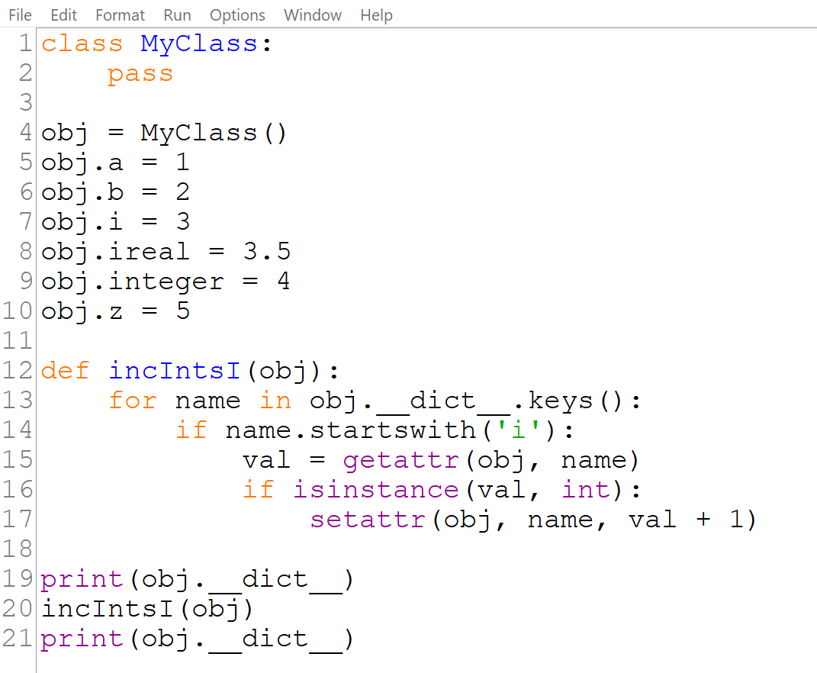
Introspection and Reflection
line 1: define a very simple class...
line 12: declare a function which:
line 13: scans the __dict__ attribute, looking for all attribute names;
line 14: if a name starts with i...
line 15: ... use the getattr() function to get its current value
line 16: check if the value is of type integer
line 17: if the check succeeds, increment the property's value by making use of the setattr() function; the function takes three arguments: an object, the property name (as a string), and the property's new value (this is reflection)

Slide 58
Introspection: Another Example
print(type(my_tesla))
dir() returns attributes and methods
print(dir(my_tesla))
<class '__main__.ElectricCar'>
['_Car__make', '_Car__model', '_Car__odometer_reading', '_Car__year', '_ElectricCar__batteryVolts', '__class__', '__delattr__', '__dict__', '__dir__', '__doc__', '__eq__', '__format__', '__ge__', '__getattribute__', '__gt__', '__hash__', '__init__', '__init_subclass__', '__le__', '__lt__', '__module__', '__ne__', '__new__', '__reduce__', '__reduce_ex__', '__repr__', '__setattr__', '__sizeof__', '__str__', '__subclasshook__', '__weakref__', 'batteryVolts', 'get_descriptive_name', 'increment_odometer', 'make', 'model', 'odometer_reading', 'read_odometer', 'year']

Slide 59
Introspection
The id() function returns a unique identifier for an object (which is actually the memory address)
print(id(my_tesla))
print(id(my_tesla2))
isinstance() returns True if the first argument is an instance of the second
print(isinstance(my_tesla, ElectricCar))
print(isinstance(my_tesla, Car))
print(isinstance(my_tesla, int))
The inspect module (https://docs.python.org/3/library/inspect.html) provides a large number of additional introspection features
1888803883328
1888803448536
True
True
False

Slide 60
Polymorphism
Polymorphism means the ability to take various forms.
Overriding (covered in previous slides) is one feature of polymorpism
An override in a subclass is called based on the type of object calling it
If an instance of the subclass calls the overridden method, then the subclass's override will be called.
If a base class calls an overridden method, the base class's version is called.
print(my_tesla.get_descriptive_name())
my_car = Car('chevy', 'corvette', 2016)
print(my_car.get_descriptive_name())
2019 Tesla Model S
battery voltage = 0
2016 Chevy Corvette

Slide 61
Polymorphism
Using polymorphism, we can assign an instance of an electric car to a variable which represents the Car base class.
The Car variable still references a car, but it is a more specialized car
… and now the subclass override is called
print(my_tesla.get_descriptive_name())
my_car = Car('chevy', 'corvette', 2016)
print(my_car.get_descriptive_name())
my_car = my_tesla
print(my_car.get_descriptive_name())
2019 Tesla Model S
battery voltage = 0
2016 Chevy Corvette
2019 Tesla Model S
battery voltage = 0

Slide 62
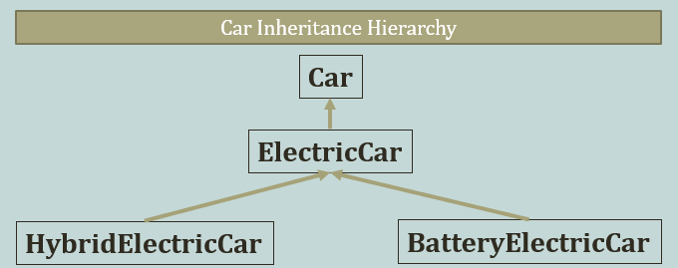
Why Use Polymorphism
The benefits of polymorphism are that we can use a base class to represent different types of related objects
If we followed through on the Car inheritance hierarchy shown previously
and created the HybridElectricCar and BatterElectricCar subclasses, we could use a single ElectricCar variable to represent either subclass at various times in a program
More importantly, we could declare a Car parameter in a function and pass instances of either subclass to that function

Slide 63
Garbage Collection in Python
As with languages like Java and C#, Python manages its own memory by implementing garbage collection.
A reference count to each object is maintained
When the count goes to 0, the object is deallocated
Python will periodically check for reference cycles (circular references) where 2 objects exclusively refer to each other, in which case both are deallocated even though the reference count is not 0
The algorithm uses heuristics by assigning objects to "generations" (relative to their age). Older objects are less likely to need garbage collection so they are not checked as often as younger generation objects.

Slide 64
Data Structures in Python
Although not in the scope of this course, the following data structure terminology may occur in the exam
A data structure represents data that has specific behavor; they can be represented by Python data types such as lists and dictionaries
They are sometimes referred to as "abstract data types"
A queue is a data structure which accesses data in the same order in which it is inserted (think of a line for tickets at a movie theater)
This is known as "first-in first-out", or FIFO
A stack is a data structure which accesses data in the reverse order in which it is inserted (think of a tray dispenser in a cafeteria)
This is known as "last-in first-out", or LIFO
https://docs.python.org/3/tutorial/datastructures.html

Slide 65
Exceptions are Classes
When an exception is raised, an object of the raised exception class is instantiated, and goes through all levels of program execution, looking for the except branch that is prepared to deal with it.
The instantiated object carries useful information
Notice in the example below that the __str__ method does not need to be called explicitly
try:
i = int("Hello!")
except Exception as e:
print(e)
print(e.__str__())

Slide 66
Working with Files
Chapter 10: Files and Exceptions

Slide 67
Objectives
Read and write text files using Python.
Read and write .csv files using Python.
Use Python's object "pickle" serialization feature.
Read and write JSON data.

Slide 68
Reading an Entire File
To do any work with a file, even just printing its contents, you first need to open the file to access it.
The open() function needs one argument: the name of the file you want to open.
open(filename)
Use a constant for the file name to make it easier to modify when necessary
Python looks for this file in the current folder
The open() function returns an object representing the file.

Slide 69
Lab for Reading an Entire File

Slide 70
The with Statement
The Python with statement is a control-flow structure which deals with errors that may occur when a file is being opened, as well as clean-up activities that need to occur when we are done with a file object.
with open(FILENAME)as f:
Improperly closed files can cause data loss and corruption and resource leaks
When with is used the file does not need to be explicitly closed.
We could use the file object's close() method, but with simplifies the operations necessary to deal with errors that could prevent close() from executing

Slide 71
File Paths
The open() function causes Python to look in the current folder for the file to open (where the program is run from)
If the file is not in the current folder, you need to specify the path where it is located
Windows uses the backslash as the folder separator, but Python allows the forward slash to be used, which maintains compatibility between platforms
FILENAME = 'd:/cop2034c/pi_digits.txt'
with open(FILENAME) as f:
contents = f.read()
print(contents)

Slide 72
pathlib
Python 3.4 introduced a new standard library for dealing with files and paths called pathlib (a tutorial link can be found in this Canvas module content)
Pass a path or filename into a new Path() object using forward slashes
The Path() object will convert forward slashes into the correct kind of slash for the current operating system
from pathlib import Path
FILEPATH = Path('d:/cop2034c')
FILENAME = FILEPATH / 'pi_digits.txt'
with open(FILENAME) as f:
contents = f.read()
print(contents)

Slide 73
Making a List of Lines From a File
The scope of data read using with is only available within the with block
To access a file's contents outside of the block, save it to a list using the readlines method of the file object
with open(FILENAME) as f:
lines = f.readlines()
for line in lines:
print(line.rstrip())

Slide 74
Lab for Reading Line by Line

Slide 75
Reading Line by Line with For
A for loop can be used to read a file line-by-line instead of using readline( ); the read operation is implicit
Instead of using end="" in the print to avoid printing extra newlines, we can use the rstrip( ) method in the line object to remove the newlines as they are read in from the file
with open(FILENAME) as f:
for line in f: # no readline necessary!
print(line.rstrip())

Slide 76
Working with Large Files
read and readlines read the entire contents of a file
This has memory implications
Use readline (or a for loop) to read large files one line at a time
Processing large files can be slow, one advanced strategy (not in the scope of this course) is to use Python's multiprocessing library
https://docs.python.org/3/library/multiprocessing.html
https://www.blopig.com/blog/2016/08/processing-large-files-using-python/
Large Files
read
readlines
readline
for loop
Small Files
read
readlines
readline
for loop

Slide 77
Writing to a File
To write to a file in Python, include a mode argument in the call to open( ) and use the write( ) function
If the file does not exist it will be created, if it does exist it will be truncated
Be sure to keep in mind things that can go wrong here: permissions, full disk, etc.
with open(FILENAME, 'w') as f:
f.write('I love programming.')
write() does not automatically include newlines. To write multiple lines to a file, you can include the newline escape character
with open(FILENAME, 'w') as f:
f.write('I love programming.\n')
f.write('I love creating new games.\n')

Slide 78
Lab for Writing and Appending to a File

Slide 79
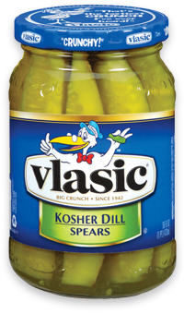
Working with Binary Files
Python provides a pickle module for working with binary files
Pickling is the process of serialization: converting an object into a stream of bytes.
Unpickling is the reverse: convert a stream of bytes into an object
dump(object, bfile) # writes an object to a binary file
load(bfile) # reads an object from a binary file

Slide 80
Lab for Working with Binary Files

Slide 81
CSV (Comma-Separated Value) files
CSV (comma-separated value) files are commonly used to store rows of text data with field separators (typically commas)
Python provides a CSV module to work with these files
#!/usr/bin/env python3
# write_csv.py
# write a CSV file
import csv
CSV_FILE = "averages.csv"
def main():
avg_list = [['Smith', 'John', '89'],
['Jones','Sally', 98],['Green','Rashad', 93]]
with open(CSV_FILE, "w", newline="") as file:
writer = csv.writer(file) # create a CSV writer
for row in avg_list: # for each row in list
writer.writerow(row) # write comma-delimited values
main()

Slide 82
Lab for Working with CSV Files

Slide 83
Using JSON
JSON (JavaScript Object Notation) is a popular lightweight, text-based, language-independent data exchange format that is easy for humans and machines to read and write.
JSON can represent two structured types: objects and arrays
An object is an unordered collection of zero or more name/value pairs.
An array is an ordered sequence of zero or more values. The values can be strings, numbers, booleans, null, and these two structured types (object and array).
JSON is often used in Ajax ("Asynchronous JavaScript + XML") applications, configurations, databases, and RESTful (REpresentational State Transfer) web services.
Many popular websites offer JSON as the data exchange format with their web services.

Slide 84
JSON Format
The following listing shows the JSON representation of an object that describes a person.
The object has string values for first name and last name, a number value for age, an object value representing the person's address, and an array value of phone number objects.
{
"firstName": "John",
"lastName": "Smith",
"age": 25,
"address": {
"streetAddress": "21 2nd Street",
"city": "New York",
"state": "NY",
"postalCode": 10021
},
"phoneNumbers": [
{
"type": "home",
"number": "212 555-1234"
},
{
"type": "fax",
"number": "646 555-4567"
}
]
}

Slide 85
Lab for Reading and Writing JSON Data

