Slide 1
Don't Start from Scratch! Crafting a Two-Year Data Science Program Summer Working Connections South 2022 Leveraging the program: FinTech Aspirations (and more)

Slide 2
Northeast Florida FinTech Initiative
https://www.fscj.edu/academics/workforce-education/grant-programs/fintech-grant
The Northeast Florida FinTech Initiative represents a partnership between Florida State College at Jacksonville and St. Johns River State College, regional schools, nonprofits and numerous financial services companies to provide new financial technology, or “FinTech” training and certification opportunities in topics such as blockchain, mobile applications, machine learning and cloud-based data management.
This innovative collaboration to provide new FinTech-related training and certifications will help equip Floridians with skills in demand by Northeast Florida’s growing FinTech industry.
The FinTech Initiative will also include the creation of a new externship program and working connections program. These programs will provide leaders of nearby K-12 schools with valuable skills and information needed to introduce students to the FinTech industry and will offer real-world industry experiences to College faculty.

Slide 3
Northeast Florida FinTech Initiative
Banking Specialist - FinTech Technical Certificate – An introductory-level certificate designed to get students on a FinTech career pathway. Available Online
FinTech Advanced Technical Certificate –For those who already hold a degree and is designed to upskill IT-based FinTech skills, particularly in software applications and development Coming Soon!
FinTech Support Technician Boot Camp Academy - a fast-track program that provides a non-credit pathway for individuals to acquire skills desirable to regional FinTech companies Coming Soon!
Security+ Boot Camp Academy - June 14-August 9, 2022, Tuesdays and Thursdays - Live Online 6-8 p.m.
MOS Excel 2019 – June 8–July 16, 2022, Wednesdays 5-7PM & Saturdays - Live Online 10AM-12PM
Python – September 1-29, 2022, Thursdays - Live Online 6-8:30 PM

Slide 4
FinTech Advanced Technical Certificate (ATC)
• Eight new courses (24 credit hours)
o FIN 3450 – Foundations of FinTech Credit Hours: 3
o IDC 3021C– Technology in FinTech Credit Hours: 3
o FIN 3740– Data Ethics and Regulatory Concepts in FinTech Credit Hours: 3
o ISM 3232C – Fintech Application Development Credit Hours: 3
o IDC 4251C – Data Mining for FinTech: 3
o IDC 4252C – Data Analytics for FinTech: 3
o IDC 4022C – Machine Learning for FinTech Credit Hours: 3
o FIN 4451 – FinTech Capstone Credit Hours: 3

Slide 5
B.A.S. in Information Systems Technology
FinTech Concentration
o FIN 3400 – Financial Management Credit Hours 3
o FIN 3450 – Foundations of FinTech Credit Hours: 3
o IDC 3021C – Technology in FinTech Credit Hours: 3
o FIN 3740 – Data Ethics and Regulatory Concepts in FinTech Credit Hours: 3
o ISM 3232C – Fintech Application Development Credit Hours: 3
o IDC 4251C – Data Mining for FinTech: 3
o IDC 4252C – Data Analytics for FinTech: 3
o IDC 4022C – Machine Learning for FinTech Credit Hours: 3
o FIN 4451 – FinTech Capstone Credit Hours: 3

Slide 6
B.A.S. in Information Systems Technology
FinTech Concentration
o FIN 3400 – Financial Management Credit Hours 3
o FIN 3450 – Foundations of FinTech Credit Hours: 3
o IDC 3021C – Technology in FinTech Credit Hours: 3
o FIN 3740 – Data Ethics and Regulatory Concepts in FinTech Credit Hours: 3
o ISM 3232C – Fintech Application Development Credit Hours: 3
o IDC 4251C – Data Mining for FinTech: 3
o IDC 4252C – Data Analytics for FinTech: 3
o IDC 4022C – Machine Learning for FinTech Credit Hours: 3
o FIN 4451 – FinTech Capstone Credit Hours: 3

Slide 7
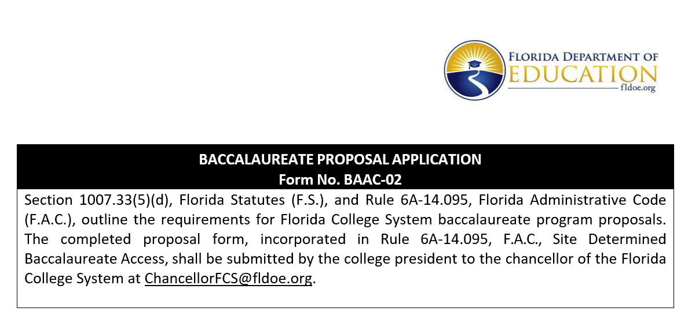
B.A.S. in Data Science (Proposed)
Florida State College at Jacksonville
New Program Prospectus

