Slide 1
Summer Working Connections South 2022 Python Data Science Packages Using Jupyter Notebook

Slide 2
Access to Horizon VDI
horizon.fscj.edu
Select the HTML option on the right
Select the AcademicIT pool

Slide 3
Clone the Repo
Open a command prompt window on Horizon
Navigate to c:\users\userID where userID is your guest account
Create a new directory for your repos: mkdir repos
Navigate to the new directory and enter this command:
git clone https://github.com/ProfSingletary/SWCSouth2022.git

Slide 4
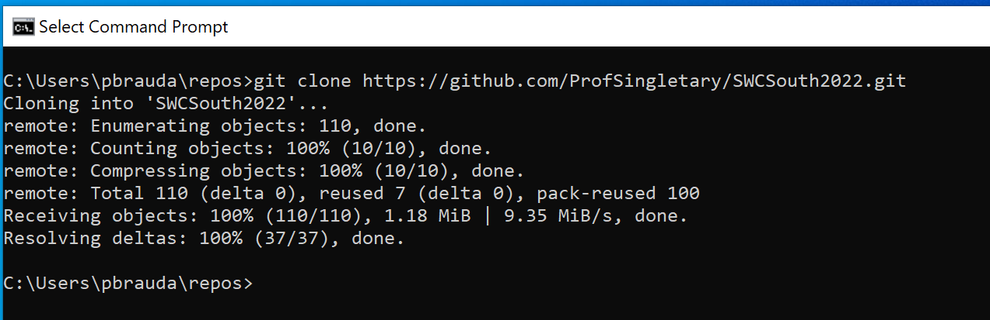

Slide 5
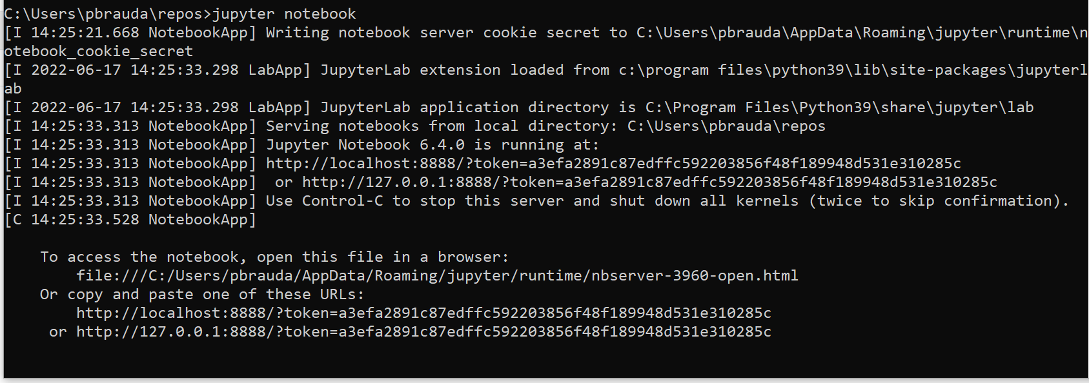
Start Jupyter Notebooks
Enter this command: jupyter notebook

Slide 6
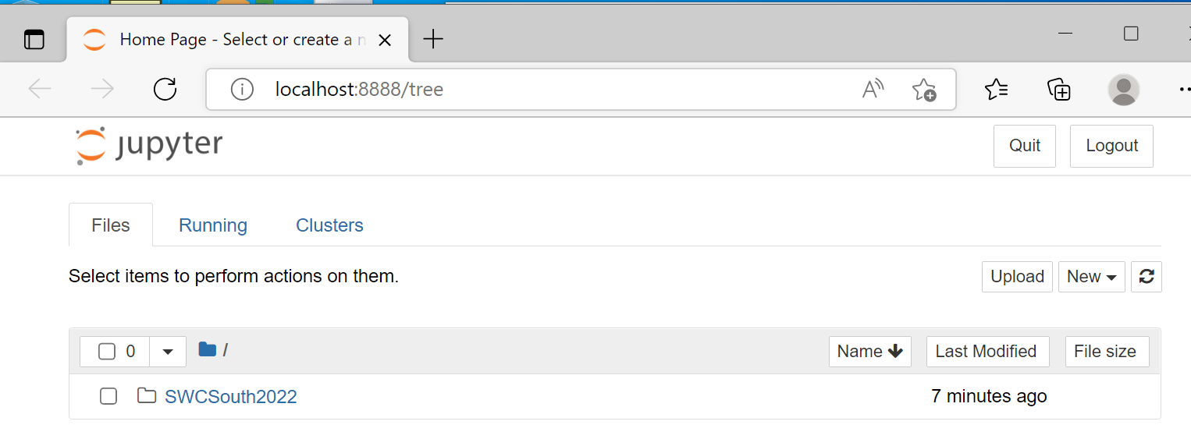
Microsoft Edge is the default browser

Slide 7
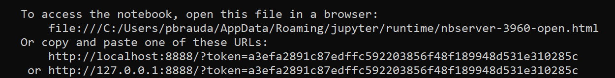
Open in your favorite browser
Open the file:///
OR
Copy one of the two URL at the bottom of the command prompt and enter into the address bar of your favorite browser

Slide 8
Click on the SWCSouth2022 folder
Start with SWC22-NumPy.ipynb

Slide 9
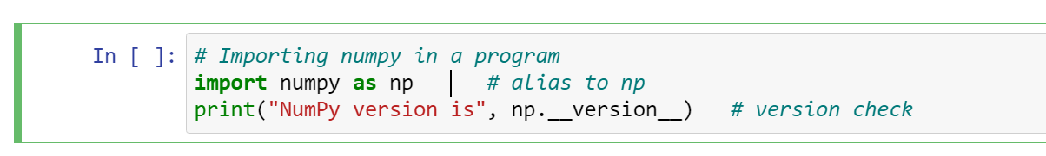
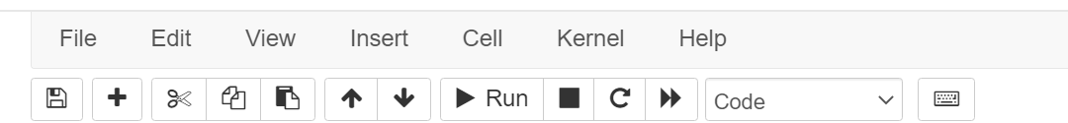
To run the code:
Execute in sequence
There are sometimes dependencies that need to be executed first
Click in the cell you want to run
Click Run on the toolbar or <Shift>Enter

Slide 10
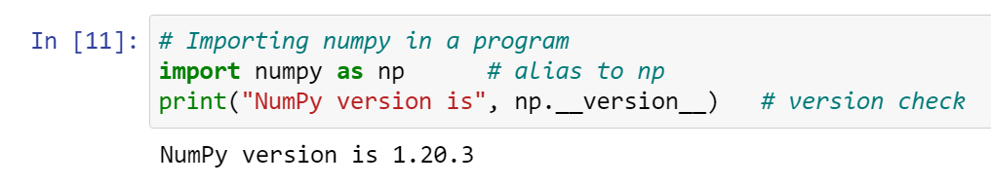
Output appears below the cell

Slide 11
You can edit the code and run again
You can edit or add to the code and run again
Errors look messy
Save if you want to keep changes
To end, close the browser, then <ctrl>c in the cmd window

