Slide 1
CAP 2741C
Data Visualization
Module 12 javascript and D3
Reading:
Ch.34, 35, 36 (Wexler, Big Book of Dashboards)
D3.js introduction https://d3js.org/
D3 graph gallery https://www.d3-graph-gallery.com/index.html

Slide 2
About Node.js (https://nodejs.org/en/about/)
Node.js is a JavaScript runtime built on Chrome's V8 JavaScript engine.
It provides an asynchronous event-driven JavaScript runtime designed to build scalable network applications
It also provides a JavaScript environment and Package Manager

Slide 3
Installing Node.js on Windows
Installing Node.js
Download and install the Node.js installer from
https://nodejs.org/en/download/
Node.js uses a tool called node-gyp ("generate your packages") to build C and C++ modules, check the dependencies at https://github.com/nodejs/node-gyp#on-windows
If you already have the latest Python and Visual Studio tools installed you should not need to do anything else
After your installation is successful, move on to the next step

Slide 4
About D3.js
D3.js is a JavaScript library for manipulating documents using HTML, SVG, and CSS.
It supports modern browsers without a proprietary framework
Visualization features are provided using visualization components and Domain Object Model (DOM) manipulation.
Allows arbitrary data to be bound to a Document Object Model (DOM), and then use data-driven transformations to manipulate the document.
e.g.
generate an HTML table from an array of numbers
create an interactive SVG bar chart with smooth transitions and interaction.
D3 is not a monolithic framework which provides every conceivable feature, it is designed to provide efficient manipulation of documents.

Slide 5
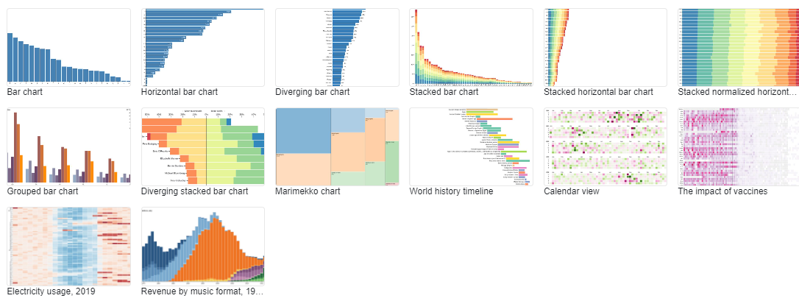
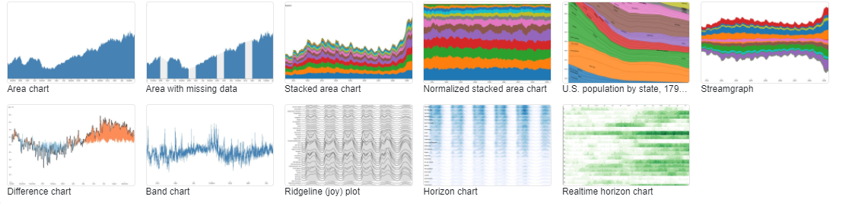
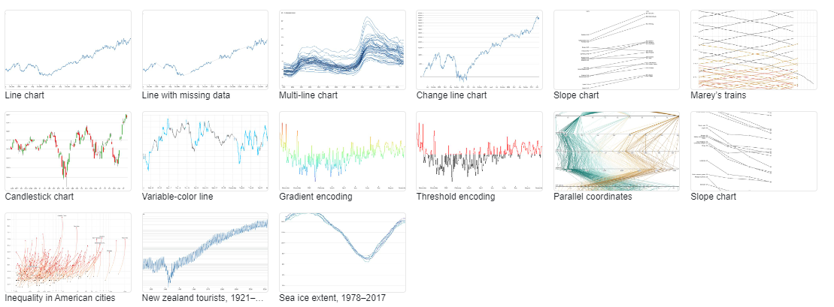
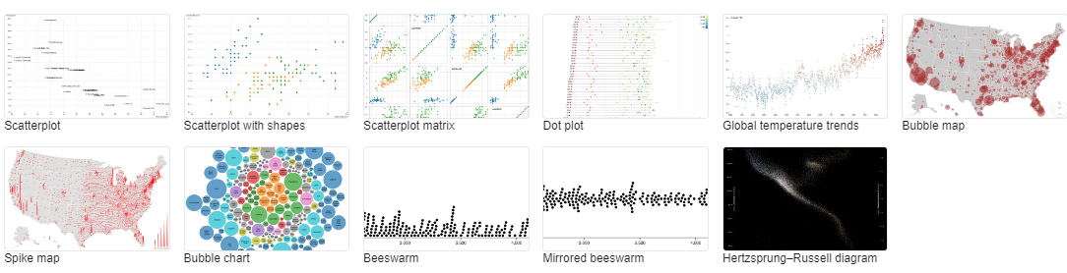
About D3.js
D3.js provides a rich set of visualization tools which support analytics, interaction, animation, and more (https://observablehq.com/@d3/gallery)

Slide 6
Installing D3.js
D3 can be accessed locally or remotely using a script element
There are compressed and uncompressed versions, compressed for performance and uncompressed for development
To load the library locally, follow the steps on the "Installing D3.js Locally" slides

Slide 7
Installing D3.js Locally
Download the latest D3.js JavaScript library from d3js.org
https://registry.npmjs.org/d3/-/d3-7.1.1.tgz (check for later versions)
As an admin user, extract the zip file into the node.js installation folder
C:\Program Files\nodejs>npm install --save d3
added 38 packages, removed 2 packages, changed 22 packages, and audited 325 packages in 7s
11 packages are looking for funding
run `npm fund` for details
6 vulnerabilities (3 moderate, 3 high) //////// see next slide

Slide 8
Installing D3.js Locally
To address issues that do not require attention, run:
npm audit fix
To address all issues (including breaking changes), run:
npm audit fix --force
Run `npm audit` for details.
C:\Program Files\nodejs>
Do not execute these commands
(see next slide)

Slide 9
Installing D3.js – Audit Warnings
https://www.voitanos.io/blog/don-t-be-alarmed-by-vulnerabilities-after-running-npm-install/
What does the audit command do? It takes the current version of a package in your project and checks the list of known vulnerabilities for that specific package & version. If it finds a vulnerability, it reports it.
Unfortunately, this message scares a bunch of developers. People see this and have the reaction they are installing a virus or something… especially when you see there are over 100 vulnerabilities & of which, 160+ are listed as high!
In my opinion, you should NOT be alarmed by this. In the world of reusable packages, and I’m not just referring to NPM as the exact same thing is true for all others including NuGet, packages can rely on other packages which creates a web of dependencies.
The NPM audit command is checking all dependencies, including those someone else has setup.

Slide 10
Installing D3.js – Audit Warnings
https://www.voitanos.io/blog/don-t-be-alarmed-by-vulnerabilities-after-running-npm-install/
You have a few options, but what I advise my students to do is just ignore these warnings on a new project.
Why? These are dependencies someone else has added to their package. You can’t just change the dependencies someone else has taken an expect nothing adverse to happen. Maybe things will work just fine, but does changing dependencies upstream sound like a trivial change? It shouldn’t… because it isn’t.
That is why I ignore them and suggest you do the same.
You shouldn’t just blindly upgrade the projects by running npm audit fix as the report says. That will automatically upgrade the package to the fixed version. While that may be easy & sound like what you want, consider if one of those fixes included different functionality, new or deprecated features or a different API signature?
Yeah… stuff just breaks

Slide 11
D3 Overview (https://d3js.org/)
D3.js uses a declarative approach, operating on arbitrary sets of nodes called selections.
e.g. to change the text color of paragraph elements:
d3.selectAll("p").style("color", "blue");
Individual nodes can be manipulated as needed:
d3.select("body").style("background-color", "black");

Slide 12
D3 Overview
D3 provides numerous methods for mutating nodes: setting attributes or styles; registering event listeners; adding, removing or sorting nodes; and changing HTML or text content.
Direct access to the underlying DOM is also possible, as each D3 selection is simply an array of nodes.
Styles, attributes, and other properties can be specified as functions of data in D3, not just simple constants.

Slide 13
D3 Overview
D3 provides many built-in reusable functions and function factories, such as graphical primitives for area, line and pie charts.
e.g. to randomly color paragraphs using HSL (hue, saturation, lightness – an alternative to the RGB color model)
d3.selectAll("p").style("color", function() {
return "hsl(" + Math.random() * 360 + ",100%,50%)";
});

Slide 14
D3 Overview
To alternate shades of gray for even and odd nodes:
d3.selectAll("p").style("color", function(d, i) {
return i % 2 ? "#fff" : "#eee";
});

Slide 15
D3 Overview
Computed properties often refer to bound data.
Data is specified as an array of values, and each value is passed as the first argument to selection functions.
The data() function is used to join (bind) an array of data to the selected DOM elements and return the updated selection
You can pass two types of value to the data() function, an array of values (number or object) or a function of data.
DOM manipulation methods in D3 such as append(), style(), text() are functions of data
Each of these functions can take in a constant value or a function as a parameter.

Slide 16
D3 Overview
var myData = ["Hello World!"];
var p = d3.select("body")
.selectAll("p")
.data(myData)
.text(function (d) {
return d;
});
In the above example, the myData array is bound to the paragraph element p
d3.select("body") selects the HTML Body element.
.selectAll("p") returns the paragraph element (assuming there is only one)
.data(myData) binds the array to the selection returned from the previous selection.

Slide 17
D3 Overview
var myData = ["Hello World!"];
var p = d3.select("body")
.selectAll("p")
.data(myData)
.text(function (d) {
return d;
});
Hello World!
Since the selection has a single p element, the data() function will bind the first value from the data array to the <p> element.
.text(function(d, i) { return d; }); adds the data as text to each of selection element.
Each array value is passed as the first argument (d) to the text function.
Any existing text from the paragraph element will get replaced with 'Hello World'.

Slide 18
D3 Overview
D3’s enter and exit selections create new nodes for incoming data and remove outgoing nodes that are no longer needed.
When data is bound to a selection, each element in the data array is paired with the corresponding node in the selection.
If there are fewer nodes than data, the extra data elements form the enter selection, which you can instantiate by appending to the enter selection.
d3.select("body")
.selectAll("p")
.data([4, 8, 15, 16, 23, 42])
.enter().append("p")
.text(function(d) { return "I’m
number " + d + "!"; });
I’m number 4!
I’m number 8!
I’m number 15!
I’m number 16!
I’m number 23!
I’m number 42!

Slide 19
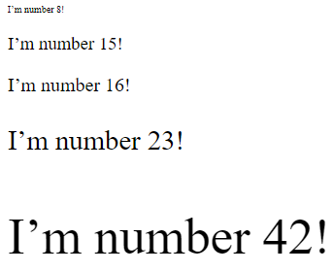
D3 Overview
Bind an array of numbers to paragraph elements and then use these numbers to compute dynamic font sizes:
d3.selectAll("p")
.data([4, 8, 15, 16, 23, 42])
.style("font-size", function(d) { return d +
"px"; });
Once the data has been bound to the document, the data operator can be omitted; D3 will retrieve the previously-bound data.
This allows properties to be recalculated without rebinding.

Slide 20
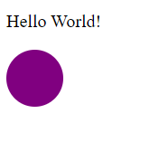
D3 Overview
adding SVG (Scalable Vector Graphic) objects
<!DOCTYPE html>
<meta charset="utf-8">
<html>
<head>
</head>
<body>
<p>
Hello World!
</p>
<div id="circle"></div>
</body>
<script src="https://d3js.org/d3.v7.js"></script>
<script>
d3.select("#circle")
.append("svg")
.attr("width", 50)
.attr("height", 50)
.append("circle")
.attr("cx", 25)
.attr("cy", 25)
.attr("r", 25)
.style("fill", "purple");
</script>
</html>

Slide 21
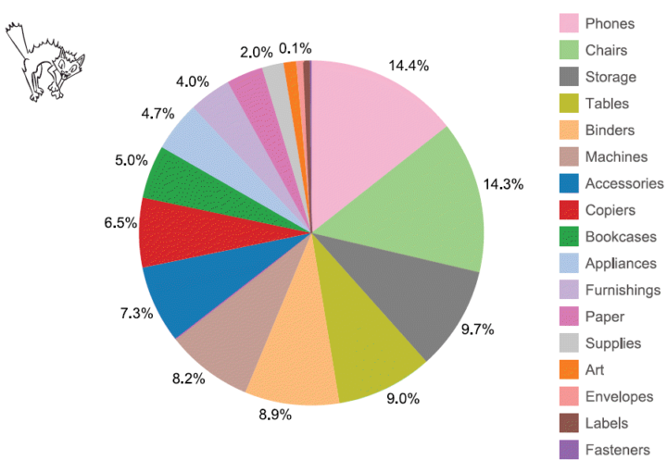

Dashboard Scenario (Wexler Ch. 34)
The Allure of Pies and Donuts
https://www.datarevelations.com/barchartpiechart_harmony/

Slide 22
Dashboard Scenario (Wexler Ch. 34)
Best encoding practices for precise quantitative comparisons are
length or height with a common baseline (e.g. bar charts)
position (e.g. dot plots)
Angles, arcs, areas, circle sizes are not as precise
Pie charts, bubble charts, and donut charts are usually not good choices
If pie charts can't be avoided, group data to reduce slices
Highlight a single slice, allow interactive selection (using a bar chart legend) of different slices

Slide 23
Dashboard Scenario (Wexler Ch. 34)
Donut charts can be more effective than pie charts for part-to-whole comparisons if the categories are minimal and a single donut is used
Avoid grouping multiple donut charts to compare additional categories
Supplementing a group of donut charts with a bar chart can be helpfule
Progress bars can be more effective

Slide 24
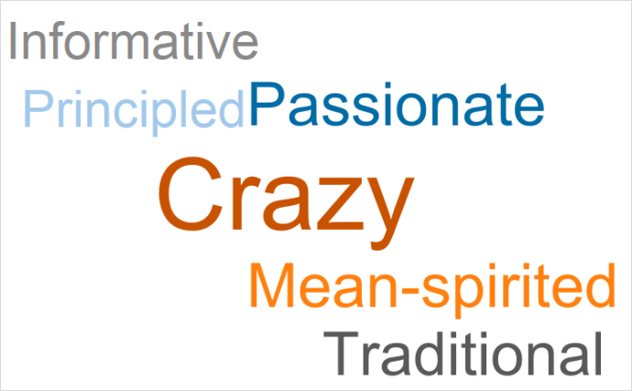
Dashboard Scenario (Wexler Ch. 35)
Clouds and Bubbles
https://www.datarevelations.com/beautiful/

Slide 25
Dashboard Scenario (Wexler Ch. 35)
Bubble charts and word clouds are "analytically impoverished"
While word clouds can be visually appealing, relative term size can be misleading or distracting
Bubble charts are also nice visually, but without associated numbers they are not as precise as a bar chart
Lollipop charts are a good compromise between precise bar chart representation and visual appeal of bubble charts
A precise and informative description (e.g. title) is very helpful

Slide 26
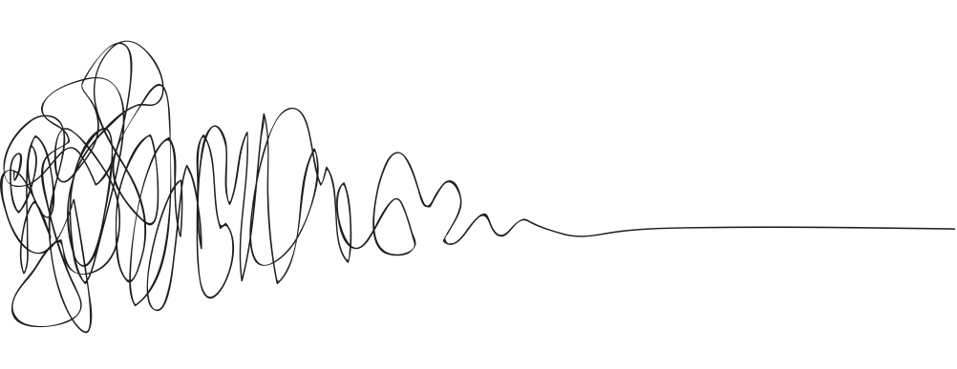
Dashboard Scenario (Wexler Ch. 36)
A Journey Into the Unknown
https://thedesignsquiggle.com/

Slide 27
Dashboard Scenario (Wexler Ch. 36)
"All dashboards are incomplete"
Known unknowns: question is known, answer is unknown (provided by dashboard)
Unknown unknowns: what questions are not asked, or not answerable by the dashboard?
Most dashboards have limited analytical paths
They follow the path the designer provides
(Re)starting from scratch and following alternate paths is sometimes the only way to determine the unknown questions

