Slide 1
Summer Working Connections South 2022 Python Data Visualization Workshop Startup Notes

Slide 2
Clone the GitHub Repo
In a Windows command tool window
Change your current directory to your desired location to clone the repo, e.g. C:\Users\YourUserName)
Run the following command:
git clone https://github.com/ProfSingletary/python-data-viz-workshop
Change your current directory to the top level of the repo (python-data-viz-workshop)
If desired, use the subst command to make your path shorter, e.g.
subst p: C:\full_path_to_your_current_directory

Slide 3
Set Up the Miniconda Environment
From a Windows command tool, run the following commands:
path=%PATH%;C:\Miniconda3;C:\Miniconda3\Scripts;C:\Miniconda3\Library\bin;
conda env create -f environment.yml
activate data-viz-workshop
https://docs.conda.io/projects/conda/en/latest/user-guide/tasks/manage-environments.html

Slide 4
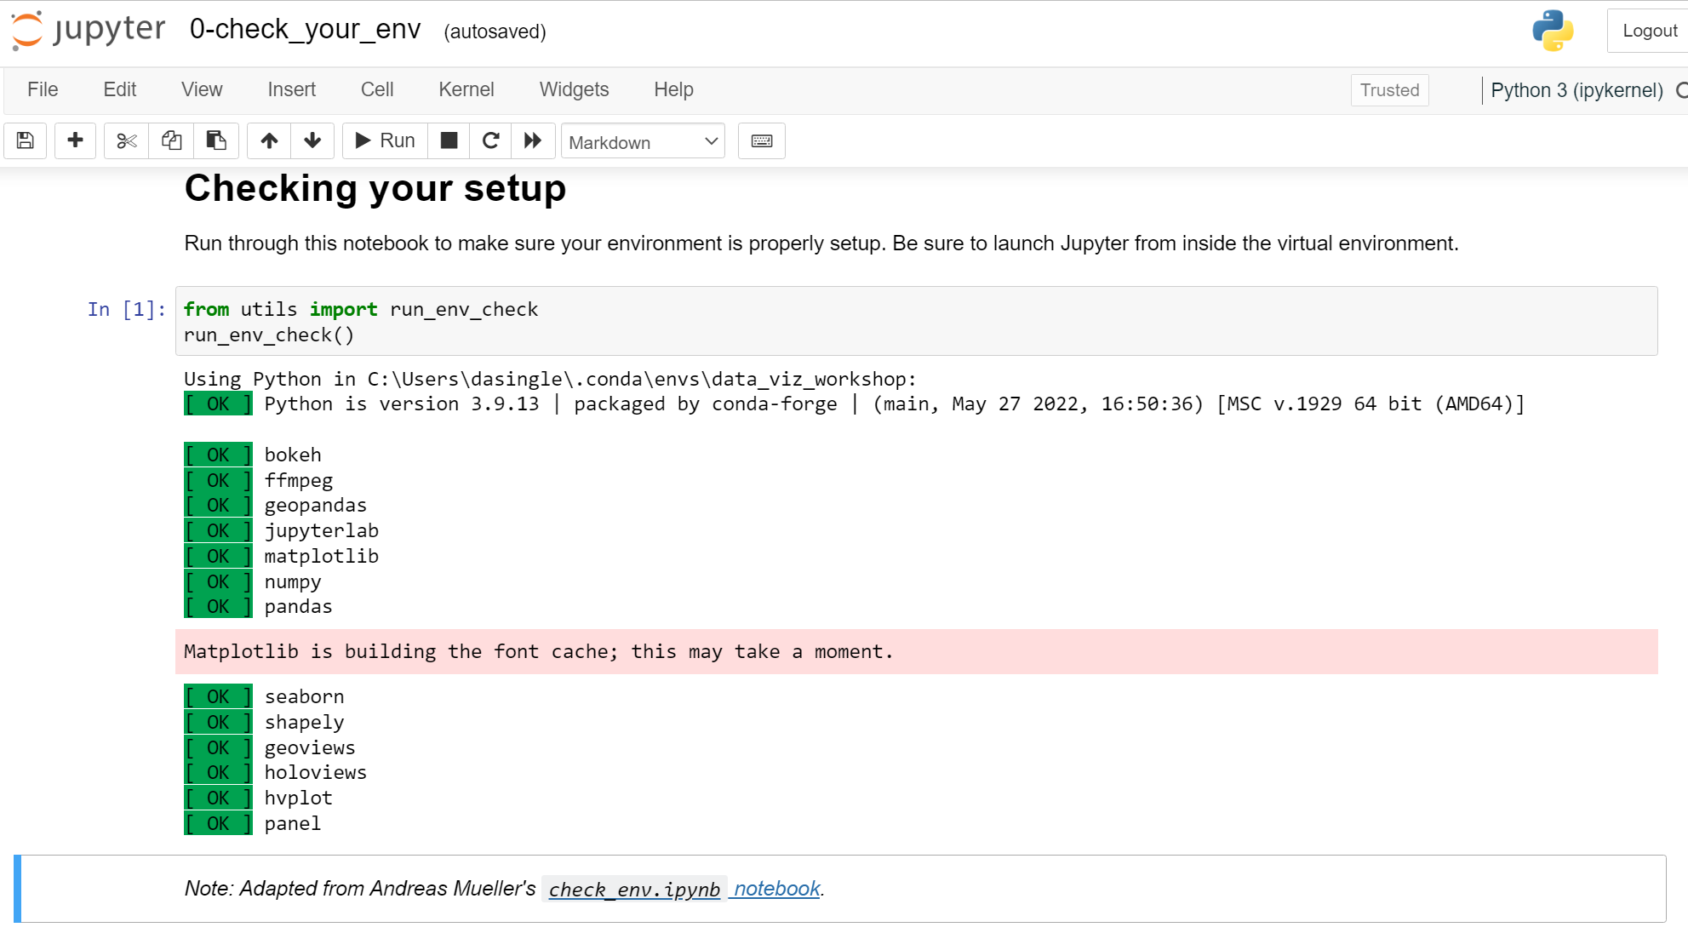
Notebook 0: Checking your setup
Be sure to activate the Conda environment first
Matplotlib font cache message may occur but is not an error, can be ignored

