Slide 1
Basic Statistical Analysis
Joan Gerard

Slide 2
Environment Settings
A rectangle area is used whose dimension is 2 x 1.5 meters.
A custom robot similar to an e-puck was used.
The robot starts in the middle of the arena (Coordinates x= 1.00, y = 0.75, theta = 180).
The robot moves in a random fashion way around the environment avoiding obstacles.
With probability p=0.01 it decides to turn to the left or to the right.
To decide the angle to the turn it selects a random angle between 1 and 30.
The robot has 8 sensors that measure the distance between the robot and the walls.
The simulator runs during 10 minutes in fast mode which is translated to around 12 hours of collected data.

Slide 3

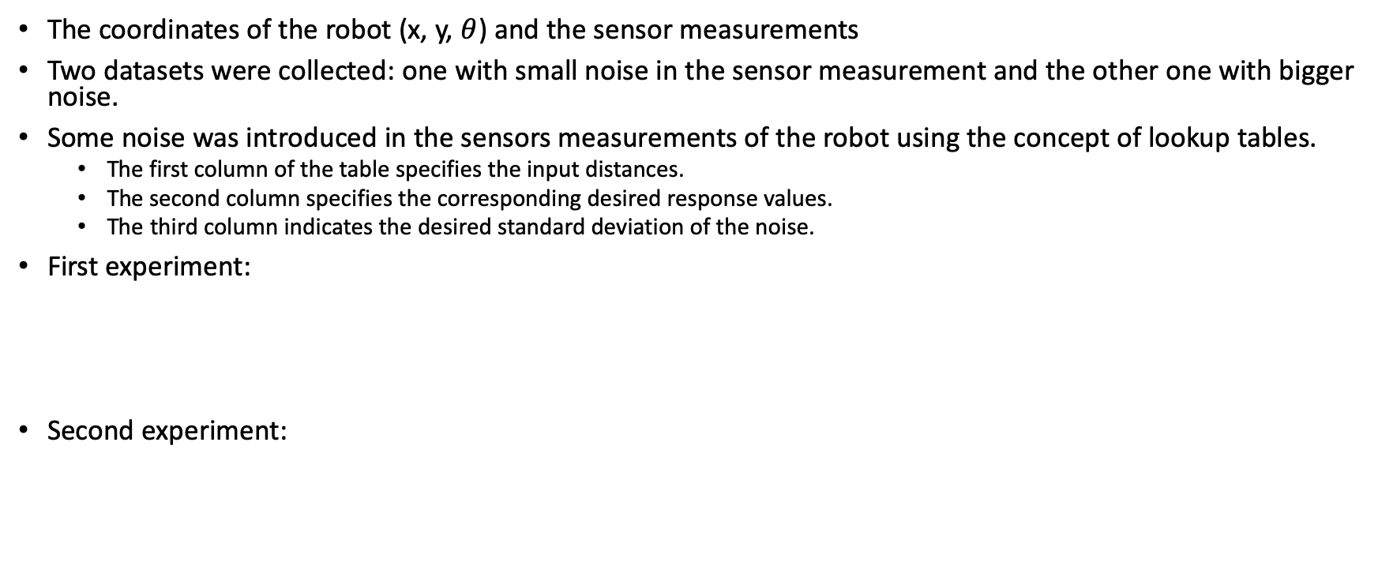
About the experiments
The coordinates of the robot (x, y, $θ$) and the sensor measurements
Two datasets were collected: one with small noise in the sensor measurement and the other one with bigger noise.
Some noise was introduced in the sensors measurements of the robot using the concept of lookup tables.
The first column of the table specifies the input distances.
The second column specifies the corresponding desired response values.
The third column indicates the desired standard deviation of the noise.
First experiment:
Second experiment:
0 | 0 | 0.01
10 | 10 | 0.01
0 | 0 | 0.2
10 | 10 | 0.2

Slide 4
About the experiments
Two models were fitted:
Random forest
Number of estimators: 5
Criterion: MSE
Neural Network
Activation of hidden layer: Relu.
Optimization: RMSprop
Loss: MSE
Metrics= MSE
Kfold = 5
Number of Epochs = 50

Slide 5
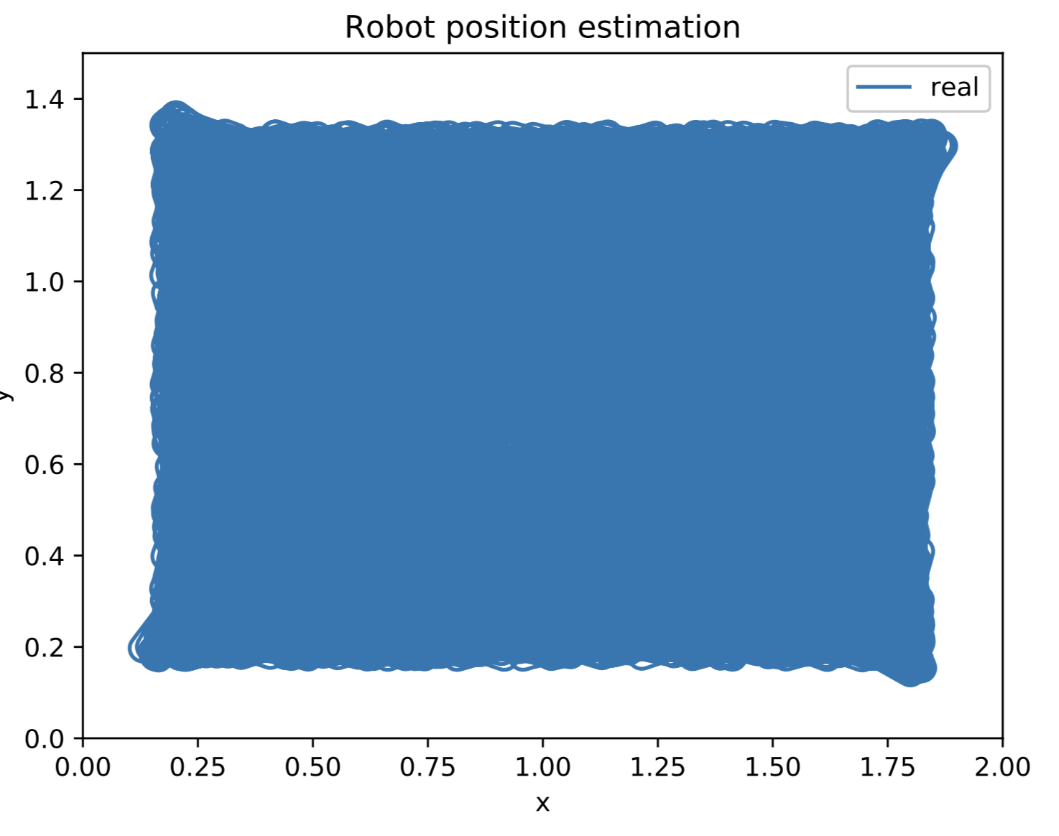
About the experiments
First experiment:
830 908 samples used for training
276 969 samples used for testing
Second experiment:
444 000 samples used for training
222 000 samples used for testing

Slide 6
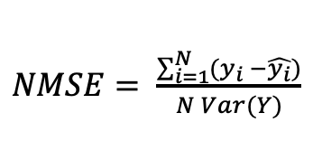
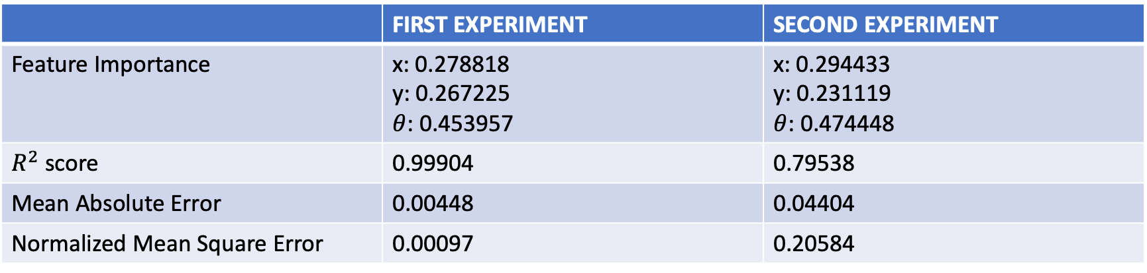
Results: Random Forest
 | FIRST EXPERIMENT | SECOND EXPERIMENT
Feature Importance | x: 0.278818 y: 0.267225 $θ$: 0.453957 | x: 0.294433 y: 0.231119 $θ$: 0.474448
$R^{2}$ score | 0.99904 | 0.79538
Mean Absolute Error | 0.00448 | 0.04404
Normalized Mean Square Error | 0.00097 | 0.20584
$NMSE= \frac{\sum_{i=1}^{N}{(y_{i} −\hat{y_{i}})}}{N Var(Y)}$

Slide 7
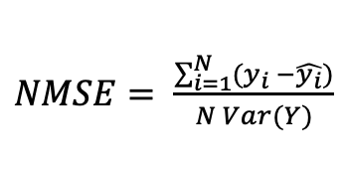
Results: Neural Network
 | FIRST EXPERIMENT | SECOND EXPERIMENT
Normalized Mean Square Error | 0.56075 | 0.56616
$NMSE= \frac{\sum_{i=1}^{N}{(y_{i} −\hat{y_{i}})}}{N Var(Y)}$

