Slide 1


t
RESEARCH METHODOLOGY & BUSINESS STATISTICS
MR. ANWESHAN JANA
Master’s of Business Administration (1st Year)
Bengal Institute of Technology & Management (163)
Maulana Abul Kalam Azad University of Technology
Roll Number- 16300923003
Reg. Number- 231630710003
anweshanjana45@yahoo.com
+91 7557859997
THE REAL LIFE APPLICATION OF LINEAR PROGRAMMING PROGRAM

Slide 2
INTRODUCTION
Linear Programming Problem is used to find the best or optimal solution to a problem that requires a decision or set of decisions about how best to use a set of limited resources to achieve a good goal of objectives. Linear Programming or Linear Optimization may be defined as the problem or maximization a linear function that is subjected to linear constraints. The constraints may be equalities or inequalities. The optimization problems involve the calculation of profit and loss. It is a method to achieve the best outcome (such as maximum profit and lower cost) in a mathematical model whose requirements are represented by linear relationships. The objective function should be specified quantitatively. Some types of Linear Programming are as follows- 1. To solve linear programs by graphical model 2. To solve linear programming using ‘R’ solve linear program using open solver Linear Programming Problem is used to find the best or optimal solution to a problem that requires a decision or set of decisions about how best to use a set of limited resources to achieve a good goal of objectives. Linear Programming or Linear Optimization may be defined as the problem or maximization a linear function that is subjected to linear constraints. The constraints may be equalities or inequalities. The optimization problems involve the calculation of profit and loss. It is a method to achieve the best outcome (such as maximum profit and lower cost) in a mathematical model whose requirements are represented by linear relationships. The objective function should be specified quantitatively. Linear Programming is heavily used in microeconomics and company management, such as planning; production; transportation; technology and other issues- either to maximize the income or minimize the costs of a production scheme. Y B A X
ax+by=c
ax/c+by/c=c/c
In the real world the problem is to find the maximum profit for a certain production. In ‘REAL LIFE’ linear programming is part of a very important area of mathematics are called “QUANTITATIVE TECHNIQUES”. Many real world problems lend themselves to linear programming modeling. Many real world problems can be approximately by linear models. There are well known successful applications in – manufacturing; marketing; finance (investment); advertising & agriculture.
A= (c/a,0)
B= (0, c/b)

Slide 3
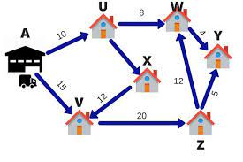
HISTORY
Year | Scientist | Remarks
1947 | George B. Dantzig | George Dantzig created a simplex algorithm to solve linear programs for planning and decision-making in large-scale enterprises. The algorithm's success led to a vast array of specializations and generalizations that have dominated practical operations research for half a century.
14th October, 1975 | The Royel Sweden Academy of Science awarded the Novel Prize in economic science to L.V.Kantorovich & T.C.Koopmans | For their contributions to the theory of optimum allocation of resources.
1979 | L.G.Khachian | The breakthrough in looking for a theoretically satisfactory algorithm to solve Linear Programming Problem.
1984 | N. Karmakar | He developed algorithm is superior to the simple method.
Let’s say a FedEx delivery man has 6 packages to deliver in a day. The warehouse is located at point A. The Six delivery destinations are given by U;V;W;X;Y;Z. The numbers on the lines indicate the distance between the cities. . To save on fuel and time the delivery person wants to take the shortest route.

Slide 4
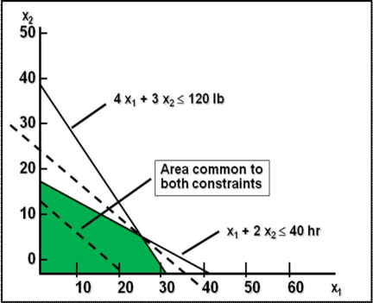
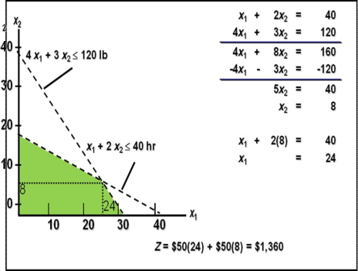
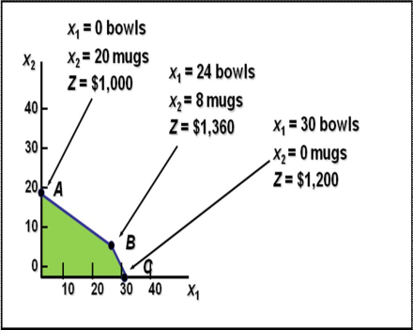
Graphical Solution Method Plot model constraints on a set of coordinates are satisfied simultaneously. Plot objective function to find the point on boundary of this space that maximizes or minimizes value of objective function.
Graphical Solution | Computing Optimal Values | Extreme Corner Points

Slide 5
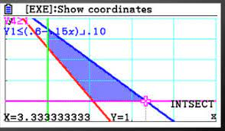
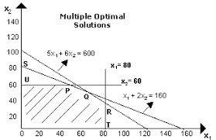
APPLICATION
Linear Programming Problem applications may include production scheduling; inventory; policies; investment portfolio; allocation of advertising budget; construction of warehouses etc. Linear Programming has proven to be extremely powerful tool, both in moldering real world problems and as widely applicable mathematical theory. Linear Programming theory falls within convex optimization theory and is also considered to be an important part of business and economics but may also be used to solve certain engineering problem. Let, x_{1;} x₂; x₃; ……x_{n} = Decision Variables Z= Objective Function or Linear Function Requirement & Minimization of the Linear Function. Z= c₁x₁ + c₂x₂ + c₃x₃ + ….. c_{n}x_{n} ----- (1) Subject to the following constraints:- a₁₁x₁ + a₁₂x₂ +..... + a_{1n}x_{n} ≤ b₁ a₂₁x₁ + a₂₂x₂ +….. + a_{2n}x_{n} ≥ b₂ ---------------------------------------- ---------------------------------------- ---------------------------------------- am₁x₁ + am₂x₂ + ….. + a_{mn}x_{n} ≤ b_{n} a₁₁x_{f} ≥ 0 Where a_{ij}; b_{j} and c_{j} are given constant.
APPLICATION
Proficiency in Operation of Dam System
Physical Distribution
Transportation Problem
Production Management
Military Application
Executive Compention
Agricultural Application
Marketing Management
Personal Assignment Problem
Manpower Management

Slide 6

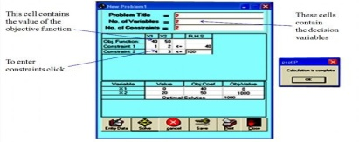
LINEAR PROGRAMMING SOFTWARE: (PROL P. EXE)- CREATED BY WIN WIN MYO 1. To input the data click entry data button 2. To obtain the optimal solution click solve button 3. To entry the new data or to delete the old data click cancel button 4. To solve the problem & solution click the save button 5. To print the problem and solution click the print button
CONCLUSION Linear Programming is a powerful technique for dealing with resource- allocation problems, cost-benefit-trade-off problems, and fixed requirements problems; as well as other problems having a similar mathematical formulation.

Slide 7


