Slide 1

CHEMICAL SPILL RESPONSE
The 7 Steps
Laboratory safety · SOP compliance · for lab technicians
AI-generated video · EU AI Act, Art. 50
Notes:
Welcome. In the next few minutes we'll walk through the seven steps of responding to a chemical spill in the lab. Follow them in order, every time. Skipping a step is both a safety risk and a compliance deviation. Let's begin.

Slide 2

1
STEP 1 OF 7
Assess the spill
Which is the right action? Select one to continue.
Consult the SDS or label first.
Never identify it by sight, smell, or touch.
Sniff the liquid to work out what it is.
Touch it to check whether it is harmless.
Notes:
Step one: assess. Before you touch anything, consult the Safety Data Sheet or the label to identify the chemical. Never identify a spill by sight, smell, or touch.

Slide 3

2
STEP 2 OF 7
Alert & evacuate
Which is the right action? Select one to continue.
Clean it up quietly on your own.
Keep working so nobody panics.
Warn the people nearby.
Clear the area — people always come first.
Notes:
Step two: alert and evacuate. Warn the people nearby and clear the area. People always come first.

Slide 4
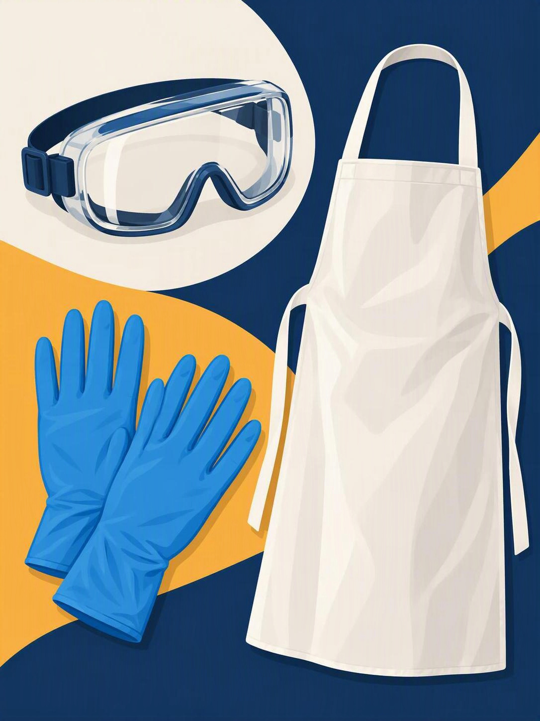
3
STEP 3 OF 7
Put on your PPE
Which is the right action? Select one to continue.
Gloves, goggles, and apron.
Before you approach the spill.
Skip the PPE for a small spill.
Put gloves on only after you finish.
Notes:
Step three: protect yourself. Put on your gloves, goggles, and apron before you approach the spill.

Slide 5
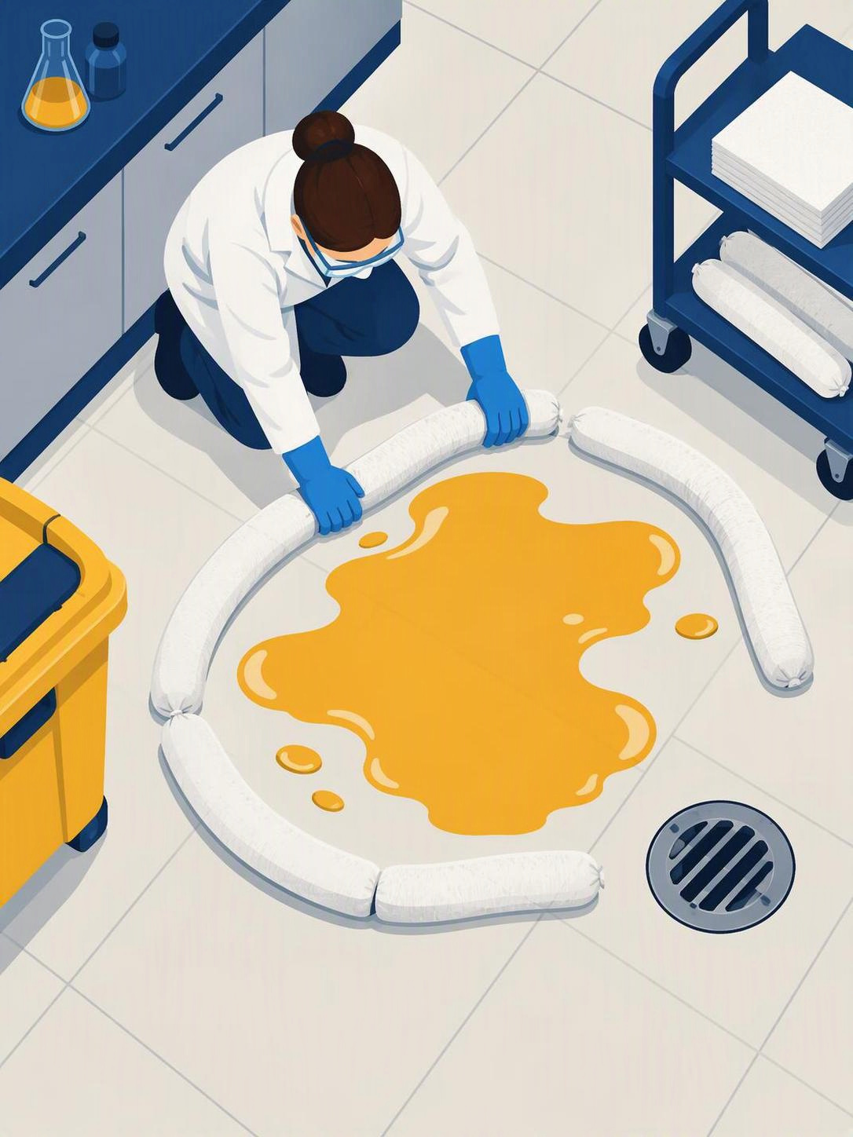
4
STEP 4 OF 7
Contain the spill
Which is the right action? Select one to continue.
Ring it with absorbent, outside in.
Keep it away from drains.
Flush it toward the drain with water.
Let it spread so it dilutes.
Notes:
Step four: contain. Ring the spill with absorbent, working from the outside in, and keep it away from drains.

Slide 6
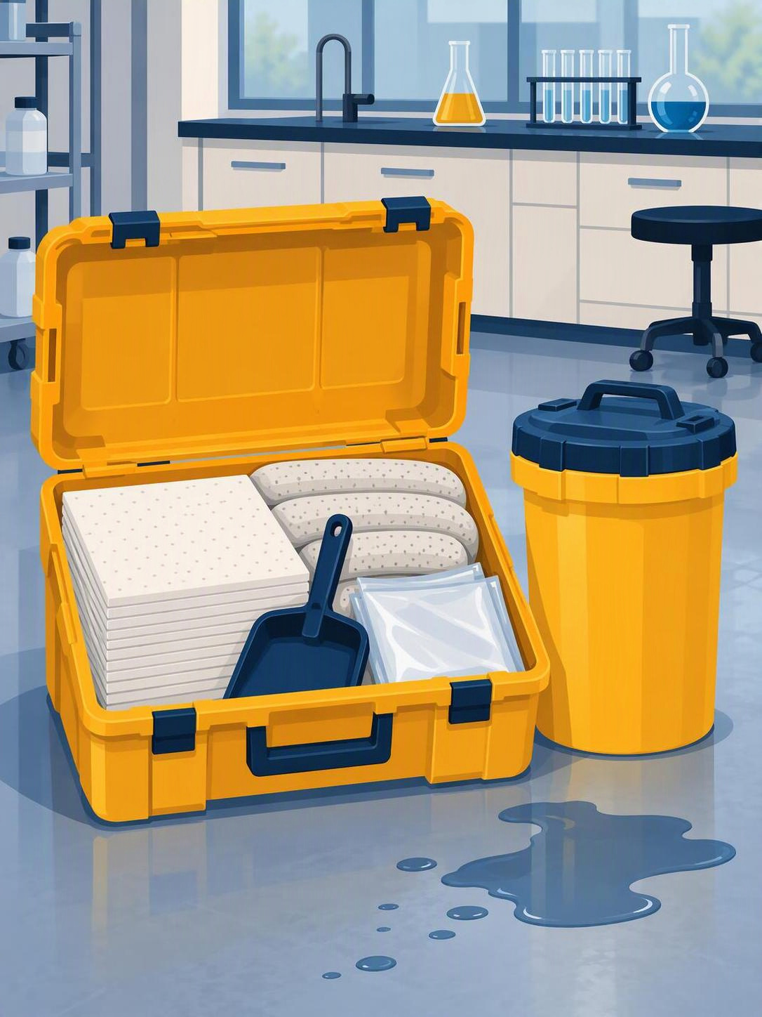
5
STEP 5 OF 7
Use the correct kit
Which is the right action? Select one to continue.
Use any kit for any chemical.
Pour water on water-reactive spills.
Match the kit to the chemical.
Water-reactive = dry kit, never water.
Notes:
Step five: use the correct kit. Match the spill kit to the chemical. If it's water-reactive, use a dry kit, never water.

Slide 7
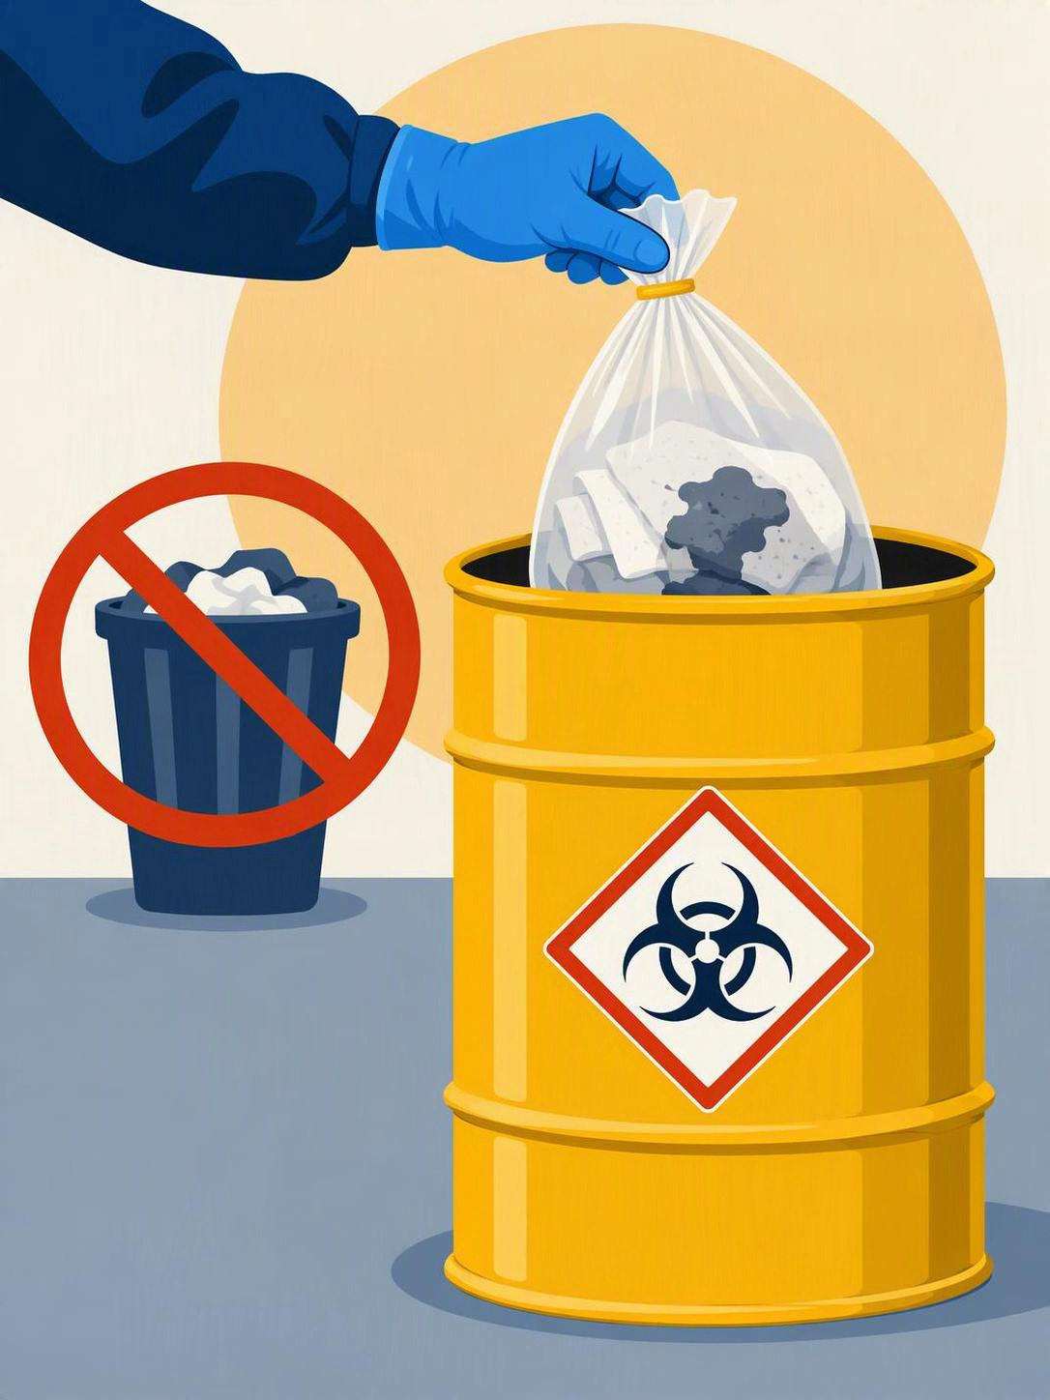
6
STEP 6 OF 7
Dispose safely
Which is the right action? Select one to continue.
Labelled hazardous-waste container only.
Never the general bin.
Throw it in the general bin.
Pour the leftovers down the sink.
Notes:
Step six: dispose. Place the waste only in the labelled hazardous-waste container, never the general bin.

Slide 8

7
STEP 7 OF 7
Document & report
Which is the right action? Select one to continue.
Skip the log if nobody was hurt.
Tell your supervisor next week.
Complete the incident log.
Notify your supervisor.
Notes:
Step seven: document. Complete the incident log and notify your supervisor. The record closes the loop and keeps you compliant.

Slide 9
7 steps, in order, every time
Follow the SOP — it protects you, your team, and our compliance.
AI-generated video · EU AI Act, Art. 50
Notes:
Seven steps, in order, every time. Follow the SOP. It protects you, your team, and our compliance.

