Slide 1

A STUDENT PRESENTATION
CHE
GUEVARA
LIFE, IDEAS, AND LEGACY OF A 20TH-CENTURY ICON
ROSARIO 1928 · LA HIGUERA 1967
Notes:
OPENING (1–2 minutes): Welcome students. Before we begin, ask: 'Raise your hand if you've ever seen Che Guevara's face on a t-shirt, poster, or wall.' Most hands will go up. Frame the question for the unit: How does a man who died in 1967 become one of the most reproduced images in human history? Who was he, what did he actually believe, and why does his image still provoke such strong reactions — both admiration and condemnation — almost 60 years after his death? Note for instructor: Che Guevara is a polarizing historical figure. The goal of this presentation is to give students a clear, evidence-based account of his life and influence so they can form their own informed views. We will discuss both his ideals and the violence associated with the revolutionary movements he led.

Slide 2
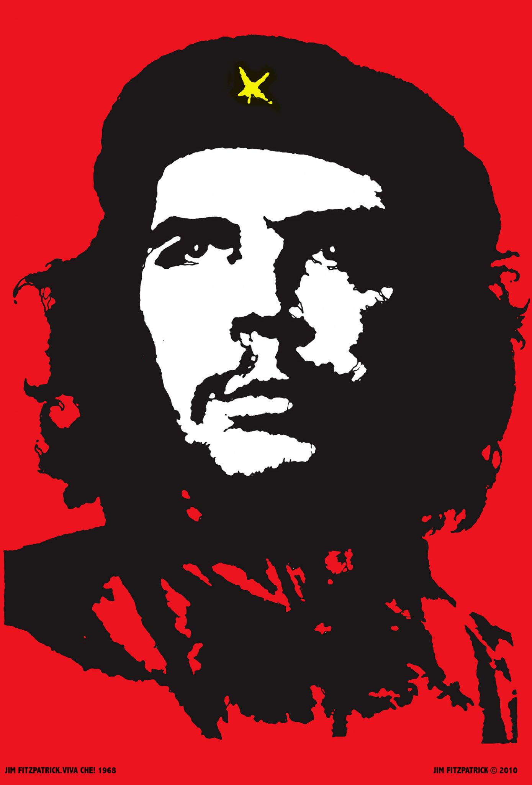
CHE GUEVARA · 1928 – 1967
Why are we still talking about him?
1
ONE OF THE MOST REPRODUCED IMAGES IN HISTORY
Alberto Korda's 1960 photograph 'Guerrillero Heróico' has been called the most widely reproduced photograph in the world — found on murals, t-shirts, and protest banners on every continent.
PHOTO
Insert: Korda's iconic 1960 portrait of Che in beret
2
HE HELPED LEAD A REVOLUTION THAT RESHAPED LATIN AMERICA
The 1959 Cuban Revolution he co-led brought Fidel Castro to power, triggering a six-decade U.S.–Cuba standoff that defined Cold War politics in the Western Hemisphere.
02 / 14
Notes:
WHY HE MATTERS (3 minutes): Two reasons we still study Che Guevara today: 1. THE IMAGE. The Maryland Institute College of Art has called Korda's photograph the most famous photo of the 20th century. The Victoria and Albert Museum says it has been reproduced more than any other image in the history of photography. That is an extraordinary claim, and it's why we'll spend time on the visual phenomenon — not just the man. 2. THE HISTORY. Che was a key military and political leader of the Cuban Revolution of 1959. That revolution turned Cuba into a Soviet ally 90 miles from Florida, led to the Bay of Pigs invasion (1961) and the Cuban Missile Crisis (1962) — the closest moment the world has ever come to nuclear war. Ask students: 'Can someone be both a historical figure AND a brand? What gets lost when a revolutionary becomes a logo?' Park this question — we'll return to it at the end.

Slide 3
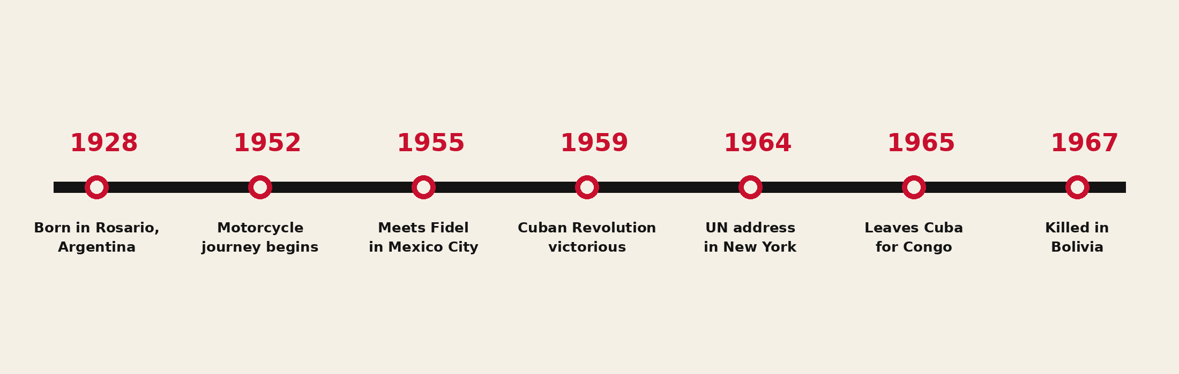
CHE GUEVARA · 1928 – 1967
A life in seven moments
From asthmatic Argentine boy to global icon — a 39-year arc.
03 / 14
Notes:
OVERVIEW TIMELINE (2 minutes): Walk students through the seven anchor dates. They will see each in detail in coming slides. 1928 — Born Ernesto Guevara de la Serna in Rosario, Argentina, into a middle-class family with leftist sympathies. Asthmatic from age two, a condition that would shape his life. 1952 — At age 23, takes an 8-month motorcycle trip across South America with friend Alberto Granado. The poverty he witnesses radicalizes him. 1955 — In Mexico City, meets Cuban exile Fidel Castro. They plan revolution. 1959 — After two years of guerrilla war, Castro's forces enter Havana. Che is one of the four top commanders. He's 30 years old. 1964 — Addresses the United Nations General Assembly in New York, denouncing imperialism and apartheid. 1965 — Resigns all positions in the Cuban government and disappears, secretly going to lead a revolution in the Congo, then Bolivia. 1967 — Captured and executed by the Bolivian army with CIA assistance, on October 9, in the village of La Higuera. Tell students: 'Notice that almost everything happens between his 23rd and 39th birthday. Sixteen years.'

Slide 4
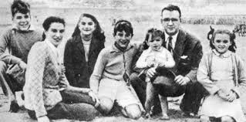
CHE GUEVARA · 1928 – 1967
1928
ROSARIO, ARGENTINA
The asthmatic son of a leftist family
PHOTO
Insert: childhood or university photo
Born Ernesto Guevara de la Serna on June 14, 1928, into a middle-class Argentine family of Spanish and Irish descent. Severe asthma from age two would shadow him for life — he carried an inhaler into combat.
His parents kept a household full of books and political conversation. Young Ernesto read voraciously: Marx, Freud, Neruda, Faulkner, Sartre. He played rugby (despite the asthma), wrote poetry, and earned high marks in school.
In 1948 he entered medical school at the University of Buenos Aires, planning to become a doctor specializing in leprosy.
04 / 14
Notes:
EARLY LIFE (3 minutes): Key teaching points: • His full name was Ernesto Guevara de la Serna. 'Che' is an Argentine slang interjection — like saying 'hey' or 'mate' — that he used so often that Cubans nicknamed him for it. • He was NOT a poor man's son. The Guevaras were middle-class — his mother Celia was outspoken and politically left-wing, his father a struggling civil engineer. Their financial situation declined over Ernesto's childhood, but he was raised reading European literature in a house full of intellectual debate. • The ASTHMA matters. It is genuinely surprising that a chronic asthmatic became a guerrilla fighter in jungle and mountain terrain. Comrades reported him having severe attacks during combat. This shapes how we read his choices: this was a man who pushed his body past what doctors thought possible. • He read widely on the political left — but also Faulkner, Kafka, Camus. He was an intellectual before he was a revolutionary. Ask: 'How does someone go from medical student to executioner of his political enemies in seven years? Hold that question — the next slide gives part of the answer.'

Slide 5
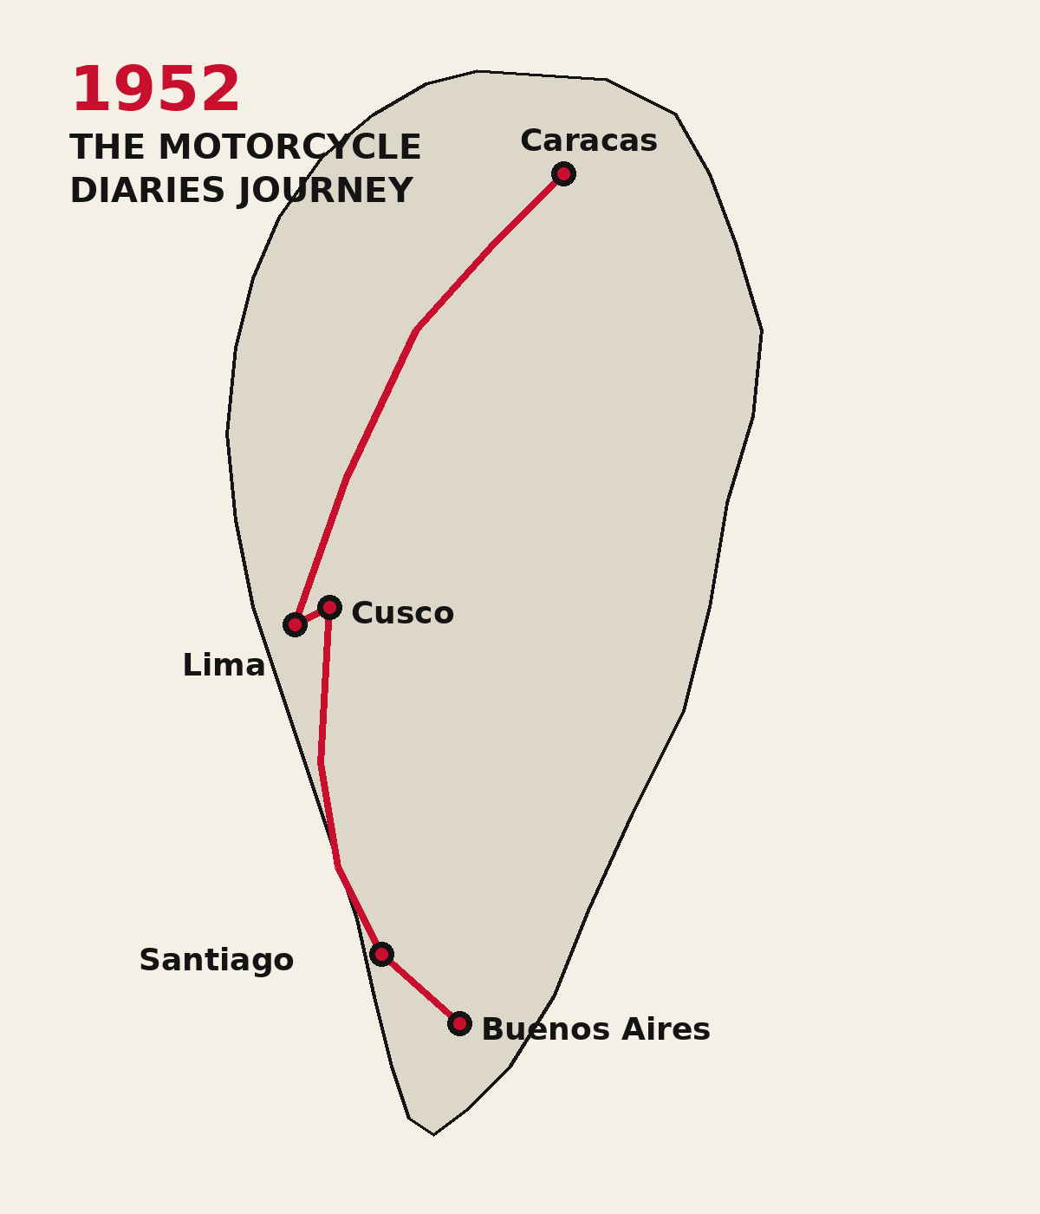
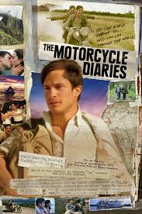
The journey that radicalized him
CHE GUEVARA · 1928 – 1967
THE MOTORCYCLE DIARIES — 1952
At 23, Ernesto and his friend Alberto Granado set out on a 500cc Norton motorcycle they nicknamed 'La Poderosa' — 'The Mighty One.' The bike broke down constantly.
Eight months. Argentina, Chile, Peru, Colombia, Venezuela. They worked at a leper colony in the Peruvian Amazon, slept in police stations, ate when strangers fed them.
What he saw: indigenous communities living in extreme poverty, mining workers dying young, U.S. companies extracting wealth from countries whose populations had nothing. He came home a different person.
He finished his medical degree the next year — and almost immediately gave up medicine for politics.
05 / 14
Notes:
THE MOTORCYCLE DIARIES (4 minutes): This is one of the most teachable moments in Che's biography because students often connect to a road-trip story. • Two young men, a beat-up motorcycle, a vague plan. They were not on a political mission. They were on what we'd today call a gap year. • The Norton 500 broke down repeatedly and was abandoned in Chile. The rest of the journey was on foot, by truck, by raft — including a homemade raft down the Amazon. • They volunteered for several weeks at the San Pablo leprosarium in Peru, treating patients hands-on without gloves — a deliberate act of human solidarity at a time when leprosy was deeply stigmatized. • What changed him: the realization that the poverty he saw was not an accident or local failure but a SYSTEM. He started writing in his diary about Latin America as a single colonized continent. • His diary was published posthumously as 'The Motorcycle Diaries' (Notas de Viaje) and adapted into a 2004 film by Walter Salles, starring Gael García Bernal. Recommended student activity: read 1-2 pages of the diary aloud. Even in translation, the prose is striking — he wrote like a literary writer, not a politician.

Slide 6
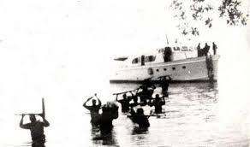
CHE GUEVARA · 1928 – 1967
Mexico City, 1955
How a doctor met a lawyer and decided to overthrow a government
01
02
03
EXILE
THE INTRODUCTION
THE GRANMA LANDING
After Guatemala's left-wing Árbenz government was overthrown in a 1954 CIA-backed coup, Che — who had been working there as a doctor — fled to Mexico City. He was now a committed revolutionary with no country.
In July 1955, the Cuban exile Fidel Castro arrived in Mexico planning an armed return to Cuba. A mutual friend introduced them. They reportedly talked all night. Che signed on as the expedition's doctor.
On Nov 25, 1956, eighty-two men sailed from Mexico on a leaky yacht, the Granma. Within days of landing in Cuba, Batista's army nearly wiped them out. About twenty survivors fled into the Sierra Maestra mountains.
06 / 14
Notes:
MEXICO CITY & THE GRANMA (4 minutes): 1. EXILE: Don't skip Guatemala. In 1954, the democratically elected president Jacobo Árbenz was overthrown by a CIA-backed coup, largely because he had nationalized land owned by the United Fruit Company. Che was in Guatemala City watching this happen. He concluded that you could not change Latin America through democratic reform — the U.S. would not allow it. This conviction shaped the rest of his life. 2. THE INTRODUCTION: Fidel Castro had just been released from prison in Cuba (after the failed 1953 Moncada barracks attack) and was now in Mexico raising money and recruits. Their first meeting in July 1955 lasted 10 hours. Fidel later said: 'Che was a more advanced revolutionary than I was, ideologically speaking, when we met.' 3. THE GRANMA: Named after the previous owner's grandmother. Built for 12 people, they crammed in 82. The crossing took 7 days instead of 5; they ran out of food and fuel. They landed in the wrong place. Batista's army ambushed them within 3 days; only about 20 survived. From this disaster came the Cuban Revolution. The lesson: revolutions don't begin with overwhelming force. They begin with very small groups of committed people willing to lose everything.

Slide 7
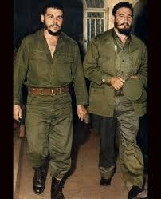
CHAPTER 03 · THE CUBAN REVOLUTION
From the Sierra Maestra to Havana
TWO YEARS IN THE MOUNTAINS
From the Sierra Maestra mountains, Castro's small force grew through guerrilla raids and political organizing among the rural poor. Che rose from medic to Comandante — the highest rank in the rebel army, equal to Castro himself.
DECEMBER 1958 · BATTLE OF SANTA CLARA
Che led 300 fighters against a much larger force. They derailed an armored troop train, captured the city, and broke the back of Batista's army. Within hours, dictator Fulgencio Batista fled the country.
PHOTO
Insert: rebel column entering Havana, or Che and Fidel together
JANUARY 8, 1959 · HAVANA
The rebels entered the capital. Che was 30 years old and now one of the most powerful men in Cuba.
Castro and Guevara entering Havana, January 1959
07 / 14
Notes:
THE REVOLUTION (4 minutes): • Don't romanticize this. The Cuban Revolution was a real war — about 5,000 to 20,000 people died (estimates vary widely), most of them Cubans on both sides. • Che's reputation in the rebel army was built partly on personal courage in combat and partly on harsh discipline. He executed deserters and informers. This is documented in his own diaries — he did not hide it. Students should sit with this complication. • THE BATTLE OF SANTA CLARA (Dec 28-31, 1958) is genuinely impressive militarily. Che's forces of about 300 lightly-armed fighters defeated several thousand government soldiers and captured the central Cuban city, cutting the island in half. The armored troop train derailment is one of the most-studied actions in 20th-century guerrilla warfare. • When Batista fled on New Year's Eve 1958, the rebel army moved on Havana. Castro arrived January 8. The American mob (Lansky, Trafficante) lost their casinos. The U.S. government realized very quickly that this was not the moderate reform government they'd expected. • Che was granted Cuban citizenship by special government decree — he was Argentine, but the Cubans considered him one of their own.

Slide 8
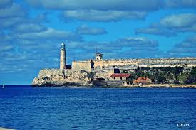
CHE GUEVARA · 1928 – 1967
In power: 1959 – 1965
Builder of a new state — and architect of its repression
LA CABAÑA
PRESIDENT OF THE NATIONAL BANK
Jan – Jun 1959
1959 – 1961
Appointed commander of the La Cabaña fortress prison in Havana. Oversaw the trials and executions of hundreds of officials and informers from the Batista regime — by his own count and that of his defenders, between 55 and 156 men; critics' counts run to 500+.
He signed Cuba's banknotes simply 'Che.' Nationalized U.S. banks, sugar mills, and oil refineries — the trigger for the U.S. embargo that remains in place today.
MINISTER OF INDUSTRIES
THE NEW MAN
1961 – 1965
1965 essay
Tried to industrialize Cuba on a Soviet model. Pushed 'voluntary labor' campaigns; was photographed cutting sugarcane and unloading docks. Results were mixed — production targets were missed.
Published 'Socialism and Man in Cuba,' arguing that revolution must create a 'new man' motivated by moral, not material, incentives. One of the most influential — and contested — political essays of the 1960s.
08 / 14
Notes:
THIS IS THE HARDEST SLIDE IN THE PRESENTATION (5 minutes): Be direct with students. Che Guevara is admired, but he also did things that historians and human rights observers consider morally serious. • LA CABAÑA: After the revolution succeeded, the new government held trials for officials of the Batista regime accused of torture, murder, and corruption. Che was put in charge. The trials were summary — defense was minimal. He signed execution orders. The exact number is disputed; defenders cite 55-156 confirmed cases under his direct command, critics cite higher figures including 500+. Either way: he killed people in cold blood, and he did not regret it. He wrote: 'We must say here what is a real truth: in a revolution, one wins or dies.' • PRESIDENT OF THE NATIONAL BANK: He did sign banknotes simply 'Che' — visible to this day in collectors' markets. The nationalizations triggered Eisenhower's first sanctions, then Kennedy's full embargo in 1962. • MINISTER OF INDUSTRIES: He pushed an aggressive industrialization model that didn't work well. Sugar production fell. By 1963 even Castro was distancing from Che's economic ideas. • 'THE NEW MAN': Required reading for understanding 1960s revolutionary thought worldwide. The essay argues that capitalism creates selfish, alienated people; socialism must consciously create a new kind of human being motivated by collective good. You can find translations free online. Discussion question: 'Can you separate someone's ideals from their actions? Should we?'

Slide 9
CHAPTER 04 · HIS WORDS
In his own words
“
I knew that the moment the great governing spirit strikes the blow to divide all humanity into just two opposing factions, I would be on the side of the common people.
— Letter to his mother, 1956
“
The true revolutionary is guided by great feelings of love.
— Socialism and Man in Cuba, 1965
“
I'd like to tell you that I know how to die.
— Reportedly said upon capture in Bolivia, 1967
09 / 14
Notes:
HIS WORDS (3 minutes): Let students sit with each quote. Read them aloud. 1. THE LETTER TO HIS MOTHER (1956): Written from Mexico shortly before the Granma sailed. He was 28. The letter shows the romantic, almost religious quality of his commitment — and explains why his image still resonates with young people facing inequality. 2. 'THE TRUE REVOLUTIONARY IS GUIDED BY GREAT FEELINGS OF LOVE': This is from his most famous essay. Critics ask: how do you reconcile this line with the executions at La Cabaña? Defenders say: he believed that overthrowing an unjust system was itself an act of love for the oppressed. Let students argue this out. 3. 'I'D LIKE TO TELL YOU THAT I KNOW HOW TO DIE': These were reportedly Che's last meaningful words, spoken to the soldier ordered to execute him in Bolivia. Whether the quote is precisely accurate, his calm under capture is well-documented. Optional activity: have a student read each quote aloud while others listen with eyes closed. Then ask: 'Does hearing them change anything about how you read them?'

Slide 10
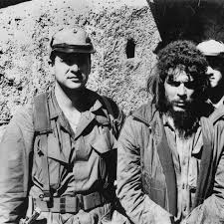
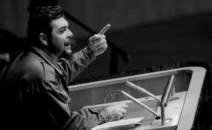
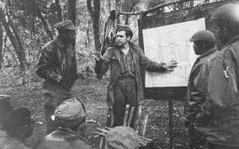
CHE GUEVARA · 1928 – 1967
The internationalist
“Create two, three… many Vietnams.” — Che, 1967
PHOTO
Insert: Che at UN podium, NYC, December 1964
PHOTO
Insert: Che disguised in Congo, 1965
PHOTO
Insert: Che bearded, Bolivia 1967
1964
1965
1966 – 67
THE U.N. SPEECH
THE CONGO
BOLIVIA
Addresses the UN General Assembly in New York wearing fatigues and beret. Denounces U.S. policy, South African apartheid, and the assassination of Patrice Lumumba. Receives a standing ovation.
Resigns ALL Cuban positions. Disappears. Secretly leads 100+ Cuban fighters into eastern Congo to support Lumumba's successors. The mission fails within months. He never speaks of it publicly.
Slips into Bolivia in disguise, hoping to ignite a continental revolution. The CIA tracks him. Local communists refuse to support him. He's captured October 8, 1967, executed the next day in La Higuera. Age 39.
10 / 14
Notes:
INTERNATIONALIST (4 minutes): These three moments show why Che became a global figure rather than just a Cuban one. 1. UN SPEECH (December 11, 1964): Worth showing students a clip if you can find one online (search 'Che Guevara UN speech 1964'). He arrived at the UN in olive fatigues — a deliberate visual statement. The speech denounced apartheid, the Vietnam War, and U.S. policy throughout Latin America. After, he met U.S. Senator Eugene McCarthy and was hosted by CBS's Face the Nation. He was, briefly, a global celebrity. 2. THE CONGO (1965): One of the strangest chapters of his life. He grew a beard, took a fake passport, and led roughly 100 Cuban fighters into the eastern Congo to support rebels resisting the Mobutu dictatorship. The mission was a disaster — language barriers, local political fragmentation, illness. He retreated after seven months. Cuba did not officially acknowledge the mission for years. 3. BOLIVIA (1966-67): The fatal mistake. He believed a continental revolution had to start in the heart of South America. But the Bolivian Communist Party, controlled by Moscow, refused to back him; the local peasantry he expected to recruit did not join him. The CIA, working with Bolivian Rangers, tracked him for months. He was wounded and captured on October 8, 1967. Executed the next day on the order of Bolivian President Barrientos. He was 39. His last words to the soldier ordered to shoot him are widely reported as: 'Shoot, coward — you're only going to kill a man.'

Slide 11
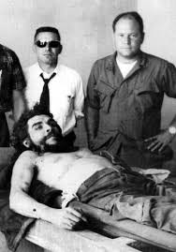
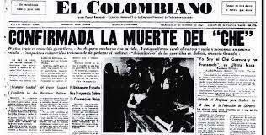
OCTOBER 9, 1967 · LA HIGUERA, BOLIVIA
A death that made him immortal
He was wounded in the leg, captured, and held overnight in a small schoolhouse in the Bolivian village of La Higuera.
Sergeant Mario Terán was ordered to execute him to make the death look like a battlefield casualty. Terán later said his hands shook.
His body was flown to Vallegrande, his hands cut off and preserved as proof of identity, and he was buried in an unmarked grave for 30 years.
In 1997 his remains were found and returned to Cuba, where he was reburied in a state mausoleum in Santa Clara — the city he had liberated 38 years earlier.
39
YEARS OLD AT HIS DEATH
11 / 14
Notes:
DEATH (3 minutes): This is the moment that turned a controversial revolutionary into a global martyr. • Captured October 8 after a firefight at the Quebrada del Yuro ravine. Wounded in the calf. Held overnight in a one-room schoolhouse. • The CIA officer on site, Felix Rodriguez, has spoken publicly about the capture; his account is in the National Security Archive. • Bolivian President René Barrientos ordered him killed rather than tried publicly — a public trial would have given Che a platform. • Sergeant Mario Terán, the man who pulled the trigger, said decades later: 'I saw Che... He looked at me and said, "Calm down, you are about to kill a man." I took a step back, towards the door, closed my eyes, and shot.' Years later, Cuban doctors performed free eye surgery on the elderly Terán in Bolivia — a moment widely covered as historic irony. • His body was displayed at the Vallegrande hospital laundry. The photographs of his open eyes, taken by Freddy Alborta, look strikingly like Renaissance paintings of the dead Christ — and were perceived that way around the world. • His remains were found in 1997 buried near a Bolivian airstrip, exhumed, and returned to Cuba where they rest today in the Santa Clara mausoleum that bears his name. Discussion: 'Why is the Christ-comparison so persistent? What does it tell us about what people projected onto him?'

Slide 12
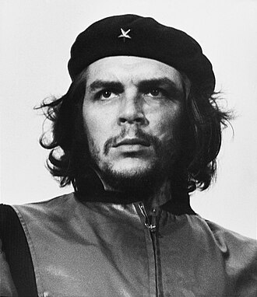
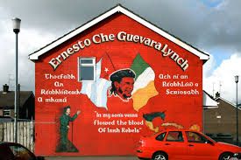
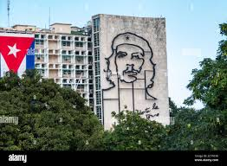
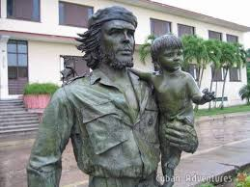
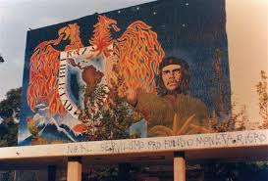
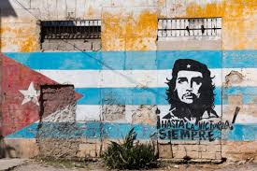
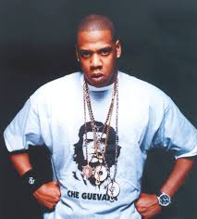
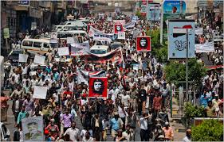
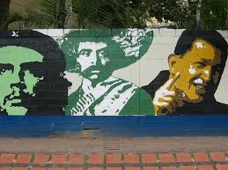
CHE GUEVARA · 1928 – 1967
How a photograph became a “movement”
Korda's 'Guerrillero Heroico' became, in two decades, the most reproduced photograph in history.
PHOTO
Santa Clara, Cuba — bronze monument & mausoleum
PHOTO
Plaza de la Revolución, Havana — 5-story steel mural
PHOTO
Belfast, Northern Ireland — political mural
Santa Clara, Cuba
Buenos Aires
Mexico City
Demonstrations in Yemen
12 / 14
Caracas
Notes:
THE IMAGE GLOBAL (4 minutes): This slide is a placeholder for instructors to insert images of murals, statues, and street art FROM AROUND THE WORLD. Strongly recommend showing real ones. The story to tell: • 1960: Alberto Korda takes the photo at a memorial service in Havana. His newspaper doesn't even use it. Korda hangs it on his studio wall. • 1967: After Che dies, an Italian publisher named Giangiacomo Feltrinelli — who had been given a print by Korda — publishes posters across Europe to publicize Che's 'Bolivian Diary.' • 1968: The image goes viral in the world's most explosive year — student riots in Paris, anti-Vietnam protests, Prague Spring, Mexico City massacre. Irish artist Jim Fitzpatrick creates the famous black/red high-contrast version. Wherever protest happens, his face appears. • Today, the image appears as: a 5-story bas-relief mural on the Ministry of the Interior building in Havana's Plaza de la Revolución; a bronze statue and mausoleum in Santa Clara, Cuba; murals from Belfast (where it features in IRA Republican imagery) to Beirut to Buenos Aires; tattoos; t-shirts at music festivals; and protest banners in causes Che himself never imagined. • Korda himself sued Smirnoff vodka in 2000 for using the image in an ad — and won. He said he supported reproduction for 'the cause of social justice' but not 'for the promotion of products such as alcohol.' INSTRUCTOR NOTE: Replace the photo placeholders on this slide with real images of murals and statues. Search terms: 'Plaza de la Revolución Che Guevara mural,' 'Santa Clara Che Guevara statue,' 'Che Guevara Belfast mural,' 'Che Guevara mural [your city].'

Slide 13
CHE GUEVARA · 1928 – 1967
How should we remember him?
Two views of the same life — both supported by evidence.
ADMIRERS SAY
CRITICS SAY
Anti-imperialist who stood up to U.S. dominance of Latin America
Personally led literacy and healthcare campaigns that reached millions of poor Cubans
Refused privilege — gave up Cuban citizenship and government posts to fight in Africa and Bolivia
Lived and died by his stated principles, unusual for any politician
His writings on guerrilla warfare and revolutionary ethics shaped political movements on every continent
Authorized hundreds of executions at La Cabaña without due process
Helped install a one-party state that has restricted free expression in Cuba for over 60 years
Wrote favorably about violence as a purifying force ('hatred as an element of struggle')
His economic policies failed and damaged Cuba's productive capacity
His revolutionary export model brought instability and authoritarianism to other countries that adopted it
13 / 14
Notes:
THE DEBATE (5 minutes — discussion-driven): This is the most important slide of the presentation pedagogically. Resist the temptation to give students YOUR view. Let them argue. Ask the room: 1. 'Can both columns be true at the same time? If so, what does that say about how we judge historical figures?' 2. 'Is it possible to admire someone's ideals while condemning their methods? Or do the methods invalidate the ideals?' 3. 'Is George Washington a fair comparison? He was a slave-owner who led a revolution that produced a country whose ideals he himself violated. How is Che similar or different?' 4. 'Why do you think the people most likely to wear his t-shirt today are often the ones who would have been executed by his Cuba — wealthy, free-speaking, individualistic Western teenagers?' POINT TO MAKE EXPLICITLY: 'Real historical figures are almost always more complicated than t-shirts allow. Studying them honestly means holding contradictions in mind without resolving them too quickly.' Encourage students to disagree with each other respectfully. Don't shut down strong opinions on either side — but require evidence.

Slide 14
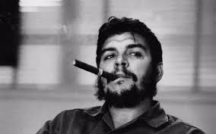
DISCUSSION
Tres Preguntas Claves….
01
What is the difference between Che Guevara the historical figure and Che Guevara the icon? Which one ends up on a t-shirt — and why?
02
Can a person who killed prisoners be remembered as a moral hero? Where would you draw the line, and what evidence would change your mind?
03
If you had to put one image on a wall to represent the political hopes of the “modern era”, would it be this one? If not, what would you choose instead?
14 / 14
Notes:
CLOSING / DISCUSSION (5–10 minutes): Don't lecture in the closing. Open the floor. Q1 — THE FIGURE VS THE ICON: This is the central paradox of his afterlife. The point is to get students to notice that t-shirts and posters compress a complicated life into a single mood. Once students see the compression, they can apply the same critical lens to other figures (MLK, Gandhi, Mandela, Lincoln — all also flattened by their iconography). Q2 — DRAWING THE LINE: Push students to be specific. 'Where would you draw the line' is concrete. Some will say: 'I'd admire him if he hadn't run La Cabaña.' Others: 'You can't have a revolution without violence — judge him by 1959 standards, not 2026 standards.' Others: 'He was a war criminal full stop.' Let all positions be heard. Require evidence. Q3 — A REPLACEMENT IMAGE: This is fun and reveals values. Some will say a Hubble photo of Earth. Others a Tiananmen tank-man. Others a smartphone. Others nothing — because no single image can do that work. All answers reveal what they think the 20th century was about. WRAP-UP (1 minute): 'Che Guevara is one of the most-photographed, most-debated, most-merchandised people who ever lived. The honest historian's job — and your job, in this class — is to look past the t-shirt at the man, and past the man at the world that produced him. The point of studying figures like this is not to give you a verdict. It's to give you the tools to reach your own.' Thank students. Hand out reading list if applicable.

