Slide 1
Penetration testing and hacking tools for Kali Linux Information and Network Security
Supervisor : Dr Mohammad Moreb By: Derar Abu Sheikha

Slide 2


Content
Introduction
Nmap
WPScan
Metasploit
Traceroute
Wireshark
Burp Suite
Maltego
Nessus
BeEF
Nikto
Social Engineering Toolkit (SET)

Slide 3

Introduction:
Best Kali Linux Tools for Hacking and Penetration Testing
Here’s our list of best Kali Linux tools that will allow you to assess the security of web-servers and help in performing hacking and pen-testing.
If you read the Kali Linux review, you know why it is considered one of the best Linux distributions for hacking and pen-testing and rightly so. It comes baked in with a lot of tools to make it easier for you to test, hack, and for anything else related to digital forensics.
It is one of the most recommended Linux distro for ethical hackers. Even if you are not a hacker but a webmaster – you can still utilize some of the tools to easily run a scan of your web server or web page.
Note that not all tools mentioned here are open source.

Slide 4
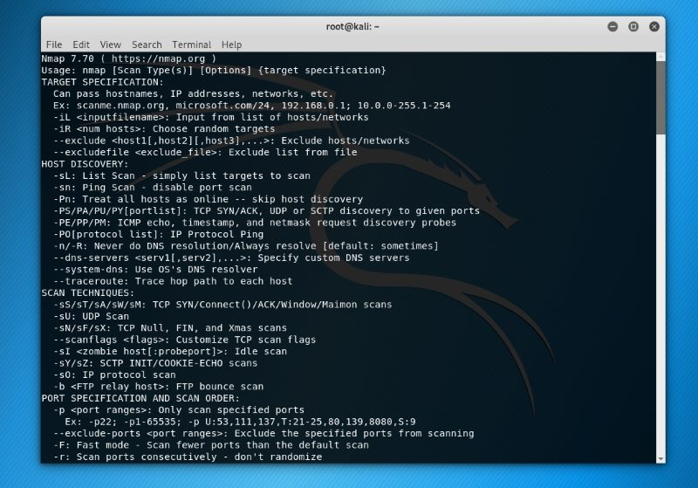
Nmap
Nmap or “Network Mapper” is one of the most popular tools on Kali Linux for information gathering. In other words, to get insights about the host, its IP address, OS detection, and similar network security details

Slide 5
WPScan
WordPress is one of the best open source CMS and this would be the best free WordPress security auditing tool. It’s free but not open source.
If you want to know whether a WordPress blog is vulnerable in some way, WPScan is your friend.
In addition, it also gives you details of the plugins active. Of course, a well-secured blog may not give you a lot of details, but it is still the best tool for WordPress security scans to find potential vulnerabilities.

Slide 6
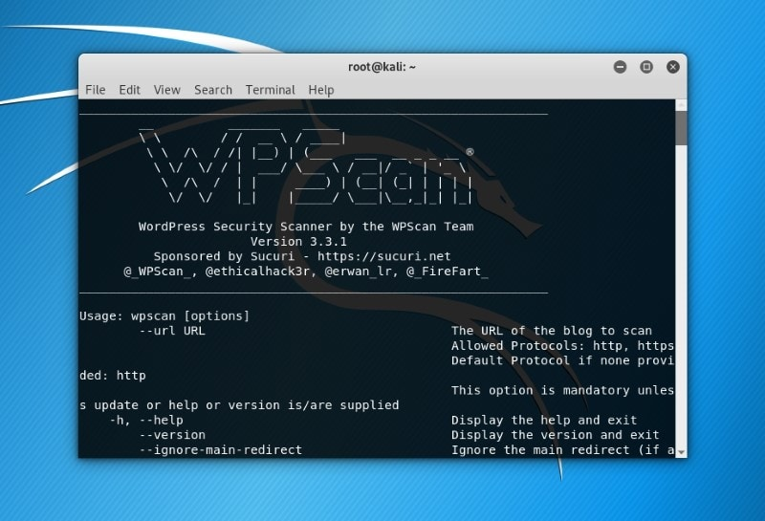
WPScan

Slide 7
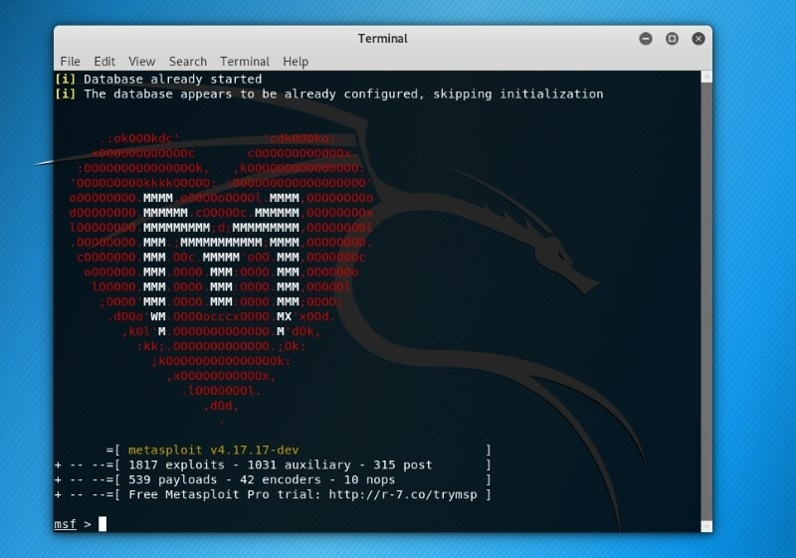
Metasploit
Metsploit Framework is the most used penetration testing framework. It offers two editions – one (open source) and the second is the pro version to it. With this tool, you can verify vulnerabilities, test known exploits, and perform a complete security assessment.

Slide 8
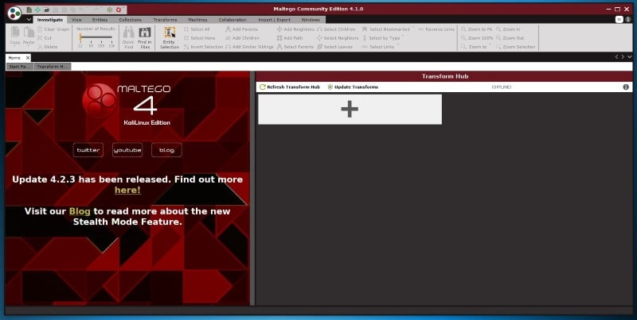
Maltego
Maltego is an impressive data mining tool to analyze information online and connect the dots (if any). As per the information, it creates a directed graph to help analyze the link between those pieces of data.

Slide 9
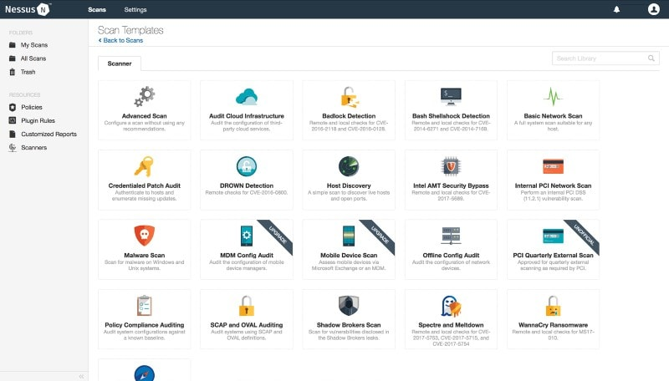
Nessus
If you have a computer connected to a network, Nessus can help find vulnerabilities that a potential attacker may take advantage of. Of course, if you are an administrator for multiple computers connected to a network, you can make use of it and secure those computers.

Slide 10
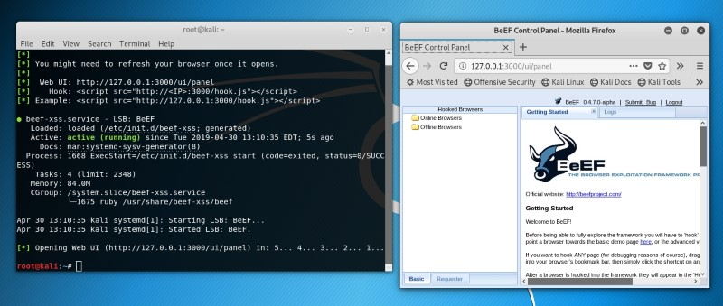
BeEF
BeEF (Browser Exploitation Framework) is yet another impressive tool. It has been tailored for penetration testers to assess the security of a web browser.

Slide 11
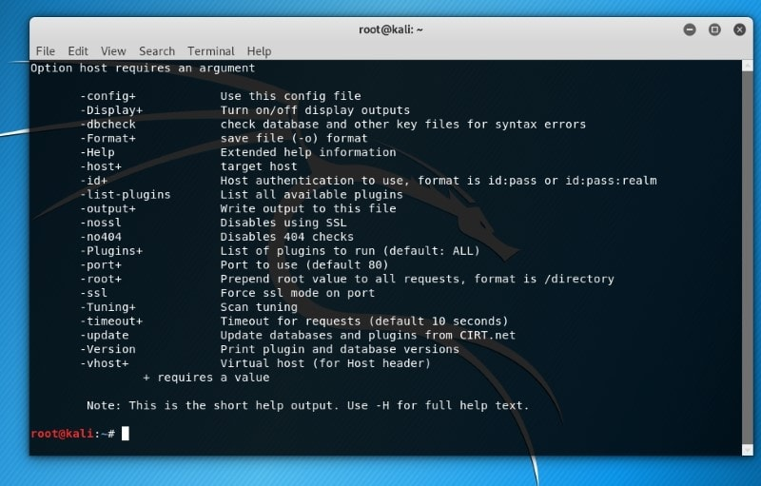
Nikto
Nikto is a powerful web server scanner – that makes it one of the best Kali Linux tools available. It checks in against potentially dangerous files/programs, outdated versions of server, and many more things.

Slide 12
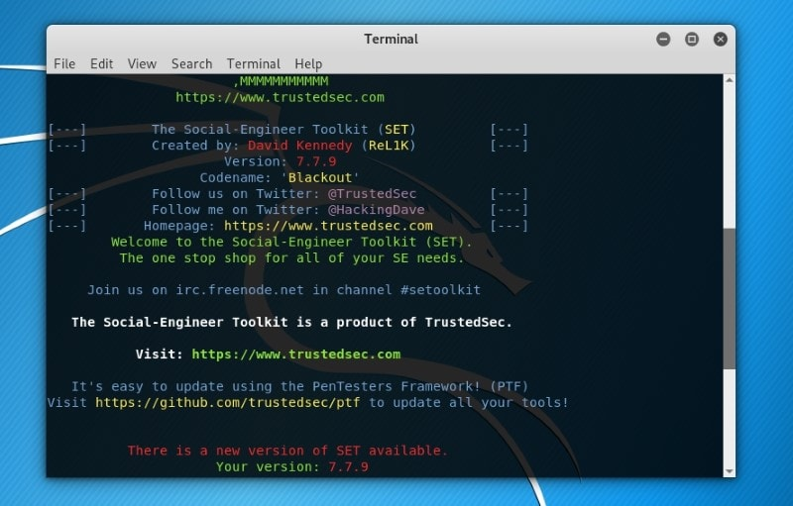
Social Engineering Toolkit (SET)
If you are into pretty serious penetration testing stuff, this should be one of the best tools you should check out. Social engineering is a big deal and with SET tool, you can help protect against such attacks.

Slide 13
THE END ☺

