Slide 1
Digital Steganography
Pelin Gul
Sankar Das

Slide 2
Outline
What is Steganography?
Uses of Steganography
Its Relation to Cryptography
Digital Watermarking
Network Security and Steganography
Types of Steganography
Detecting Steganography: Steganalysis
Future of Steganography

Slide 3
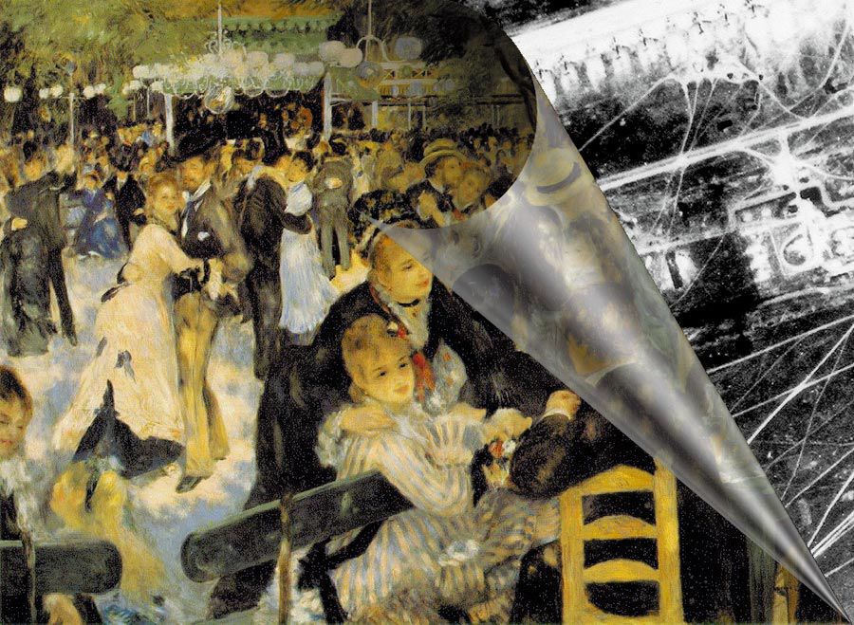
What is Steganography?
Origin of the term: steganos: secret – graphy: writing

Slide 4
History of Steganography
Steganography in Ancient Greece
Ancient Rome - 1499, Steganographia, the first book about steganography
World War II Germany - microdots
Modern Steganography - 1985, with the development of personal computers
Digital Steganography – with internet (e.g.digital watermarking)

Slide 5
Uses of Steganography
Governments
Businesses: Digital Watermarking
Individuals

Slide 6
Steganography & Cryptography
Steganography and Cryptography are closely related
The difference is in their goals...
  Cryptography: although encypted and unreadable, the existence of data is not hidden
  Steganography: no knowledge of the existence of the data
Steganography and Cryptography can be used together to produce better protection

Slide 7

Digital Watermarking
Image “painted” with the watermark: “Invisible Man” © 1997, Neil F. Johnson

Slide 8
Digital Watermarking
Used primarily for identification
Embedding a unique piece of information within a medium (typically an image) without noticeably altering the medium
Almost impossible to remove without seriously degrading an image

Slide 9
Digital Steganogaphy & Watermarking
Digital watermarking hides data in a file, and the act of hiding data makes it a form or steganography
The key difference is their goals...
  Steganography: hiding information
  Watermarking: extending the file with extra information
Steganographic information must never be apparent to a viewer unaware of its presence.

Slide 10
Network Security and Steganography
Confidentiality: any unauthorized person does not know that sensitive data exists
Survivability: verifying that the data does not get destroyed in the transmission
No detection: cannot be easily found out that the data is hidden in a given file
Visibility: people cannot see any visible changes to the file in which the data is hidden

Slide 11
Types of Digital Steganography
Hiding a Message inside Text
Hiding a Message inside Images
  Most popular technique
Hiding a Message inside Audio and Video Files

Slide 12
Hiding a Message inside Text
Partially effective
randoM capitalosis is a rarE disEase ofTen
contrAcTed by careless inTernet users. tHis sad
illnEss causes the aFfected peRsON To randomly
capitalize letters in a bOdy oF texT. please
do not confuse this disease witH a blatant
attEmpt aT steganogRAPhy.
Reveals: MEET AT THE FRONT OF THE TRAP

Slide 13
Hiding a Message inside Text
First-letter algorithm
Every n-th character
Altering the amount of whitespace
Using a publicly available cover source

Slide 14
Hiding a Message inside Images
The most popular medium!
Least-significant bit (LSB) modifications
  24-bit vs. 8-bit images
  Tools to implement LSB: EzStego and S-Tools
Masking and Filtering
Algorithms and Transformations

Slide 15


Hiding an Image within an Image
Removing all but the two least significant bits of each color component produces an almost completely black image. Making that image 85 times brighter produces the image below
source: wikipedia.org

Slide 16
Hiding a Message inside Audio or Videos Files
Advantages
  Human limitations – 20.000 Hz.
  Large amount of data that can be hidden inside
  Hard to recognize because of because of the continuous flow of information (moving stream of images and sound)

Slide 17
Steganalysis
Detecting and decoding the hidden data within a given medium
Even if secret content is not revealed, modifying the cover medium changes the medium’s statistical properties
Distributed Dictionary Attack

Slide 18
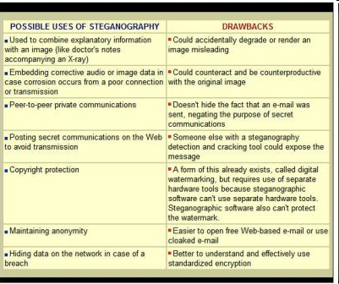

Slide 19
Future of Steganography
The most important use of steganographic techniques will probably lie in the field of digital watermarking
Might become limited under laws - governments claimed that criminals use steganography to communicate
...the End

