Slide 1
LEARNING

Slide 2
What is Learning?
Learning is a an area of AI that focuses on processes of self-improvement.
Information processes that improve their performance or enlarge their knowledge bases are said to learn.
A goal of AI is to enable computers that can be taught rather than programmed.
Why Learning is hard?
It must be able to learn to do new things.
This requires knowledge acquisition, inference, updating/refinement of knowledge base, acquisition of heuristics, applying faster searches, etc.
Intelligence implies that an organism or machine must be able to adapt to new situations

Slide 3
How can we learn?
Skill Refinement
Knowledge acquisition
Taking advice
Problem solving
Induction
Discovery
Analogy

Slide 4
General Model of Learning Agents
Percepts are used not just for acting, but for improving future performance.
Four Basic Components are:
Performance element
responsible for selecting actions for good agent performance
agent function considered previously: percepts→actions
Learning element
responsible for improving performance element
requires feedback on how the agent is doing
Critic element
responsible for providing feedback
comparison with objective performance standard (outside agent)
Problem Generator
responsible for generating new experience
requires exploration — taking suboptimal actions

Slide 5
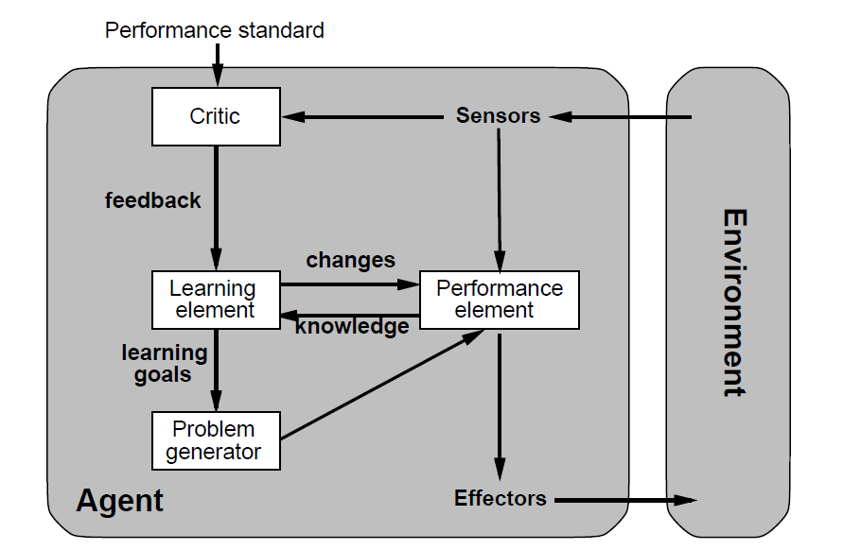
General Model of Learning Agents

Slide 6
Example- Taxi Driver Agent
Performance element —Lets take Winthrop Ave, I know it works.
Problem generator — Nah, lets try Mounts Bay Rd for a change.You never know, it may be quicker.
Critic — Wow, it was 5 mins quicker, and what a lovely view!
Learning element — Yeh, in future we’ll take Mounts Bay Rd.

Slide 7
Learning from Observations
Two Goals:
Improve outcome of performance element
Improve time performance of performance element
Design of a learning element is affected by four issues:
the components of the performance element to be improved
representation of those components
feedback available
prior information available

Slide 8
Components
An intelligent agent may have to learn, for instance, the following components:
A direct mapping from conditions on the current state to actions
A means to infer relevant properties of the world from the percept sequence
Information about the way the world evolves and about the results of possible actions the agent can take
Utility information indicating the desirably of world states
Action-value information indicating the desirably of actions
Goals that describe classes of states whose achievement maximizes the agent’s utility

Slide 9
Types of Learning from Observation
The type of feedback available for learning determines the nature of the learning problem that the agent faces
Supervised learning involves learning a function from examples of its inputs and outputs
Unsupervised learning involves learning patterns in the input when no specific output values are supplied
In reinforcement learning the agent must learn from reinforcement (reward, less exact feedback than in supervised learning)

Slide 10
Rote Learning
Rote Learning is basically memorisation.
Saving knowledge so it can be used again.
Retrieval is the only problem.
No repeated computation, inference or query is necessary
Memorisation is a key necessity for learning:
It is a basic necessity for any intelligent program
Memorisation can be a complex subject
A simple example of rote learning is caching
Store computed values (or large piece of data)
Recall this information when required by computation.
Significant time savings can be achieved.

Slide 11
Samuel's Checkers program
It employeed Rote Learning First.
It is also used as Parameter adjustment
Implementation:
A minimax search was used to explore the game tree.
Time constraints do not permit complete searches.
It records board positions and scores at search ends.
Now if the same board position arises later in the game the stored value can be recalled and the end effect is that more deeper searched have occurred.

Slide 12
Issues Related to Rote Learning
Organisation
access of the stored value must be faster than it would be to recompute it
Generalisation
The number of potentially stored objects can be very large. We may need to generalise some information to make the problem manageable.
Stability of the Environment
Rote learning is not very effective in a rapidly changing environment. If the environment does change then we must detect and record exactly what has changed -- the frame problem..

Slide 13
Continued
Store v Compute
Rote Learning must not decrease the efficiency of the system.
We be must able to decide whether it is worth storing the value in the first place. Eg. It is quicker to recompute the product of two numbers rather than store a large multiplication table.
Selective forgetting
here we allow the information to be stored initially and decide later if we retain it. Clearly the frequency of reuse is a good measure
Cost-benefit analysis
Decide when the information is first available whether it should be stored. An analysis could weigh up amount of storage required, cost of computation, likelihood of recall

Slide 14
Learning By Advice
Two basic Approaches:
Take high level, abstract advice and convert it into rules that can guide performance elements of the system. Automate all aspects of advice taking
Develop sophisticated tools such as knowledge base editors and debugging. These are used to aid an expert to translate his expertise into detailed rules. Here the expert is an integral part of the learning system. Such tools are important in expert systems area of AI

Slide 15
Automatic Advice Taking
Request
This can be simple question asking about general advice or more complicated by identifying shortcomings in the knowledge base and asking for a remedy.
Interpret
the advice into an internal representation
Operationalise
Translated advice may still not be usable so this stage seeks to provide a representation that can be used by the performance element
Integrate
When knowledge is added to the knowledge base care must be taken so that bad side-effects are avoided
Evaluate
The system must assess the new knowledge for errors, contradictions etc

Slide 16
Learning by Problem Solving
There are three basic methods in which a system can learn from its own experiences
Learning by Parameter Adjustment
Learning by Macro Operators
Learning by Chunking

Slide 17
Learning by Parameter Adjustment
Evaluation Function:
c1t1+c2t2+c3t3+….
where c= weights n t = values
Concept:
Start with some estimate of the correct weight settings.
Modify the weight in the program on the basis of accumulated experiences.
Features that appear to be good predictors will have their weights increased and bad ones will be decreased

Slide 18
Learning by Macro Operators
The basic idea here is similar to Rote Learning:
Avoid expensive recomputation
Macro-operators can be used to group a whole series of actions into one
Eg. Making dinner can be described a lay the table, cook dinner, serve dinner. We could treat laying the table as on action even though it involves a sequence of actions

Slide 19
Learning by Chunking
Chunking involves similar ideas to Macro Operators and originates from psychological ideas on memory and problem solving
SOAR is a system that use production rules to represent its knowledge. It also employs chunking to learn from experience
Basic Outline of SOAR's Method:
SOAR solves problems it fires productions these are stored in long term memory.
Some firings turn out to be more useful than others.
When SOAR detects are useful sequence of firings, it creates chunks.
A chunk is essentially a large production that does the work of an entire sequence of smaller ones.
Chunks may be generalised before storing

Slide 20
Explanation Based Learning
EBL can take a single training example and determine what are the relevant features in order to form a generalization
EBL system works by finding a way to deduce each training example from the system's existing database of domain theory
EBL software takes four inputs:
a hypothesis space (the set of all possible conclusions)
a domain theory (axioms about a domain of interest)
training examples (specific facts that rule out some possible hypotheses)
operationality criteria (criteria for determining which features in the domain are efficiently recognizable, e.g. which features are directly detectable using sensors)

Slide 21
Inductive Learning
This involves the process of learning by example -- where a system tries to induce a general rule from a set of observed instances
This involves classification -- assigning, to a particular input, the name of a class to which it belongs. Classification is important to many problem solving tasks
A learning system has to be capable of evolving its own class descriptions
Initial class definitions may not be adequate
The world may not be well understood or rapidly changing
The task of constructing class definitions is called induction or concept learning

Slide 22
Decision Tree
A decision tree is a simple representation for classifying examples. Decision tree learning is one of the most successful techniques for supervised classification learning
A decision tree or a classification tree is a tree in which each internal (non-leaf) node is labeled with an input feature.
The arcs coming from a node labeled with a feature are labeled with each of the possible values of the feature.
Each leaf of the tree is labeled with a class or a probability distribution over the classes

Slide 23
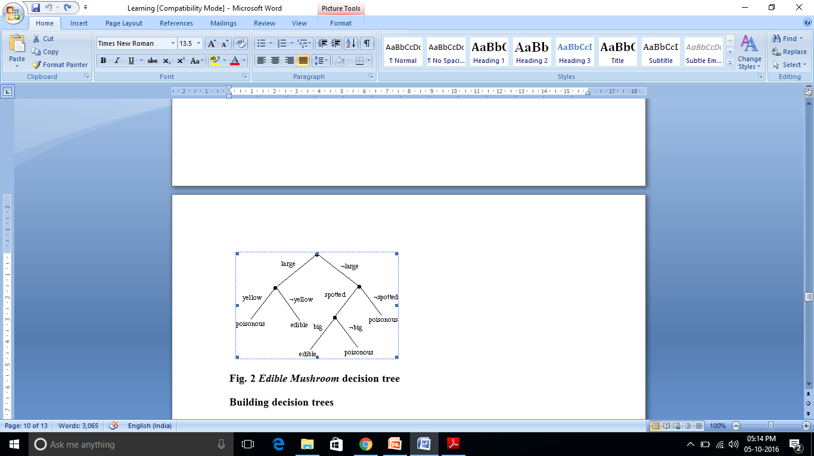
Learning Decision Trees
Basically each leaf of a decision tree asserts a positive or negative concept. To classify a particular input we start at the top and follow assertions down until we reach an answer

Slide 24
Building Decision Trees
ID3 uses an iterative method.
Simple trees preferred as more accurate classification is afforded.
A random choice of samples from training set chosen for initial assembly of tree -- the window subset.
Other training examples used to test tree.
If all examples classified correctly stop.
Otherwise add a number of training examples to window and start again

Slide 25
Top Down Induction of Decision Tree
• The input to the algorithm is a training set, which consists of examples (X, y), where X is a vector of input attribute values and y is the single output value (class value) attached to them
• We could simply construct a consistent decision tree that has one path from the root to a leaf for each example
• Then we would be able to classify all training examples correctly, but the tree would not be able to generalize at all
• Applying Occam’s razor, we should find the smallest decision tree that is consistent with the examples
• Unfortunately, for any reasonable definition of “smallest,” finding the smallest tree is an intractable problem
• Successful decision tree learning algorithms are based on simple heuristics and do a good of finding a smallish tree
• The basic idea is to test the most important attribute first
• Because the aim is to classify instances, “most important” attribute is the one that makes the most difference to the classification of an example

Slide 26
If there are no examples left, it means that no such example has been observed, and we return a default value calculated from the majority classification at the node’s parent (or the majority classification at the root)
If there are no attributes left but still instances of several classes in the remaining portion of the data, it means that these examples have exactly the same description, but different classification
Then we say that there is noise in the data
Noise may follow either when the attributes do not give enough information to describe the situation fully, or when the domain is truly nondeterministic
One simple way out of this problem is to use a majority vote Choosing attribute tests
The idea is to pick the attribute that goes as far as possible toward providing an exact classification of the examples
A perfect attribute divides the examples into sets that contain only instances of one class

Slide 27
A really useless attribute leaves the example sets with roughly the same proportion of instances of all classes as the original set
To measure the usefulness of attributes we can use, for instance, the expected amount of information provided by the attribute – i.e., its Shannon entropy
Information theory measures information content in bits
One bit of information is enough to answer a yes/no question about which one has no idea, such as the flip of a fair coin

