Slide 1
Collaboration Diagrams
CSIS3600

Slide 2
What is a Collaboration Diagram
Collaboration diagrams illustrate interactions between objects
The collaboration diagram illustrates messages being sent between classes and objects (instances).
Collaboration diagrams express both the context of a group of objects (through objects and links) and the interaction between these objects (by representing message broadcasts)

Slide 3
Purpose of the Collaboration Diagram
They are very useful for visualizing the relationship between objects collaborating to perform a particular task
They provide a good view – albeit static - view of interaction between objects which may be difficult to see at the class level

Slide 4
Collaboration Diagram
Represents a Collaboration and Interaction
Collaboration­set of objects and their interactions in a specific context
Interaction­set of messages exchanged in a collaboration to produce a desired result

Slide 5
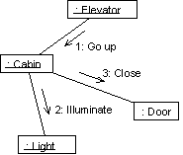
Ex. Collaboration Diagram

Slide 6
Collaboration Diagram Elements
There are three primary elements of a collaboration diagram:
Objects
Links
Messages

Slide 7
Collaboration Diagram Syntax
AN ACTOR
AN OBJECT
AN ASSOCIATION
A MESSAGE
anObject:aClass
aMessage()

Slide 8
Objects
Objects­rectangles containing the object signature­object signature:
object name : object Class
object name (optional) - starts with lowercase letter
class name (mandatory) - starts with uppercase letter
Objects connected by lines­actor can appear

Slide 9
Objects
Objects participating in a collaboration come in two flavors—supplier and client
Supplier objects are the objects that supply the method that is being called, and therefore receive the message
Client objects call methods on supplier objects, and therefore send messages

Slide 10
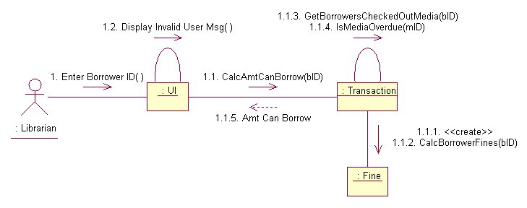
Transaction object acts as a Supplier to the UI (User Interface) Client object. In turn, the Fine object is a Supplier to the Transaction Client object.

Slide 11
Links
The connecting lines drawn between objects are links
They enable you to see the relationships between objects
This symbolizes the ability of objects to send messages to each other
A single link can support one or more messages sent between objects

Slide 12
The visual representation of a link is a straight line between two objects. If an object sends messages to itself, the link carrying these messages is represented as a loop icon. This loop can be seen on both the UI object and the Transaction object.

Slide 13
Messages
An interaction is implemented by a group of objects that collaborate by exchanging messages
Messages in collaboration diagrams are shown as arrows pointing from the Client object to the Supplier object.
Typically, messages represent a client invoking an operation on a supplier object

Slide 14
Messages
Message icons have one or more messages associated with them
Messages are composed of message text prefixed by a sequence number
Time is not represented explicitly in a collaboration diagram, and as a result the various messages are numbered to indicate the sending order

Slide 15
Flow by Number

Slide 16
Flow by Numbers
1. Enter Borrower ID
1.1 CalcAmtCanBorrow
1.1.1 <<create>>
1.1.2 CalcBorrowerFines
1.1.3 GetBorrowersCheckedOutMedia
1.1.4 IsMediaOverdue
1.1.5 Amt Can Borrow
1.2 Display Invalid User Msg

Slide 17
Message Flow Notation
Same as for sequence diagrams
Synchronous
Flow of control
Asynchronous
Return

Slide 18
Iterating Messages
Collaboration diagrams use syntax similar to sequence diagrams to indicate that either a message iterates (is run multiple times) or is run conditionally
An asterisk (*) indicates that a message runs more than once
Or the number of times a message is repeated can be shown by numbers (for example, 1..5)

Slide 19
Conditional Messages
To indicate that a message is run conditionally, prefix the message sequence number with a conditional [guard] clause in brackets [ x = true ]:
[IsMediaOverdue]
This indicates that the message is sent only if the condition is met

Slide 20
Collaboration vs Sequence Diagram
In reality, sequence diagrams and collaboration diagrams show the same information, but just present it differently
Not used as often as sequence diagrams but are closely related

Slide 21
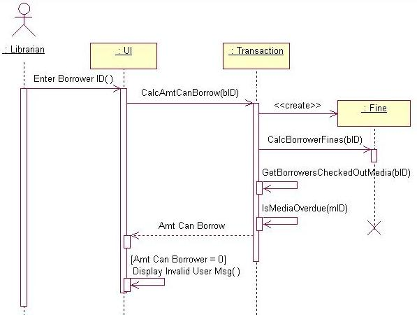
Sequence diagram is better at ‘time ordering’

Slide 22
Collaboration diagram is better at showing the relationship between objects

Slide 23
Number of Messages
In sequence diagrams, each message icon represents a single message.
In collaboration diagrams, a message icon can represent one or more messages.
Notice between the Transaction and Fine objects - there is a single message icon, but there are two messages (1.1.1 and 1.1.2) associated with the icon.

Slide 24
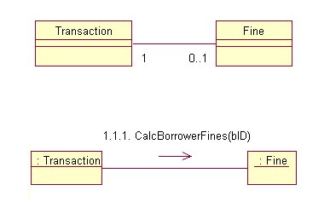
Collaboration and Class Diagrams
Links in a collaboration diagram directly correlate to associations between classes in a class diagram

Slide 25
Steps to Creating a Collaboration Diagram
Determine the scope of the diagram- the use case it relates to
Place the objects that participate in the collaboration on the diagram
Remember to place the most important objects towards the center of the diagram.
If a particular object has a property or maintains a state that is important to the collaboration, set the initial value of the property or state

Slide 26
Steps to Creating a Collaboration Diagram
Create links between the objects
Create messages associated with each link
Add sequence numbers to each message corresponding to the time-ordering of messages in the collaboration

Slide 27
Creation and Deletion
Unlike sequence diagrams, you don't show an object's lifeline in a collaboration diagram
If you want to indicate the lifespan of an object in a collaboration diagram, you can use create and destroy messages to show when an object is instantiated and destroyed

Slide 28
Objects Changing State
State of on object can be indicated
Initial state is indicated with <<create>>
If an object changes significantly during an interaction, you can add a new instance of the object to the diagram, draw a link between them and add a message with the stereotype <<become>>

Slide 30
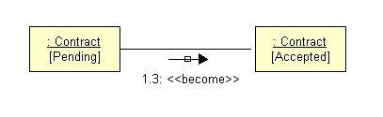
Change State of an Object

Slide 31
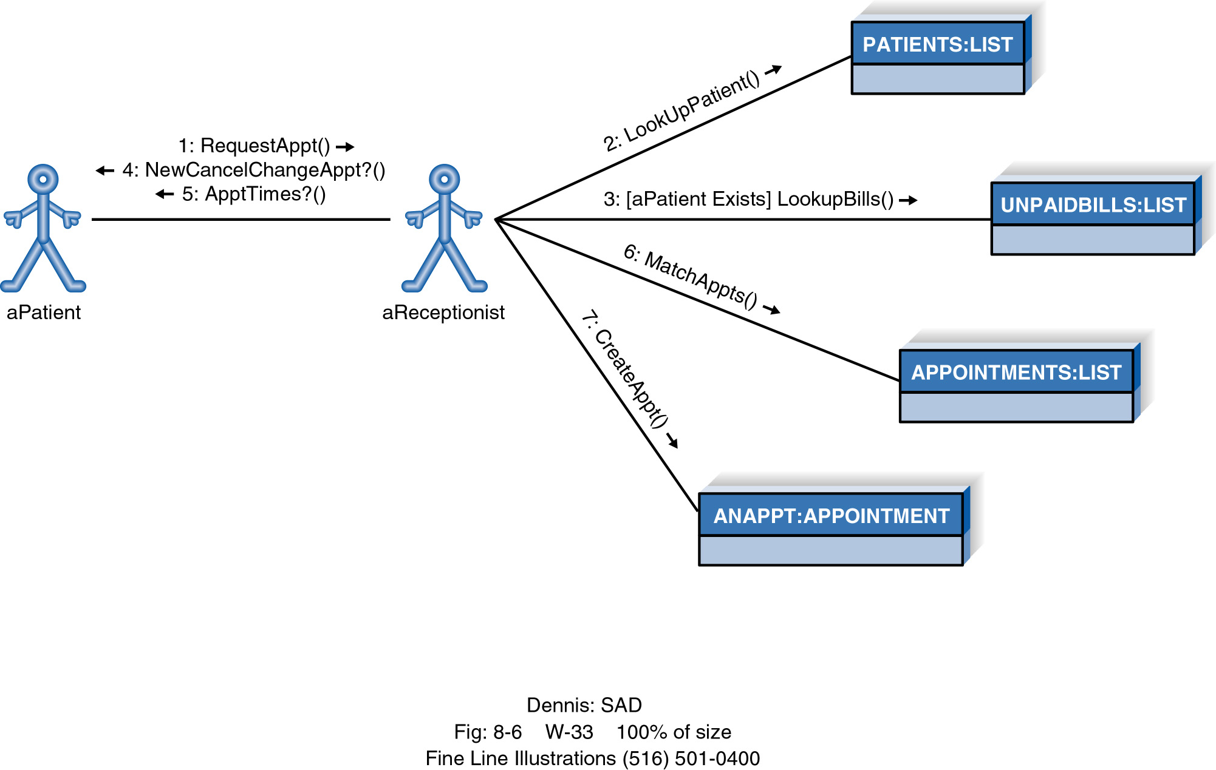
Example Collaboration Diagram

Slide 32
Reference
http://www.devx.com/codemag/articles/2002/mayjune/collaborationdiagrams/codemag-2.asp

