Slide 1
KMeans Clustering Algorithm
Done By
Mohammed K Jumaah
Mohammed Q Kareem
Kayrat Jawad Hasan

Slide 2
OUTLINE
What is Clustering?
What is K-Means?
K-Means Clustering.
K-Means Algorithm.

Slide 3
Clustering
Clustering is the process of dividing the datasets into groups, consisting of similar data points.
Points in the same group are as similar as possible.
Points in different groups are as dissimilar as possible.

Slide 4
K-Means
K-Means is a clustering algorithm whose main goal is to group similar elements or data points into a cluster.
It’s the most common algorithm that uses an iterative refinement technique.

Slide 5
K-Means Clustering
Strengths
Simple iterative method
User provides “K”
Weaknesses
Often too simple bad results
Difficult to guess the correct “K”

Slide 6
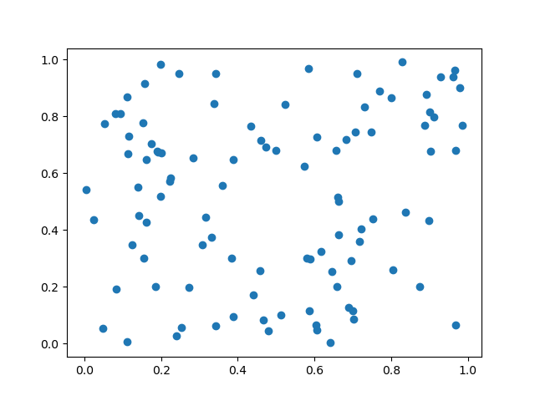
K-Means Algorithm
Initialize data with 2 columns
K = 2

Slide 7
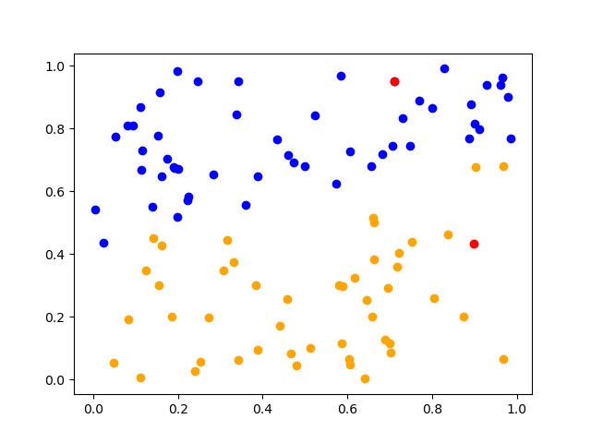
K-Means Algorithm con.
Pick random Centroids.

Slide 8
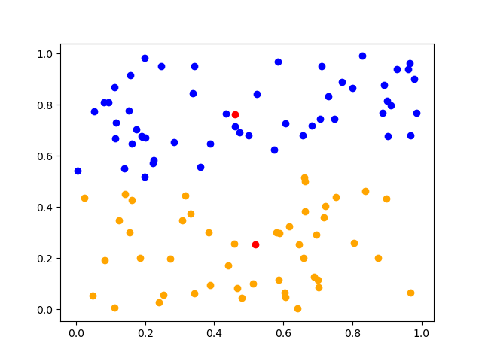
K-Means Algorithm con.
Calculate the distance between every data point with Centroids using Squared Euclidean distance.
Assign data points
to the closest centroid.
Recalculate new
centroids.

Slide 9
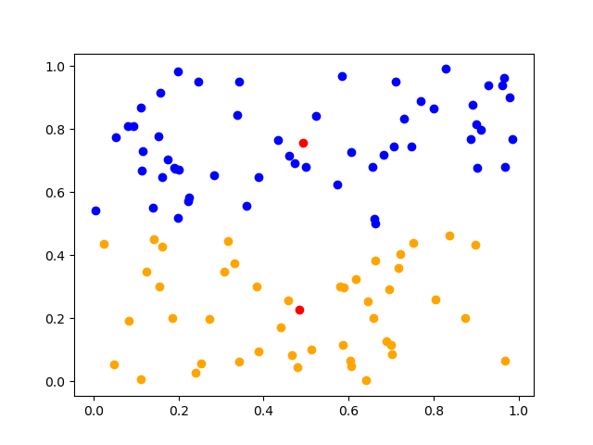
K-Means Algorithm con.
Iterate the previous steps.
Stop based on convergence criteria.
No change in clusters

Slide 10
THANK YOU!

