Slide 1
IMAGE SEGMENTATION METHOD USING KMEANS AND KNN
Students
Supervised
Mohammed Kifah Jumaah
Kayrat Jawad Hasan
Dr. Zahra Rezaei

Slide 2
OUTLINE
Image Segmentation Method
Methodologies
Tools and Packages
Preposed Algorithm
Results
Conclusion
References

Slide 3
IMAGE SEGMENTATION METHOD
Image segmentation is considered as the first step in the image processing and therefore, a better segmentation will make it easier to analyze in the subsequent image processing steps.

Slide 4
METHODOLOGIES
We used in our project this algorithms for image segmentation:
Kmeans
KNN
PCA
The k-means algorithm is the powerful clustering algorithm but it need some optimization on it. So we combine KNN algorithm for optimize the output of K-Means results.
Also we used PCA method for decomposition and clean image data before segmentation.

Slide 5
KMEANS ALGORITHM
K-Means Clustering is an unsupervised learning algorithm that is used to solve the clustering problems in machine learning or data science.
K-Means main goal is to group similar elements or data points into a cluster.

Slide 6
KNN ALGORITHM
K-Nearest Neighbor is one of the simplest Machine Learning algorithms based on Supervised Learning technique.
K-NN algorithm assumes the similarity between the new case/data and available cases and put the new case into the category that is most similar to the available categories.
K-NN algorithm stores all the available data and classifies a new data point based on the similarity.

Slide 7
PCA ALGORITHM
Principal component analysis (PCA) is a technique to bring out strong patterns in a dataset by suppressing variations.
It is used to clean data sets to make it easy to explore and analyze.

Slide 8
TOOLS AND PACKAGES
Visual Studio Code as editor.
Python programming language.
Matplotlib.
CV2.
Numpy.

Slide 9
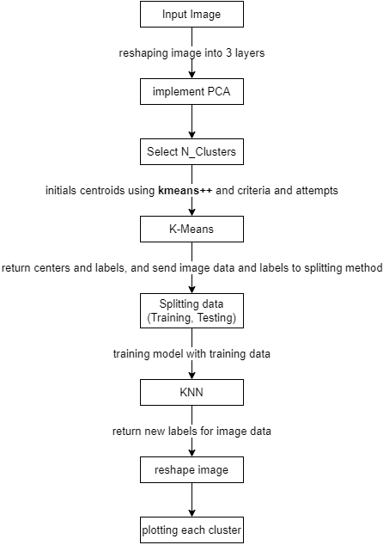
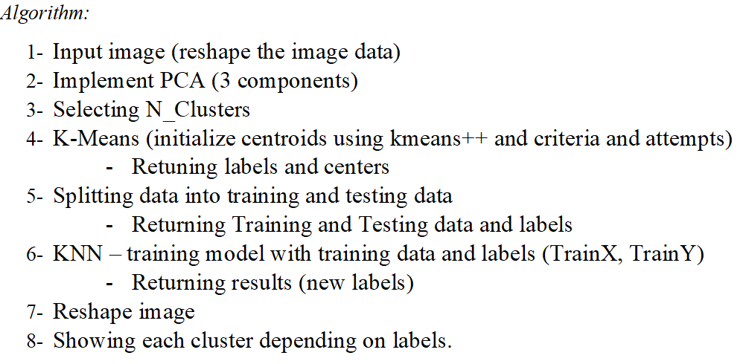
PROPOSED ALGORITHM
Flowchart:

Slide 10
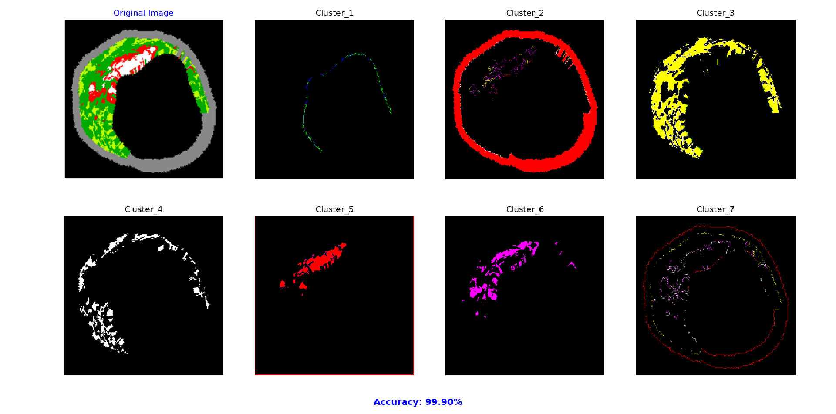
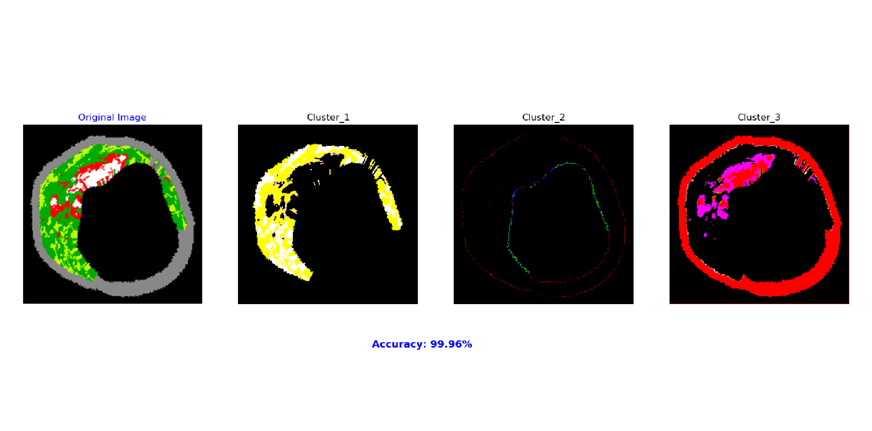
RESULTS
Here is the subplot for each cluster depending on N_Clusters, showing all layers for original image after segmentation.
3 Clusters
7 Clusters

Slide 11
CONCLUSION
In this project we try our way for image segmentation based on the k-means and knn algorithms. And that made a some optimization and segment the image into there layers based on number of clusters. As we see the accuracy for 3 clusters is 99.96% and for 7 clusters 99.60%. This accuracy values shows how much there is similarity between the k-means output labels and knn output labels. So there is 0.04% optimization on k-means for 3 clusters and 0.40% for 7 clusters.

Slide 12
REFERENCES
Altini, N., De Giosa, G., Fragasso, N., Coscia, C., Sibilano, E., Prencipe, B., Hussain, S., Brunetti, A., Buongiorno, D., Guerriero, A., Tatò, I., Brunetti, G., Triggiani, V. and Bevilacqua, V., 2021. Segmentation and Identification of Vertebrae in CT Scans Using CNN, k-Means Clustering and k-NN. Informatics, 8(2), p.40.
Dhanachandra, N., Manglem, K. and Chanu, Y., 2015. Image Segmentation Using K -means Clustering Algorithm and Subtractive Clustering Algorithm. Procedia Computer Science, 54, pp.764-771.
D. and Kumar Mishra, M., 2017. Frequency Domain Digital Image Segmentation based on a Modified kMeans. SSRN Electronic Journal,.
Mesecan, I., & Bucak, I. O. (2014). Searching the effects of image scaling for underground object detection using KMEANS and KNN. 2014 European Modelling Symposium. https://doi.org/10.1109/ems.2014.64

Slide 13
THANKS

