Slide 1
Chapter 1 – A Simple iOS Application
Building the 'Quiz' App
CS-397 – Professor Breaker
Notes:
Introduce the chapter: building the Quiz app using Xcode. Mention that this is the first hands-on project.

Slide 2

Introduction & Objectives
- Purpose: Create a simple iOS app with Xcode & Interface Builder
- Learn MVC (Model–View–Controller)
- Build and run the 'Quiz' app
- Outcomes: Create project, design UI, connect UI, test app
- Add GitHub account to Xcode
Notes:
Explain the learning objectives clearly: students will learn MVC, project setup, UI design, and connecting code.

Slide 3
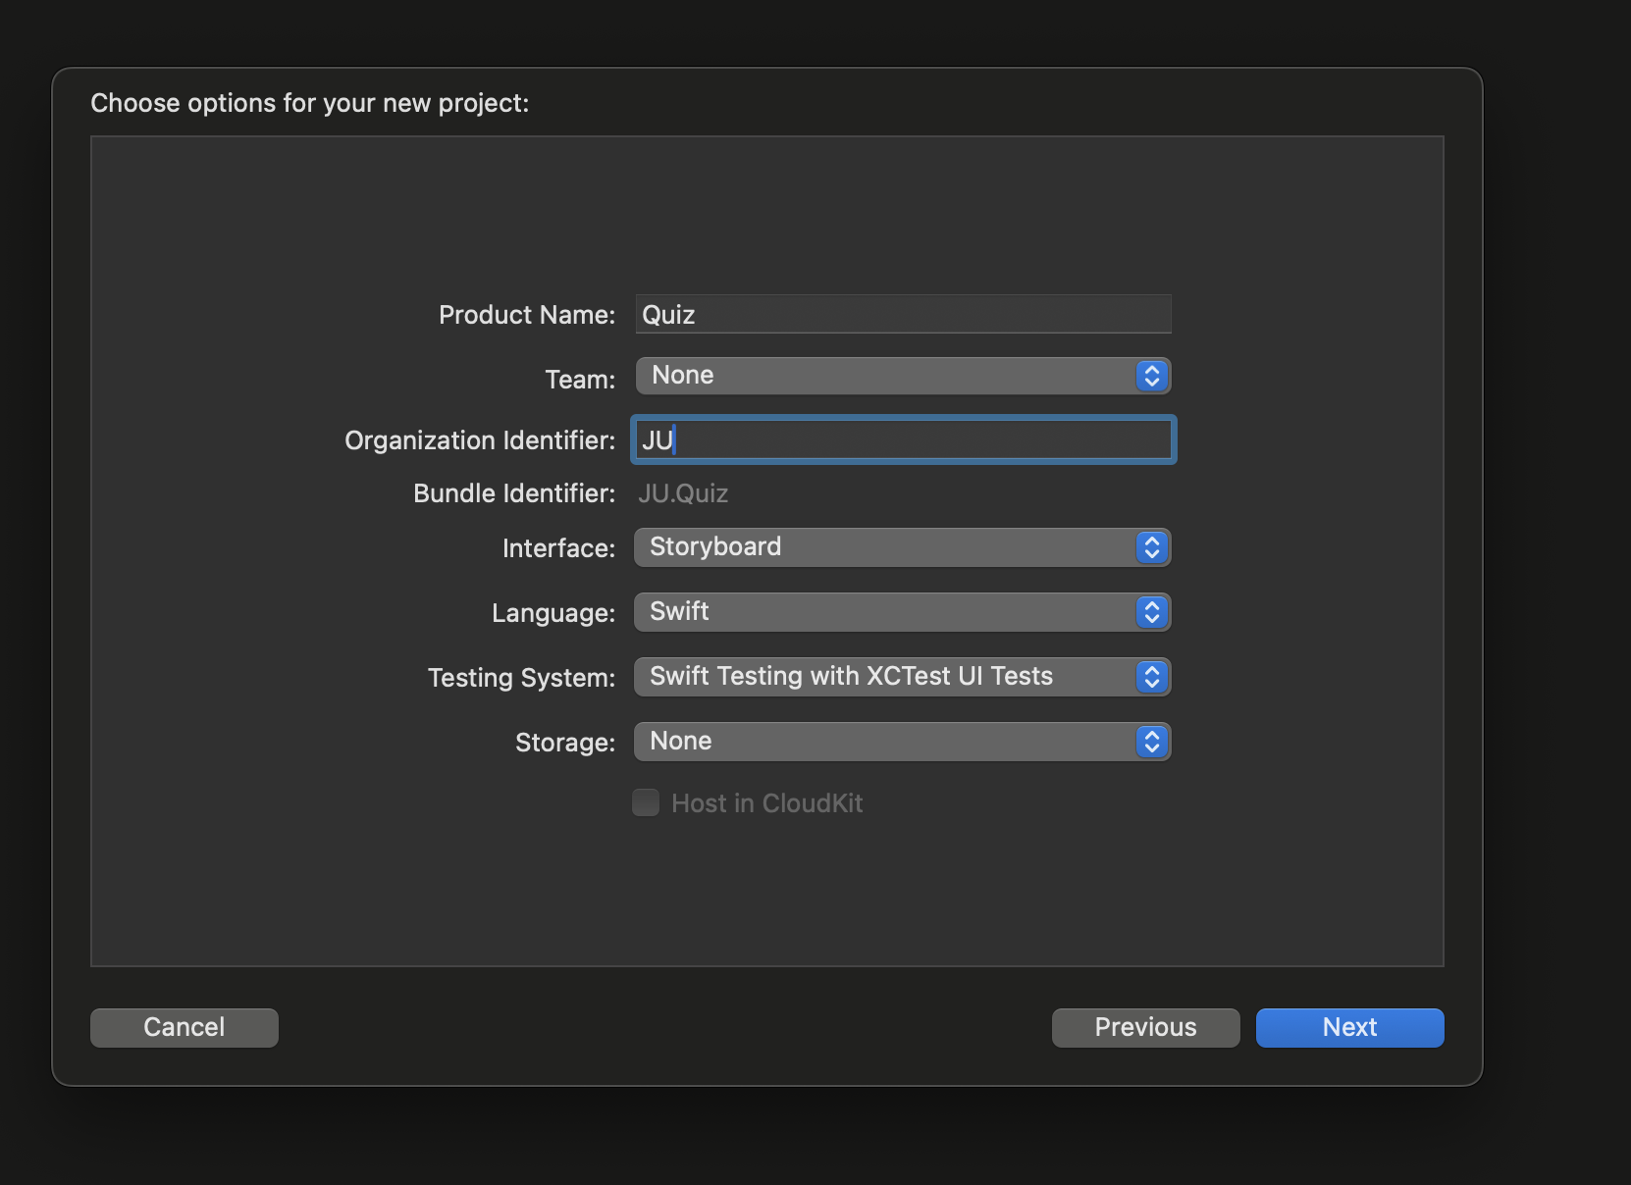
Creating an Xcode Project
1. Open Xcode → New Project → Single View App
2. Product Name: Quiz, Language: Swift, UI: Storyboard
3. Save project → Explore navigator, inspector areas
Notes:
Walk through creating an Xcode project step by step. Suggest showing screenshots of Xcode project setup.

Slide 4

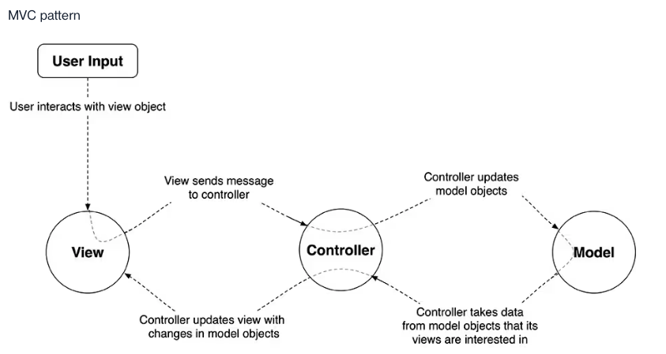
MVC Design Pattern
- Model: Data (arrays of questions/answers)
- View: UI (labels, buttons)
- Controller: Coordinates model & view (ViewController)
- Models & views do not directly communicate
Notes:
Introduce MVC with a diagram. Explain how each layer interacts, with the ViewController as mediator.

Slide 5
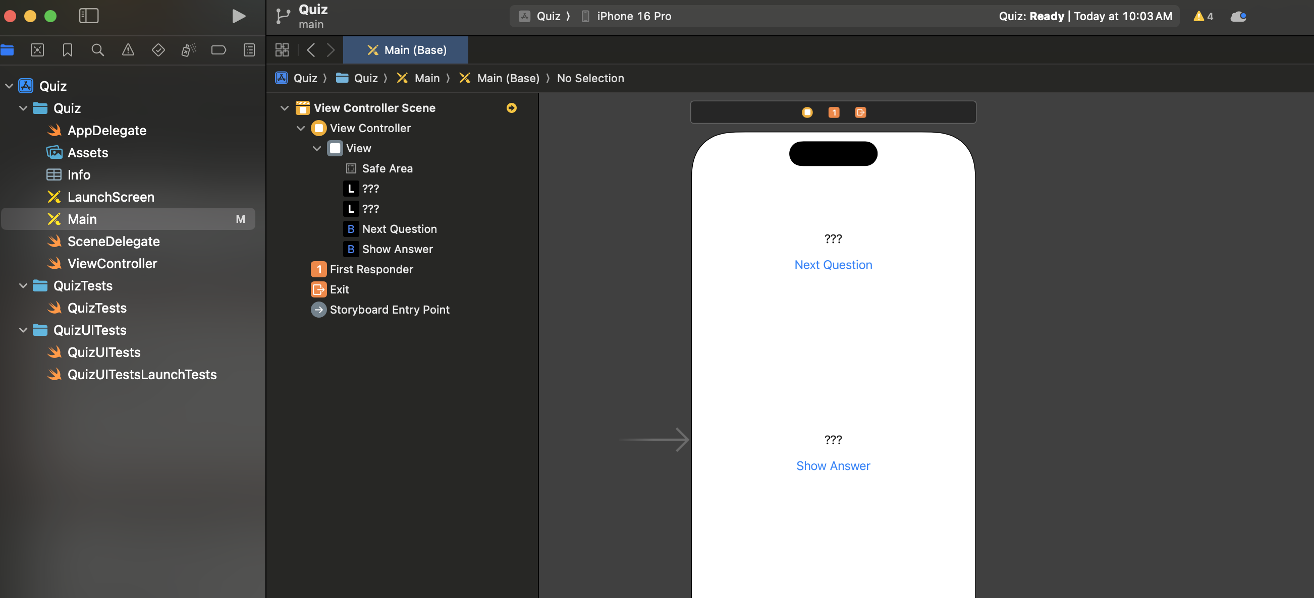
Designing the UI (Interface Builder)
- Use Main.storyboard for layout
- Add 2 UILabels (questions, answers)
- Add 2 UIButtons (Next Question, Show Answer)
- Arrange elements with guides
Notes:
Demonstrate Interface Builder. Show where to find labels and buttons in Xcode. Add screenshot placeholders.

Slide 6

Auto Layout Basics
- Ensure UI adapts to all screen sizes
- Constraints: center labels, align elements, vertical spacing
- Fix issues by clearing and re-adding constraints
Notes:
Explain Auto Layout importance. Recommend live demo or screenshots of constraints being added.

Slide 7

Simulator Testing
- Build & run on iPhone 16 or 16 Pro (Command–R)
- Check centered layout
- Run on iPhone 16 Pro Max → reveals missing constraints
- Motivates using Auto Layout
Notes:
Run the app in simulator. Show screenshots of iPhone 11 Pro and Pro Max layouts to highlight issues.

Slide 8
Outlets & Actions
- Outlets: Connect UI elements to code
- Actions: Trigger methods when user interacts
Example in Swift:
@IBOutlet var questionLabel: UILabel! @IBOutlet var answerLabel: UILabel! @IBAction func showNextQuestion(_ sender: UIButton) { // Update the question label } @IBAction func showAnswer(_ sender: UIButton) { // Reveal the answer }
Notes:
Demonstrate connecting outlets & actions. Show Control-dragging in Interface Builder with screenshot.

Slide 9
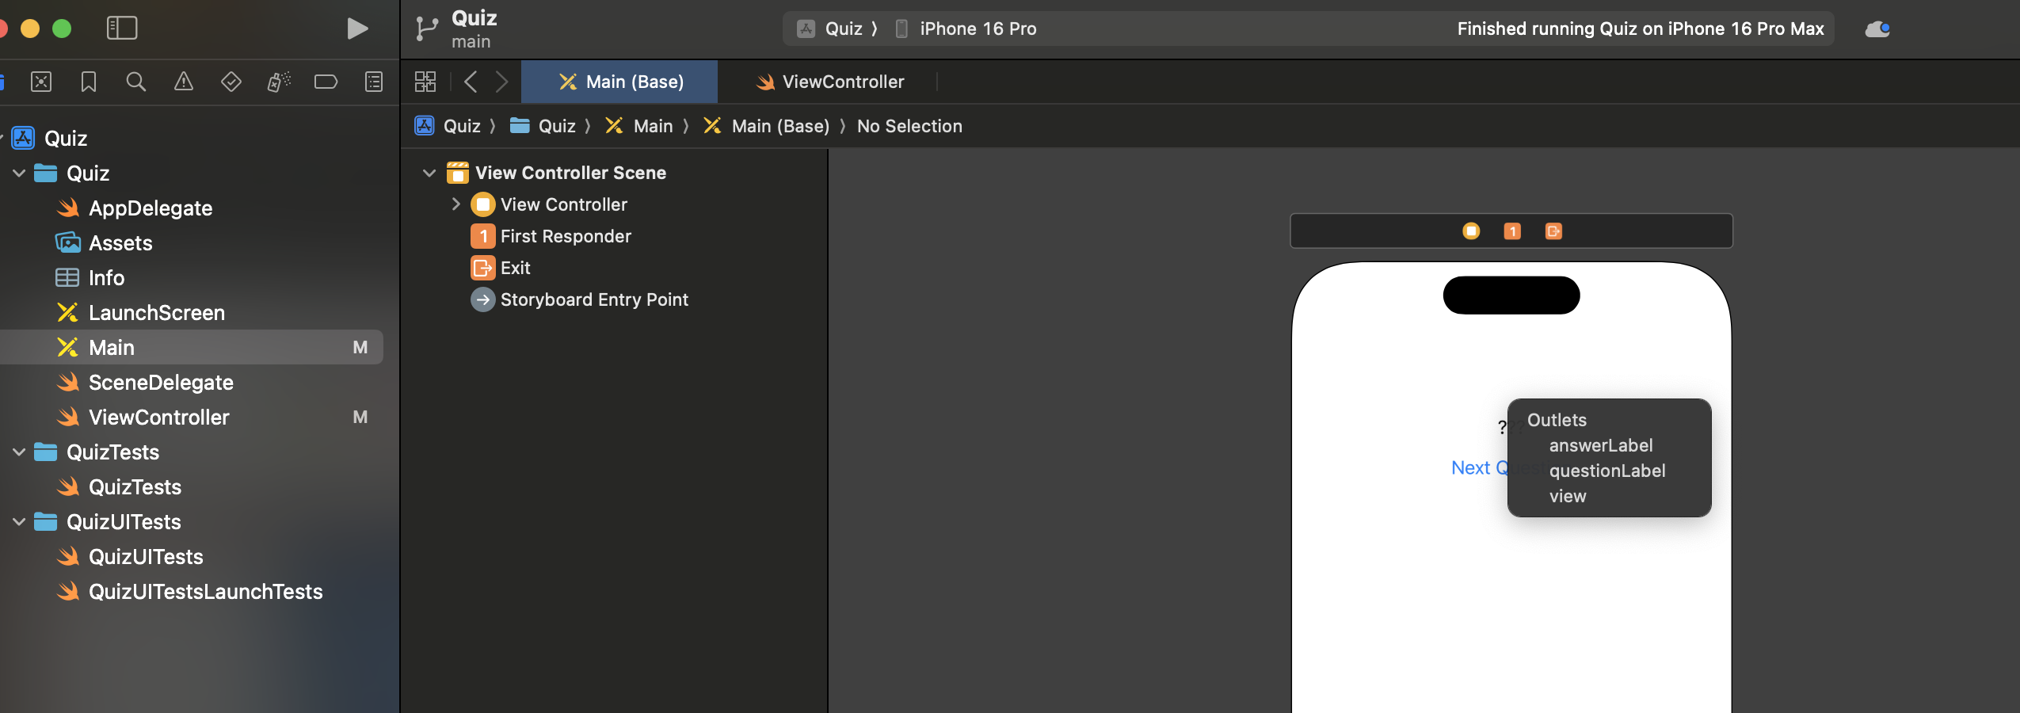
Outlets & Actions
Notes:
Demonstrate connecting outlets & actions. Show Control-dragging in Interface Builder with screenshot.

Slide 10
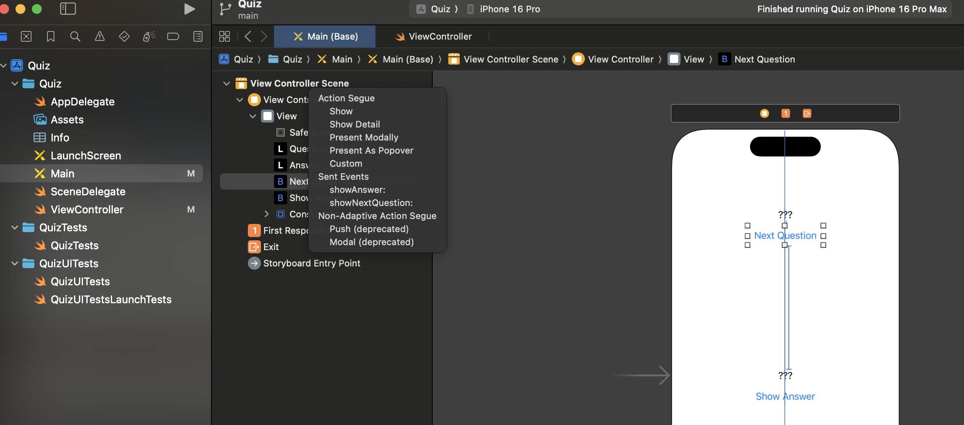
Summary of Connections
- 2 outlets (labels)
- 2 actions (buttons)
- 1 default view connection
- Use Connections Inspector to review/manage
Notes:
Review all connections. Open Connections Inspector live or with screenshot.

Slide 11

Building a Model (Next Steps)
- Model: Two arrays (questions, answers)
- showNextQuestion → updates question
- showAnswer → reveals answer
- Adds logic to the app
Notes:
Preview the next step: adding model logic (arrays of questions/answers).

Slide 12

Build the App
- Build and run the app on the iPhone 16 or 16 Pro Simulator
- You have built a working iOS App
- Application Icons
- Launch Screen
- GitHub integration
Notes:
Preview the next step: adding model logic (arrays of questions/answers).

Slide 13
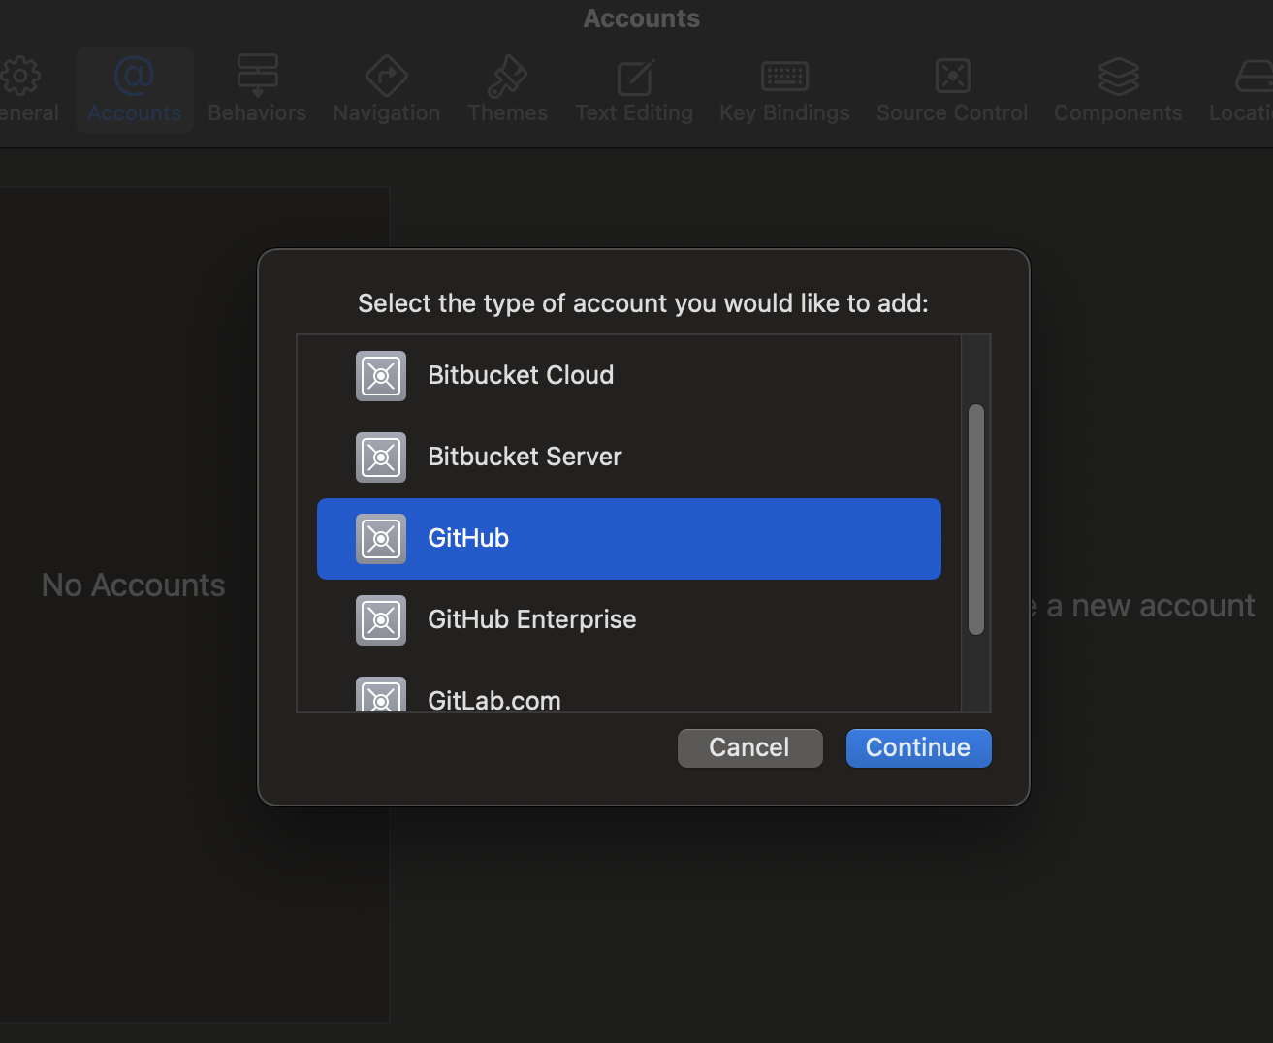
Adding GitHub Account in Xcode
- Open Xcode → Settings → Accounts
- Click '+' → Choose GitHub
- Sign in with username/password or Personal Access Token
- GitHub account will appear in Accounts list

Slide 14
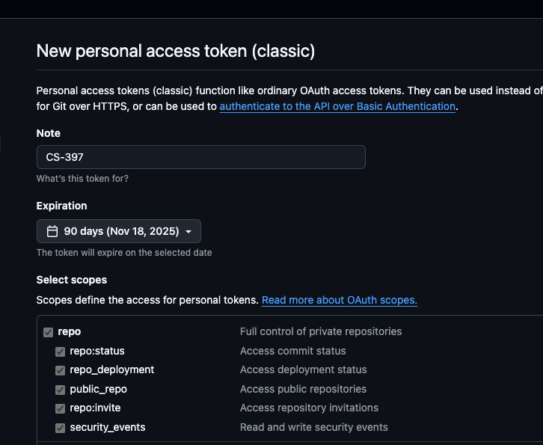
Create a Token on GitHub
- Select Create a Token on GitHub
- Add CS-397 to the Note and check repo, workflow, write:packages, delete:packages
- Set Expiration to 90 Days
- Generate Token
- GitHub account will appear in Accounts list

Slide 15

Creating a New GitHub Repository
- In Xcode: Source Control → New Git Repositories
1
- Then: Source Control → New GitHub Repository
2
- Choose account, set name & visibility
3
- Click 'Create' to push project to GitHub
4

Slide 16

Cloning a GitHub Repository
- In Xcode: File → Clone Repositories
1
- Select GitHub account → choose repository
2
- Click 'Clone' to download project
3

Slide 17
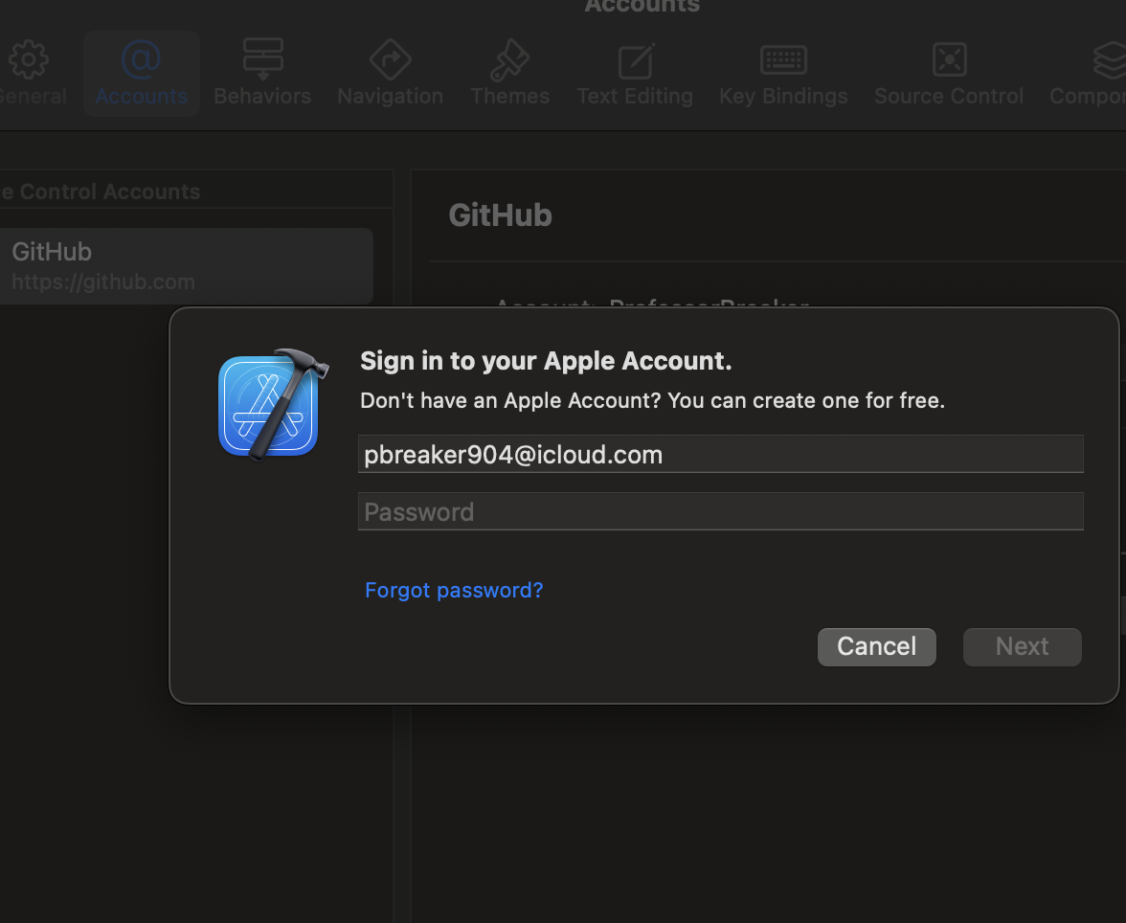
Adding Apple Developer Account
- Open Xcode → Settings → Accounts
- Click '+' → Choose Apple ID
- Sign in with Apple Developer credentials
- Xcode will sync signing certificates & profiles

Slide 18
Recap & Next Chapter
- Learned project setup, UI design, Auto Layout
- Connected UI with outlets & actions
- Next: Implement app logic fully
- Practice hands-on with challenges
Notes:
Summarize what was achieved in Chapter 1. Encourage trying exercises and challenges.

