Slide 1
Basketball Game
in JavaScript
Prof. Gail Harris
Notes:
Title Slide

Slide 2
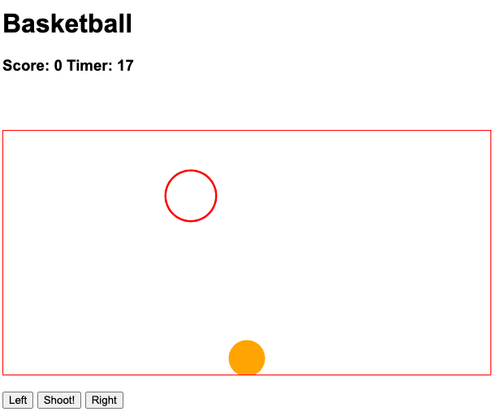
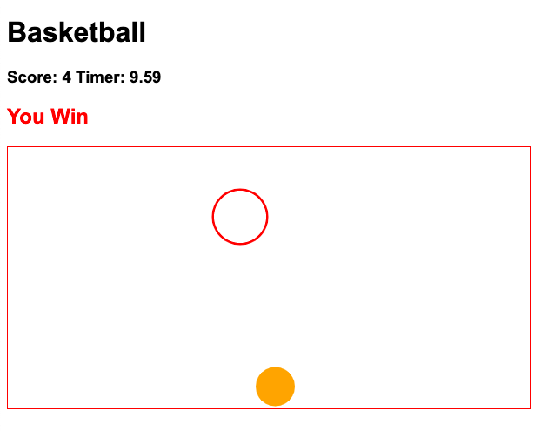
Build a game in an hour!
Notes:
5 min

Slide 3
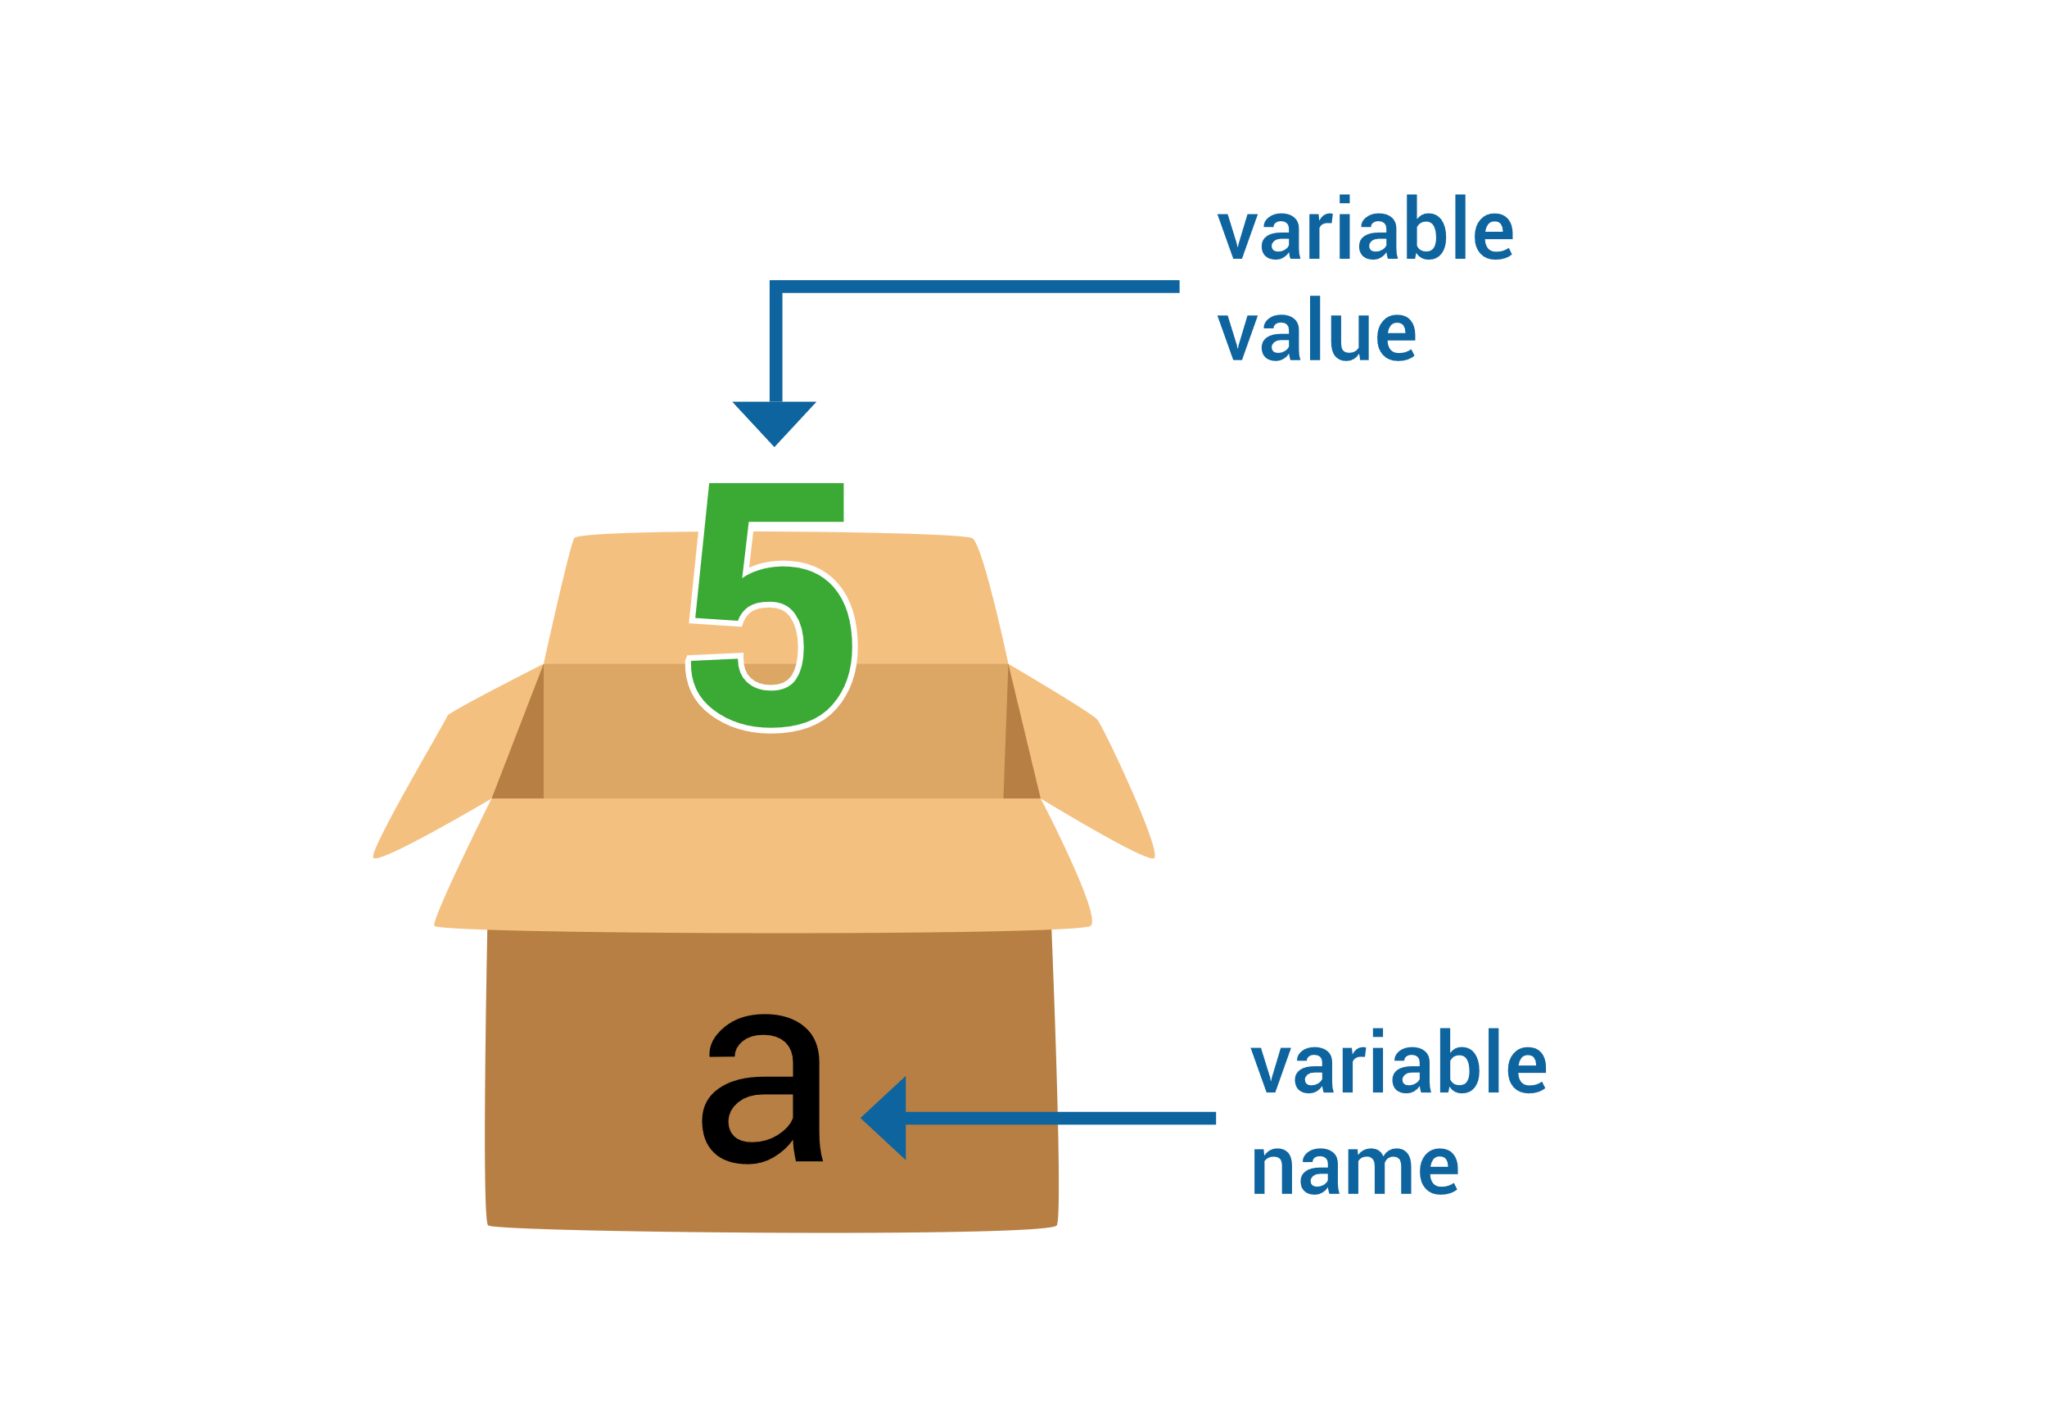
What is a variable ?
A place to store a data value that can be used or changed later on

Slide 4


What is an object?
A place to store a group of variables, and functions that use and change them.
Circle
x
y
radius
draw()

Slide 5
Move the basketball left and right
// add this code to left() function
basketball.dx = -2.5
// add this code to the right() function
basketball.dx = 2.5

Slide 6
Animate motion of the hoop
// add this code to Circle’s update() function
this.x += this.dx;
this.y += this.dy;
if ( (this.x < this.radius) || (this.x > (canvas.width – this.radius) )
{
this.dx *= -1;
}

Slide 7
Shoot the basketball upward
// add this code to shoot() function
if ( basketball.dy == 0 )
{
basketball.dx = 0;
basketball.dy = -9;
}

Slide 8
Gravity! We need Gravity!
// add this code to Circle’s update() function
this.dy += 0.2;

Slide 9
Two Issues:
watch hoop fall
and watch both fall through the floor

Slide 10
We have a floor
// add this to Circle’s update()
if ( this.y >= canvas.height – this.radius )
{
this.y = canvas.height - this.radius;
this.dy = 0;
}
choose no bounce, for simplicity

Slide 11
A hoop is not a basketball
// Let’s add a flag for that
// add the characters in bold
function Circle(color_, fill_, x_, y_, dx_, dy_, r_, isBall_)
// add this line
this.isBall = isBall_;
// add characters in bold
if ( this.isBall ) this.dy += 0.2;

Slide 12
Scoring a basket
// add this code to collide() function
let otherleft = other_.x – other_.radius + this.radius
let otherright = other_.x + other_.radius – this.radius
if ( this.y <= other_.y &&
this.x >= otherleft && this.x <= otherright )
{
this.y = other_.y + this.radius * 0.5;
return true;
}
else
{
return false;
}

Slide 13
Hide/show text on web page
// add this code to gameover() function
my_shoot_button.style.visibility = “hidden”;
my_left_button.style.visibility = “hidden”;
my_right_button.style.visibility = “hidden”;

Slide 14
Final Code
// add text in bold
// to let ball fall to ground before stopping the animation
if ( score >= winningScore
&& (basketball.y >= canvas.height – basketball.radius) )
provide final code, especially if ran out of time

Slide 15
Thank you.
Notes:
See you in the next section

