Slide 1

JupyterHub in Engineering Education PyPDX West 2019-11
Peter D. Kazarinoff
Division of Engineering and Industrial Technology
Portland Community College
@pkazarinoff GitHub: ProfessorKazarinoff
Slides: github.com/ProfessorKazarinoff/PyDataPDX-2019-11

Slide 2



Who is Peter?
Engineering Transfer
2-year Engineering Tech
Blog: pythonforundergradengineers.com
GitHub: github.com/ProfessorKazarinoff
Twitter: @pkazarinoff

Slide 3

6 in 10 of CC students experience food insecurity
3 in 10 CC students experience housing insecurity
1 in 10 of CC students is homeless
(according to PCC in-service 2019)

Slide 4


Moving from MATLAB to Python
Could save students $25,000 in one year
(7 classes of 24 students $49 license + $105 book)

Slide 5

Students use Desktops, Laptops, Chromebooks, Tablets and Phones

Slide 6
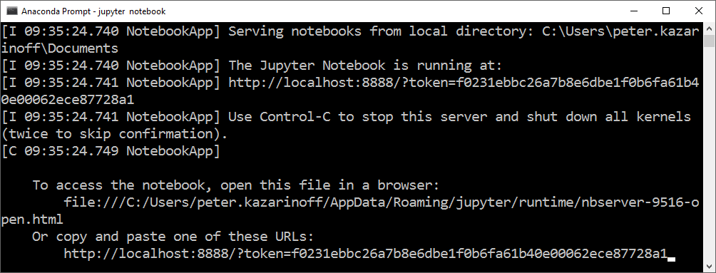
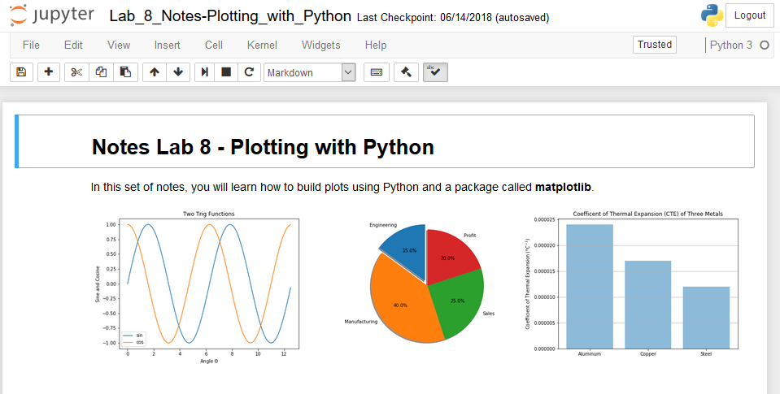
Jupyter Notebooks

Slide 7
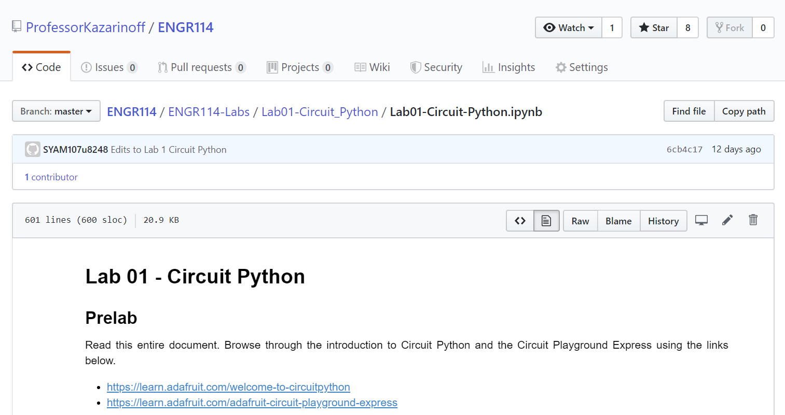
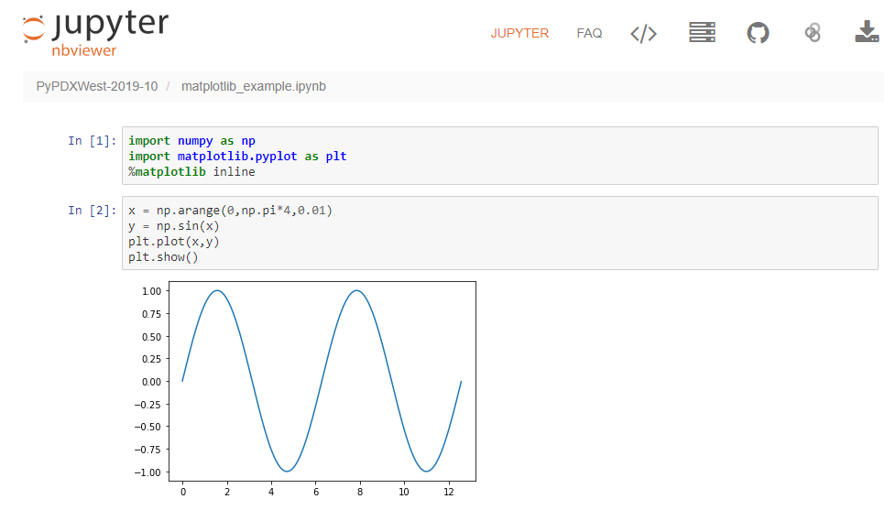
Static Jupyter Notebooks Online
GitHub
nbviewer

Slide 8
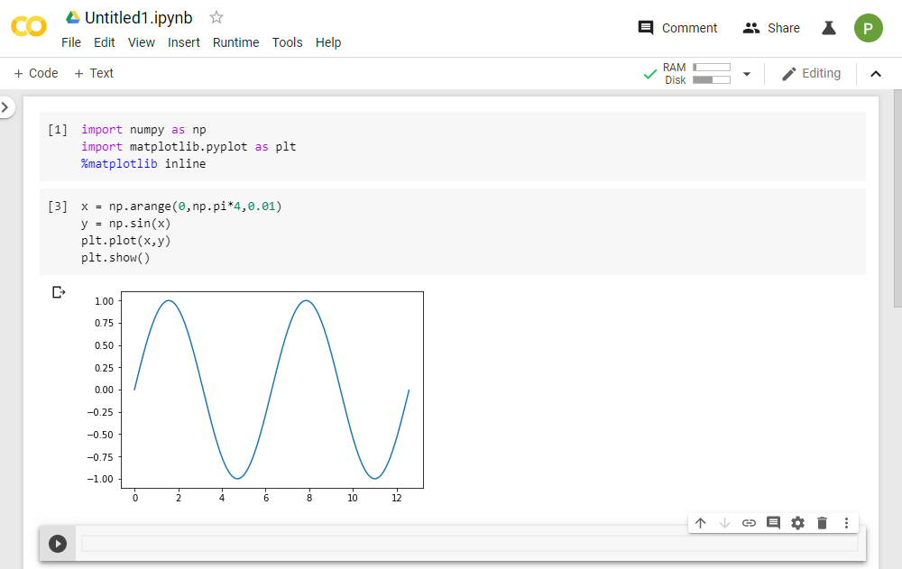
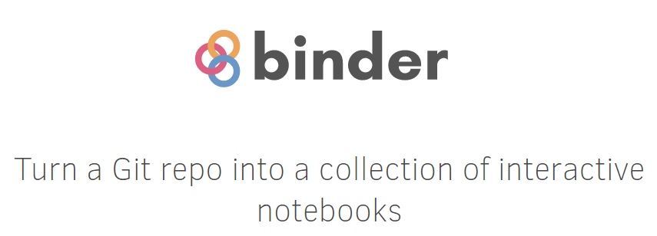
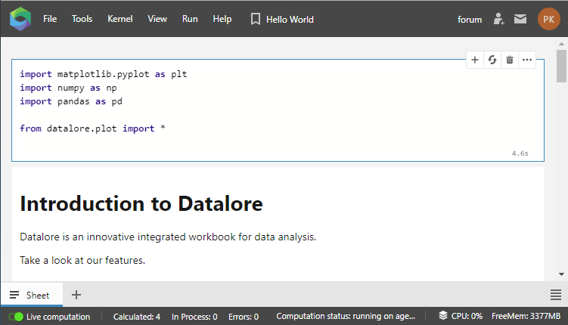

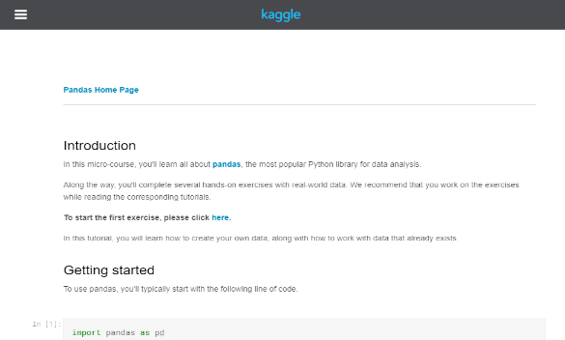
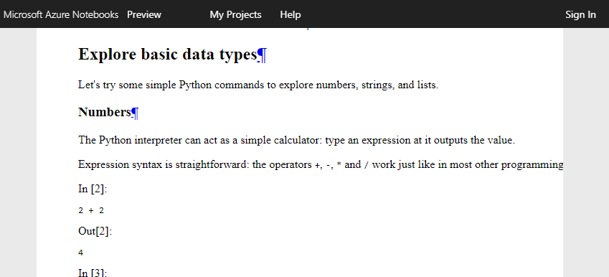
Dynamic Jupyter Notebooks Online
Google CoLab
Kaggle Kernels
JetBrains Datalore
Microsoft Azure Notebooks

Slide 9








JupyterHub

Slide 10







JupyterHub

Slide 11


Why use JupyterHub?
You have your own OAuth and don’t want to use additional usernames and passwords
Your data is private and can’t be shared in the public cloud
Need custom packages, custom environment not available publically
Share documents/data across users

Slide 12
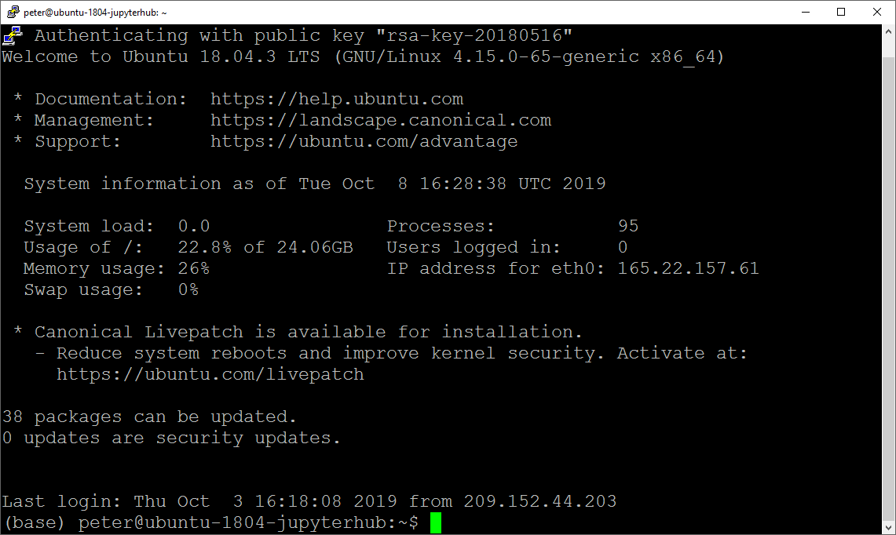
Setting up JupyterHub
VPS (Digital Ocean, Linode, AWS, Google Cloud, Azure, or Local Server)
Root access (can run without sudo, but it’s more complicated)
Install Python and JupyterHub
Configuration file
Domain name and SSL cert
Can use Nginx reverse proxy
Authentication: PAM, GitHub, Google or other OAuth
https://jupyterhub.readthedocs.io/en/stable/

Slide 13
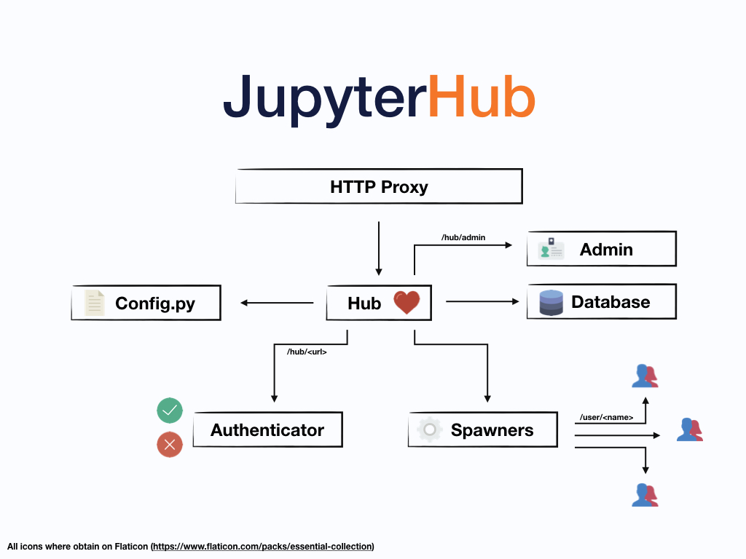
Image: JupyterHub Docs

Slide 14
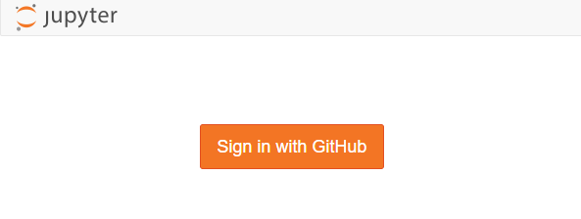
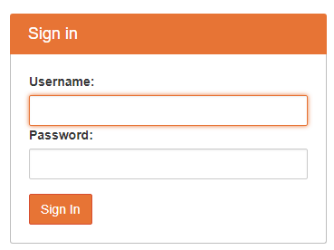
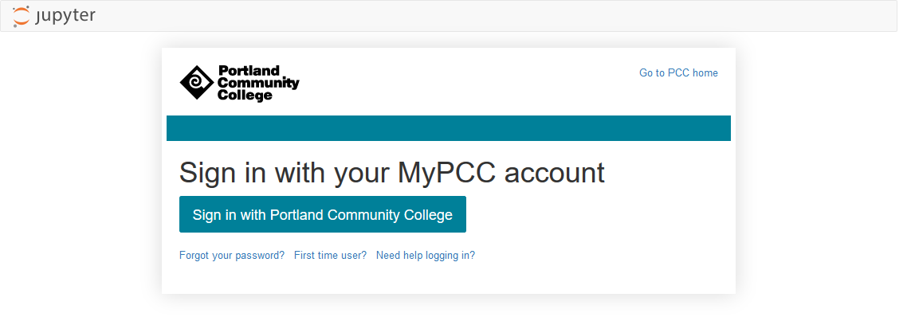
Authentication
GitHub OAuth
PAM Authenticator (built into Linux)
Google OAuth
Other OAuth Services: BitBucket, GitLab, Globus, MediaWiki, Okpy, OpenShift, CILogon, AuthO

Slide 15



Storage
VPS File System
Docker
Kubernetes

Slide 16
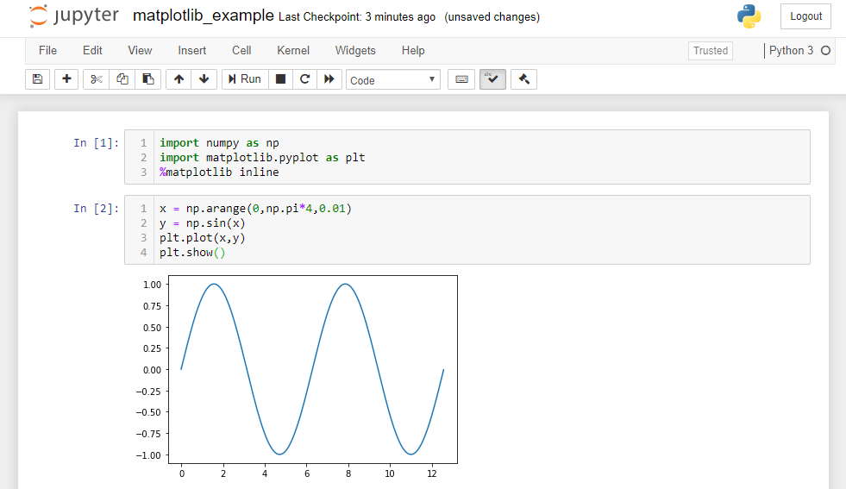
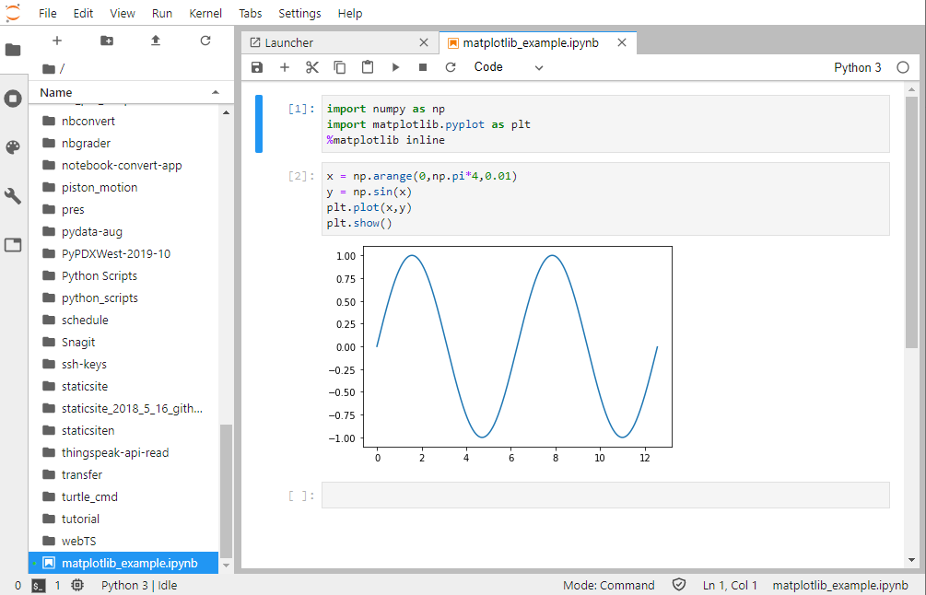
Classic Notebook or JupyterLab Interface
Classic Notebook Interface
JupterLab Interface

Slide 17
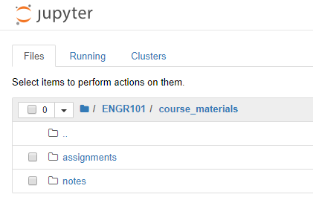
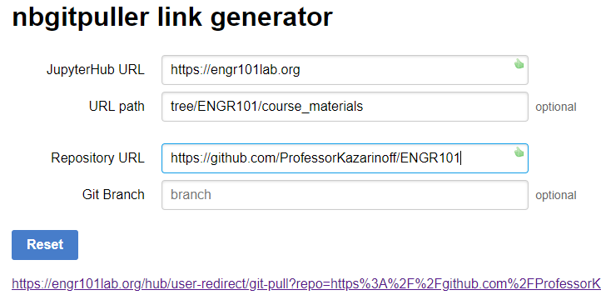
nbgitpuller Extension
Build a URL for your users
GitHub Repo Pre-populates in user’s file system
https://jupyterhub.github.io/nbgitpuller/

Slide 18
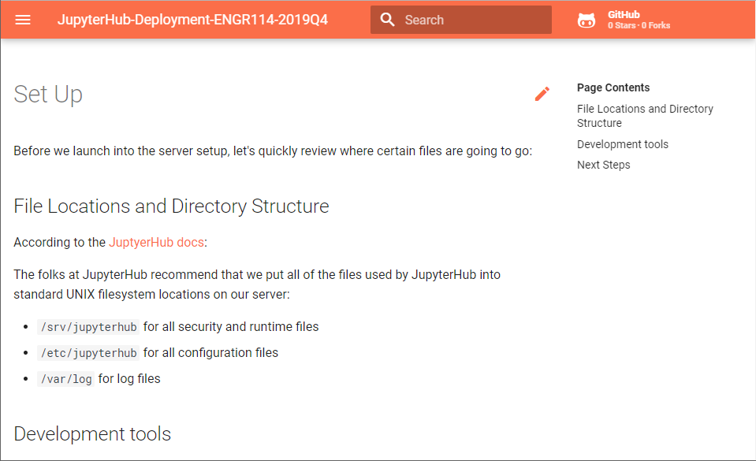
Try your own deployment: https://professorkazarinoff.github.io/ jupyterhub-ENGR114-2019Q4/

Slide 19

Lessons Learned
Authentication can be tricky. Linux does not like usernames with special characters
A $5/month server works with a few users. 25 users overloads a $5/month server. Use $40/month server for a class.
Custom login page is possible, but takes work (html and css)
Use a cull idle servers script to save resources
Document! Document! Document!: You may want to spin up a new JupyterHub instance in the future.

Slide 20


Interested in a JupyterHub Deployment Tutorial?
Email: peter.kazarinoff@pcc.edu Twitter @pkazarinoff

Slide 21

Questions?
Slides: github.com/ProfessorKazarinoff/PyDataPDX-2019-11
My JupyterHub Deployment Docs: https://professorkazarinoff.github.io/jupyterhub-ENGR114-2019Q4/
JupyterHub Docs: https://jupyterhub.readthedocs.io/en/stable/
nbgitpuller Plugin: https://jupyterhub.github.io/nbgitpuller/

Slide 22

I’m Looking for Guest Speakers!
Share your experience with a community college class
Email: peter.kazarinoff@pcc.edu or DM on Twitter @pkazarinoff

