Slide 1
Events in Windows Forms

Slide 2
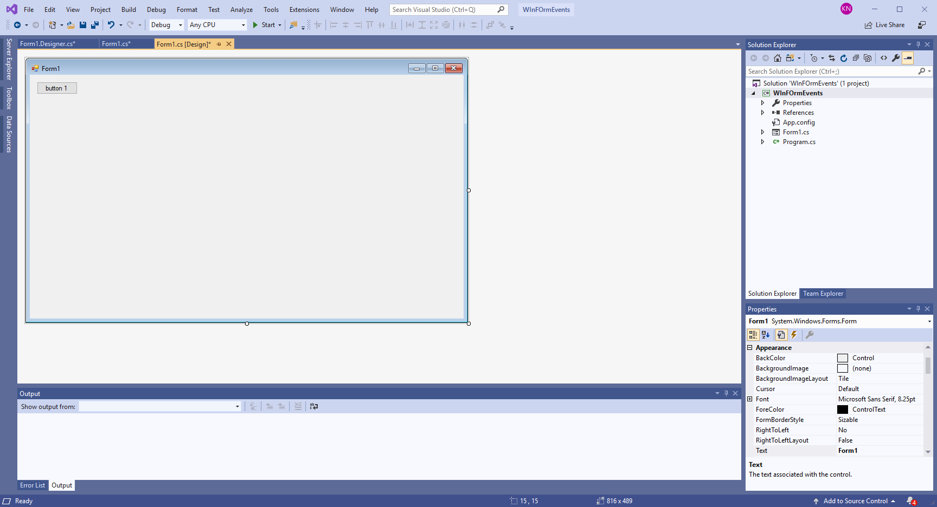
A form with a button

Slide 3
C# Event wiring
using System.Windows.Forms;
namespace WInFOrmEvents
{
public partial class Form1 : Form
{
public Form1()
{
InitializeComponent();
}
private void Button1_Click(object sender, EventArgs e)
{
}
}
}
private void InitializeComponent()
{
this.ULC_Button = new System.Windows.Forms.Button();
this.SuspendLayout();
//
// ULC_Button
//
this.ULC_Button.Location = new System.Drawing.Point(13, 13);
this.ULC_Button.Name = "ULC_Button";
this.ULC_Button.Size = new System.Drawing.Size(75, 23);
this.ULC_Button.TabIndex = 0;
this.ULC_Button.Text = "button 1";
this.ULC_Button.UseVisualStyleBackColor = true;
this.ULC_Button.Click += new System.EventHandler(this.Button1_Click);
Form code
Hidden code

Slide 4
VB is explicit about the wiring
Public Class Form1
Private Sub Button1_Click(sender As Object, e As EventArgs) Handles ULC_Button.Click
' note that this code can handle more than 1 event
' the handlers are a comma separated list
End Sub
End Class

Slide 5
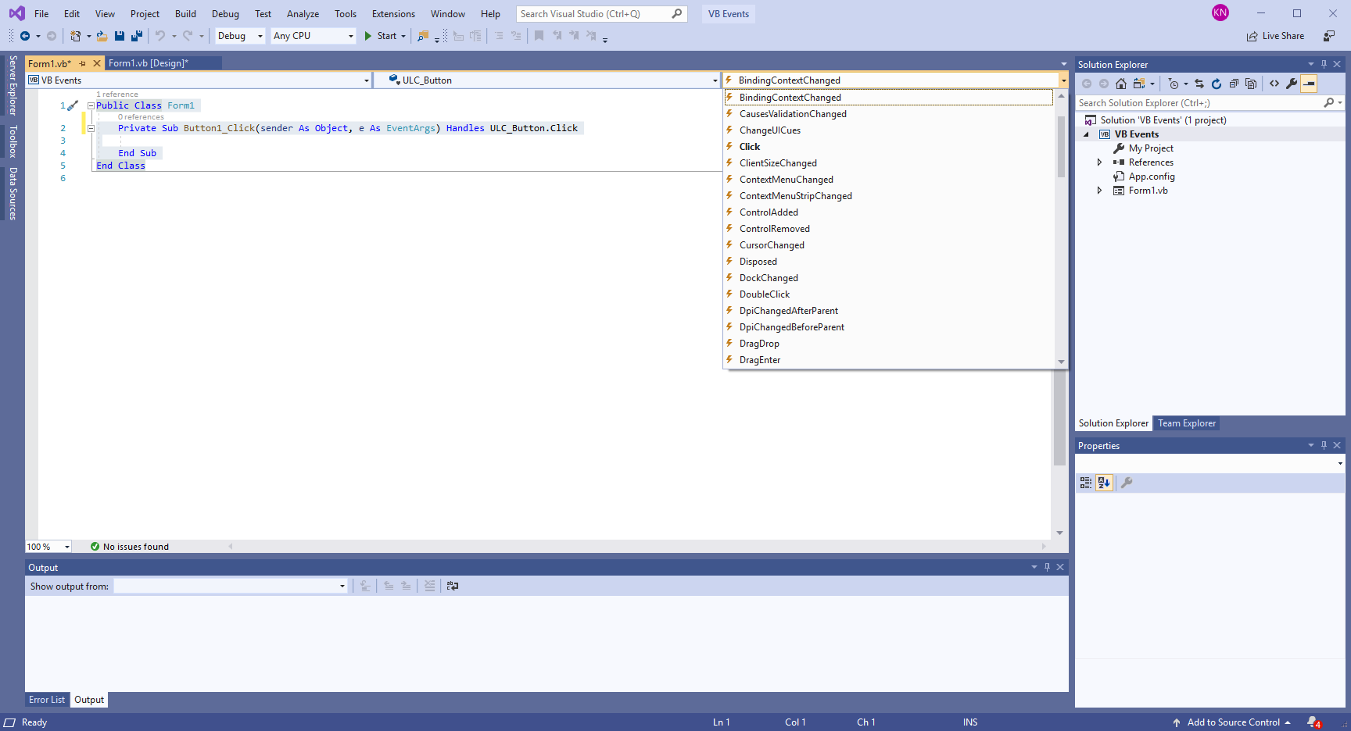
VB gives you an event list dropdown C# has it in properties

