Slide 1
Source Code Control
With Git

Slide 2
Source Code Control / Version Control
What do we get?
Undo capability
Safe storage
Single place to find everything
Can do disaster recovery / total reload
Controlled isolation
At the project level
At the developer level
A way to find things

Slide 3
Let’s translate those things to Git operations
Commit
Clone
Push / Pull
Branch / Merge
Tag

Slide 4
Big Picture
Multiple repositories
Disk space is cheap
One per project
One per developer
We clone the project repository to create our local repository
What software issue did we just create?

Slide 5
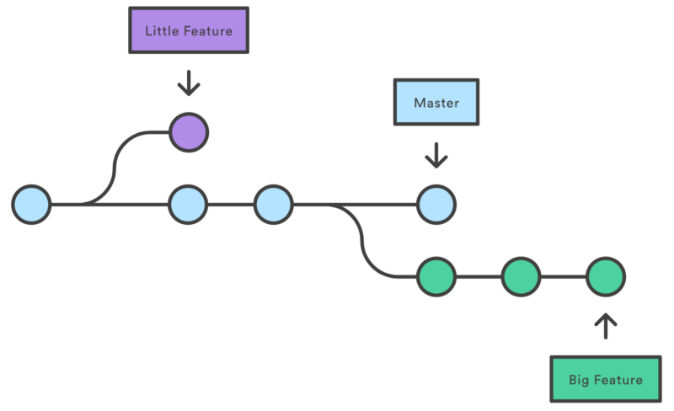
Coherency – feature not a bug
We control when differences are dealt with at the project level
We branch the project when adding new features or releases to isolate them from the current working stable release
We merge the branches when the code in them is ready for prime time

Slide 6
Coherency – feature not a bug
We control when differences are dealt with at the developer level
Developers commit their local changes to the current branch in the local repository – provides the undo capability via revert
Developers push their commits to the project only when they are ready
Developers pull commits made to the project to their local repository when they are ready to bring them in

Slide 7
Finding things
We tag when we want to leave a marker in the system
You will tag your submissions for most sprints so that the graders can find them
It is a good idea to tag things along the way, particularly when everything present is working, even if there are more things to add before you are done

Slide 8
Completeness
This is not “everything you need to know about Git”
This should be a guide to “things you need to learn how to do in Git”
Research, collaboration, and learning-by-doing are how this class rolls

Slide 9
In this class:
Every team sprint needs to be developed on a new branch
Sprint2
Sprint3
Sprtint4
Sprint5
You turn in a tag on the master branch
You need to merge individual repos to the sprint branch
When that code is right, merge to master and tag it
What you turn in is information about your repository especially that tag.
Work with the graders on this to make sure that you know how to turn in code.

Slide 10
More?
There is a cheat sheet in piazza and plenty of doc on the web
2 sample links:
https://medium.com/around-the-app-in-365-days/a-primer-on-git-a4efe705cb5f
https://www.atlassian.com/continuous-delivery/continuous-integration/trunk-based-development

