Slide 1
Understanding Siri
Inspirit AI
Notes:
Everyone introduce themselves
Sahana
Ojas
advaith
Aranya
Abhinav

Slide 2
Outline
1. Overall project - OJ
2. NLP (training, testing, validation) and data – sahana
3. BERT (tokenization -> BERT) – aranya
4. BIO and NER - abhinav
5. Best/Hardest part of project - OJ
6. How it's applied daily life - advaith
7. Bias - sai
8. Backend

Slide 3
Webapp Instructions
Tutorial for how to make a webapp using anvil and google collab
https://anvil.works/learn/tutorials/google-colab-to-web-app
Google Collab file
https://colab.research.google.com/drive/1-znZ6dIgQV2ALAp61aqqeKk3zQaMiDcz?usp=sharing
Anvil Link
https://anvil.works/build#page:start
`

Slide 4

The Project
01
Predict the intent
Sentence-level classification task
Analyzing verbal commands to help Siri figure out response/action
02
Place the text into categories
NER/Token-level classification task
Notes:
OJ
Throughout the Understanding Siri Project, we analyzed verbal commands to help Siri determine the correct response or action. We do this in 2 steps.
The first step is predicting the intent of the speaker, or what the speak mainly wants to do, and we do this by utilizing a sentence-level classification task. An example of this could be making a reservation at a restaurant.
Next, we need to place the rest of the text into categories that specify the command given, such as placing a reservation in a specific restaurant. We place the text into categories using NER, or Named Entity Recognition, which is a token-level classification task. NER classifies specific pieces of text into predefined categories, such as locations or names.
After completing both of these steps, only then can Siri give the correct response or complete the correction action.

Slide 5
01
Machine Learning
04
BIO and NER
Brief overview of how ML works
What these concepts are
02
NLP
Applications
05
What it is and procedures
Usage in daily life
03
BERT
06
Bias
The model and how it works
How is this impacted by bias?
Notes:
Advaith

Slide 6
Machine Learning: Natural Language Processing
Interactions between computers and human language
read text, hear speech, comprehend, measure sentiment and classify!
Sample Pipeline:
Polite
Offensive
01
02
03
04
Tweet
Feature Engineering
Classification
Output
Inputs tweets from large dataset
Splits data and performs train/test methods
Uses new data to apply ‘learning’ and classify
Positive or negative classification of tweet
Notes:
Sahana

Slide 7
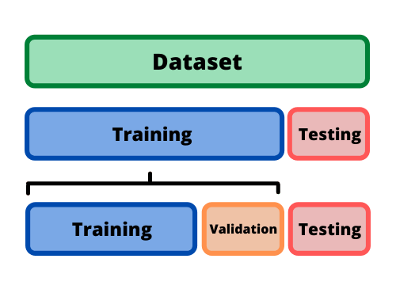
Machine Learning Split
INPUT DATA
What is ‘learning’
in NLP?
OUTPUT RESULTS
Notes:
Data has labels - siri what is the weather, command dealing with weather
Book a table at le ritz have what output should be and have a lot of data that has this
Training pass through this allow model to take that and see if output is correct
Or if it’s wrong something needs to be changed
Testing we have what output is but don’t know what model is
What movies are playing nearby - command is about movies
Give input of movies nearby but model doesn’t have output to compare it to
Produces output and we check

Slide 8
Properties of NLP
Named Entity Recognition:
- locates and classifies entities in text
- predefined categories:
- names, organizations, and locations.
Intent
01
What does speaker want?
Request
02
How to accomplish goal?
Training?
Testing?
Notes:
Predict intentions of statement
Extract phrased entities in command
Advaith

Slide 9
Machine Learning Infographics
Book a table for two at Le Ritz for Friday night.
{
'intent': 'BookRestaurant',
'slots': {
'party_size_number': 'two',
'restaurant_name': 'Le Ritz',
'timeRange': 'Friday night'
}
}
Intent
Slot
Slot
Slot
Notes:
Abhinav

Slide 10
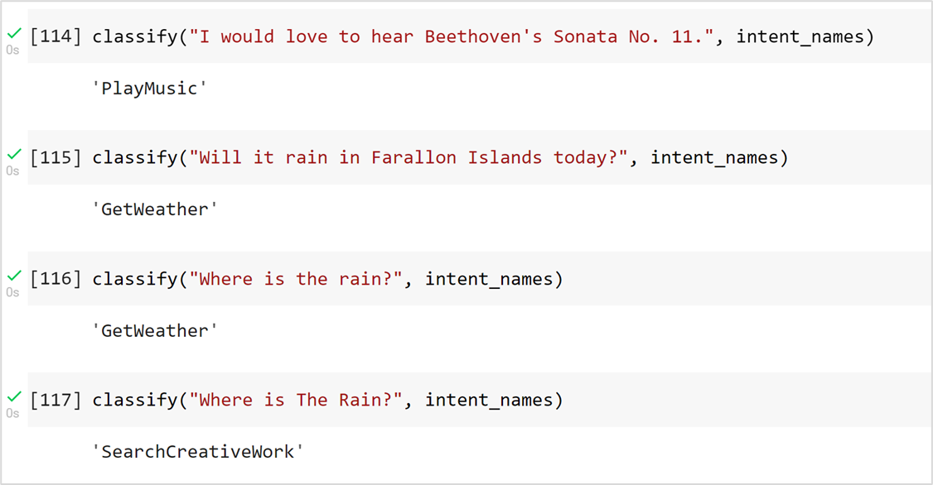
BERT (Bidirectional Encoder Representations from Transformers)
Pre-trained Machine Learning Model for NLP
Deciphers the meaning of a given piece of text
Notes:
Aranya

Slide 11
BERT Tokenizer
01
Known words/characters
From BERT vocabulary
(containing ~30,000 unique tokens)
The tokenizer splits text into tokens of two types
02
Unknown words/characters
Not in the BERT vocabulary
Notes:
OJ

Slide 12
BERT Tokenizer
Input: Word
Input: Sentence
Tokenization
Will it rain in Farallon Islands today?
Output: Tokenized Word
Output: Tokenized Sentence
[‘To’, ‘##ken’, ‘##ization’]
[‘Will’, ‘it’, ‘rain’, ‘in’, ‘Far’, ‘##allo’, ‘##n’, ‘Islands’, ‘today’, ‘?’]
Notes:
Sahana

Slide 13
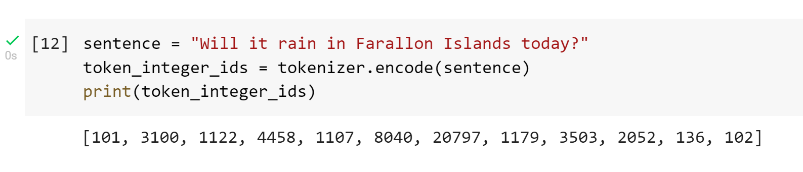
Token Encoding
Each token is assigned a unique integer id
This helps the program run faster
Input
Will it rain in Farallon Islands today?
[‘[CLS]’, ‘Will’, ‘it’, ‘rain’, ‘in’, ‘Farallon’, ‘Islands’, ‘today’, ‘?’, ‘[SEP]’]
[‘[CLS]’, ‘Will’, ‘it’, ‘rain’, ‘in’, ‘Far’, ‘##allo’, ‘##n’, ‘Islands’, ‘today’, ‘?’, ‘[SEP]’]
[101, 3100, 1122, 4458, 1107, 8040, 20797, 1179, 3503, 2052, 136, 102]
Notes:
Advaith

Slide 14
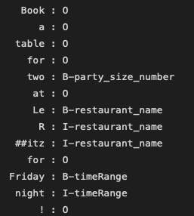
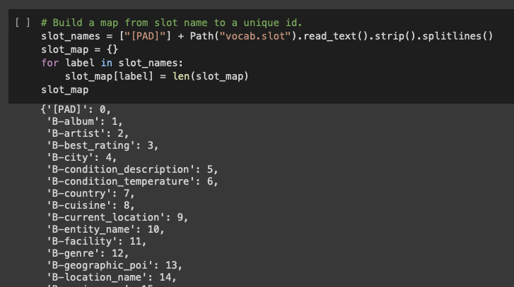
BIO and NER
NER (Named Entity Recognition) is used to classify entities in text such as people or places into predefined categories
Helps us predict what the speaker wants in addition to the intent classification
BIO is used to tag individual tokens for a NER task
B indicates a tag is the beginning of a chunk, I indicates a tag is inside a chunk, and O indicates a tag is outside a chunk (i.e. not in a chunk at all)
However, this identification format is not perfect; for example, some tokens may not be in the database
Notes:
Abhinav

Slide 15
Best vs Hardest part of project
Best
Hardest
Vs
Working through the CoLab Notebooks!
Making the slides
Collaborating with teammates
Compiling actual model
BERT Comprehension
BIO/NER Involvement
Notes:
Andrew
Sahana Backup

Slide 16
Applications in Daily Life
Task automation
Allows for daily tasks to be simplified
Understanding Siri
Social connection
Uses video platforms to connect people
Customer help
Supports consumers around the clock
Boosts education
Provides tutoring to students at any time
Notes:
Advaith

Slide 17
Limitations
Language
Biases in the Pre-Trained Model
Computational Resources
Bert is Pre-Trained primarily on english content, meaning it will extract features only from english text.
The original data used to pre-train BERT was collected from the internet and contains a multitude of data, including offensive and hateful speech
The BERT model has many parameters which takes up a lot of memory. It also requires powerful GPU’S to process the data at a reasonable speed.
Solution:
Solution:
Solution:
To build a model for another language we would need to collect a similar body of text, with diverse, representative examples.
Designing alternative architectures with fewer parameters or more efficient training and prediction methods, or just have a decent GPU.
Audit any biases that are in the pre trained models before deploying the system
Notes:
Sai

